Slide 1




Slide 2

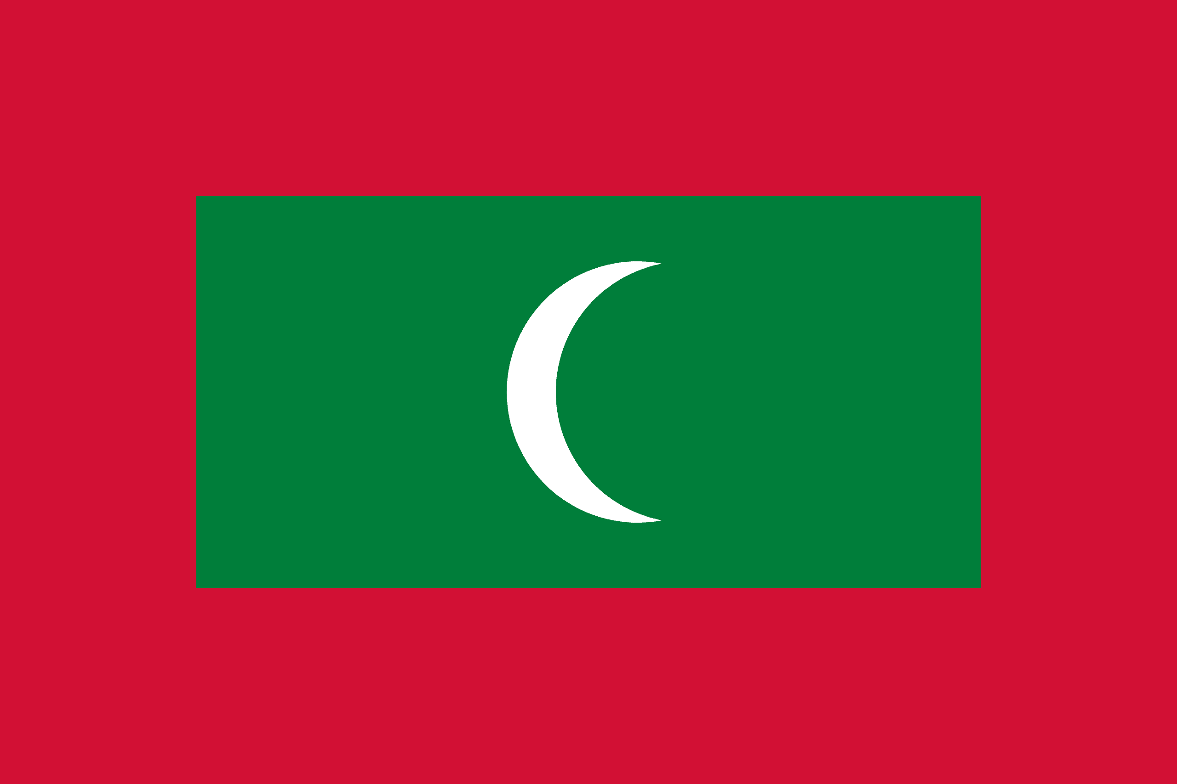
PRAYING FOR
MALDIVES

Slide 3
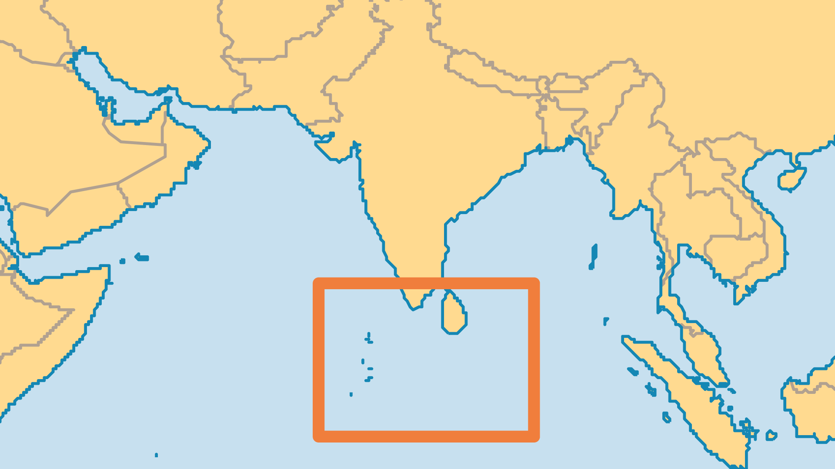
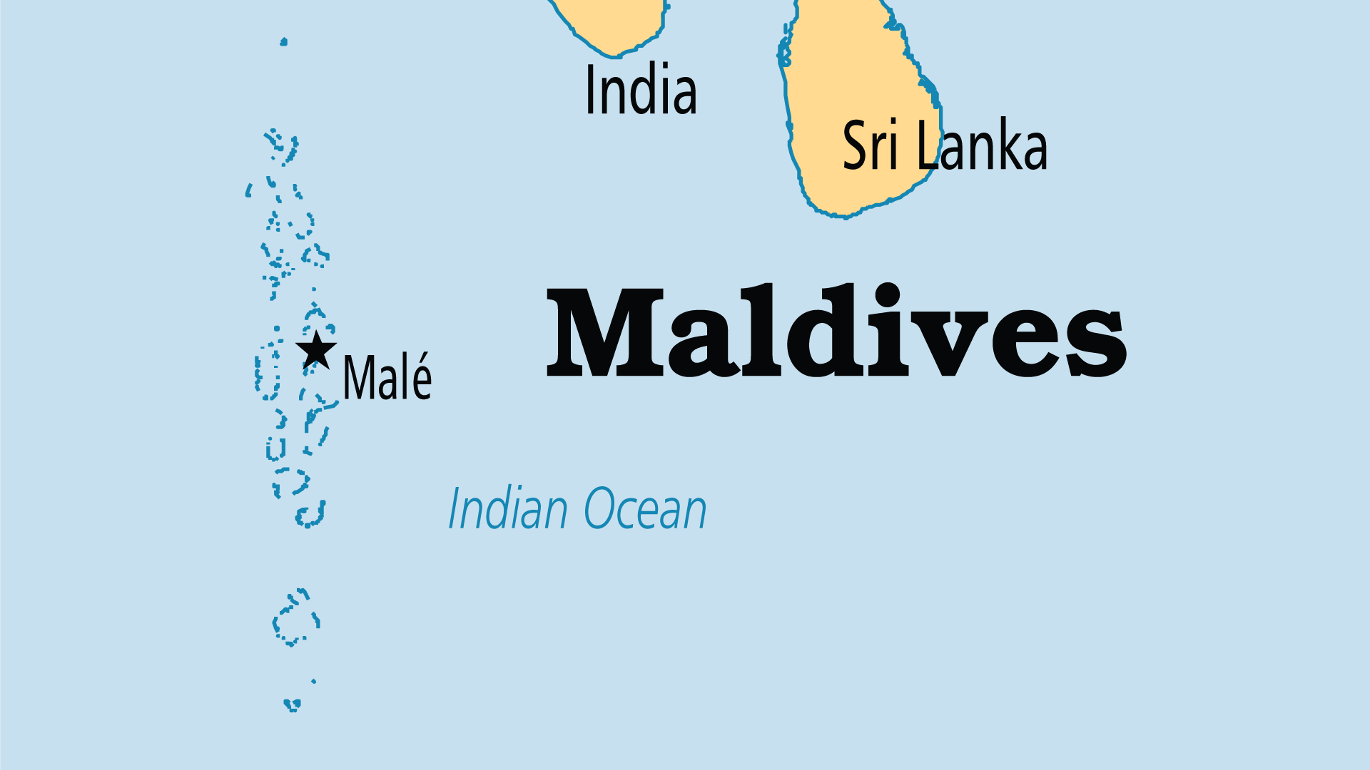
KEY STATS
Capital: | Malé
Population: | 529,676
Pop Under 15 Yrs: | 19.9 %
Official Language: | Dhivehi
Literacy Rate: | 98 %
HDI Ranking: | 90/193
% Christian: | 0.2 %
% Evangelical: | 0.1 %
Largest Religion: | Muslim
% Unevangelized: | 76 %
Persecution Ranking: | 16/50

Slide 4

FOR PRAYER
Tourists see the Maldives as an island paradise, but a darker reality hides below the surface. Powerful social and official forces limit freedom of expression and belief. Child abuse and teenage drug abuse (among up to 70% of teens) indicate deep problems. Islam is the only recognized religion, and the government forbids open practice of all others. Beyond Islamic beliefs, many people follow occult practices called fanditha. Pray for the light of the gospel to shine among Maldivians. Pray against strongholds of pride, fear, and selfish pursuit of physical pleasures.
Want to know more? Go to www.operationworld.org

