Slide 1




Slide 2

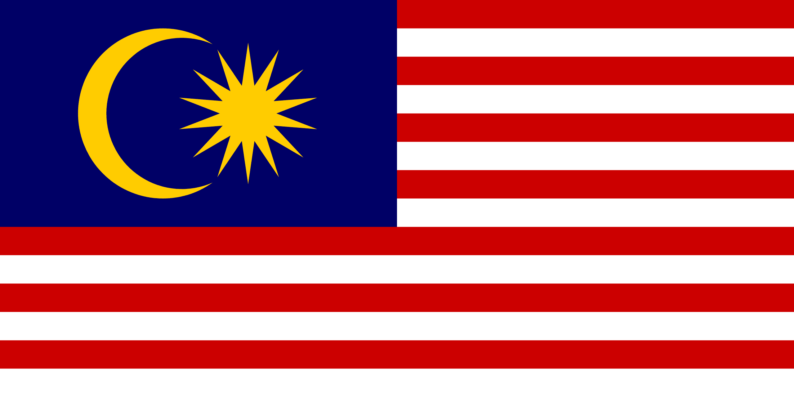
PRAYING FOR
MALAYSIA

Slide 3
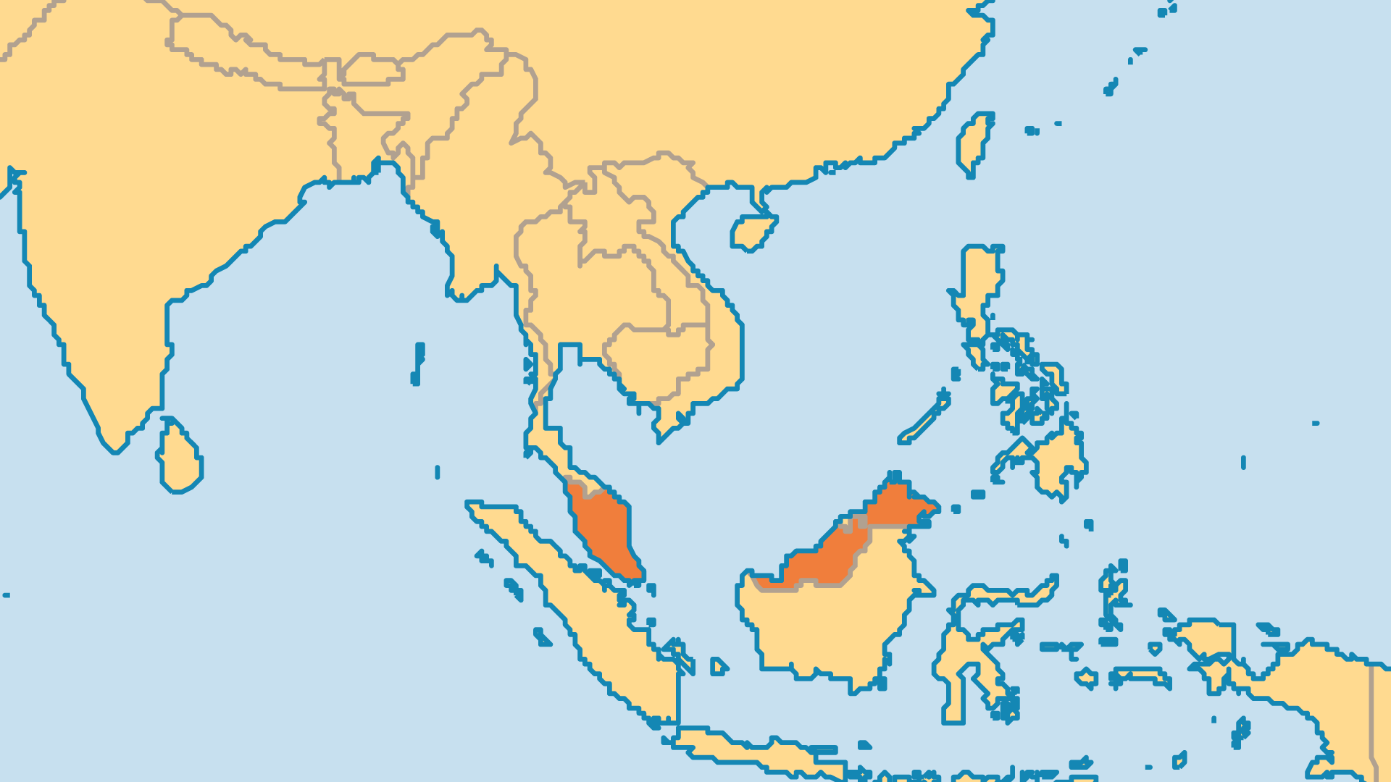
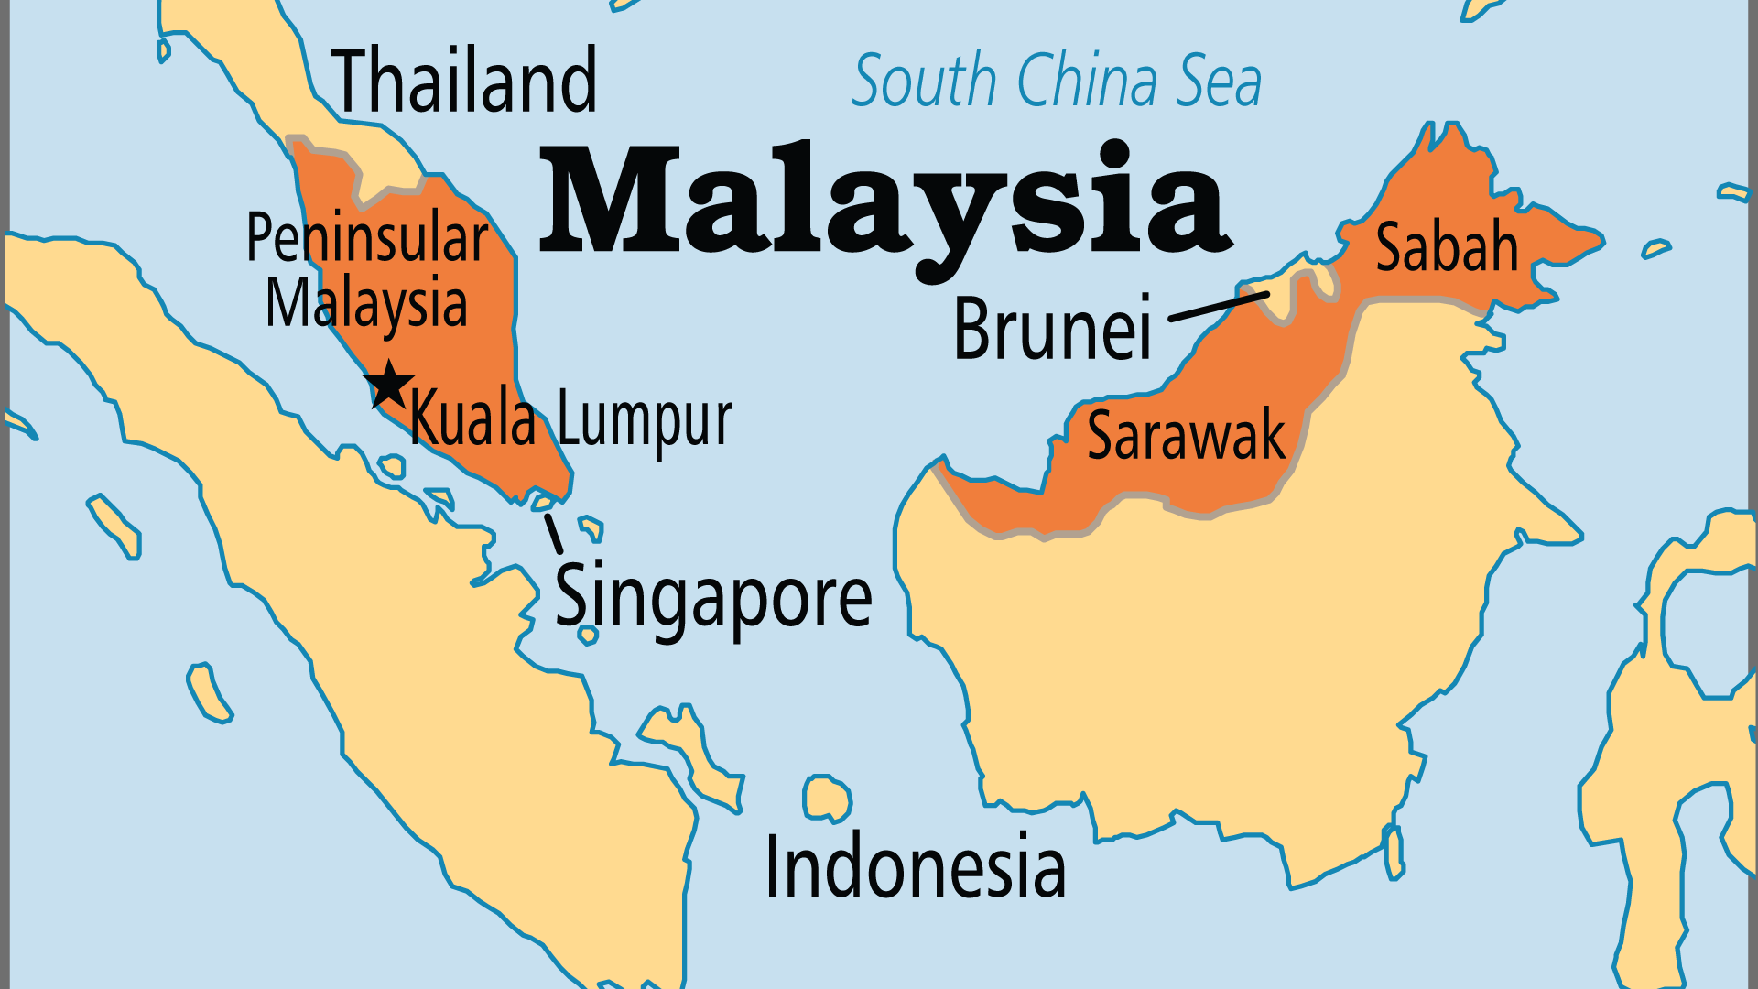
KEY STATS
Capital: | Kuala Lumpur
Population: | 35,977,838
Official Language: | Malay
Languages: | 145
Literacy Rate: | 93 %
HDI Ranking: | 62/193
% Christian: | 9.4 %
% Evangelical: | 4.3 %
Largest Religion: | Muslim
% Unevangelized: | 43 %
Persecution Ranking: | 43/50

Slide 4

FOR PRAYER
Malaysian society faces an uncertain future. The Malay- and Islam-centric UMNO party dominated Malaysia's political scene from independence. It followed policies that favoured ethnic Malays but enriched a small proportion of them at the expense of everyone else. UMNO was defeated in the 2018 elections, and its corrupt leader put in jail. This, along with the 2022 election, signaled a new era in Malaysia. Pray for the leaders, who must seek to hold the country together in ways that satisfy both moderate and conservative Muslims, as well as the sizeable and diverse minorities.
Want to know more? Go to www.operationworld.org

Slide 5
FOR PRAYER
Pray for the less evangelized. The Malaysian Church has the resources and cultural knowledge to reach them, but it also needs the courage and commitment. The Malays are one of the world's largest unreached groups. Some now worship in house groups and multi-ethnic churches, but no public congregation of ethnic Malays exists. The Orang Asli of Peninsular Malaysia (PM) are original inhabitants of the Malaysian peninsula. The Malay-dominated government considers them Muslim, but most practise animism. 8 of the 19 groups have no churches or believers.

