Slide 1




Slide 2


PRAYING FOR
MALAWI

Slide 3
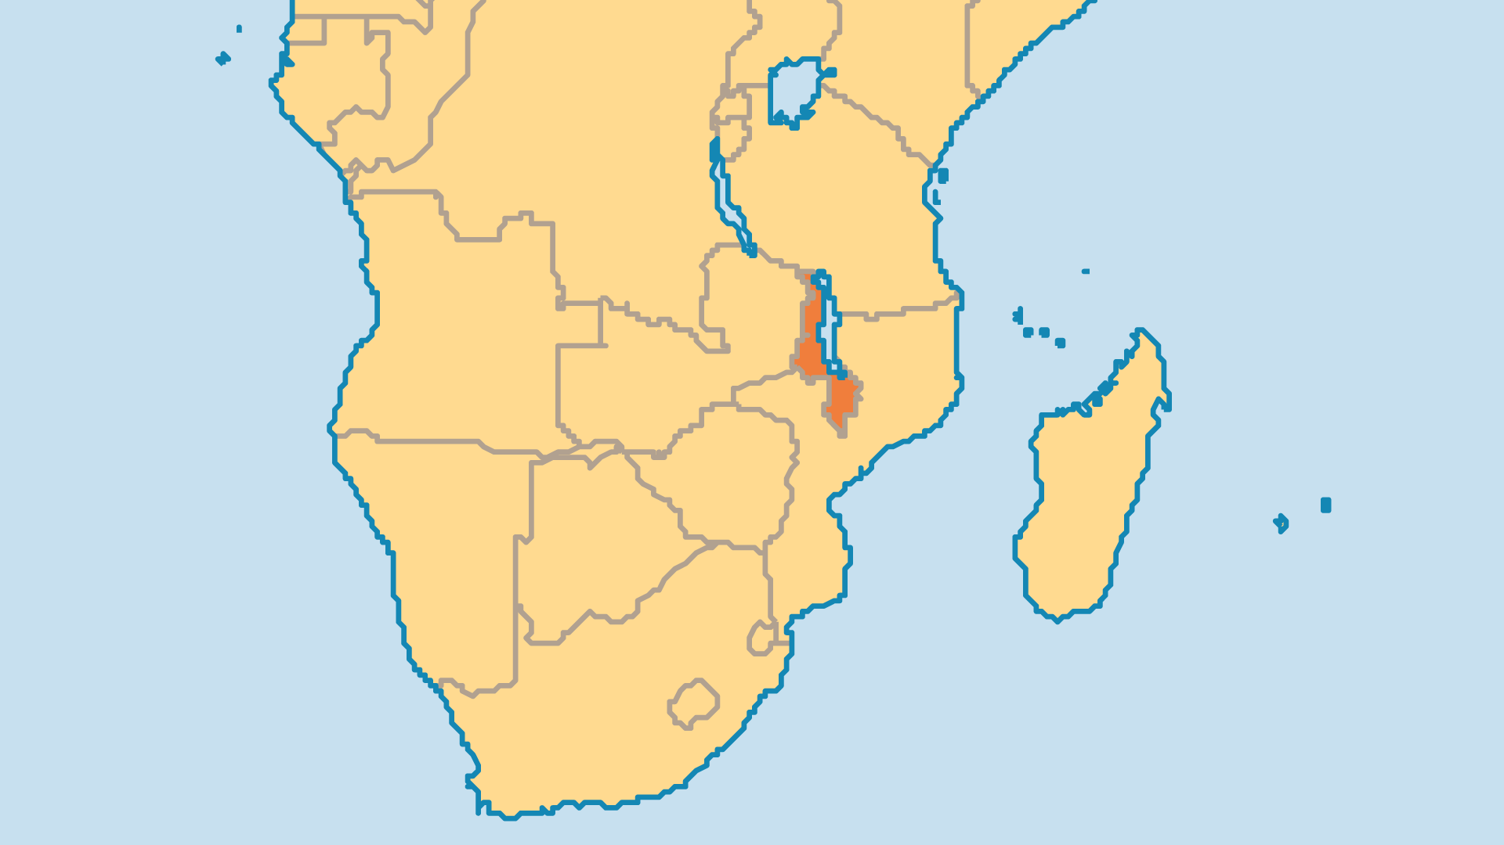
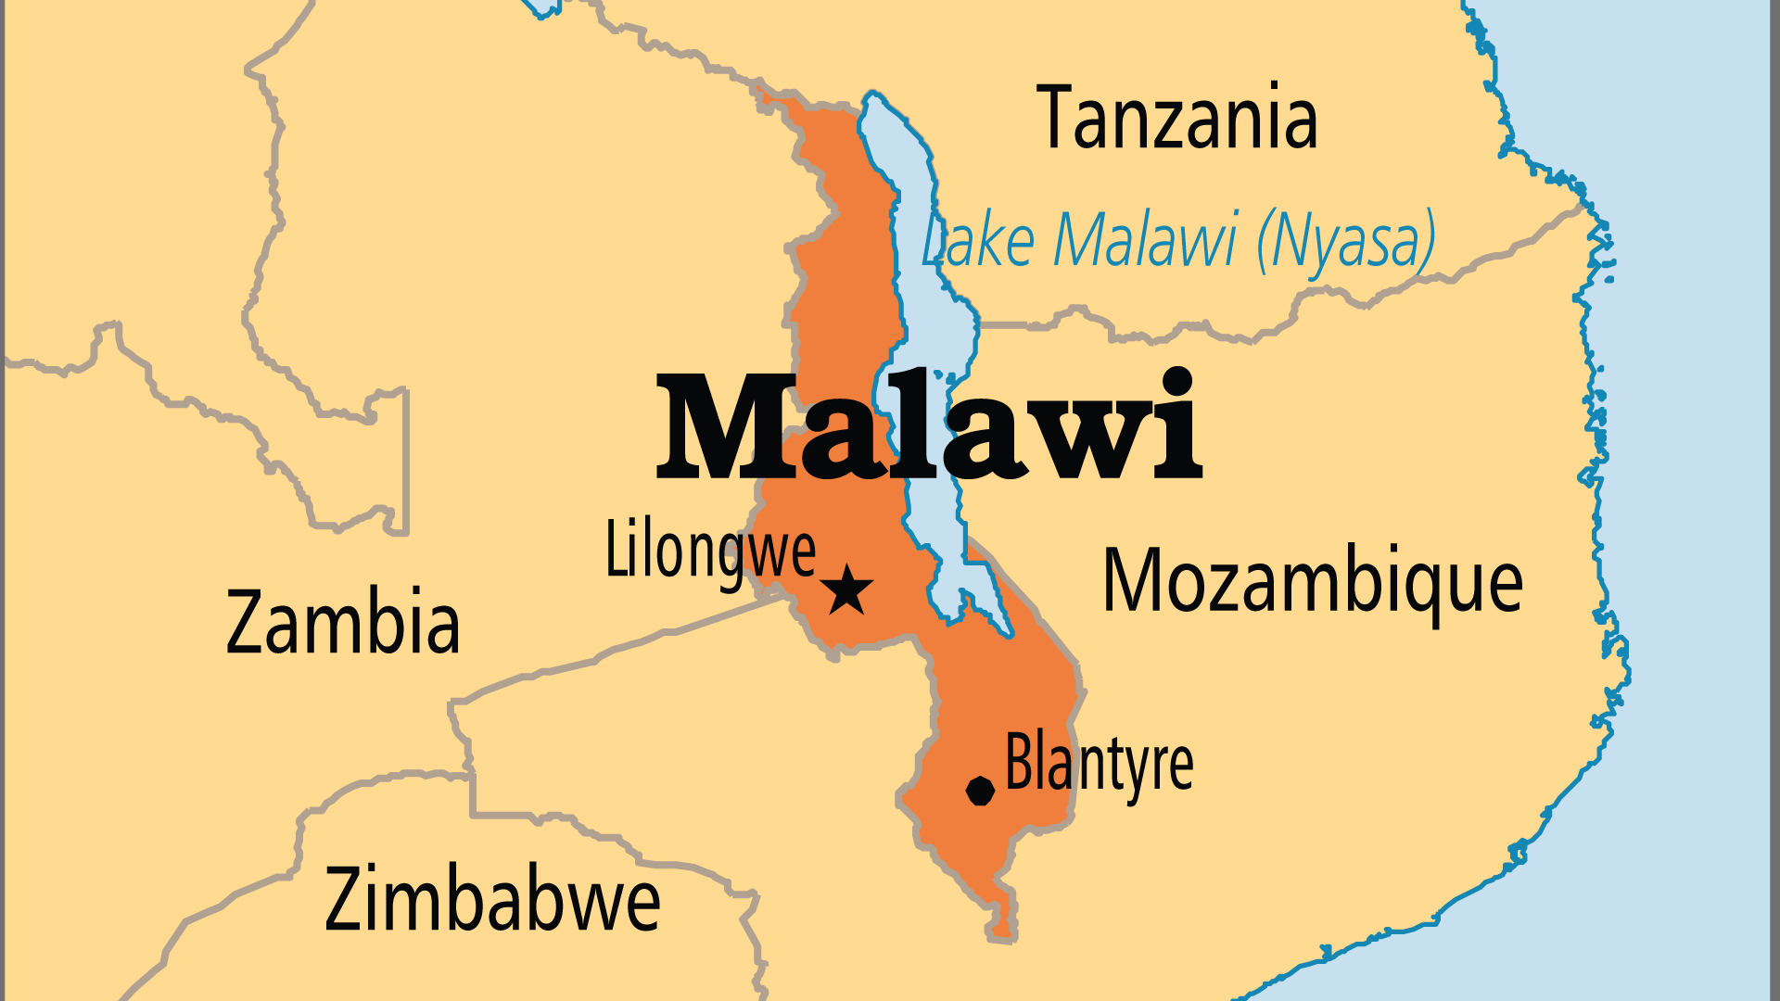
KEY STATS
Continent: | Africa
Capital: | Lilongwe
Population: | 22,216,120
Pop Under 15 Yrs: | 43.5 %
Official Language: | English, but Chewa is common.
Languages: | 24
Literacy Rate: | 66 %
HDI Ranking: | 169/193
% Christian: | 76 %
% Evangelical: | 19.6 %
% Unevangelized: | 3 %

Slide 4

FOR PRAYER
Malawi faces serious challenges in the future, such as the combination of poverty, high population growth and increasing pressure on agricultural land. The grip of poverty hampers development not only in the financial sense but also in terms of education, AIDS prevention, family life and even effective ministry and discipleship. Pray for leaders in Malawi, most of whom are church members, to act with wisdom, humility and long-term planning on biblical principles.
Want to know more? Go to www.operationworld.org

