Slide 1




Slide 2

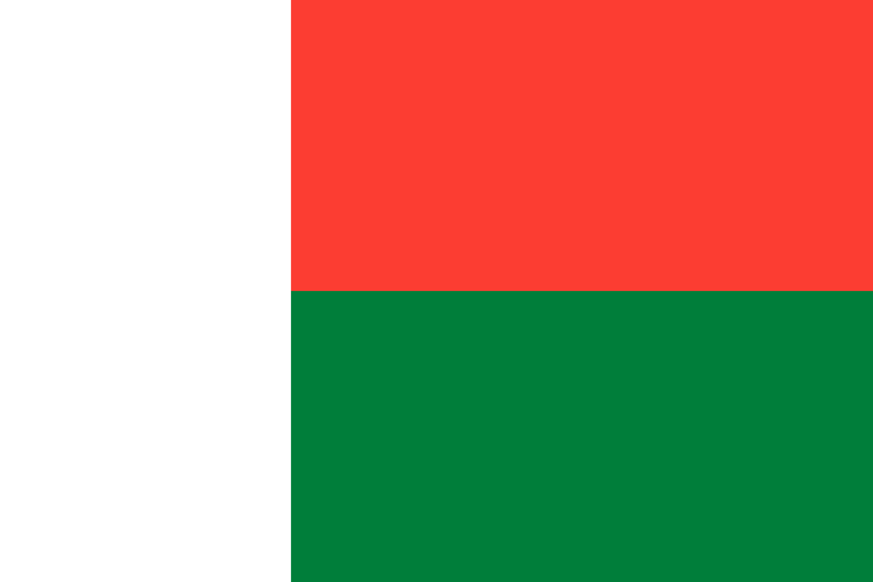
PRAYING FOR
MADAGASCAR

Slide 3
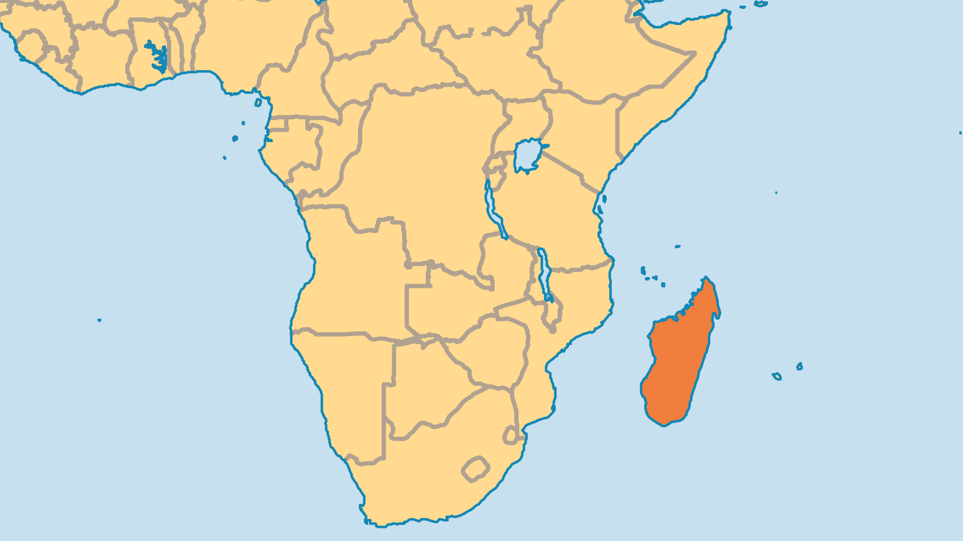
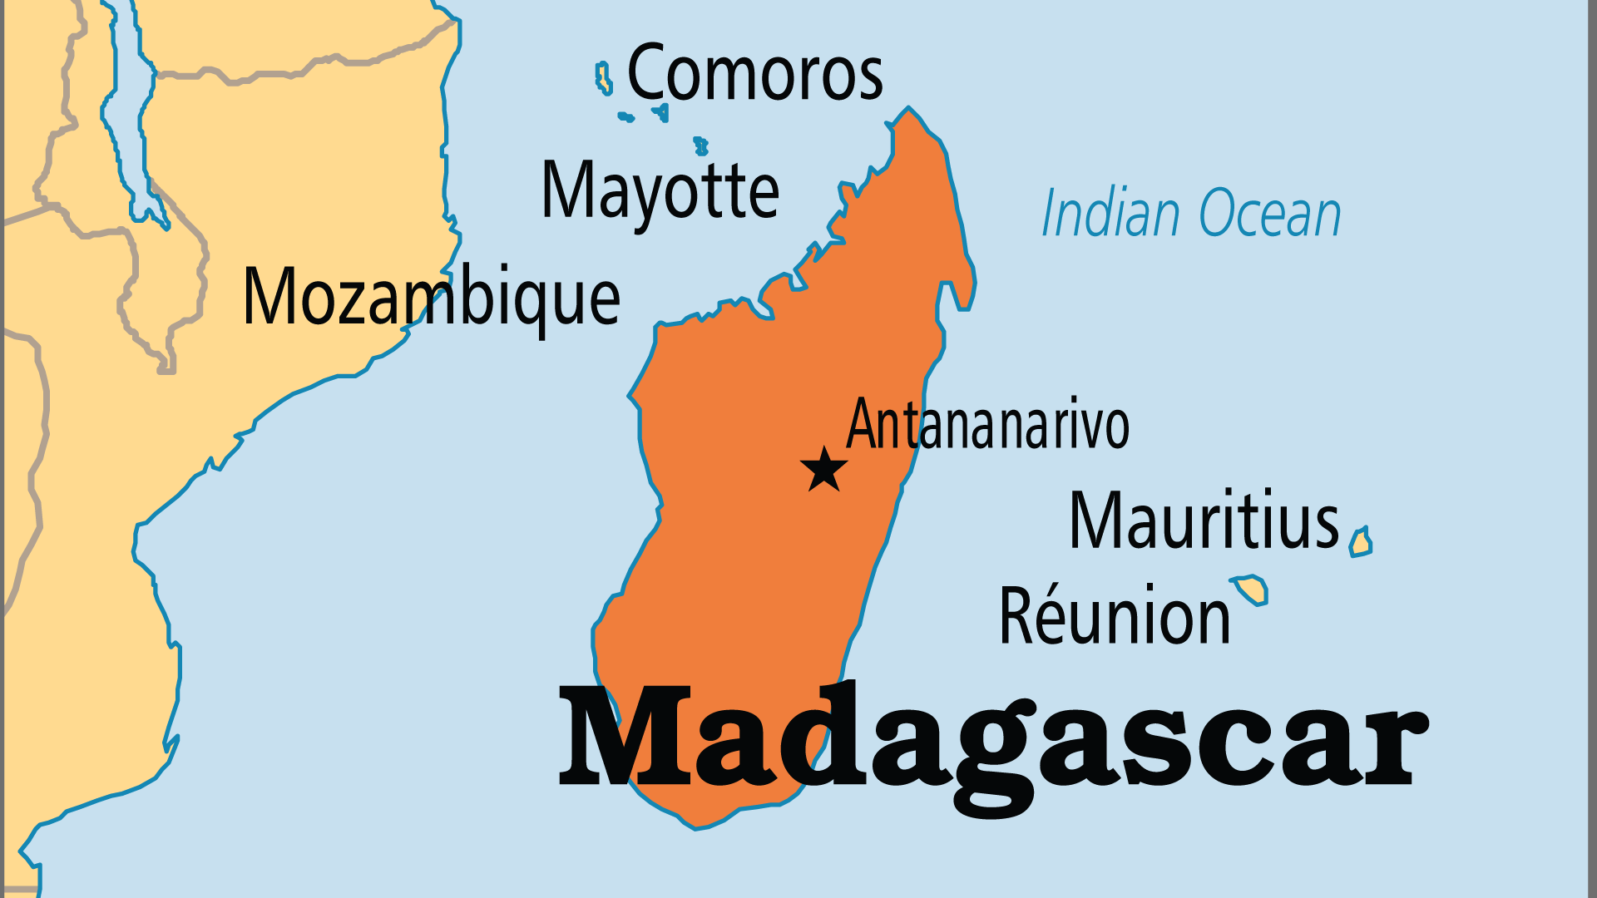
KEY STATS
Capital: | Antananarivo
Population: | 32,740,678
Pop Under 15 Yrs: | 40.4 %
Official Language: | Malagasy and French
Languages: | 20
HDI Ranking: | 173/193
% Christian: | 53.5 %
% Evangelical: | 11.5 %
% Unevangelized: | 11 %

Slide 4

FOR PRAYER
The old beliefs still prevail in many ways, despite the growth and spread of Christianity. Compromise with the old beliefs, veneration of ancestral spirits, and witchcraft is widespread among those who claim to be Christian. A Christian veneer often prevails, but many have little understanding of the biblical message of salvation. Many churches appear to be spiritually dead and in numerical decline, particularly in mainline denominations. Revival as well as biblical teaching and leadership are urgently needed. Pray for a new move of the Holy Spirit to reawaken these churches that have such a strong legacy.

