Slide 1




Slide 2


PRAYING FOR
LUXEMBOURG

Slide 3
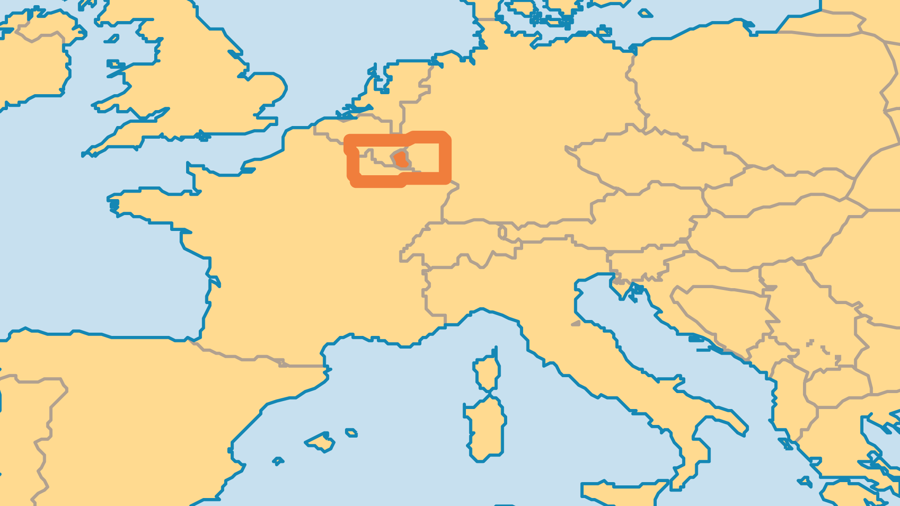
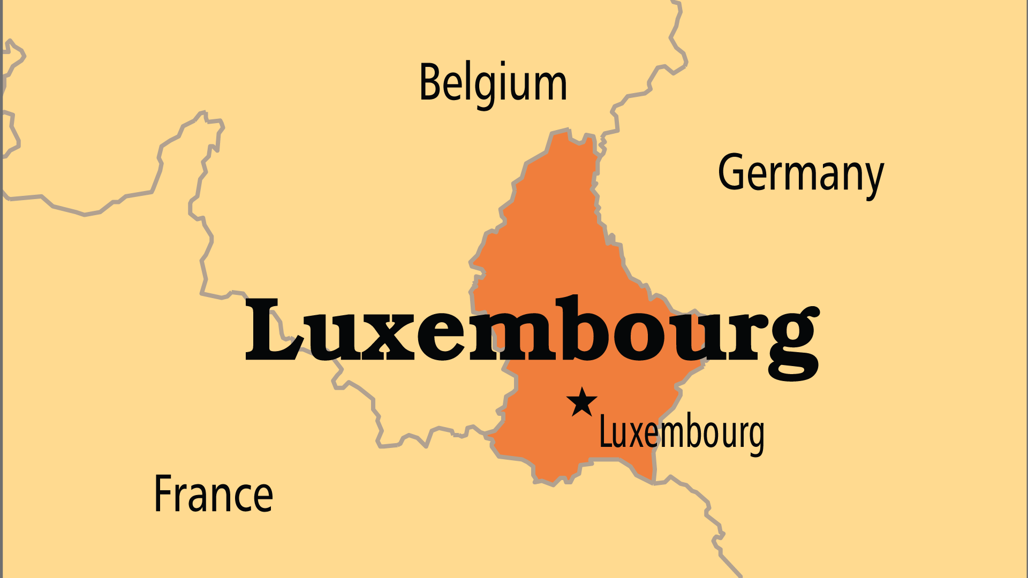
KEY STATS
Capital: | Luxemburg
Population: | 680,454
Official Language: | French, Lëtzebuergesch
Languages: | 6
Literacy Rate: | 99 %
Life Expectancy: | 82.6 yrs (17th/236)
HDI Ranking: | 17/193
% Christian: | 81.6 %
% Evangelical: | 0.5 %
% Unevangelized: | 2 %

Slide 4

FOR PRAYER
Nearly half the population of Luxembourg are expatriates. The resulting growth of other faiths presents a challenge to traditional faith. Islam, Orthodoxy, Jehovah's Witnesses, and Eastern mysticism and the multiplication of Protestant and Independent groups have transformed this small nation into a melting pot of religious expression. Pray that believers in the Lord Jesus might seek and make use of chances to share the gospel, and help shape the nation according to biblical principles.
Want to know more? Go to www.operationworld.org

