Slide 1




Slide 2


PRAYING FOR
LITHUANIA

Slide 3
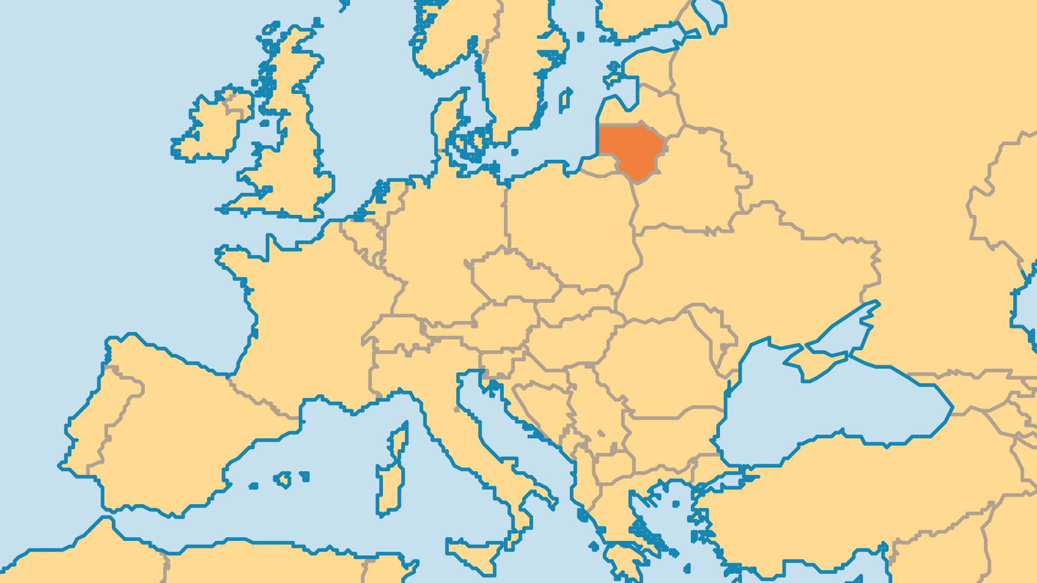
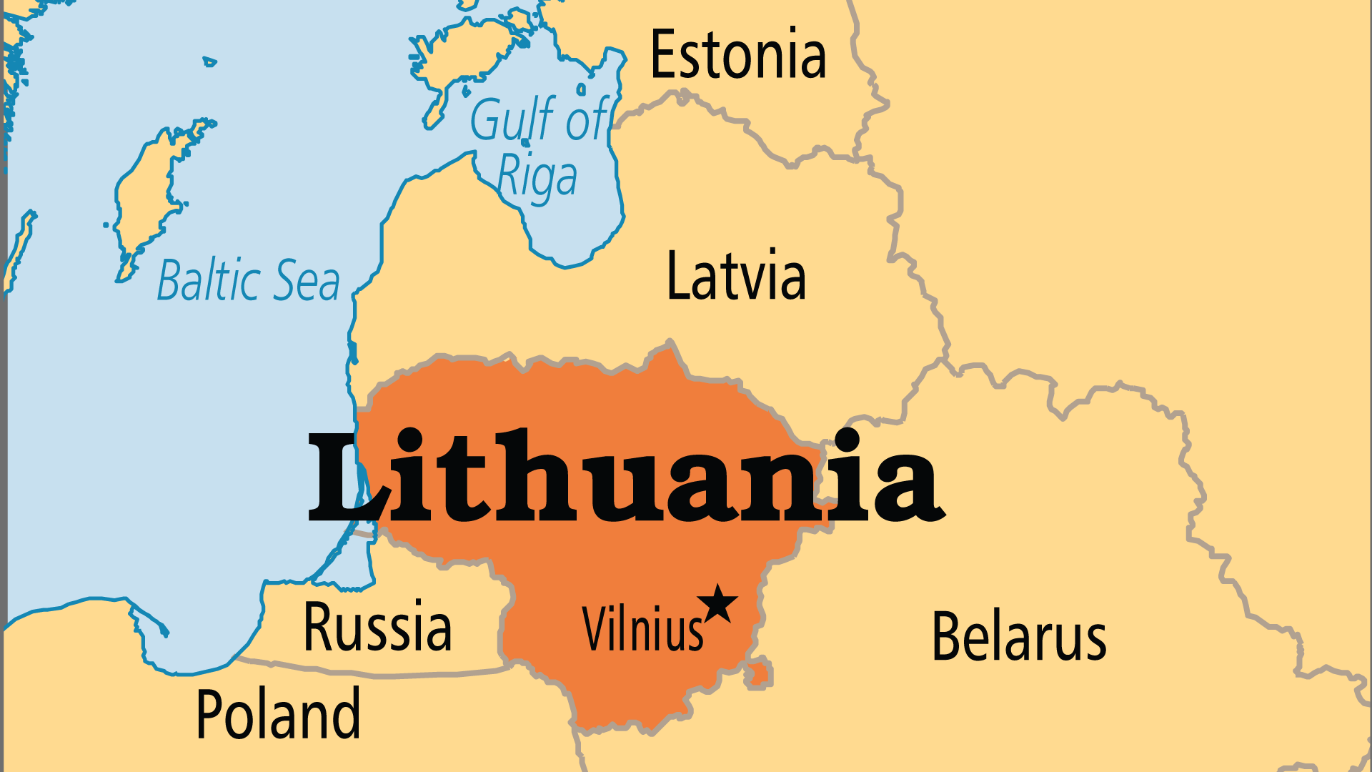
KEY STATS
Capital: | Vilnius
Population: | 2,830,145
Pop Under 15 Yrs: | 15.1 %
Official Language: | Lithuanian
Languages: | 12
Literacy Rate: | 99 %
HDI Ranking: | 35/193
% Christian: | 85.4 %
% Evangelical: | 1.1 %
% Unevangelized: | 1 %

Slide 4

FOR PRAYER
Freedom brought good progress. Doors for the gospel remain open! However, freedom also brought dangers like greed for material goods, selfish pleasure-seeking, and a belief that traditional morals have no value. Substance abuse, suicide, and trafficking of women for prostitution all damage the social foundations. Spiritual transformation must accompany economic growth. Lithuania was the last European nation to be Christianized. Pray that God will bring massive social change through His people!
Want to know more? Go to www.operationworld.org

