Slide 1




Slide 2

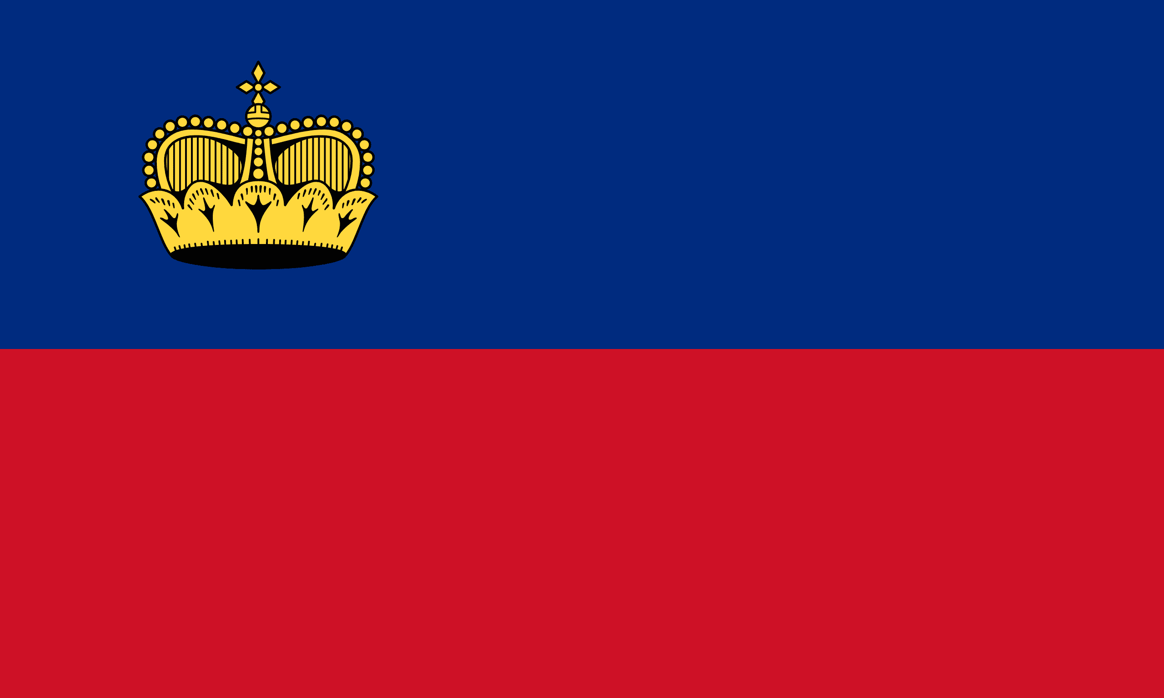
PRAYING FOR
LIECHTENSTEIN

Slide 3
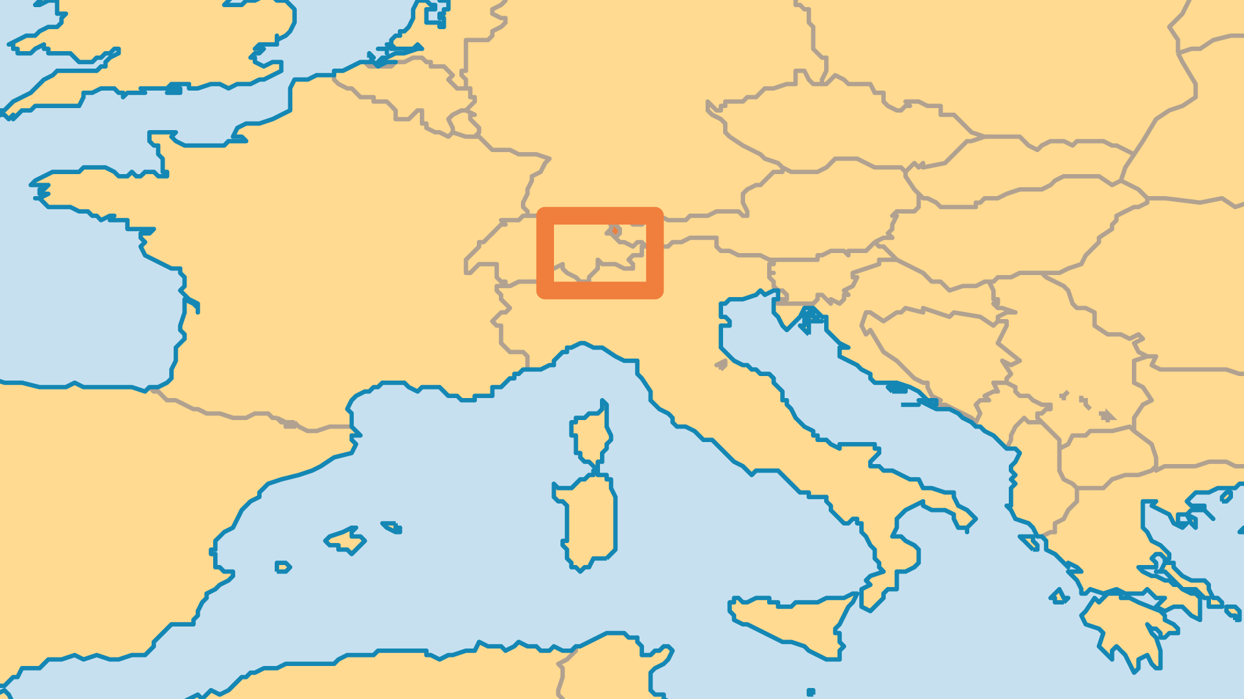
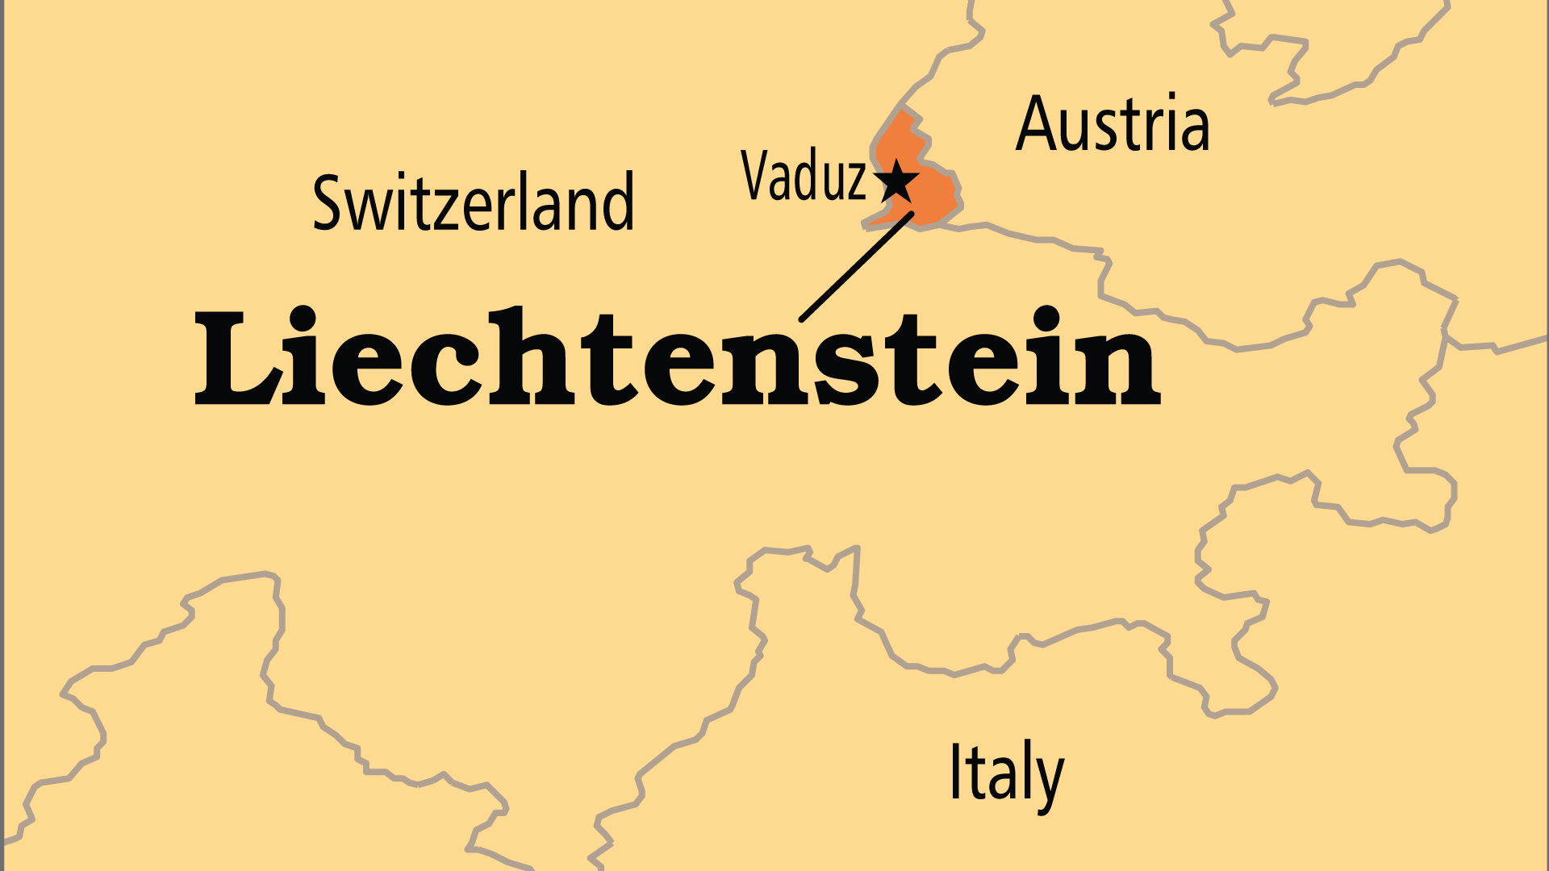
KEY STATS
Capital: | Vaduz
Population: | 40,128
Official Language: | German
Literacy Rate: | 100 %
Life Expectancy: | 83.3 yrs (9th/236)
HDI Ranking: | 16/193
% Christian: | 79.2 %
% Evangelical: | 0.5 %
% Unevangelized: | 4 %

Slide 4

FOR PRAYER
Liechtenstein is a constitutional principality, and has some ties with Switzerland. The Prince's family have always been Catholic, as are the native citizens, though most do not actively practise their faith. The numbers of Muslims and non-religious people grow. British, Norwegian, and Swiss believers started the only evangelical fellowship in 1985. Some of the extended royal family have connections with the Catholic charismatic renewal movement, and profess personal faith in Christ.
Want to know more? Go to www.operationworld.org

