Slide 1




Slide 2

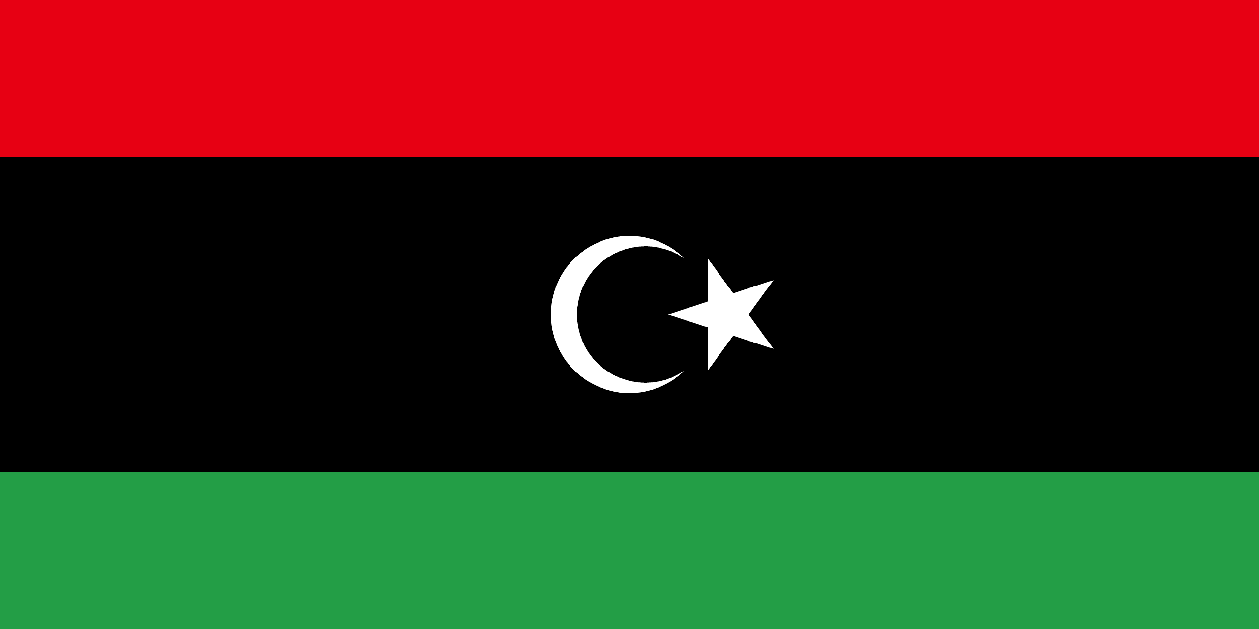
PRAYING FOR
LIBYA

Slide 3
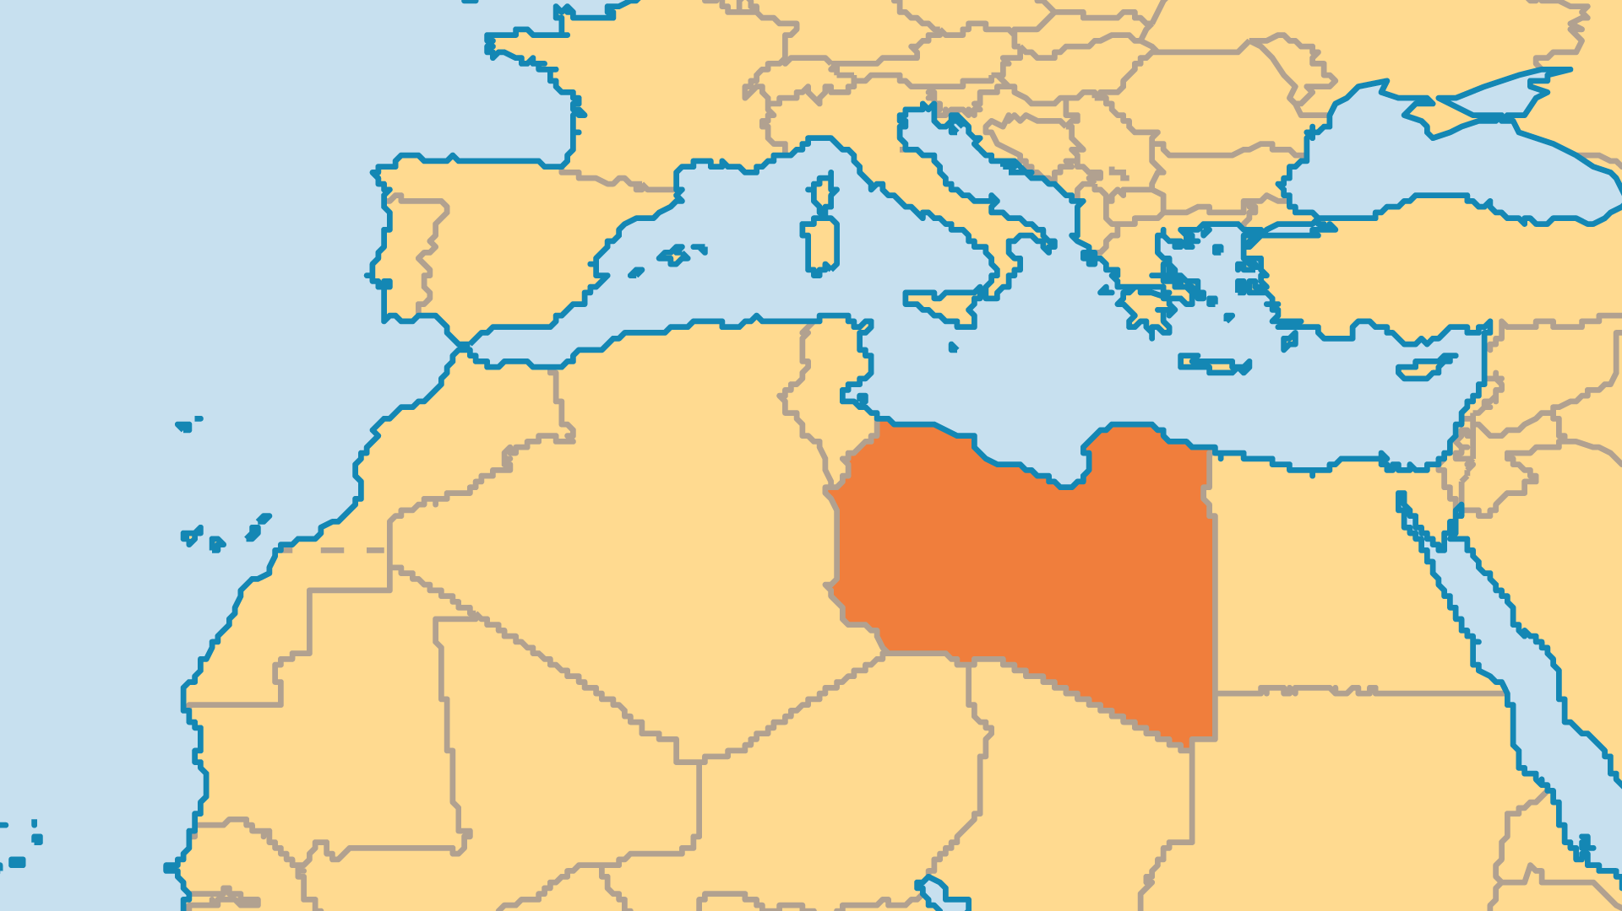
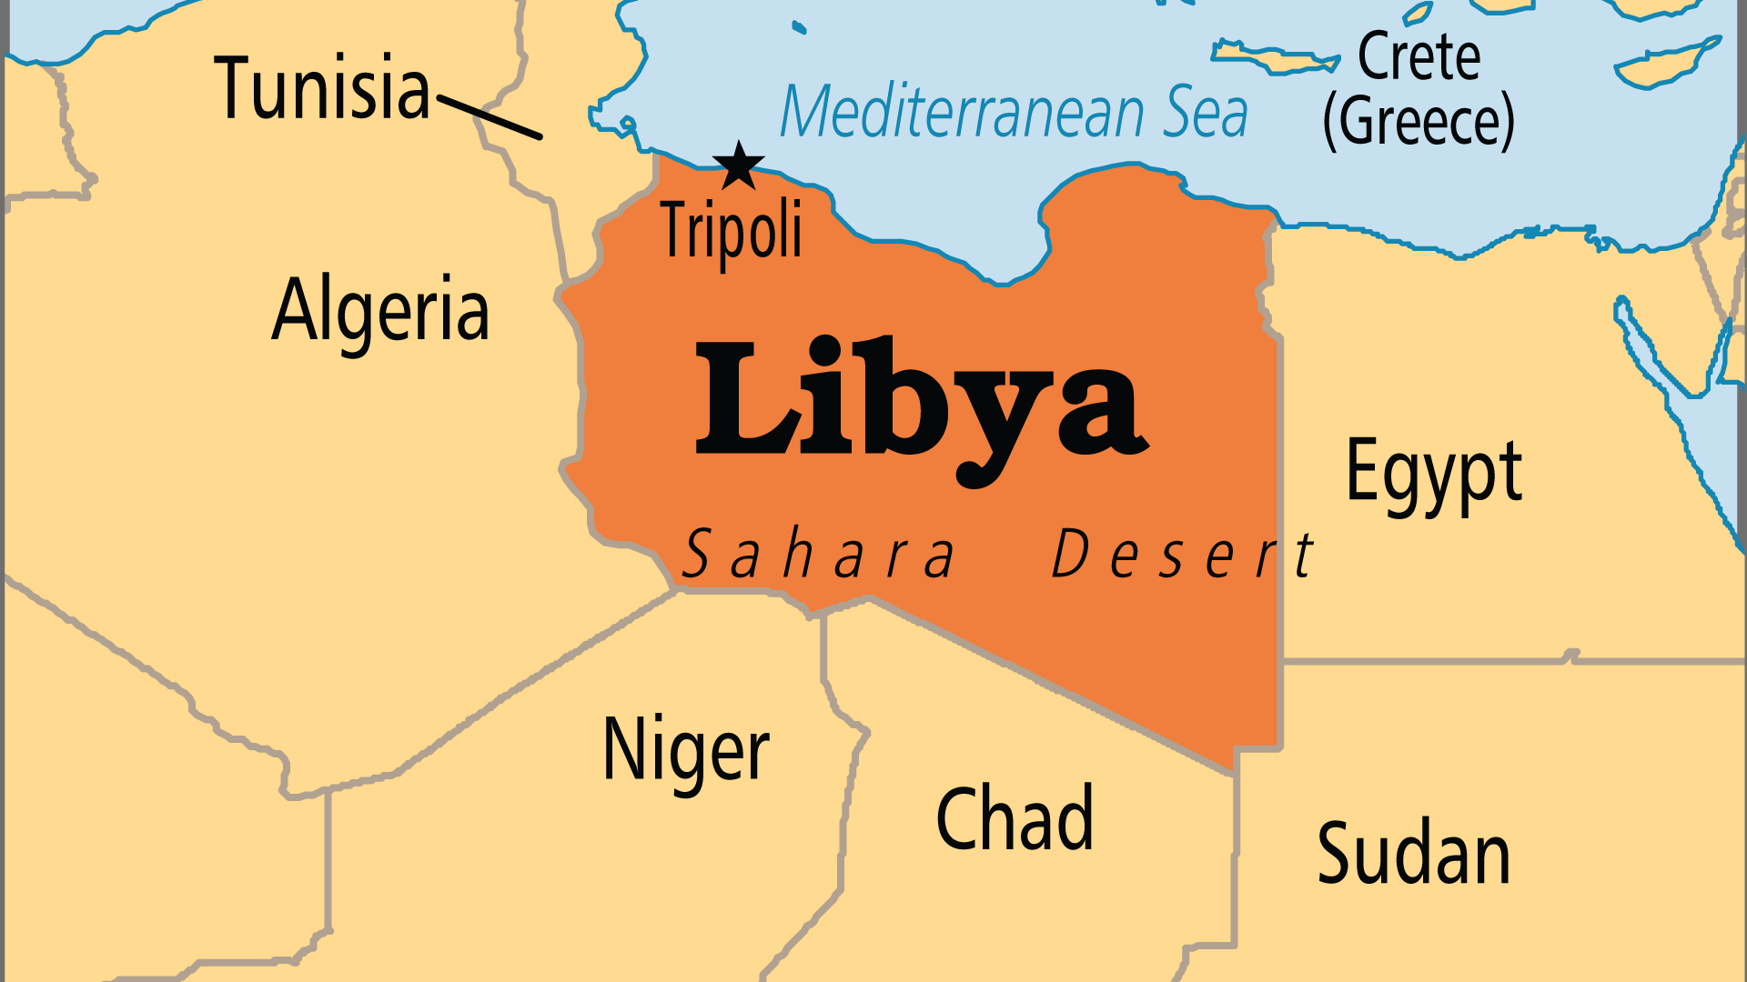
KEY STATS
Capital: | Tripoli
Population: | 7,458,555
Official Language: | Arabic
Languages: | 32
% Christian: | 2.6 %
% Evangelical: | 0.3 %
Largest Religion: | Muslim
% Largest Religion: | 97 %
% Unevangelized: | 66 %
Persecution Ranking: | 4/50

Slide 4

FOR PRAYER
Qaddafi's fall in 2011 led to nearly a decade of civil war between different factions. A permanent ceasefire was signed in 2020, but political wrangling between the factions have prevented elections. Libyans desire to see progress in their nation, but those in power - and foreign interests as well - continue to prefer conflict over reconciliation. Pray for a resolution to the issue of governance, for the rebuilding of infrastructure that enables communities to thrive, and most of all, for an opening of these lands and people to the gospel.
Want to know more? Go to www.operationworld.org

Slide 5
FOR PRAYER
Large numbers of migrants come into Libya. Most come from Sub-Saharan Africa, but some from North Africa and even parts of Asia. A few find work in Libya, but more cross the dangerous deserts and seas in search of a new life in Europe. In the last decade, around 1 million people have made the dangerous crossing to Italy. The current chaos in Libya gives freedom for traffickers to exploit these vulnerable people. Pray that these tens or even hundreds of thousands would find salvation, and not just earthly gain. Some of these migrants are believers; many others find Jesus in the midst of their turbulent lives. Pray that they might have a powerful spiritual impact on Libyans and on fellow migrants.

