Slide 1




Slide 2

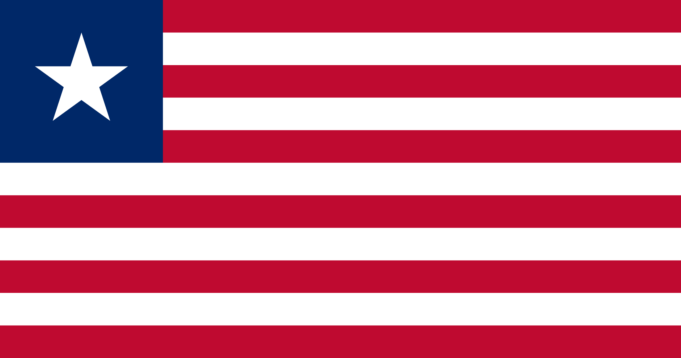
PRAYING FOR
LIBERIA

Slide 3
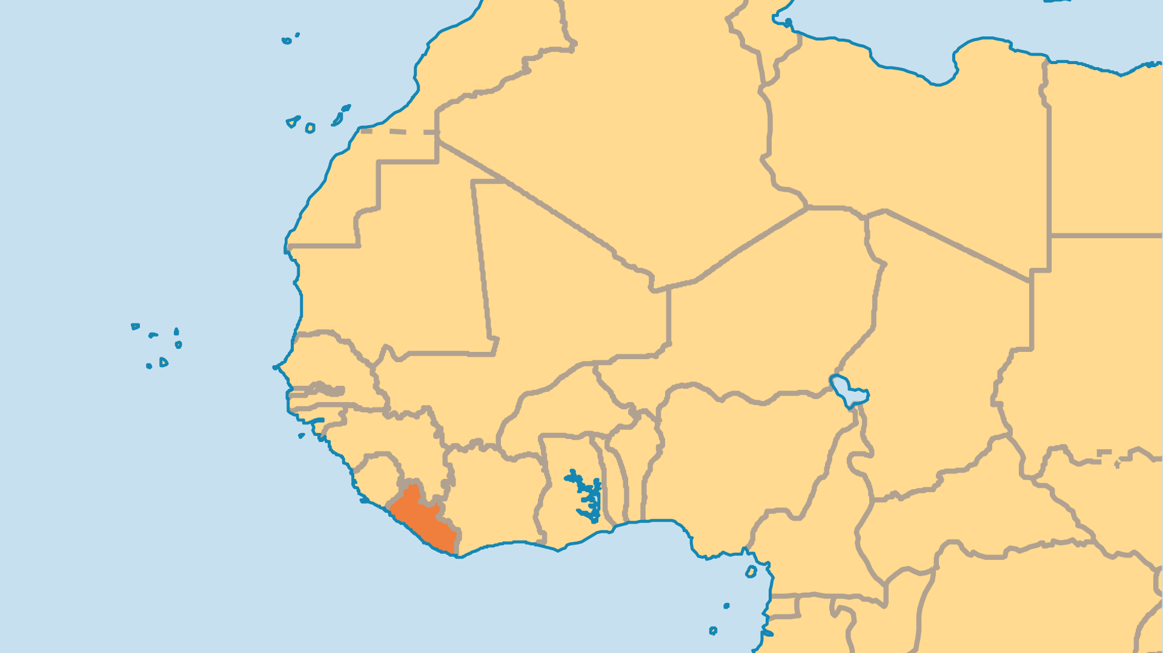
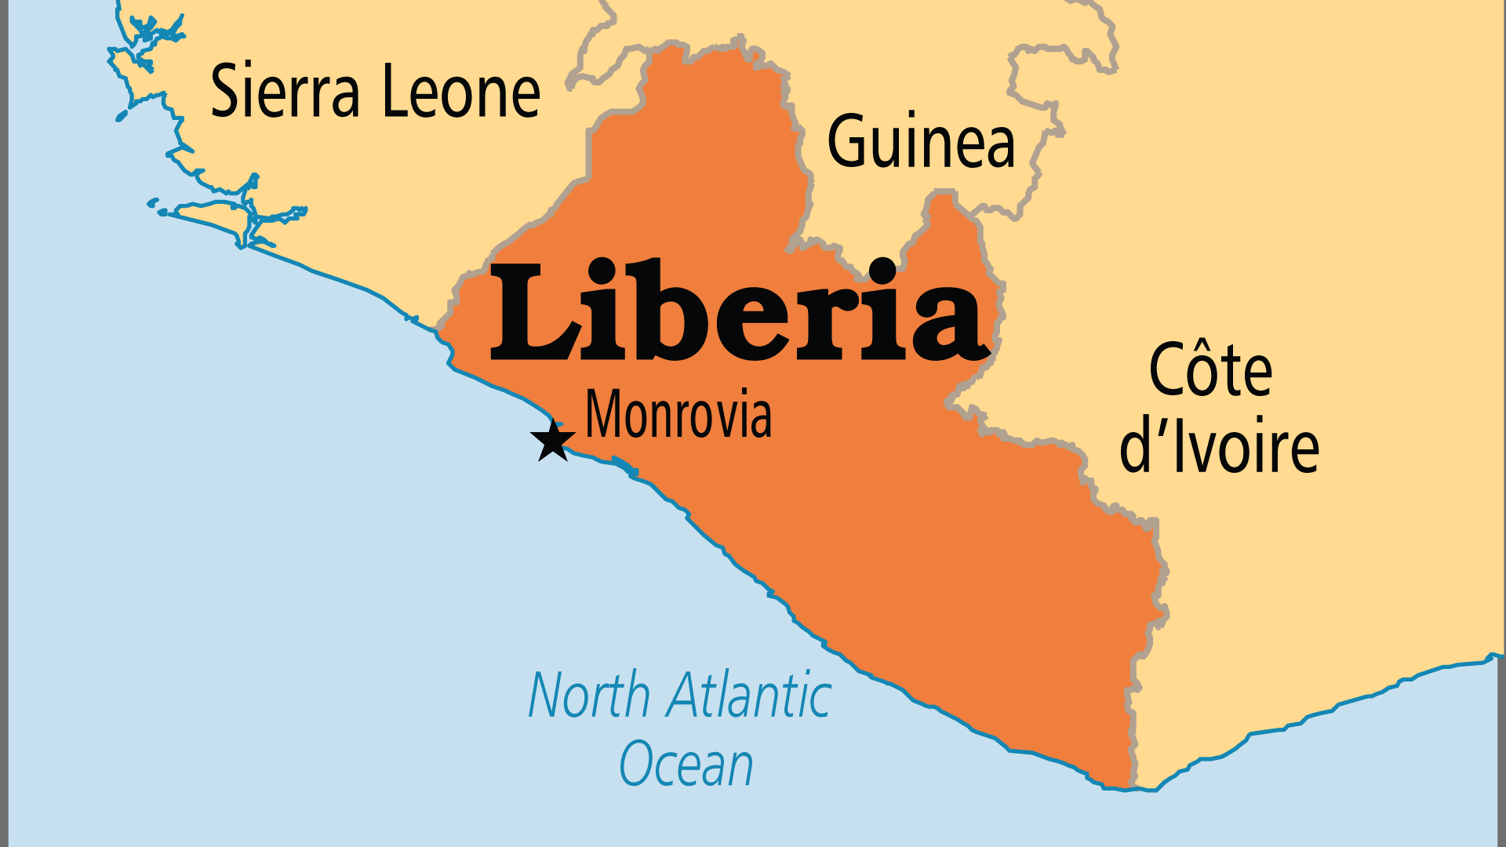
KEY STATS
Capital: | Monrovia
Population: | 5,731,206
Official Language: | English
Languages: | 31
Literacy Rate: | 48 %
HDI Ranking: | 178/193
% Christian: | 41.4 %
% Evangelical: | 14.6 %
Largest Religion: | Ethnoreligionist
% Largest Religion: | 42.5 %
% Unevangelized: | 22 %

Slide 4

FOR PRAYER
Liberia has a complex and painful history, including racism and colonialism. It endured terrible conflict from 1985-2005. But Praise God for the stability and peace of recent years. Hundreds of thousands of refugees returned, a new president came to power (the former leader was exiled), the country began to rebuild, and Christian ministry began to thrive once again. Liberia has an atmosphere of hope and progress, despite the obvious challenges which remain from the civil wars and the devastation and trauma they caused. Pray that Liberia might truly fulfil its name as a "land of freedom".
Want to know more? Go to www.operationworld.org

