Slide 1




Slide 2


PRAYING FOR
LESOTHO

Slide 3
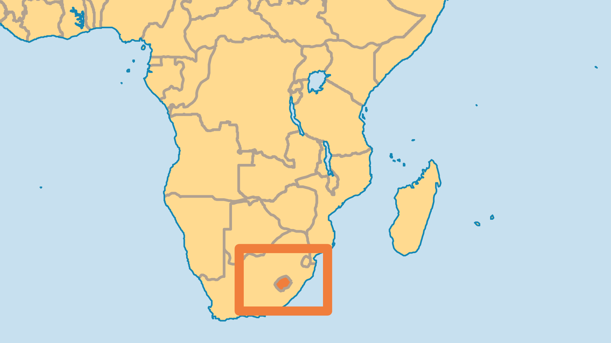
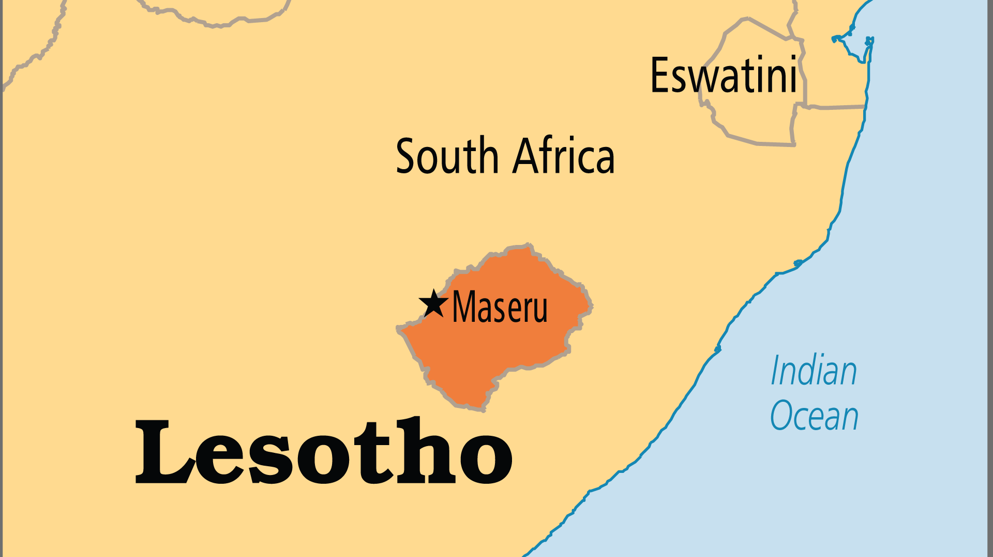
KEY STATS
Capital: | Maseru
Population: | 2,363,325
% Urban: | 31.4 %
Official Language: | Sesotho, English
Languages: | 6
Life Expectancy: | 53.1 yrs (234th/236)
HDI Ranking: | 168/193
% Christian: | 89.3 %
% Evangelical: | 12.1 %
Largest Religion: | Christian
% Unevangelized: | 1 %

Slide 4

FOR PRAYER
Lesotho faces great challenges. Family breakdown, poverty, unemployment, and limited access to water frustrate daily life. Pray for wise leadership and creative ways to improve quality of life. Mission Aviation Fellowship planes transport medical supplies and Christian workers in this mountainous country with few roads. The mountain peoples are much less reached because of their isolated location. Christian radio reaches many in the lowlands, even non-churchgoers. Scripture Union shares God's Word with young people through school groups. Pray for fruitful ministry in this needy land.
Want to know more? Go to www.operationworld.org

