Slide 1




Slide 2


PRAYING FOR
LEBANON

Slide 3
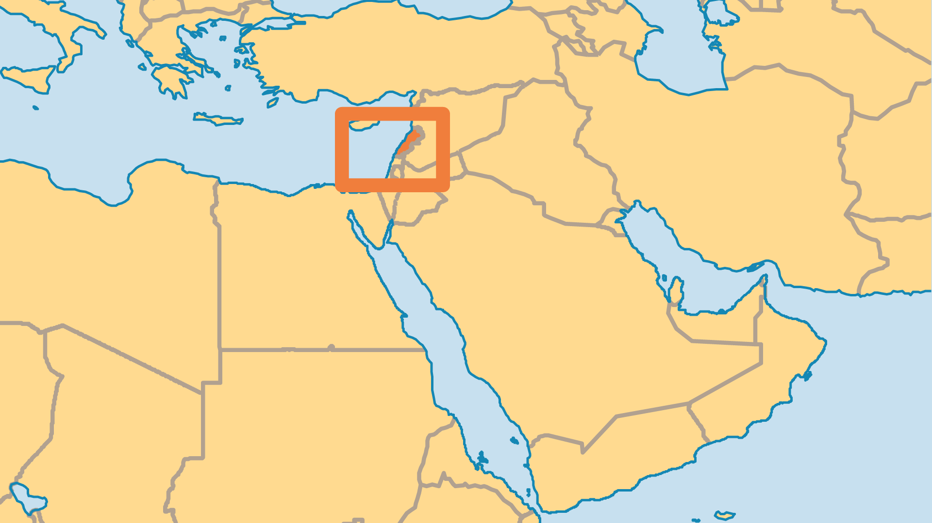
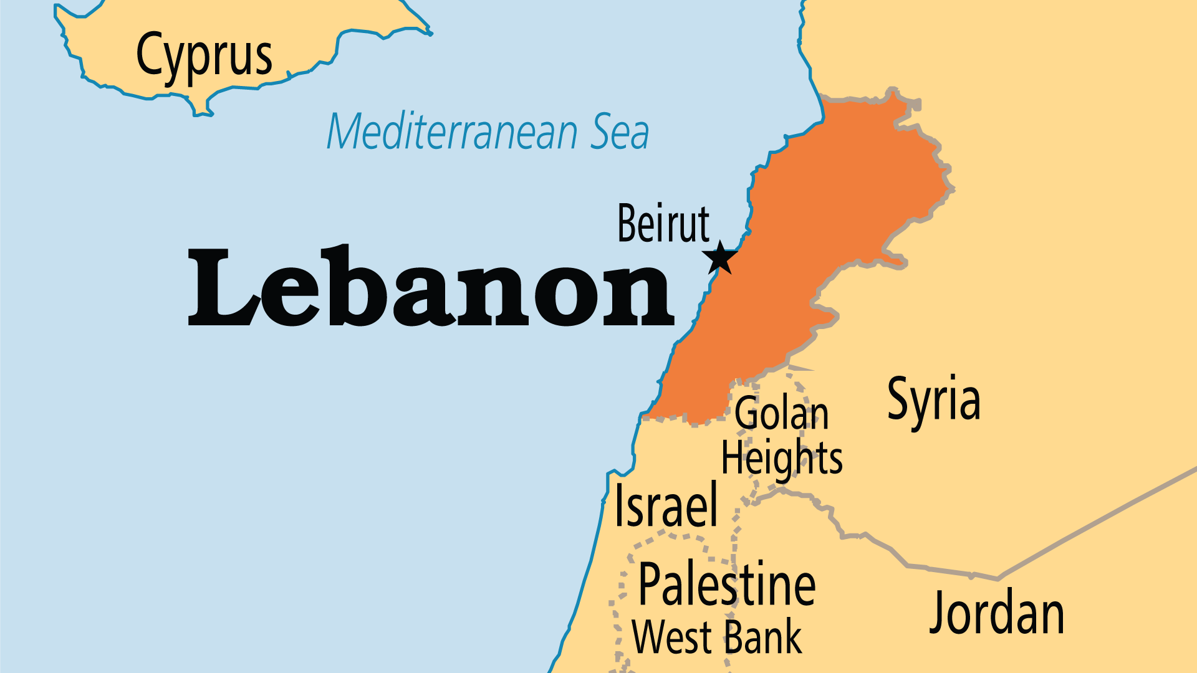
KEY STATS
Capital: | Beirut
Population: | 5,849,421
Official Language: | Arabic; French and English are widely used
Languages: | 9
HDI Ranking: | 112/193
% Christian: | 32 %
% Evangelical: | 0.5 %
Largest Religion: | Muslim
% Unevangelized: | 11 %

Slide 4

FOR PRAYER
Lebanon reels from decade after decade of tragic communal wars, foreign interventions, and internal crises of government corruption, joblessness, and economic stagnation. These crises have been made worse by constant conflict and war in both of its neighbours, Israel and Syria, leading to a million Lebanese being internally displaced. Meanwhile, nearly one-third of Lebanon's population are foreign refugees – from Syria, Palestine, Iraq, and beyond. These refugees are often used as scapegoats for Lebanon's many woes. But growing numbers of them are also encountering Jesus for the first time. Pray for this biblical land to know the loving mercy and rich blessings of our loving Father.

