Slide 1




Slide 2


PRAYING FOR
LATVIA

Slide 3
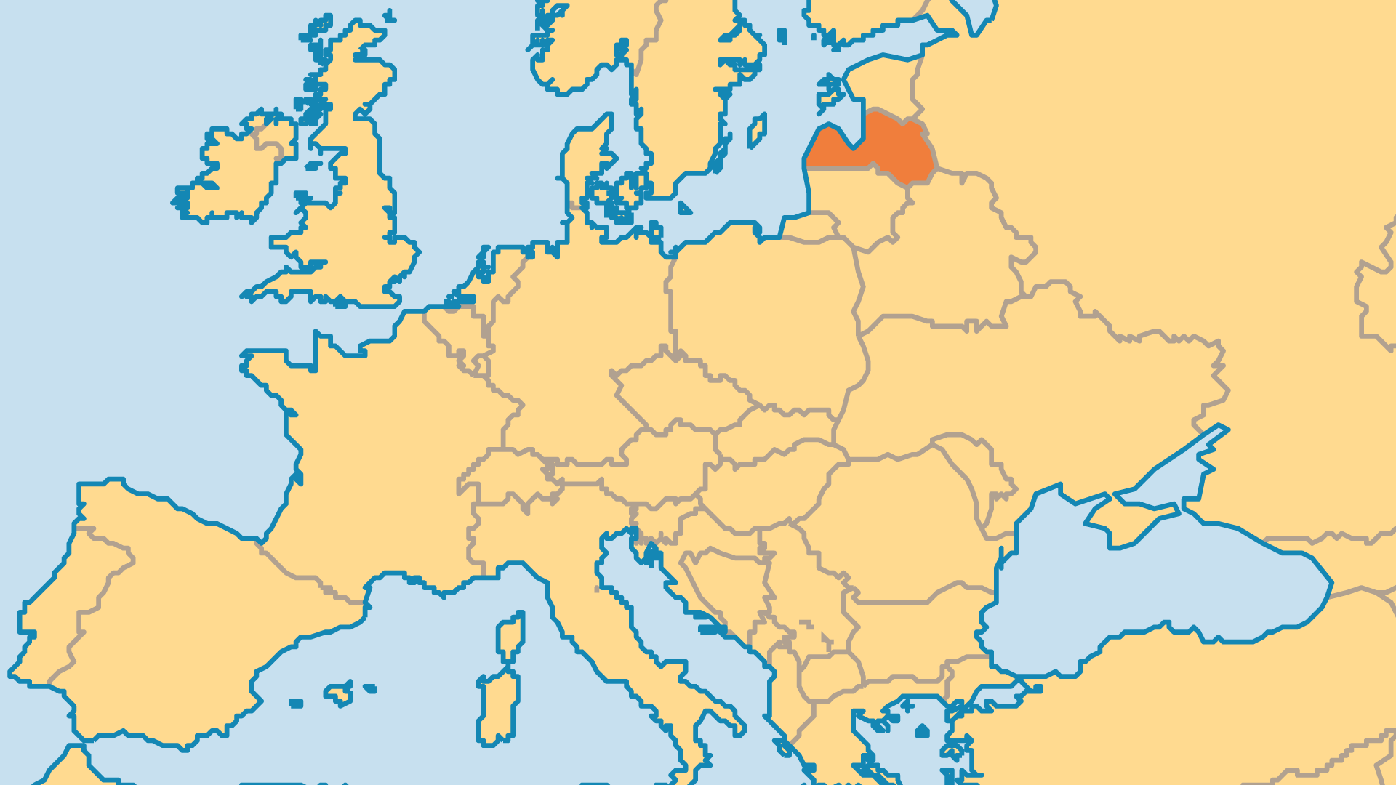
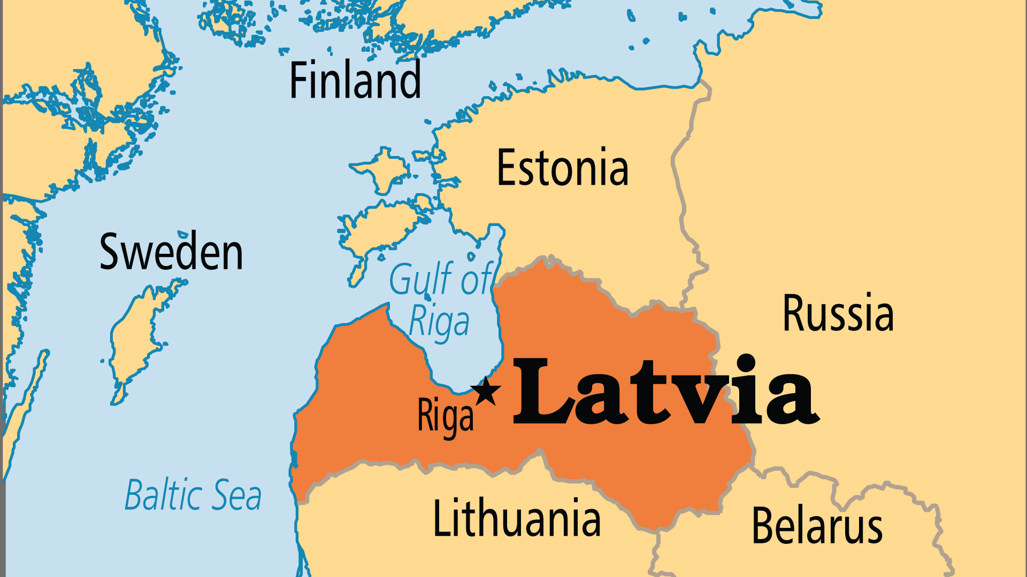
KEY STATS
Capital: | Riga
Population: | 1,853,559
Pop Under 15 Yrs: | 16.3 %
Official Language: | Latvian (Lettish)
Literacy Rate: | 99 %
HDI Ranking: | 39/193
% Christian: | 60 %
% Evangelical: | 7 %
Least Reached People Groups: | 4
% Unevangelized: | 1 %

Slide 4

FOR PRAYER
After decades of Communism, the Soviet Union's collapse left a moral vacuum in Latvia which was quickly filled by opportunistic negative influences. Rates of drug and alchohol abuse, the sex trade, abortion, and suicide have thankfully been reduced from the sharp rise in the aftermath of Latvia's independence. As a member of the European Union, Latvia has done relatively well from a technology and development perspective, but there remains an emptiness that no amount of prosperity can fill. Latvia needs prayer for the deeper and eternal needs of its people.
Want to know more? Go to www.operationworld.org

