Slide 1




Slide 2


PRAYING FOR
KYRGYZSTAN

Slide 3
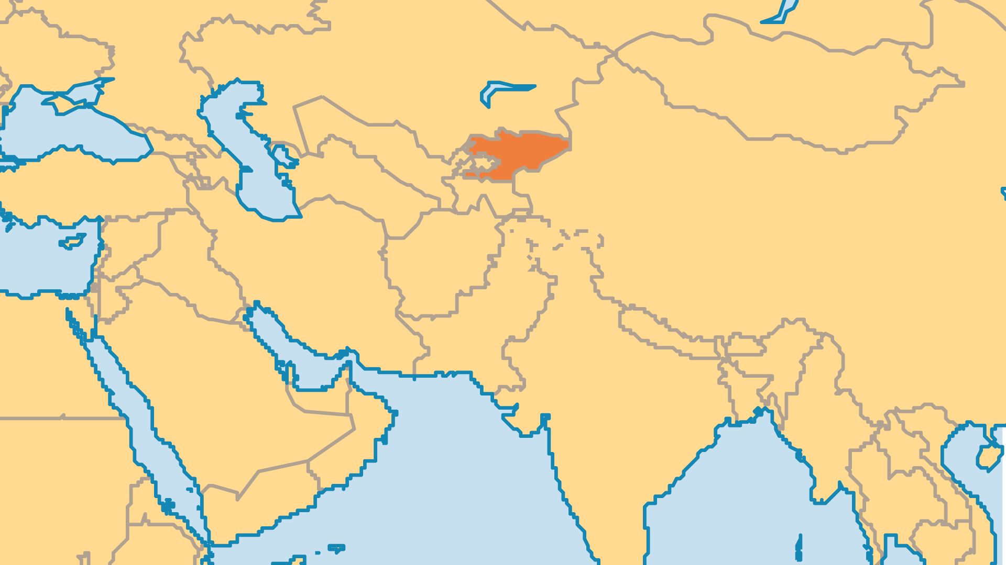
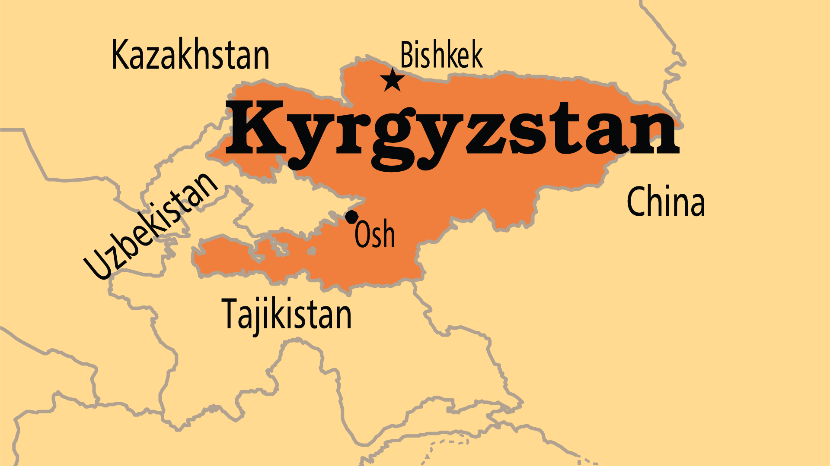
KEY STATS
Capital: | Bishkek
Population: | 7,295,035
% Urban: | 38.6 %
Official Language: | Kyrgyz; Russian
HDI Ranking: | 118/193
% Christian: | 5.3 %
% Evangelical: | 0.7 %
Largest Religion: | Muslim
% Largest Religion: | 88.7 %
% Unevangelized: | 53 %
Persecution Ranking: | 47/150

Slide 4

FOR PRAYER
The government needs courage, resources, and even miracles to make right the economy and society. The regimes that followed Communism have so far only brought more corruption, crime, and poverty. Many people migrate from rural to urban areas, which results in large slum populations in Bishkek. Others leave the country to find work. Pray for Christians to find good, legal jobs. High rates of alcoholism, drug trafficking, gambling, and prostitution create huge challenges. The poor, elderly, and disabled suffer the most. Pray that believers can address these challenges and positively affect their society and economy.
Want to know more? Go to www.operationworld.org

