Slide 1




Slide 2


PRAYING FOR
KUWAIT

Slide 3
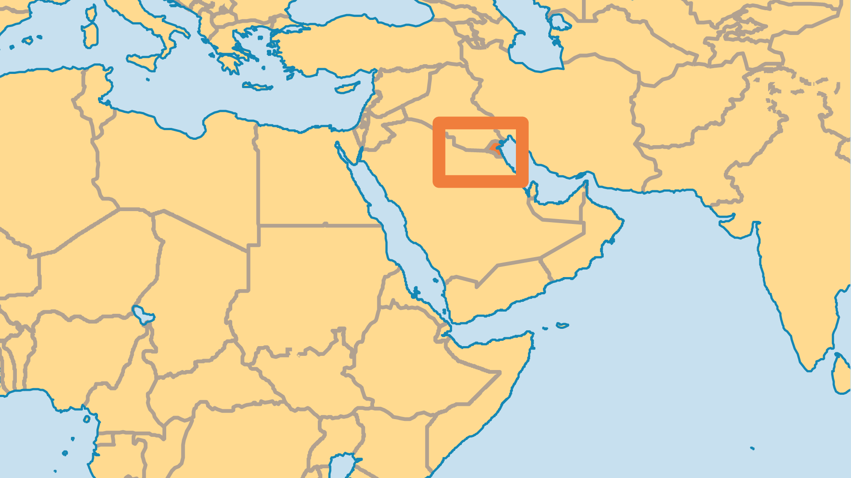
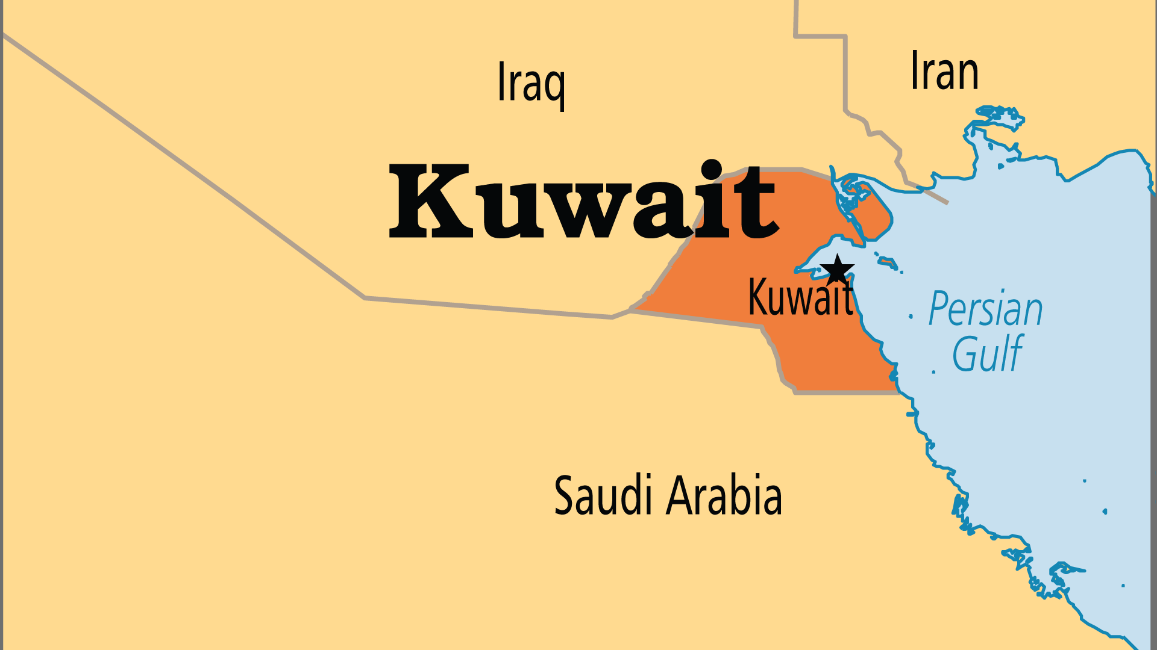
KEY STATS
Capital: | Kuwait
Population: | 5,026,078
% Urban: | 100 %
Pop Under 15 Yrs: | 21.6 %
Official Language: | Arabic
HDI Ranking: | 50/193
% Christian: | 13.8 %
% Evangelical: | 1.5 %
Largest Religion: | Muslim
% Largest Religion: | 81.6 %
% Unevangelized: | 43 %

Slide 4

FOR PRAYER
Foreign ethnic minority groups form most of the workforce. Most are men from Arab lands who leave families for work. Workers also come from Asia (India, the Philippines, Indonesia, others) to provide housework and childcare for Kuwaiti Arab families. Many feel lonely, and receive unjust treatment. Pray for God to encourage the many Christians among them, and through them bring the love of Christ into the homes and lives of Kuwaitis.
Want to know more? Go to www.operationworld.org

