Slide 1




Slide 2

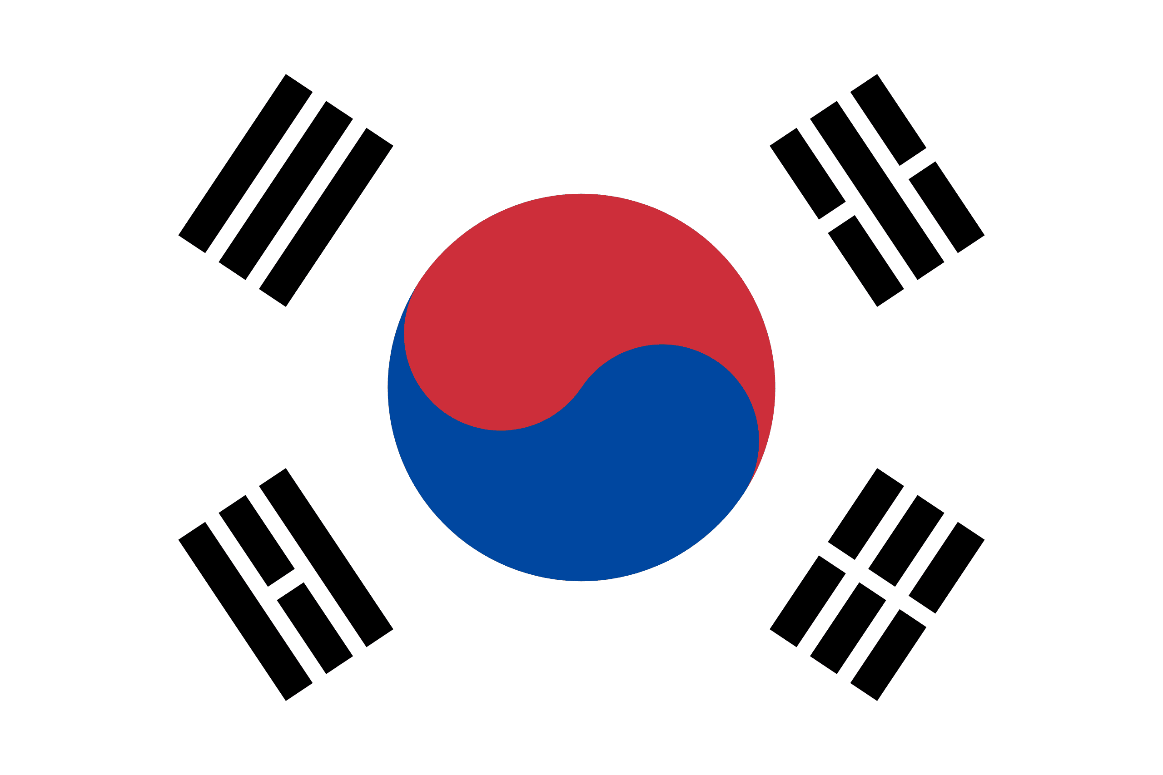
PRAYING FOR
SOUTH
KOREA

Slide 3
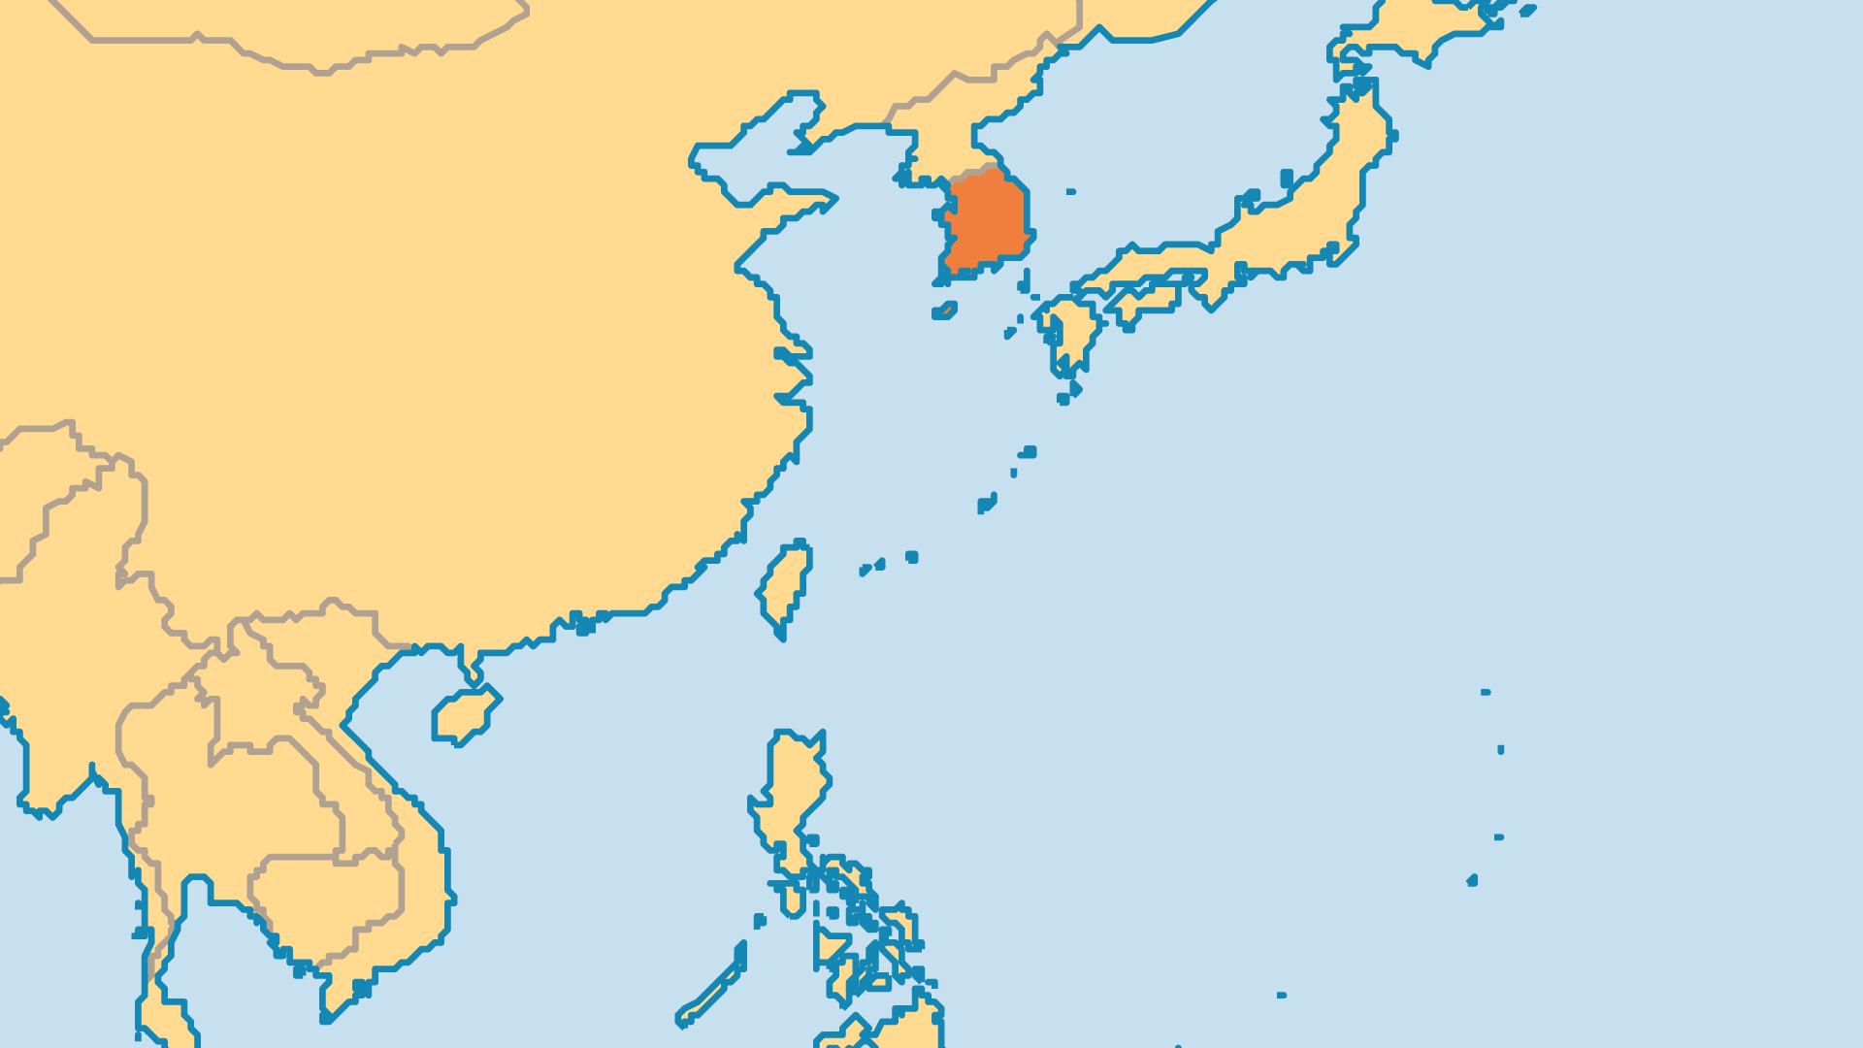
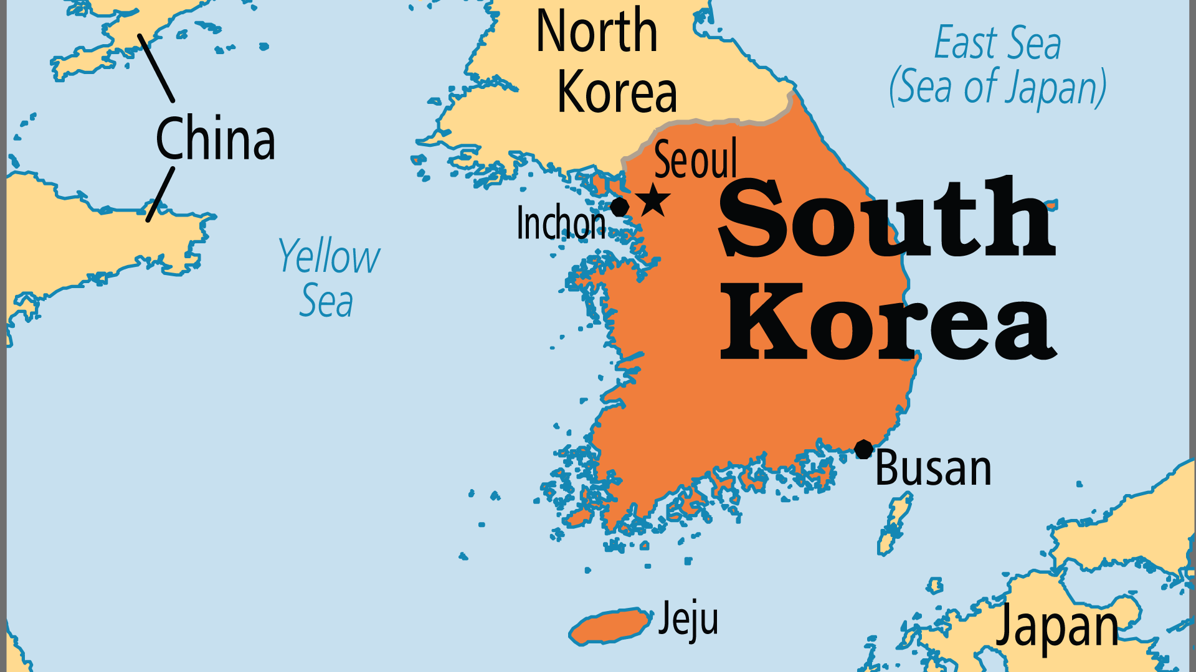
KEY STATS
Capital: | Seoul
Population: | 51,667,030
Pop Under 15 Yrs: | 12.7 %
Official Language: | Korean
Life Expectancy: | 83.7 yrs (8th/236)
HDI Ranking: | 19/193
% Christian: | 31 %
% Evangelical: | 16.8 %
Largest Religion: | Non-religious
People Groups: | 23
% Unevangelized: | 2 %

Slide 4

FOR PRAYER
Society and culture in South Korea changed rapidly in the last generation. Economic growth was remarkable, but global success also exposed corruption in politics and industry. The global popularity of K-pop and Korean films and TV masks an obsession with appearance, social media addiction, high suicide rates, widespread loneliness and cynicism, a broken education system, the exploitation of migrant workers, and more. Pray for wisdom for leaders, and justice for the most vulnerable. Digital ministry is widespread for both evangelism and discipleship. Pray for the gospel to impact the many spiritual needs of this society.
Want to know more? Go to www.operationworld.org

Slide 5
FOR PRAYER
Praise God for the unique Korean Church! From the 1st Protestant congregation in 1884, South Korea now has as many as 50,000. God blessed the Church with a series of revivals, and refined it through times of persecution. It has a strong heritage in theological education, mission, and prayer. At the same time, corruption and scandals in church leadership and an inability to connect well with the younger generation means that South Korean Christianity faces rapid decline and decreasing cultural relevance. Pray for fresh expressions of following Jesus that will bring new life - and a new generation - into the churches.

