Slide 1




Slide 2

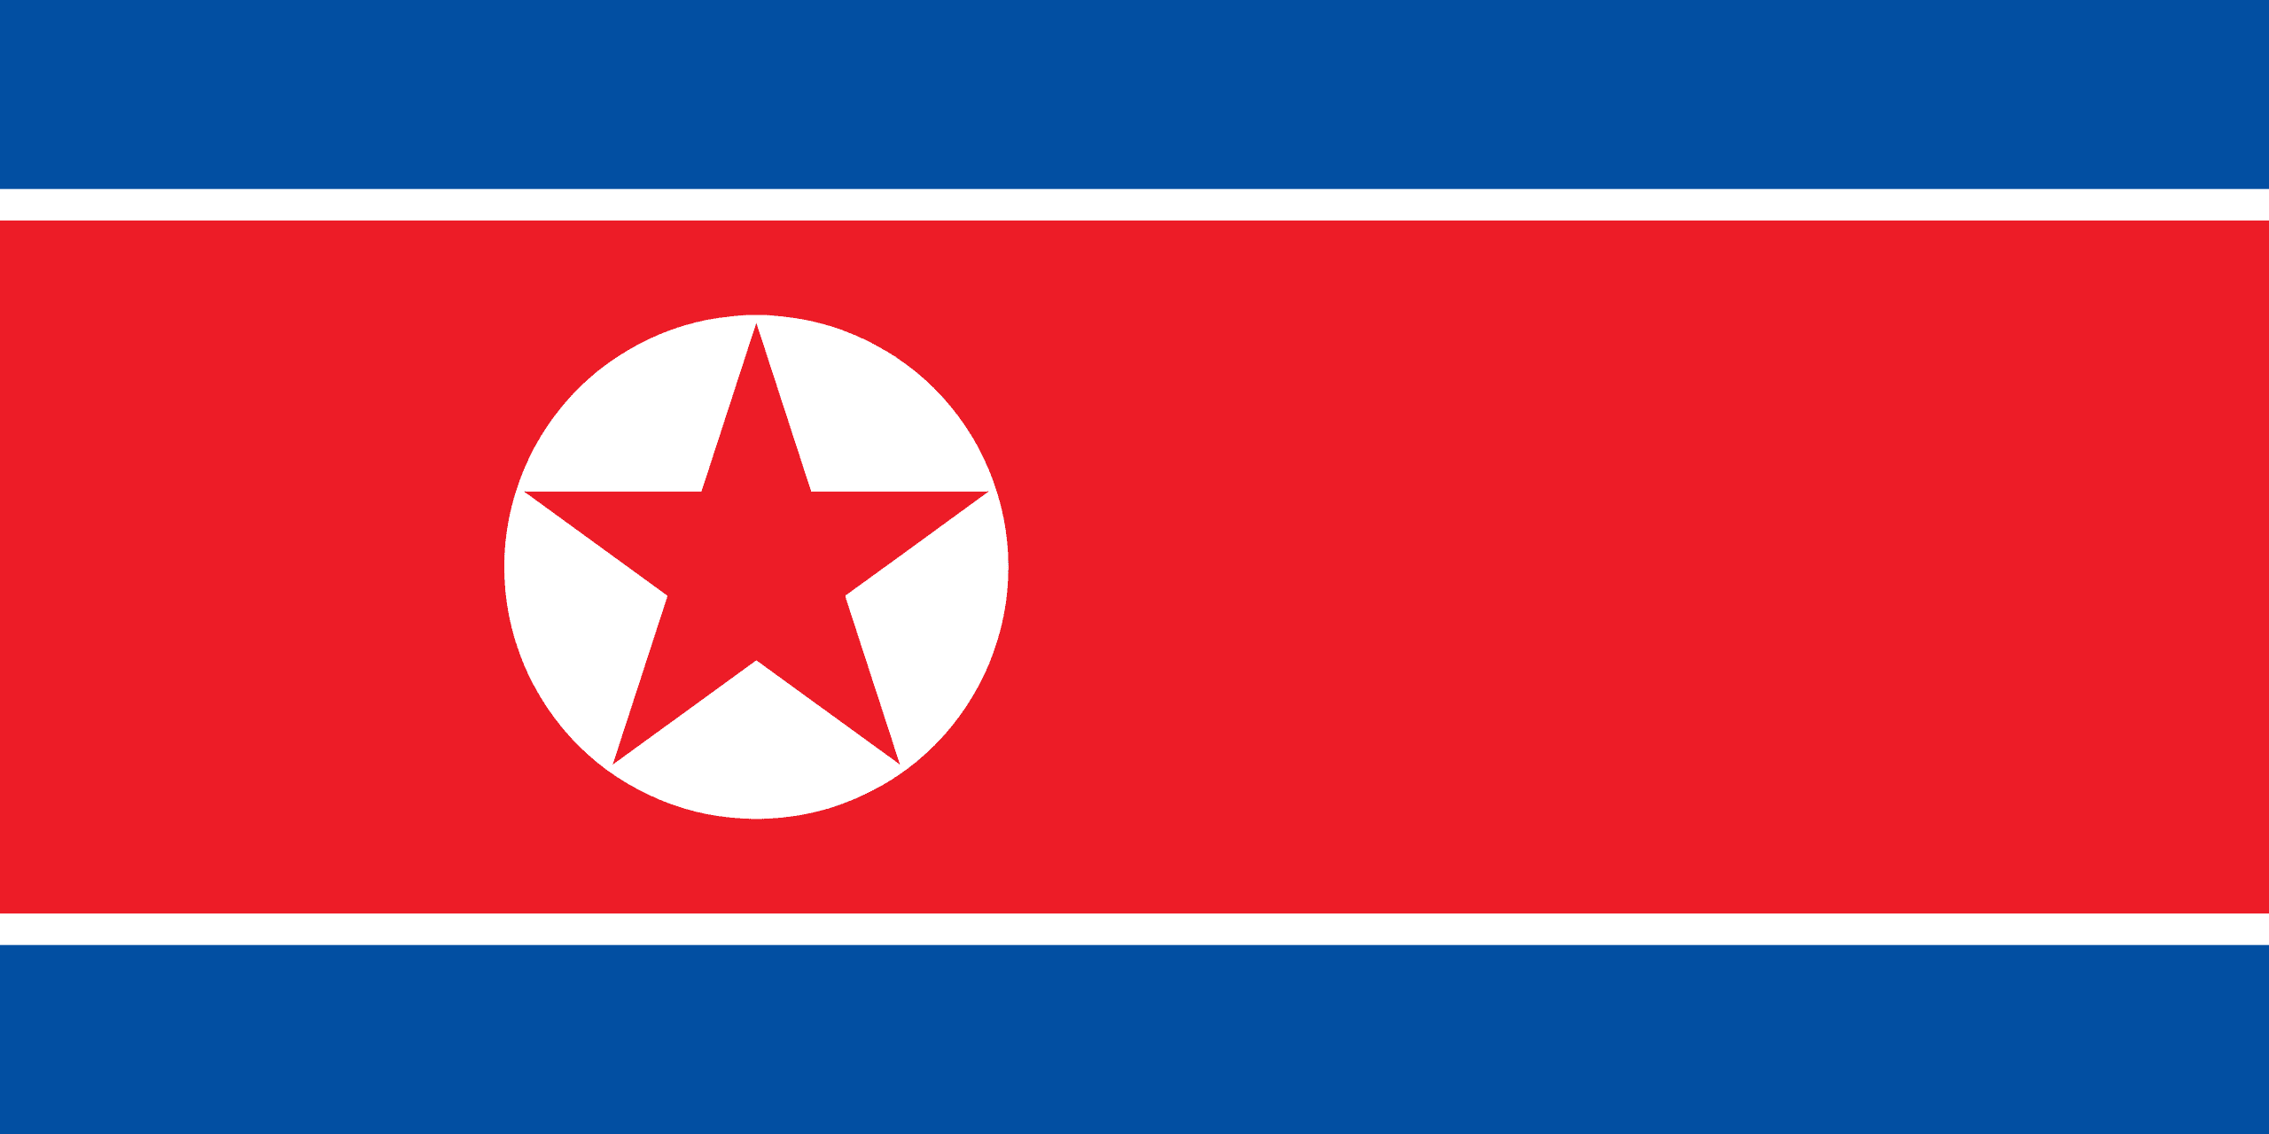
PRAYING FOR
NORTH
KOREA

Slide 3
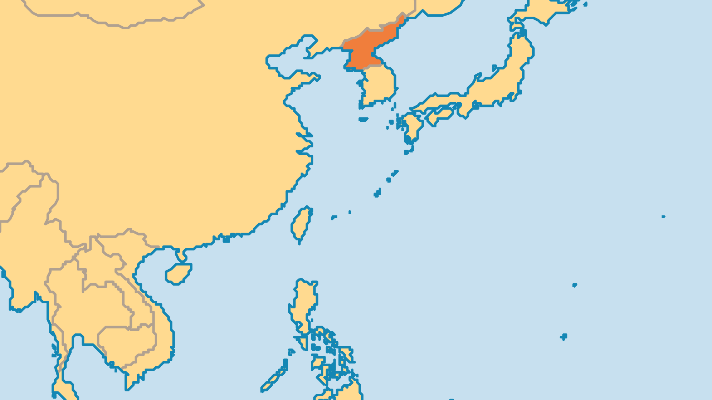
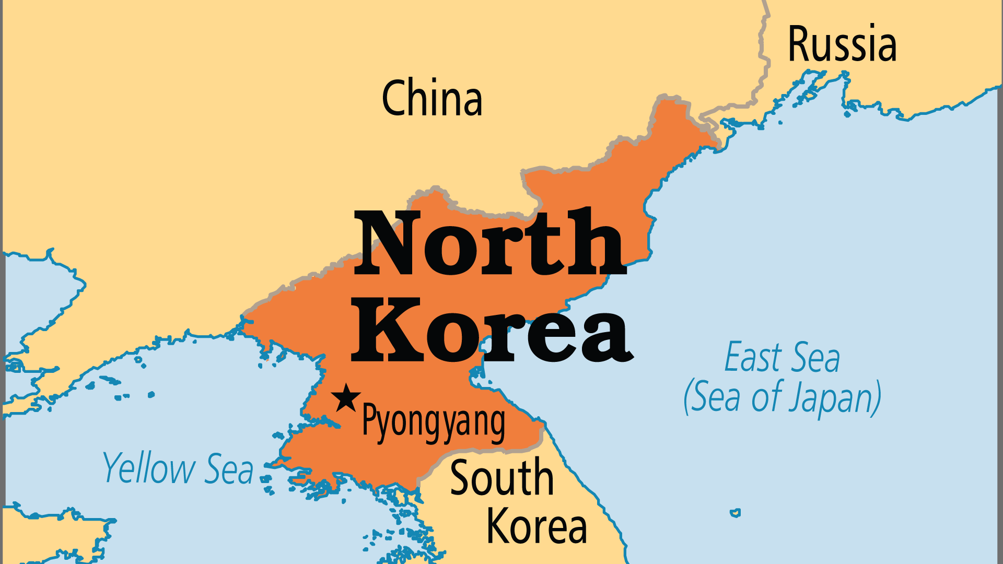
KEY STATS
Capital: | Pyongyang
Population: | 26,571,037
Official Language: | Korean
Literacy Rate: | 99 %
Life Expectancy: | 73.3 yrs (119th/236)
% Christian: | 1.5 %
% Evangelical: | 1 %
Largest Religion: | Non-religious
% Unevangelized: | 70 %
Persecution Ranking: | 1/50

Slide 4

FOR PRAYER
North Korea today is like a nightmare. The state creates a cult around the young "Supreme Leader" (Kim Jong-un) and his dead grandfather (Kim Il-Sung), and does not allow the people to interact with the outside world. More than 3 million people have starved to death since 1994. Foreign charities can bring food, farming technology, training, and start business ventures, but are restricted in their activites and closely watched. Pray that help will reach the desperate, hungry people. Pray that in God's timing a change would come to completely free and transform this land.

Slide 5
FOR PRAYER
The Korean revival (1907) began in the Church in North Korea! People in those days called Pyongyang the "Jerusalem of the East". But most Christians fled to the South during the Korean War, or died as martyrs. Now if you even say the name "Jesus" aloud you may die for it. We do not know much about the underground Church, but we know it survived and even grows. The government holds up to 100,000 Christians in labour camps. Pray for North Korean believers to persevere in probably the most difficult country for Christians.

