Slide 1




Slide 2

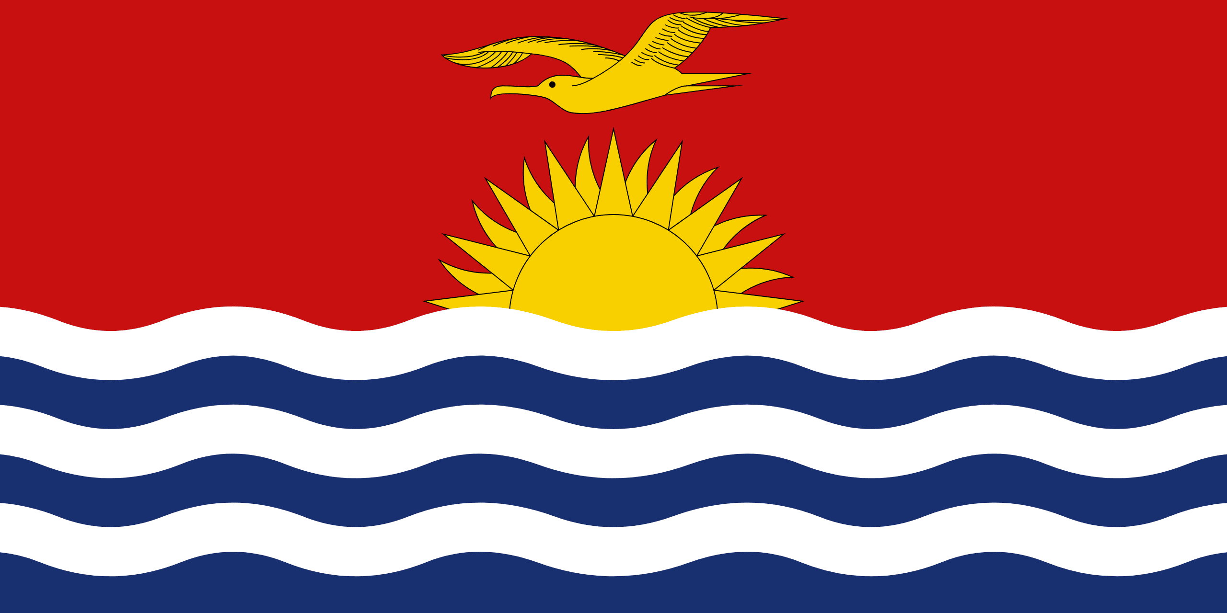
PRAYING FOR
KIRIBATI

Slide 3
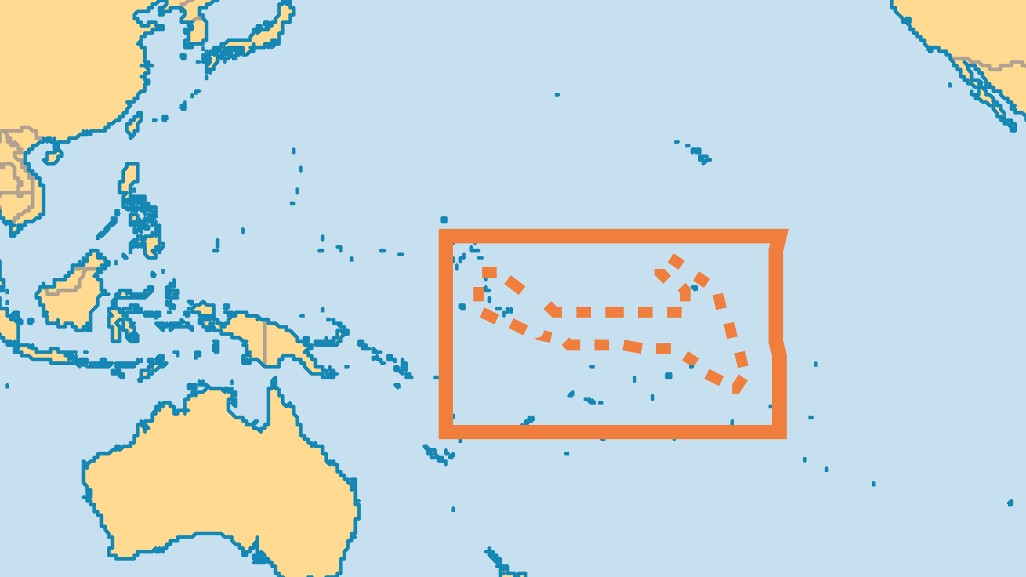
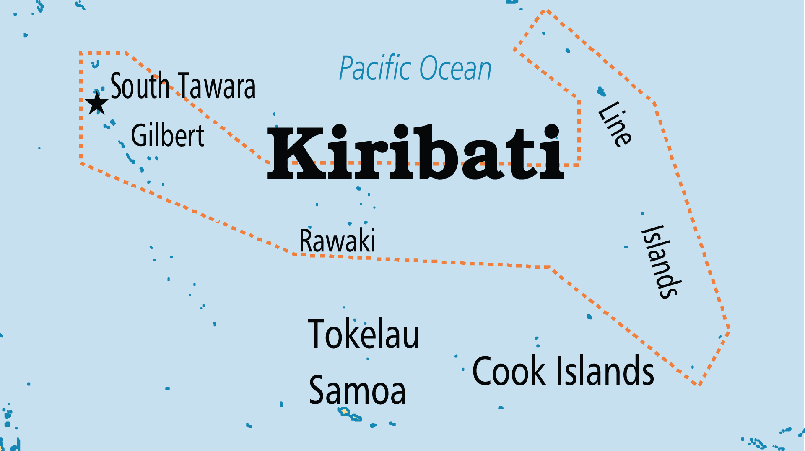
KEY STATS
Capital: | Tarawa
Population: | 136,489
Pop Under 15 Yrs: | 35.8 %
Official Language: | English, but I-Kiribati widely spoken
HDI Ranking: | 136/193
% Christian: | 98.5 %
% Evangelical: | 7.2 %
% Unevangelized: | 1 %

Slide 4

FOR PRAYER
The once-strong Congregational Church (Kiribati Protestant) is in slow decline and losing members to other groups. The theological college in Tarawa is not evangelical. Pray for a return to the Bible. Nominalism and syncretism with traditional spiritist practices are all too common.
Want to know more? Go to www.operationworld.org

