Slide 1




Slide 2

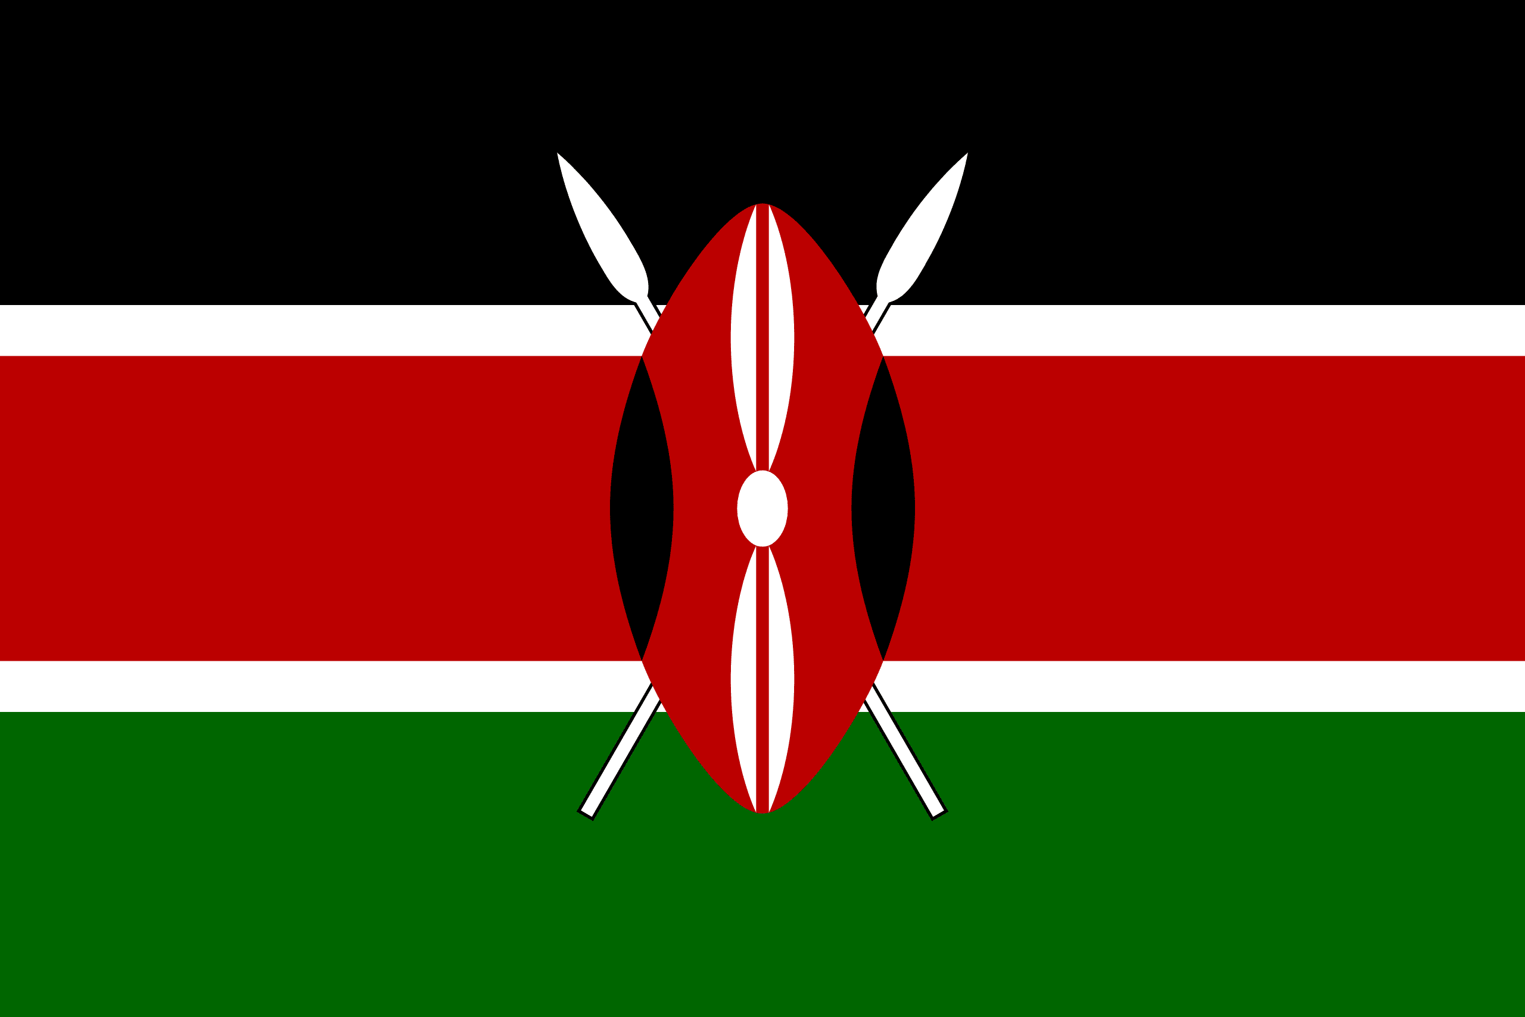
PRAYING FOR
KENYA

Slide 3
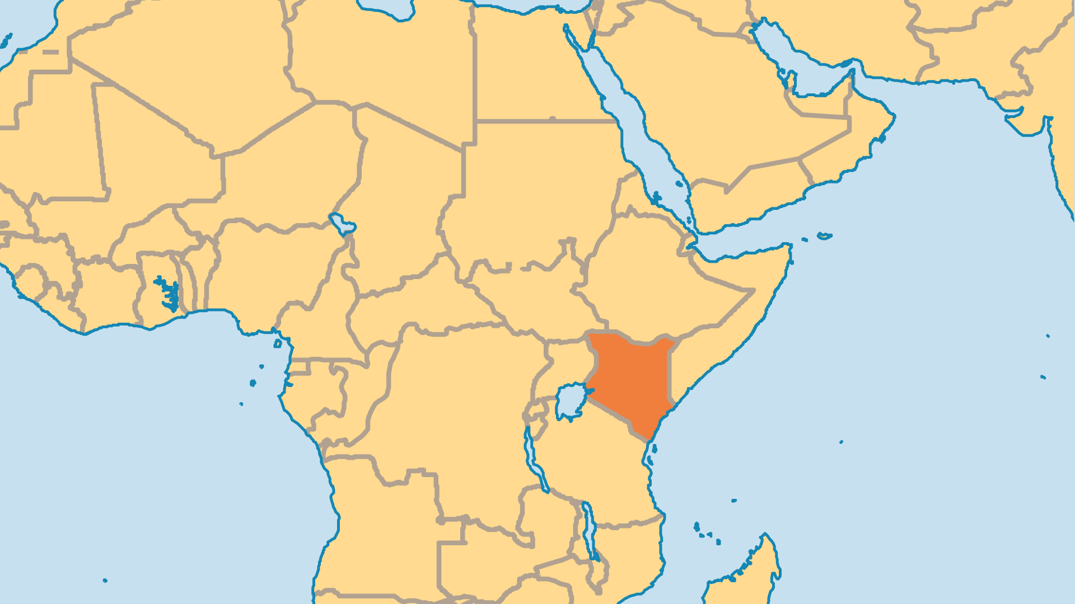
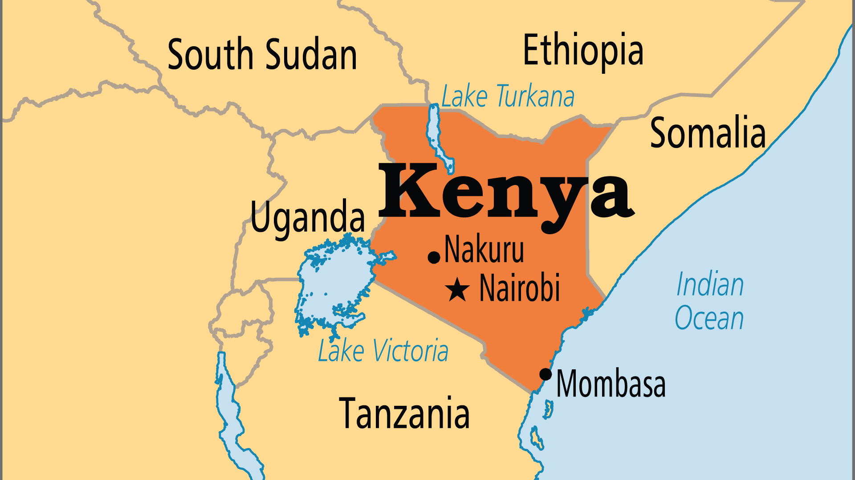
KEY STATS
Capital: | Nairobi
Population: | 57,532,493
% Urban: | 30.6 %
Pop Under 15 Yrs: | 39.2 %
Official Language: | English, Swahili
Languages: | 74
HDI Ranking: | 152/193
% Christian: | 82.7 %
% Evangelical: | 48.9 %
Largest Religion: | Christian
% Unevangelized: | 5 %

Slide 4

FOR PRAYER
Kenya is stable at this time, but faces many threats. Ethnic groups clash violently over limited resources, which are themselves environmentally fragile. The fast-growing population, widespread poverty, spreading urban slums, and urgent need for land reform create tension in Kenyan society. Kenya shares borders with Somalia, Ethiopia, Uganda, and South Sudan - all notorious for upheaval. The political scene is fraught with tribalism and corruption. Pray for peace, for wise governance, and for practical, sustainable, long-term solutions that work for the whole of Kenya.

Slide 5
FOR PRAYER
Kenya has a massive evangelical presence. Nearly 50% of the population are affiliated to evangelical churches, from Protestant, Independent, Anglican, and Catholic backgrounds! Pentecostals especially experienced rapid growth. Overall, 82% of Kenyans call themselves "Christian". Why then does Kenya have so much poverty, and such corruption? With so much corruption, terrorists and international drug traffickers use Kenya as a base. Pray for Christians to unite to oppose wrongdoing, and to promote policies that honour God. Kenya needs a just and honest government that will uplift the poor and punish the wicked.

