Slide 1




Slide 2

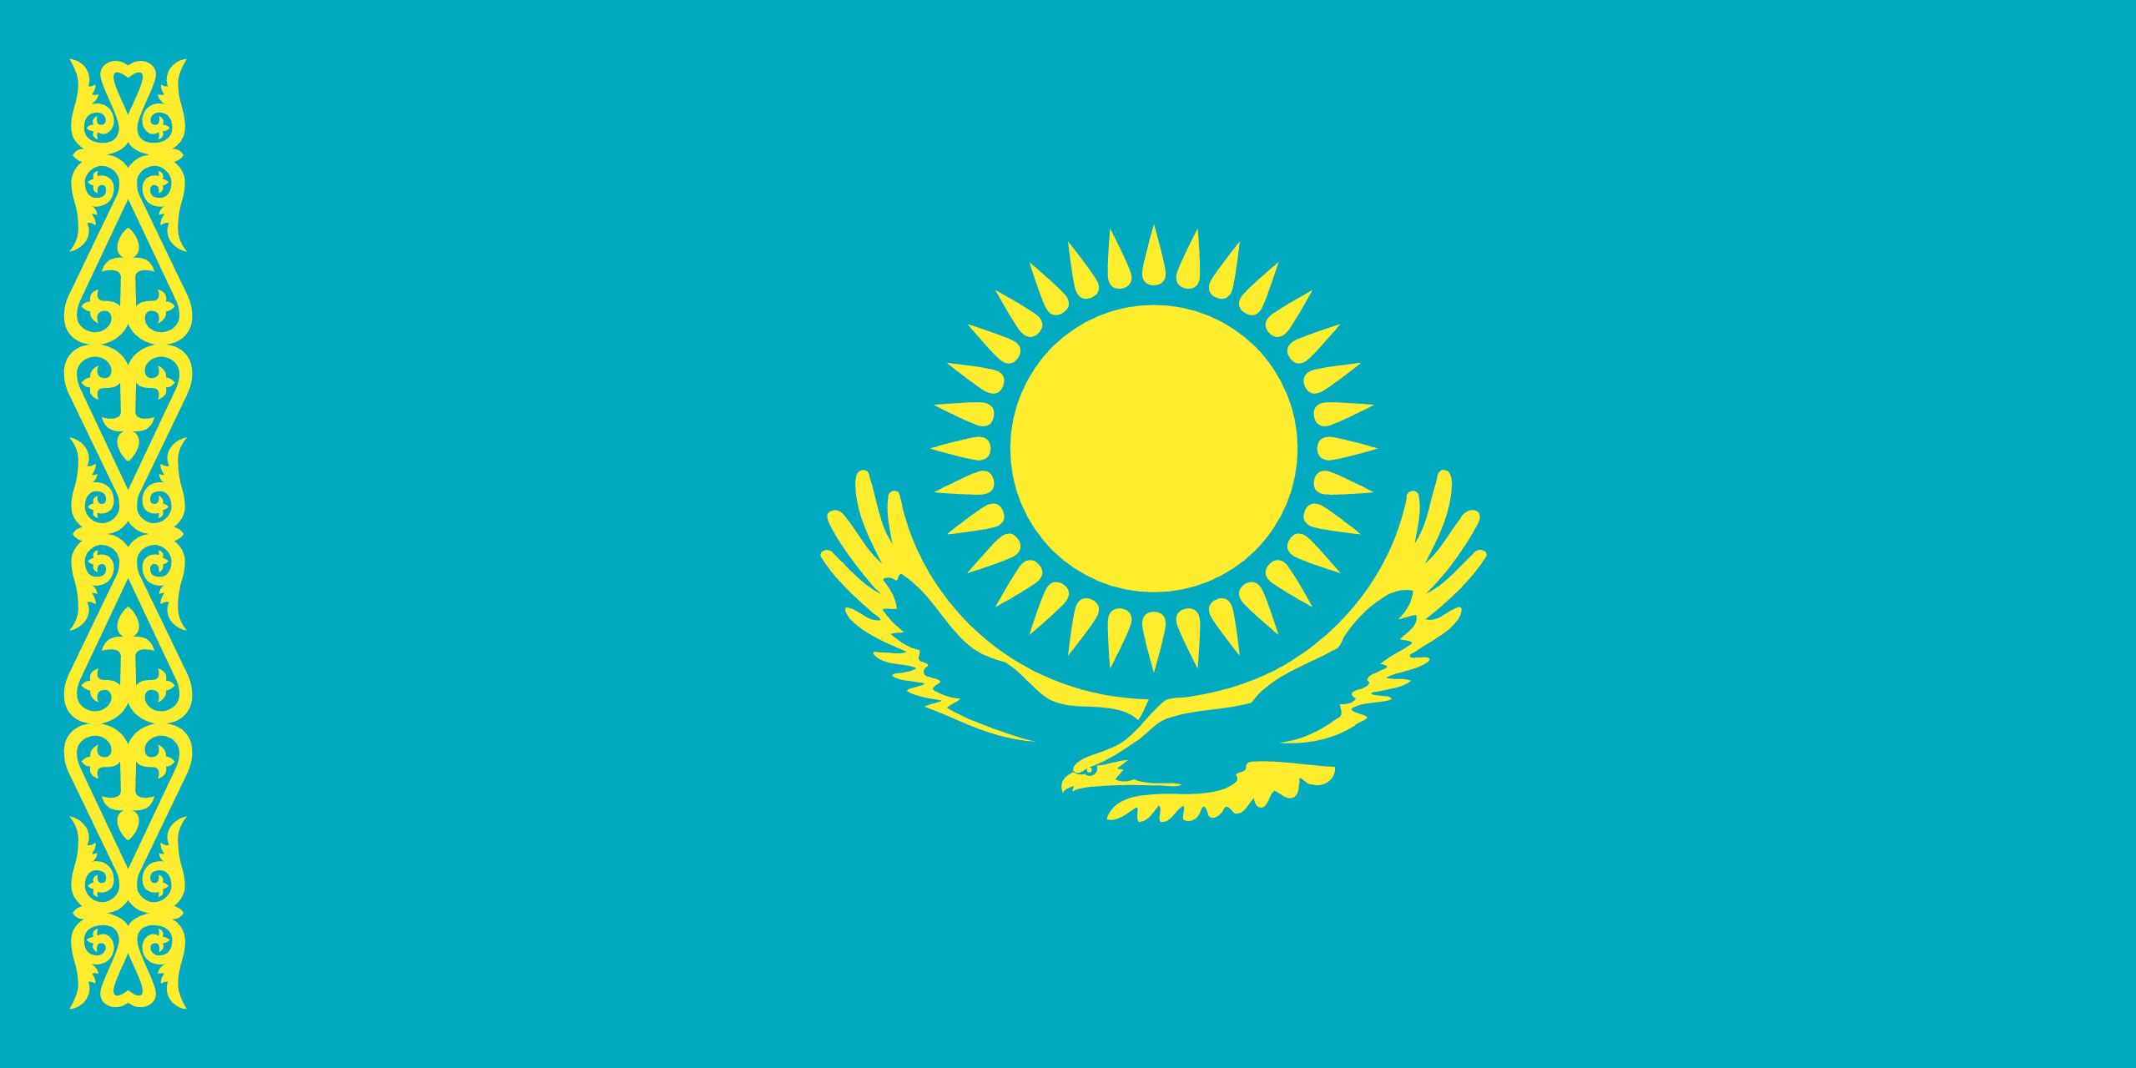
PRAYING FOR
KAZAKHSTAN

Slide 3
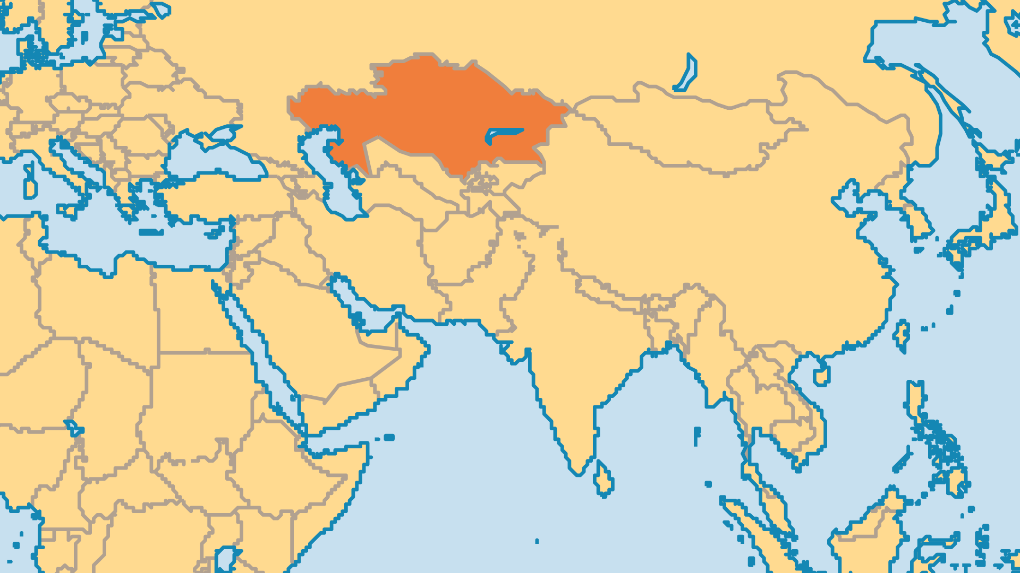
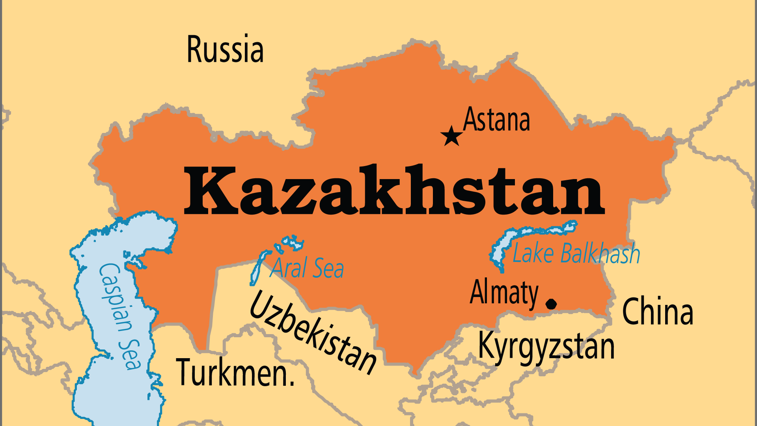
KEY STATS
Capital: | Astana
Population: | 20,843,755
Official Language: | Kazakh, Russian
Languages: | 43
HDI Ranking: | 56/193
% Christian: | 12.2 %
% Evangelical: | 0.7 %
Largest Religion: | Muslim
% Largest Religion: | 53.7 %
% Unevangelized: | 32 %
Persecution Ranking: | 38/50

Slide 4

FOR PRAYER
Kazakhstan has abundant natural resources, but too much of this wealth remains in the possession of the powerful elite. Kazakhstan's first president ruled as an autocrat for nearly 30 years. After anti-government protests and a new president, the country can establish a new course. The new leader may continue to take Kazakhstan beyond its autocratic past or fall back into those familiar patterns. Pray for the Kazakh people to have leadership that governs as a servant to its citizens, that is free from corruption, and that uses the nation's vast wealth for the benefit of all.

Slide 5
FOR PRAYER
Some people say that "to be a Kazakh is to be a Muslim". Most Kazakhs follow a version of Islam strongly influenced by shamans and indigenous practices. Other Muslim countries invest huge amounts of money to send Muslim missionaries to Kazakhstan. They successfully convert even some ethnic Russians to Islam. After the Soviet Union broke up, the number of mosques grew from 46 (1989) to 2300 (2020)! The government works to keep Islam moderate, and Kazakhstan is the only Central Asian state where Islam is not accorded special status. Pray for freedom from historic spiritual bondages.
Want to know more? Go to www.operationworld.org

