Slide 1




Slide 2

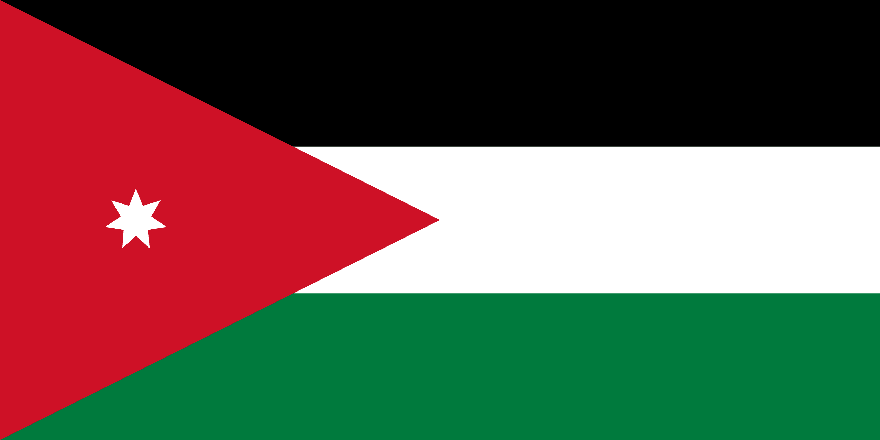
PRAYING FOR
JORDAN

Slide 3
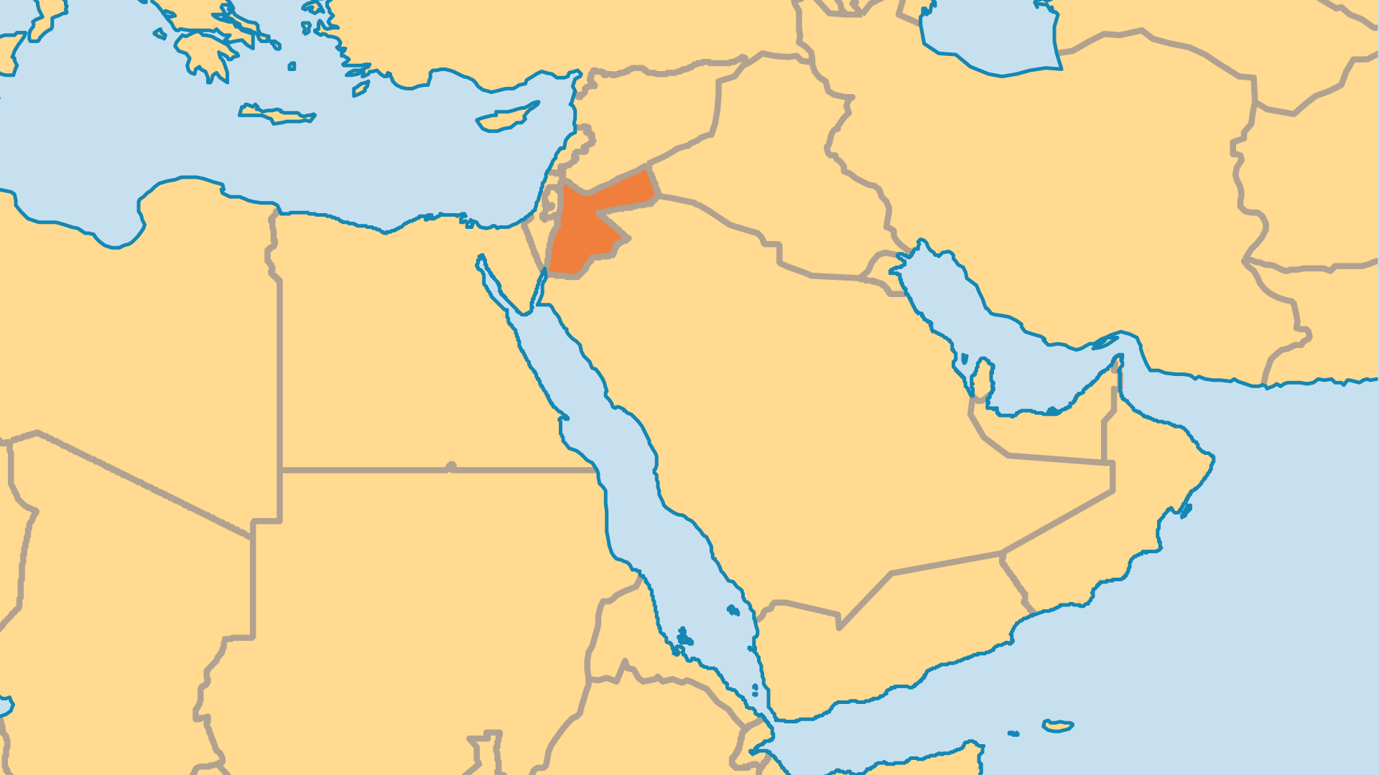
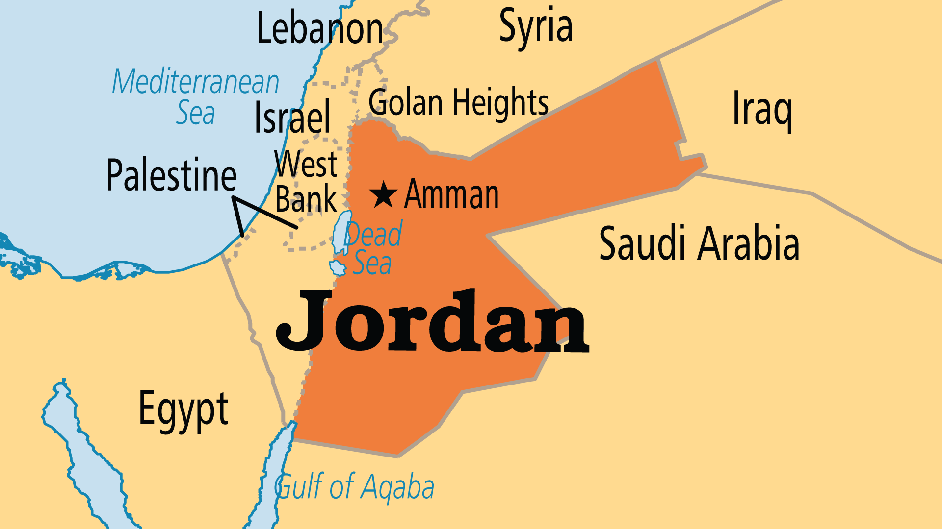
KEY STATS
Capital: | Amman
Population: | 11,520,685
% Urban: | 92.4 %
Pop Under 15 Yrs: | 33.6 %
Official Language: | Arabic
HDI Ranking: | 102/193
% Christian: | 2.2 %
% Evangelical: | 0.3 %
Largest Religion: | Muslim
% Unevangelized: | 56 %
Persecution Ranking: | 50/50

Slide 4

FOR PRAYER
King Abdullah's rule began with promise and hope, but the wars and continued conflicts in Iraq and Syria placed great pressure on the nation. Over a million immigrants flowed in, and many remain. Murderous attacks by Muslim extremists across the years have shown Jordan's vulnerability to violent troubles. Jordan serves as a regional centre for many Christian activities and ministries, and much Christian work in the Middle East would suffer if religious freedom in Jordan changed. Pray for the peace of this land, and for the King and government.
Want to know more? Go to www.operationworld.org

Slide 5
FOR PRAYER
Jordan's once-thriving Christian population dropped since 1980. Lower birth rates, Christians who left Jordan, and a large influx of Muslim refugees all contributed to this change. Still, Christians serve in all parts of society, even in parliament or other positions of influence. Although small, the evangelical community has more than doubled in size since 1995! Most newer believers come from communities with a culturally Christian background, but recently more Muslims came to faith. Pray that all Christians in Jordan, whether in traditional churches, evangelical churches, or believers from a Muslim background, might cooperate to make Christ known throughout society.

