Slide 1




Slide 2

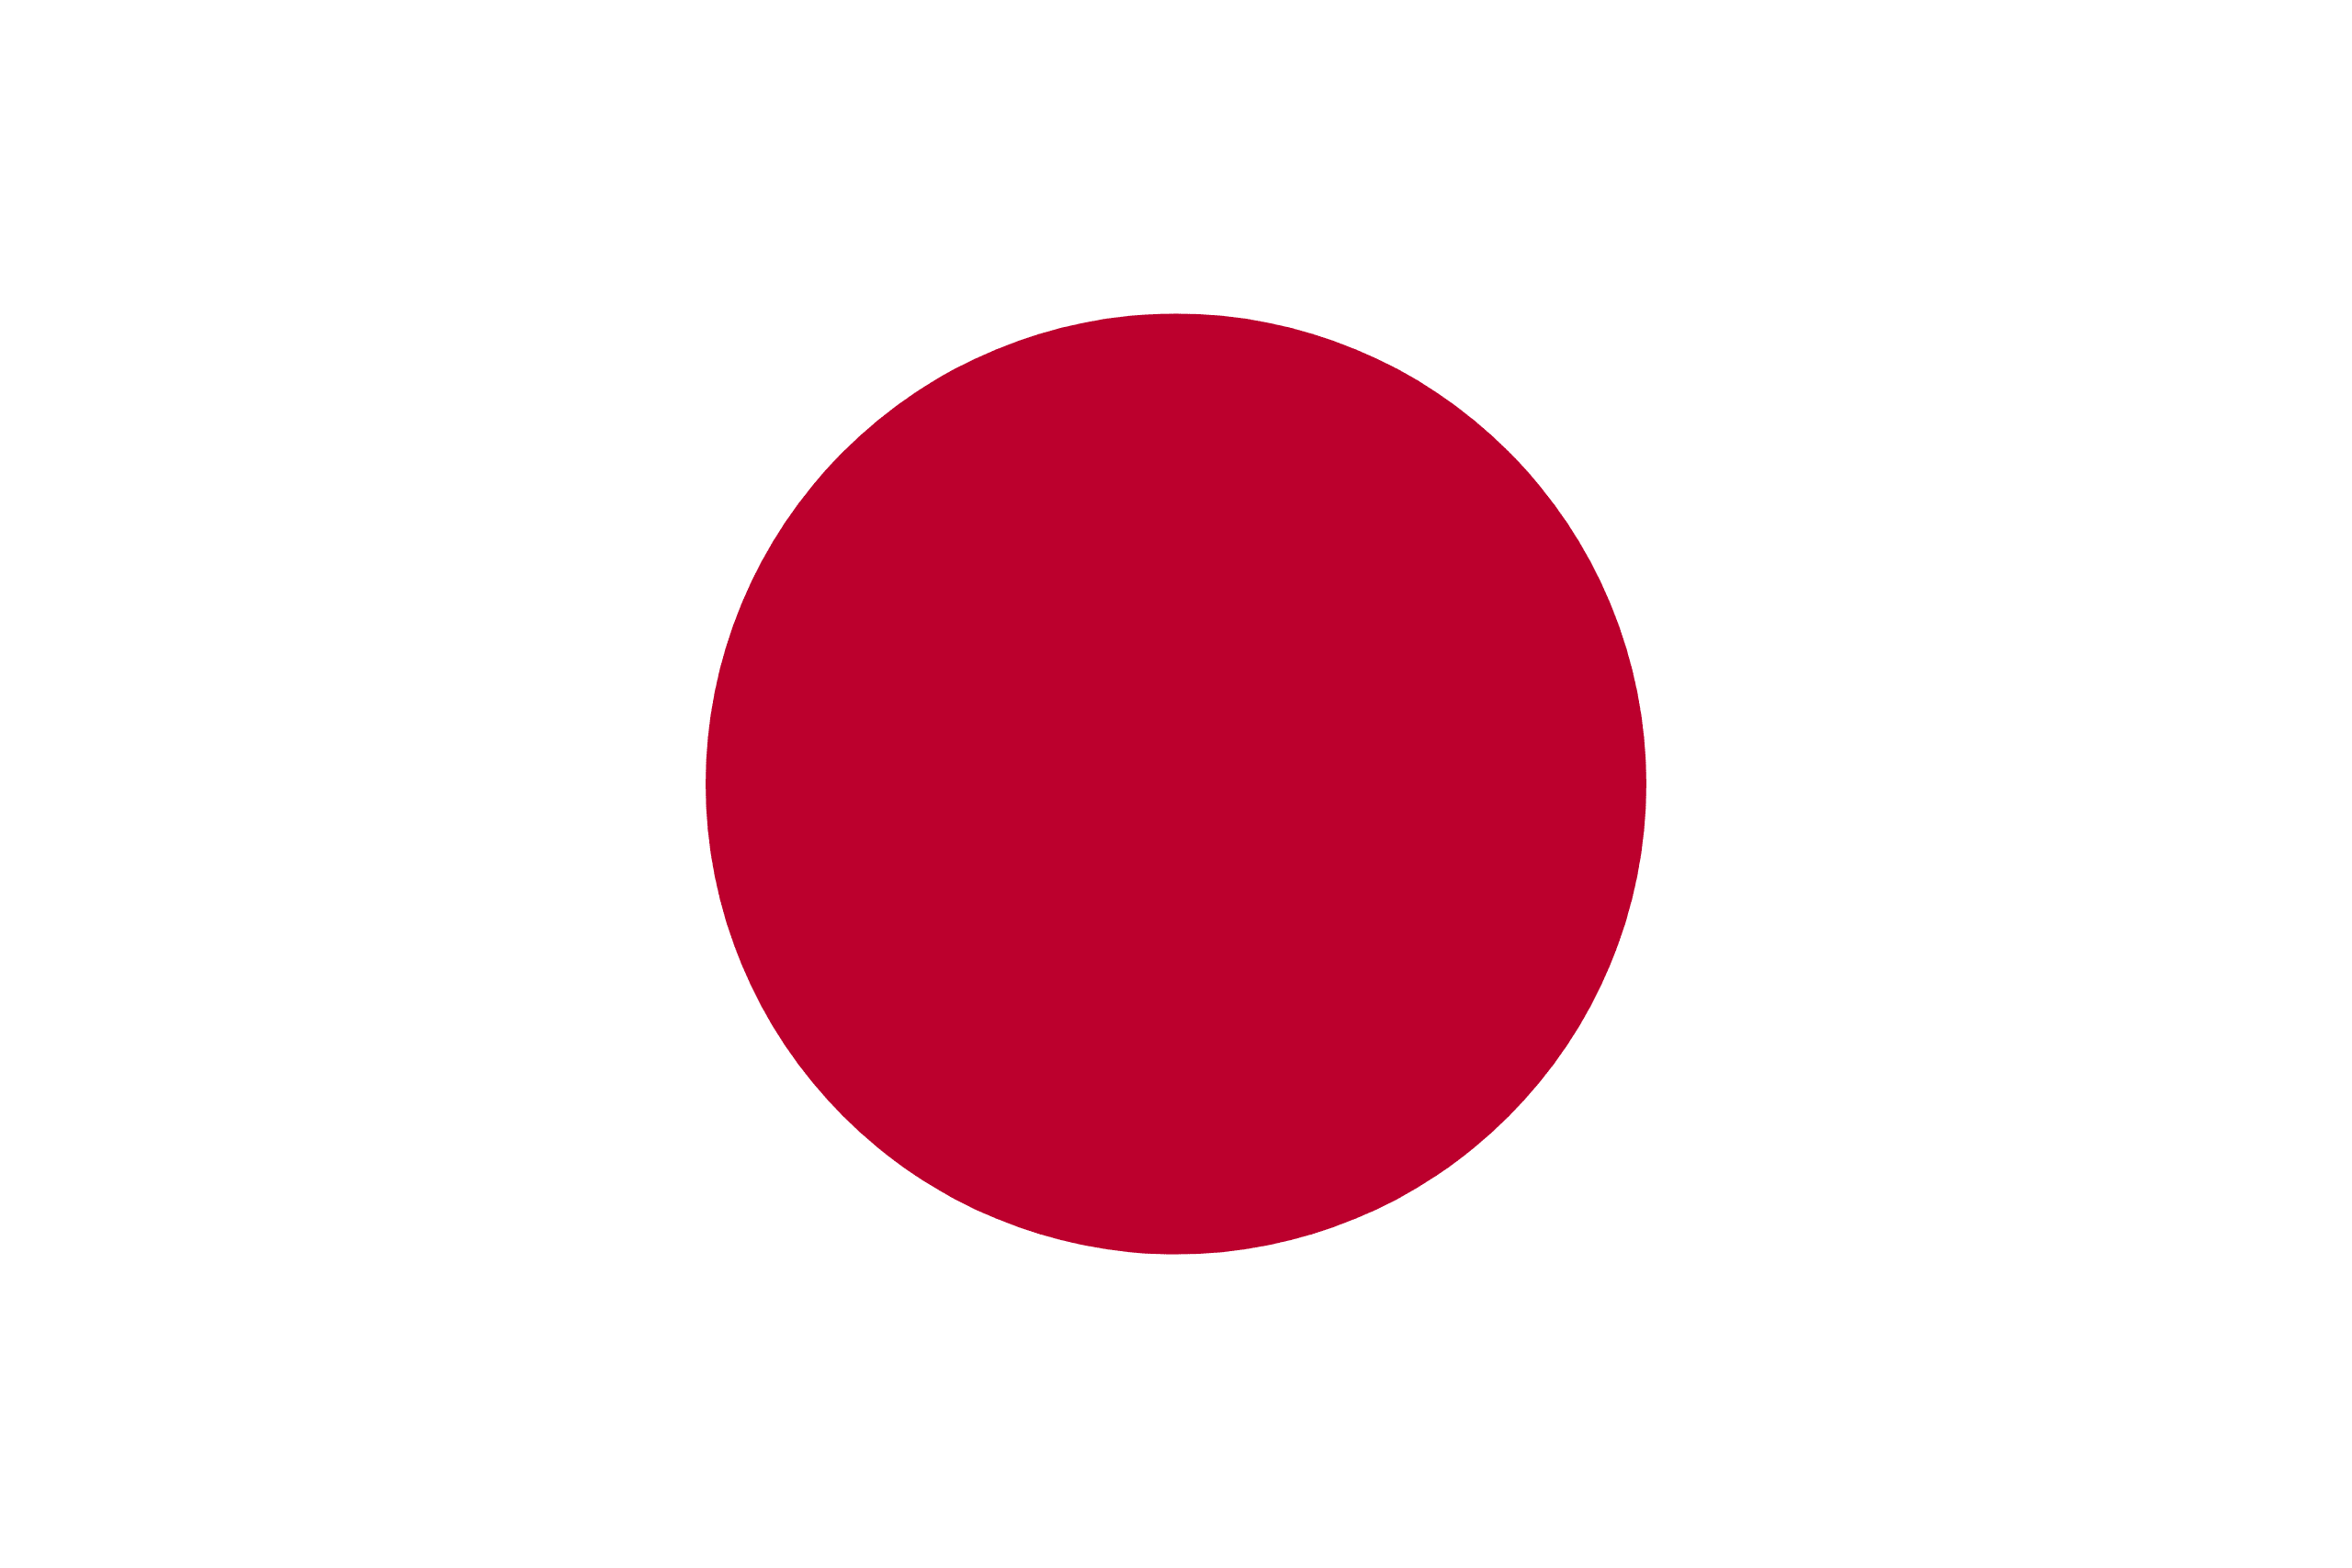
PRAYING FOR
JAPAN

Slide 3
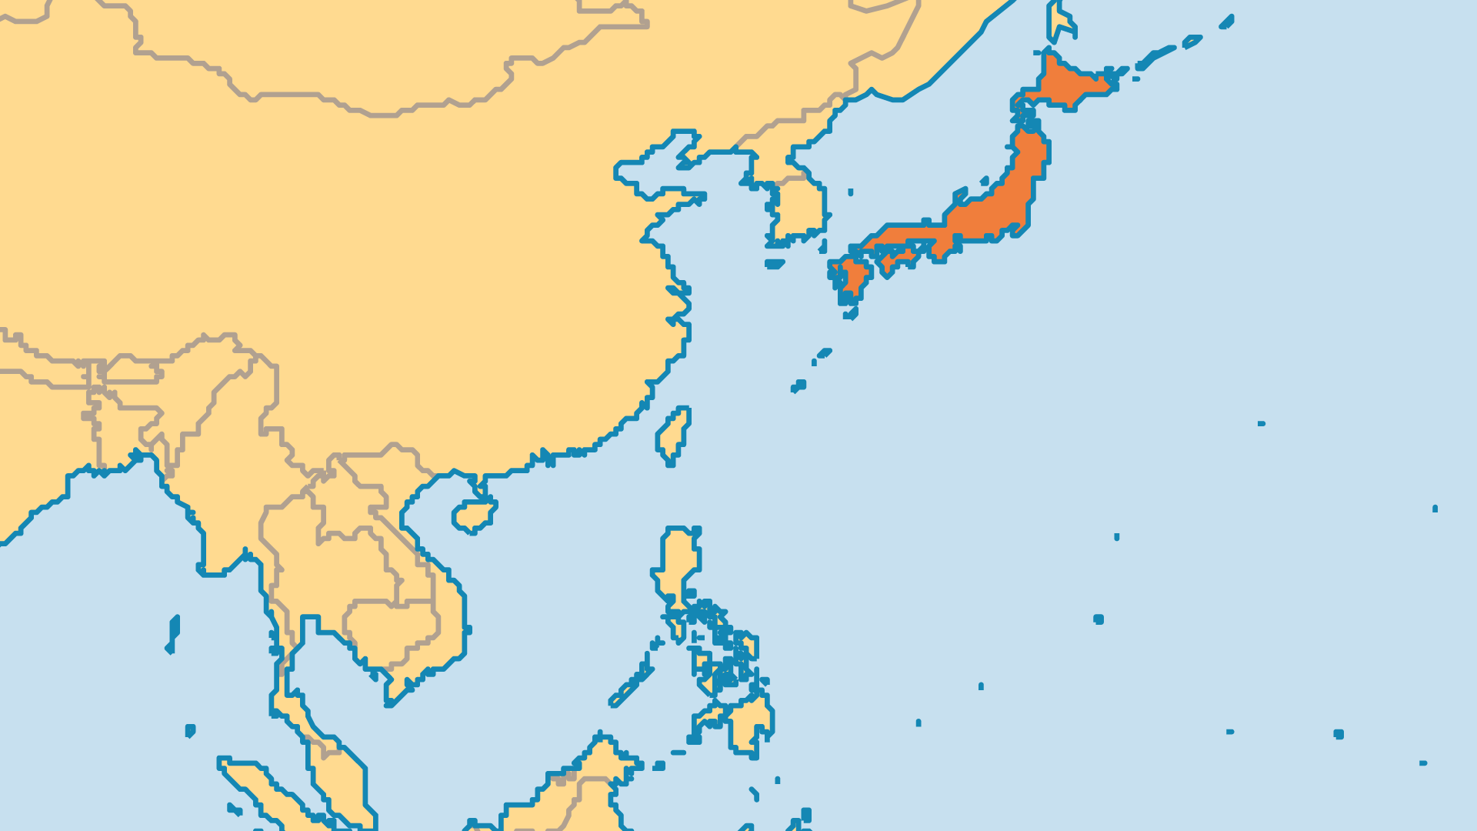
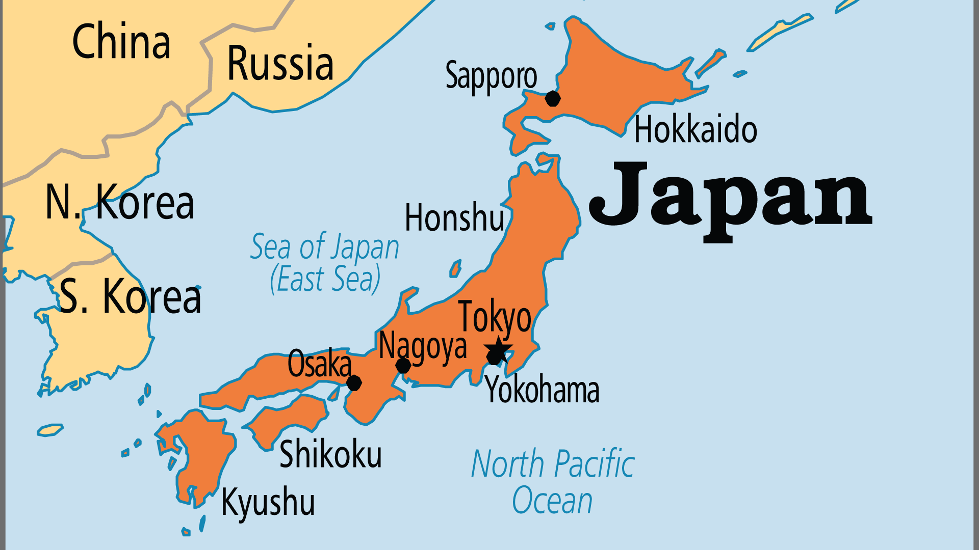
KEY STATS
Capital: | Tokyo
Population: | 123,103,479
Pop Under 15 Yrs: | 12.6 %
Official Language: | Japanese
Languages: | 16
Life Expectancy: | 84.8 yrs (4th/236)
HDI Ranking: | 19/193
% Christian: | 1.5 %
% Evangelical: | 0.5 %
Largest Religion: | Buddhist
% Unevangelized: | 28 %

Slide 4

FOR PRAYER
Japan faces many crises. Even its leaders called it "a superpower without a moral compass". Many lack hope or confidence in the future. Young people struggle the most, in particular with problems such as a suicide epidemic, mistreatment by peers, and teenage prostitution. High suicide and divorce rates in other age groups confirm the crisis. The constant threats of earthquakes, economic decline, and social isolation leave many people open to spiritual matters. The government alone cannot solve Japan's social problems. This gives the Church a chance to engage with society. Pray that the Church might become prominent in Japan through ministries of compassion, kindness, and love.

Slide 5
FOR PRAYER
Spiritual powers and principalities in Japan hinder the gospel. The powers associated with idolatry in temples and ancestor worship in homes remain strong. Many Japanese claim no religion, but actually follow some rituals of Buddhism and Shintoism. Even the idea of a Creator God is foreign to the Japanese worldview. Many new religions get started in Japan each year, often based on Buddhism, but also on the occult, the worship of extra-terrestrial aliens, and other strange ideas. Ask God to remove the spirit of delusion!
Want to know more? Go to www.operationworld.org

Slide 6
FOR PRAYER
Japan has one of the world's lowest birth rates and highest life expectancy, so the population rapidly ages. The social and economic challenge this creates is enormous. By 2055, half of Japanese will be retired and collect a pension. No other country has faced this before. Pray for more Christian nursing homes and hospices. Japan will need many care workers, and this will create a mission opportunity for believers from other nations. Japan's low birth rate results in a small younger generation with their own challenges and issues. Those aged 18-23 are the most open to the gospel, but few actually become active believers.

