Slide 1




Slide 2


PRAYING FOR
JAMAICA

Slide 3
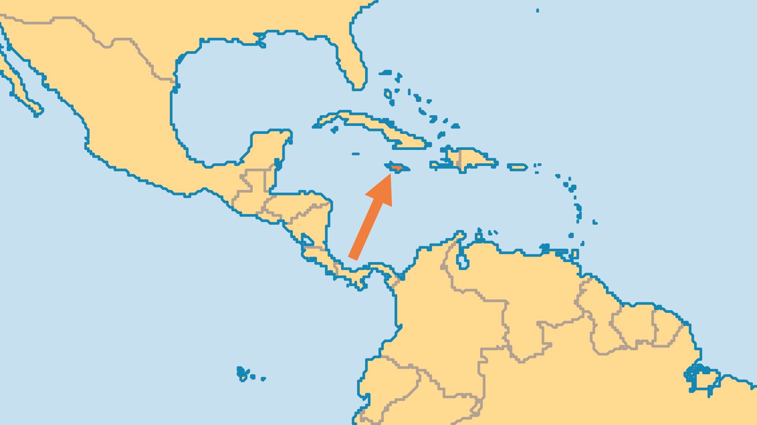
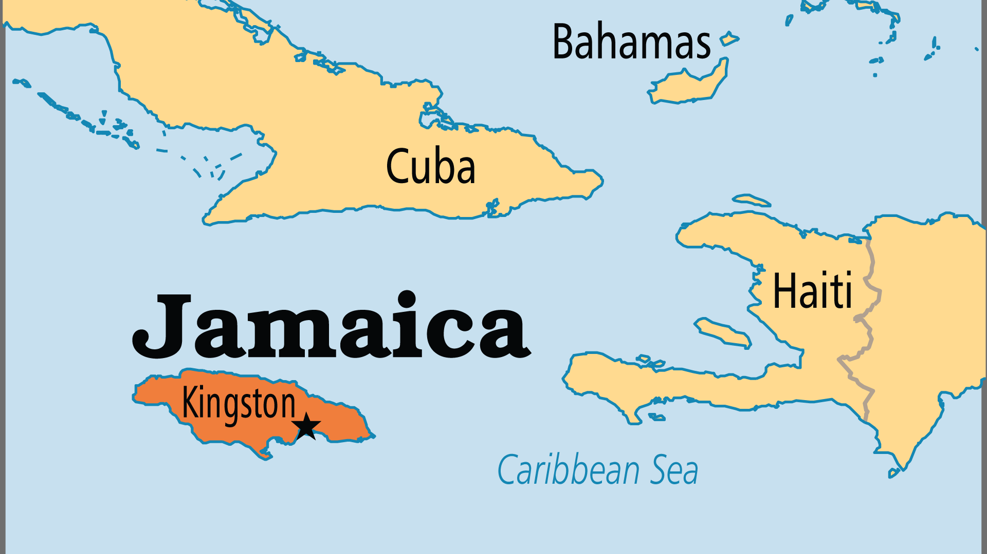
KEY STATS
Capital: | Kingston
Population: | 2,837,078
Official Language: | English; 97% of the population speak Jamaican Creole
Literacy Rate: | 88 %
HDI Ranking: | 110/193
% Christian: | 82.9 %
% Evangelical: | 28 %
% Unevangelized: | 1 %

Slide 4

FOR PRAYER
Jamaica has a wonderful Christian heritage, with a rich history of sending missionaries. It has the most evangelicals and the best-resourced churches in the Caribbean. The Bible Society (Kingston) provides Bibles to most mini-states of the region with a special vision for young people. Praise God that many foreign workers entrusted leadership to national leaders, and the Jamaican Church became its own. Pray that the 15 Bible schools and seminaries, and the Keswick teaching conferences may be strongholds of biblical theology, godly lifestyle, and mission sending for the Caribbean!
Want to know more? Go to www.operationworld.org

