Slide 1




Slide 2


PRAYING FOR
ITALY

Slide 3
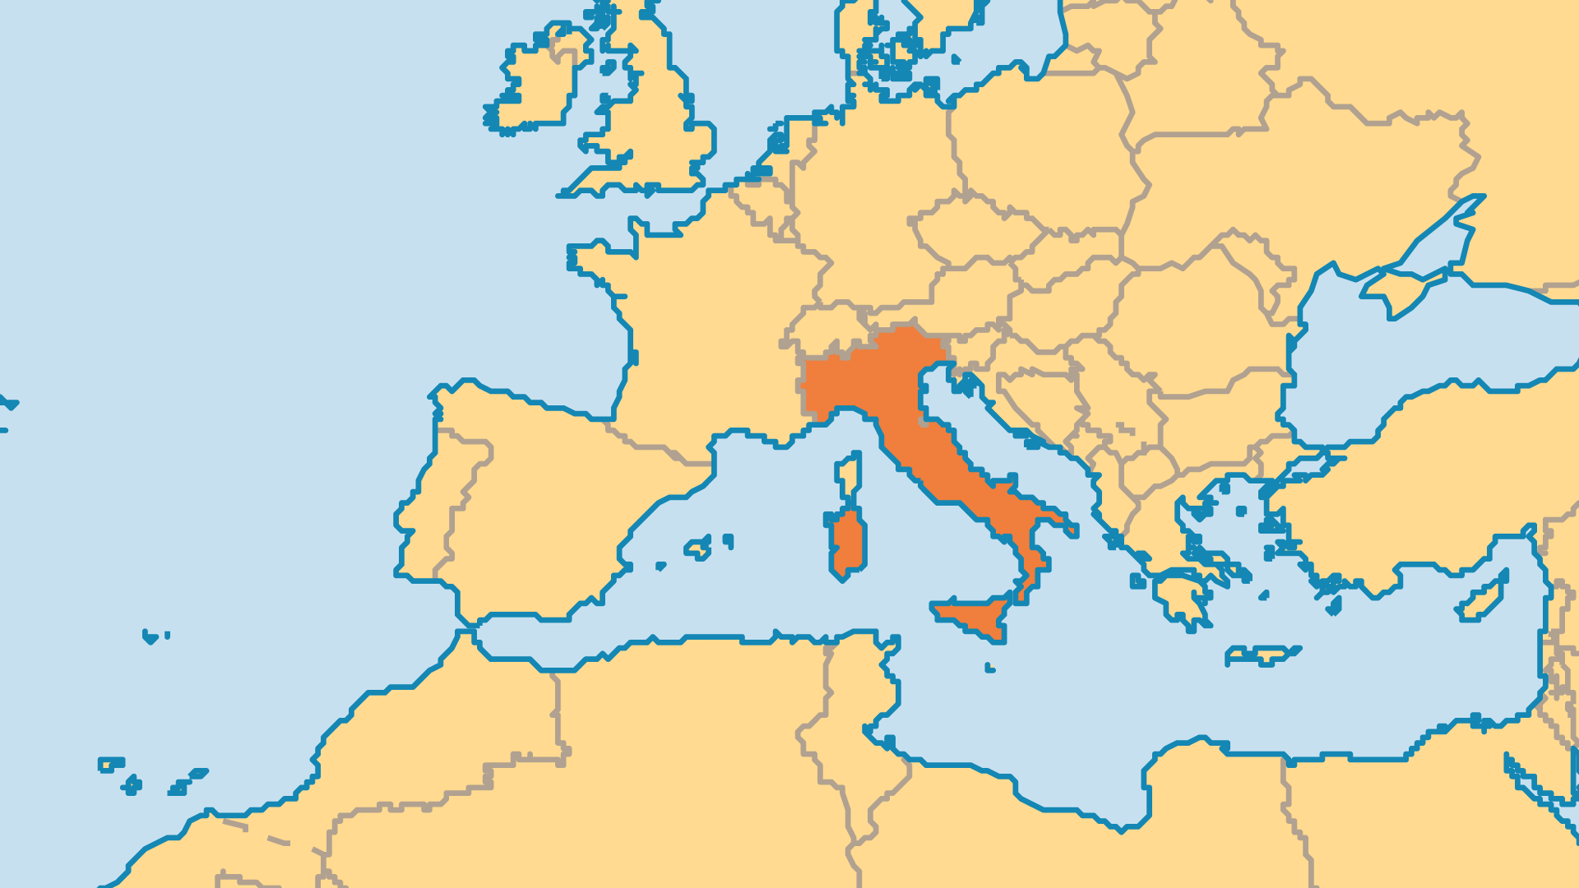
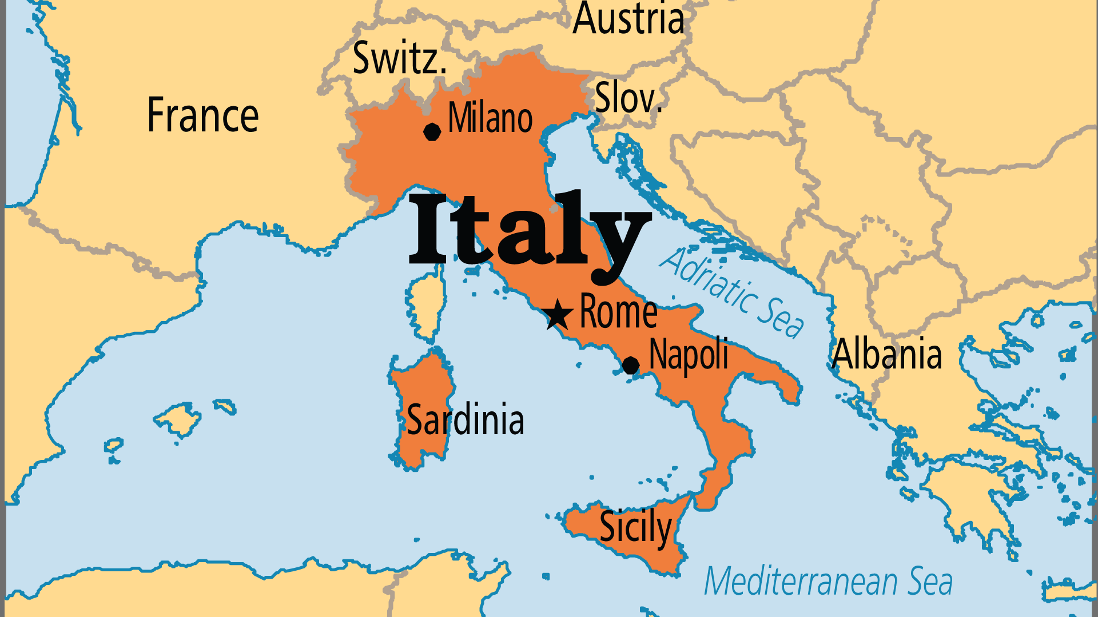
KEY STATS
Capital: | Rome
Population: | 59,146,260
Official Language: | Italian
Languages: | 42
Literacy Rate: | 99 %
Life Expectancy: | 82.9 yrs (13rd/236)
% Christian: | 82.4 %
% Evangelical: | 1.1 %
Least Reached People Groups: | 23
% Unevangelized: | 4 %

Slide 4

FOR PRAYER
This great nation contributed much to the world through its legal systems (Roman law), language (Latin), culture (Renaissance, art, music), and innovation (fashion, cars). But the country struggles with financial troubles and organized crime. Networks such as the Sicilian Mafia, Neapolitan Camorra, and now the powerful Calabrian ‘Ndrangheta influence local and federal governments, and every level of society. Pray for courageous people who will oppose this criminal system which hurts the Italian economy. Pray for Christians to live out Kingdom values when they face difficult decisions.

Slide 5
FOR PRAYER
Christianity once thrived in Italy, but it soon became a formalized state religion. Today the majority of Italians are Roman Catholic by culture, but many distrust the Church. Some studies suggest as few as 3% faithfully practise Catholicism. Those who do pray will more often pray to a saint than to Jesus. Satanism grows in some areas, and Turin acts as a global centre for its followers. Italians will more likely explore a New Age or pagan practice than explore the Bible. Ask God to remove the many barriers that keep people from understanding the gospel.
Want to know more? Go to www.operationworld.org

