Slide 1




Slide 2

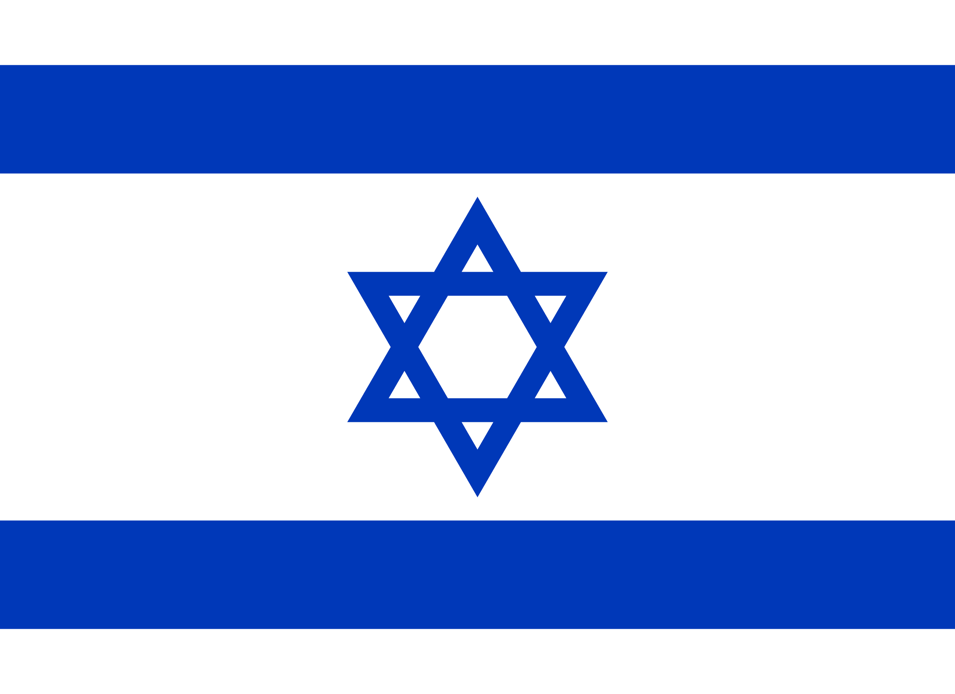
PRAYING FOR
ISRAEL

Slide 3
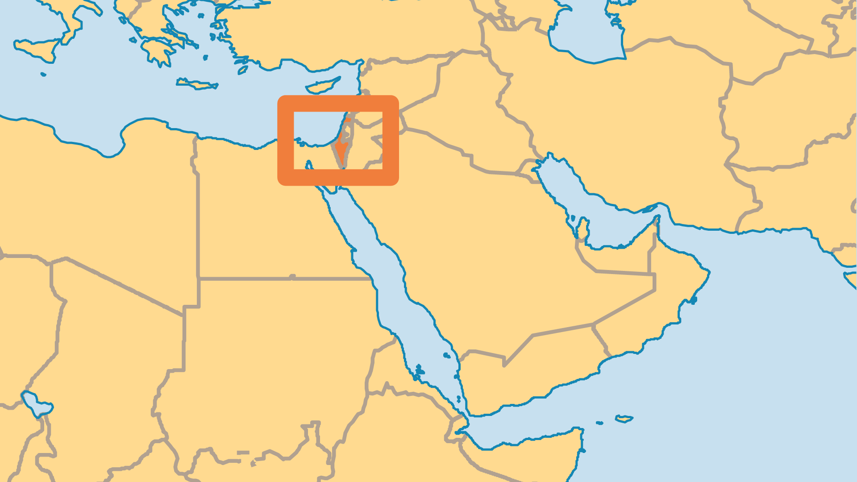
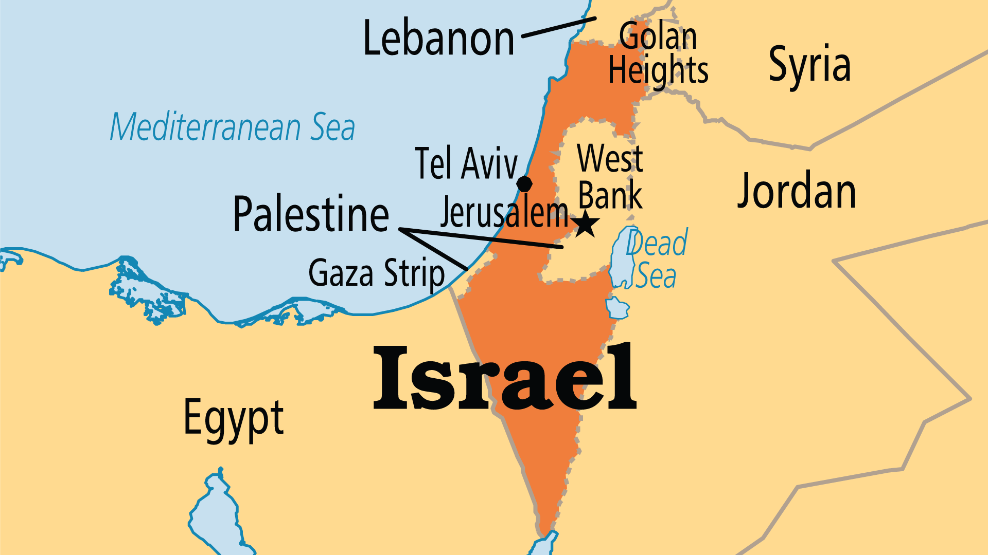
KEY STATS
Capital: | Jerusalem
Population: | 9,517,181
Official Language: | Hebrew, Arabic.
Languages: | 48
Literacy Rate: | 98 %
HDI Ranking: | 22/193
% Christian: | 2 %
% Evangelical: | 0.4 %
Largest Religion: | Jewish
% Largest Religion: | 75.4 %
% Unevangelized: | 52 %

Slide 4

FOR PRAYER
Israeli-Arab conflict in the Holy Land moved to a new level over a century ago, intensifying since 1948. The terrorist attacks by Hamas in 2023 provoked the invasion of Gaza, and the death and destruction that followed was orders of magnitude worse. Waves of global marches, protests, and counter-protests divided the world about who was to blame. Gaza has been destroyed but Hamas has not. Genocide is a valid description. As long as corrupt evil men who desire violence control both governments, and while hatred is harboured in people's hearts, no ceasefire can last long. Cry out for God's mercy. Pray that both sides of this conflict will find true reconciliation and genuine Shalom through Jesus the Messiah.

Slide 5
FOR PRAYER
Major outreach challenges:
The ultra-Orthodox Haredi are only 10% of the population, but have strong political influence.
The Ethiopian Jews (Beta Israel) arrived as immigrants over a decade ago. Now they are largely a poor, urban underclass of around 120,000.
Israeli Arabs are over 90% Muslim. But Arabs also make up the majority of Christians in the Holy Land. They face pressure from all sides, persecuted by both Muslims and Jews.
The Druze community are closed to outsiders, but a small movement to Jesus has begun among them.

