Slide 1




Slide 2

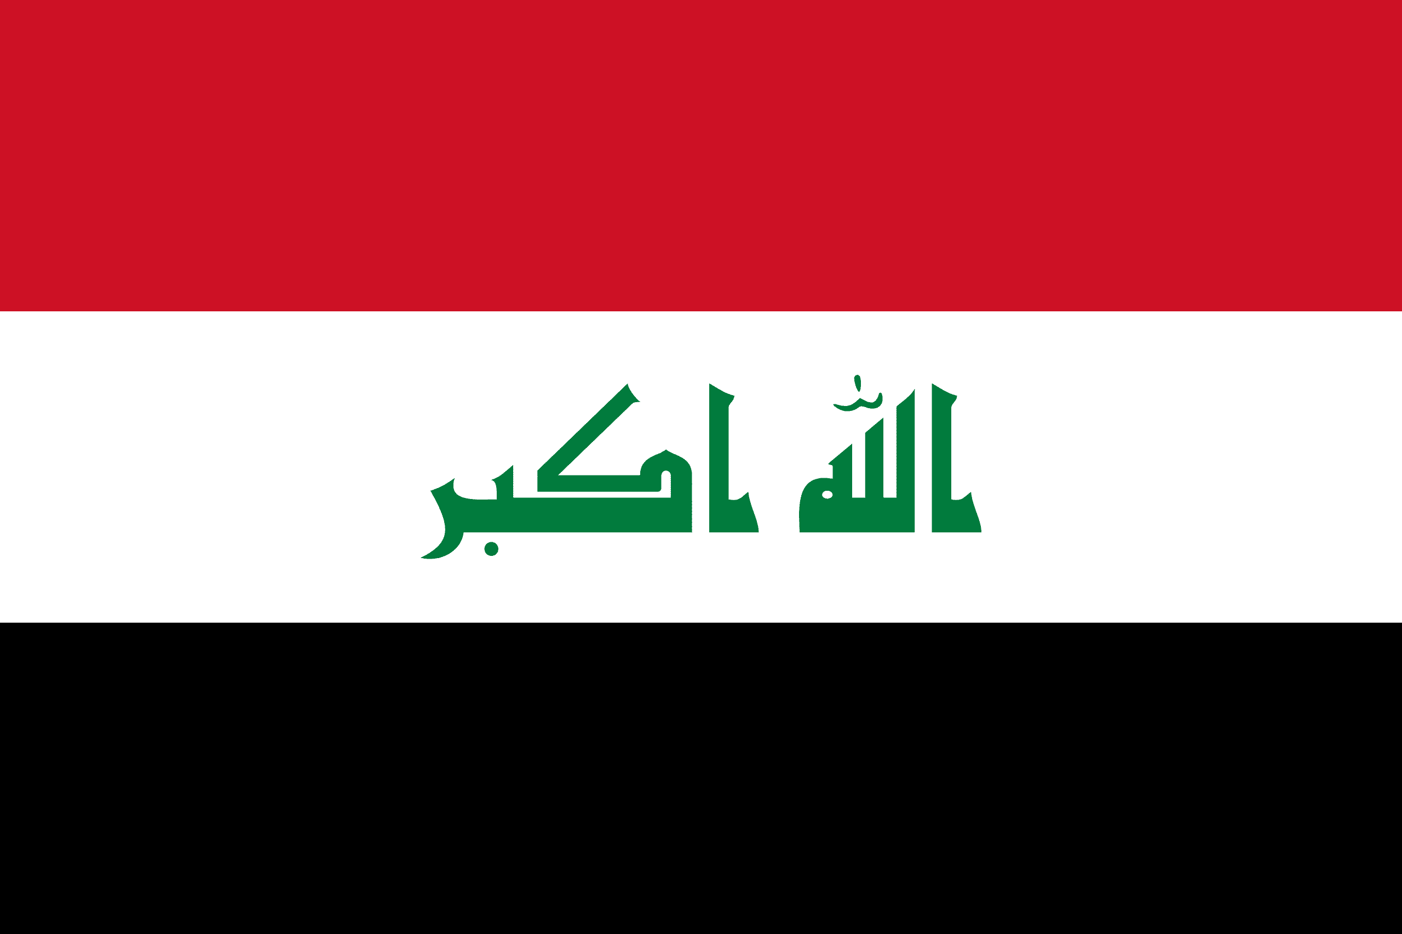
PRAYING FOR
IRAQ

Slide 3
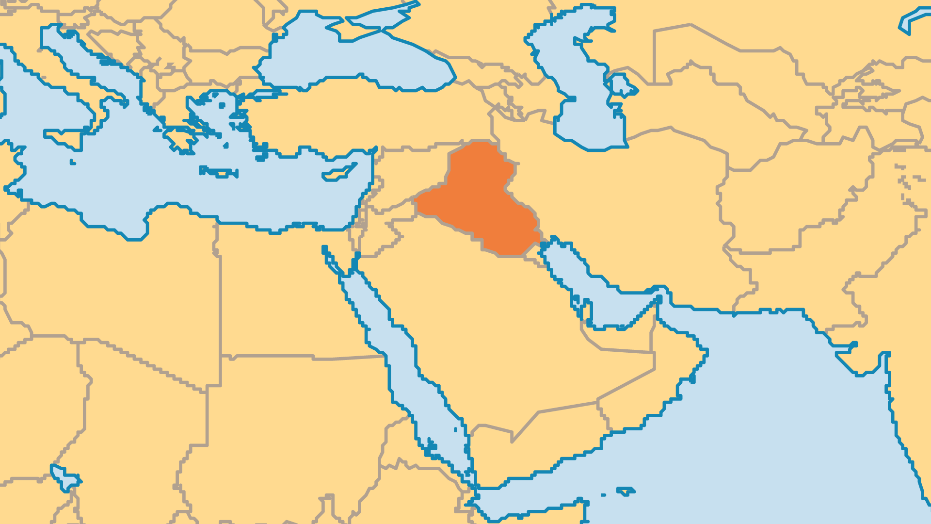
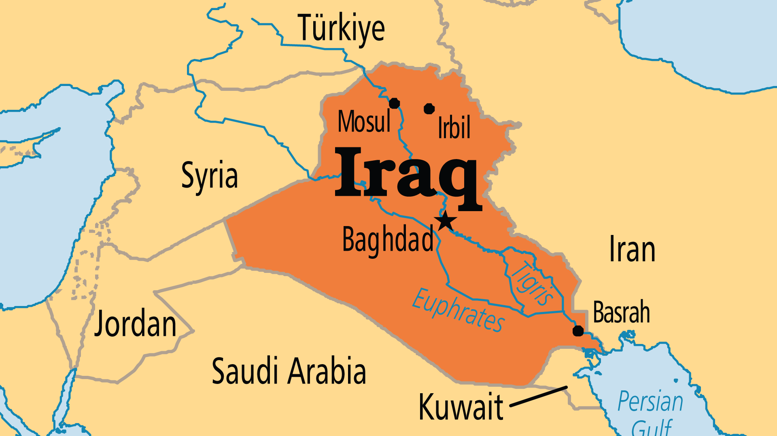
KEY STATS
Capital: | Baghdad
Population: | 47,020,774
Official Language: | Arabic; Kurdish
Languages: | 26
HDI Ranking: | 121/193
% Christian: | 1.6 %
% Evangelical: | 0.2 %
Largest Religion: | Muslim
% Unevangelized: | 59 %
Persecution Ranking: | 17/50

Slide 4

FOR PRAYER
The emergence of Iraqi Arab evangelicals in recent years (now over 50,000) is an answer to prayer! Many of them come from Muslim and even extremist backgrounds, but they encountered Christ through evangelical witness, gospel radio, and especially through dreams and visions of Jesus. Pray for leaders for the churches. Many fled the country and others died, often targeted by Islamists. Many times the Christian widows of these leaders continue with the pastoral and discipleship work.
Want to know more? Go to www.operationworld.org

Slide 5
FOR PRAYER
Iraq suffered great upheaval in 1991 (with the Gulf War), in 2003 (with the 2nd Iraq War and the fall of Saddam Hussein), yet again in 2013 with the rise of ISIS (Islamic State of Iraq and Syria), and then in 2018 and beyond with widespread civil unrest and a broken political system. Pray for God to deliver this land from seemingly interminable conflict!
Want to know more? Go to www.operationworld.org

