Slide 1




Slide 2

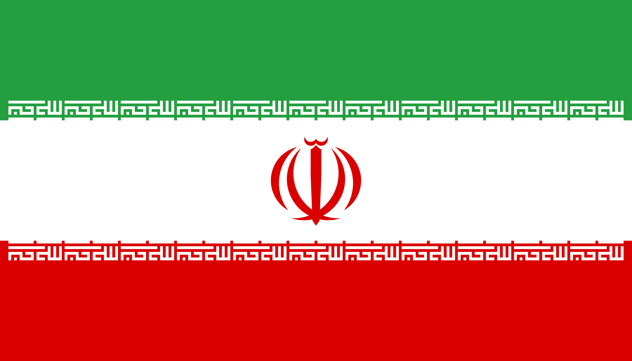
PRAYING FOR
IRAN

Slide 3
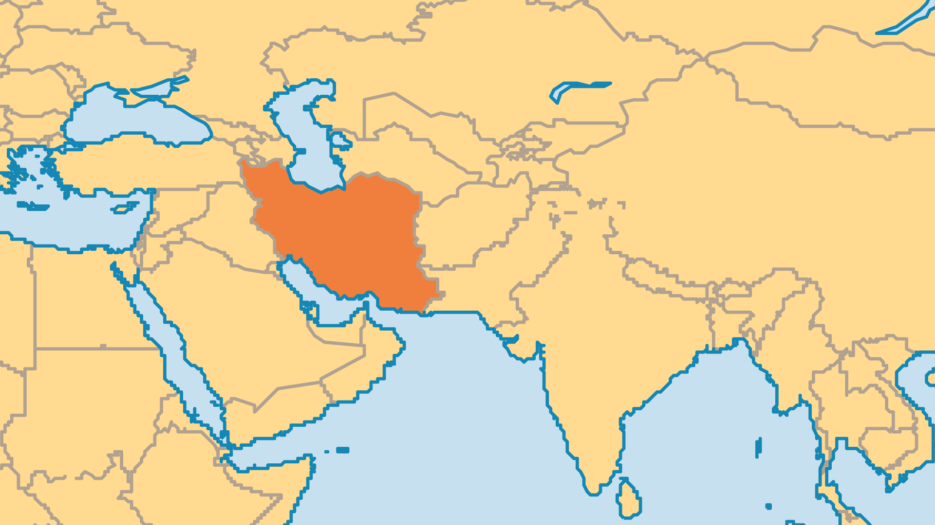
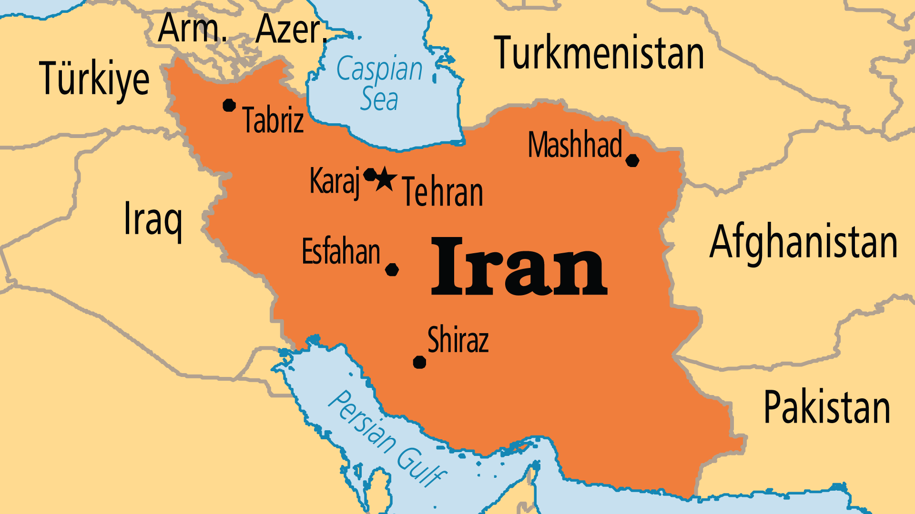
KEY STATS
Capital: | Tehran
Population: | 92,417,681
Official Language: | Persian (Farsi; Dari and Tajik are major dialects)
Literacy Rate: | 85 %
% Christian: | 0.5 %
% Evangelical: | 0.2 %
Largest Religion: | Muslim
% Unevangelized: | 65 %
Persecution Ranking: | 9/50

Slide 4

FOR PRAYER
Massive numbers of Iranians have come to Jesus in recent years! From only 500 Muslim-background believers in 1979, some estimates suggest more than 1 million now. Large numbers of Persian people have also encountered the risen Christ outside of Iran. The Church in Persia has not grown this fast since the 7th century, but only a fraction actively participate in church life. In Iran, a person can receive a death sentence for apostasy (abandoning religious faith). Despite this, 50,000 mosques have closed in recent years as Iranians are disillusioned with both the regime and with Islam. This growth is a remarkable move of the Holy Spirit, with many signs and wonders, dreams and visions.

Slide 5
FOR PRAYER
The 1979 Islamic Revolution promised peace and prosperity, but more than 40 years later, greater and greater numbers are throwing off their shackles. Widespread protests in 2022 demonstrated that the younger generation is fed up with the legacy of oppression, bloodshed, cruel ‘justice’, corruption, economic hardship, and cultural isolation from most of the world. Iran is an ancient, noble, and proud civilization, these modern struggles have made people very open to the gospel. Many others are turning to atheism or to Iran's ancient religion, Zoroastrianism. Pray that Iranians’ desires for greatness, prosperity, freedom, and even for righteousness might ultimately be met through Jesus.

Slide 6
FOR PRAYER
Iran contains some of the largest unreached peoples in the world:
The Zoroastrians (Parsees) follow an ancient Persian religion founded 1,000, years before Christ.
The Baha’i religion started in Iran, but the government seeks to drive its followers out.
The nomadic and semi-nomadic Luri, Bakhtiari, and Qashqai live in the Zagros Mountains. Only a few dozen known believers exist from these groups.
The Turkic Azeri and Turkmen in the north have had almost no positive contact with Christianity. Azeris form the largest minority group within Iran.

