Slide 1




Slide 2


PRAYING FOR
INDONESIA

Slide 3
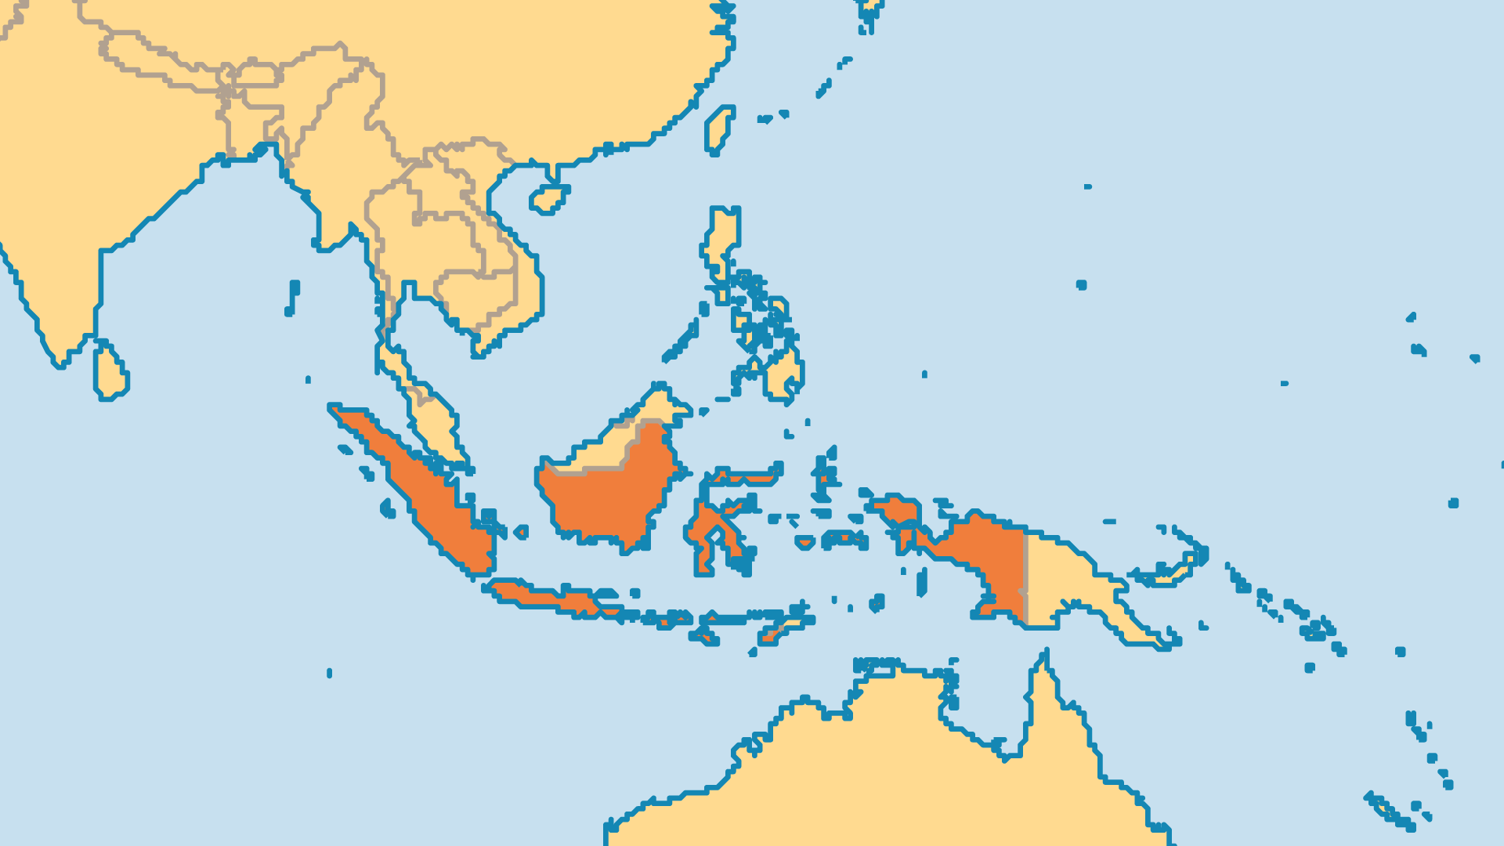
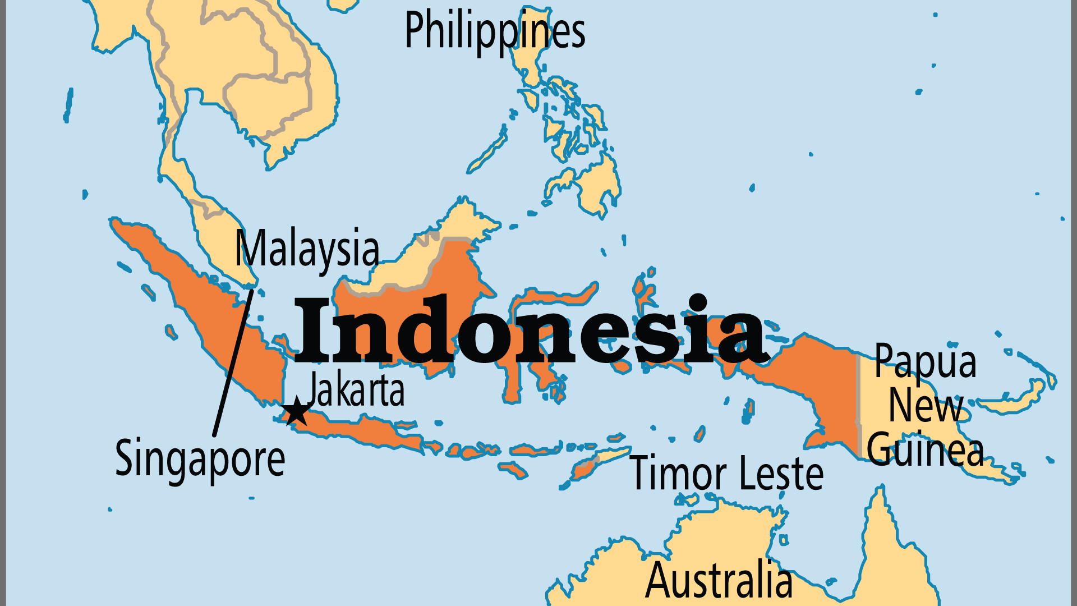
KEY STATS
Capital: | Jakarta
Population: | 285,721,236
Official Language: | Bahasa Indonesia
Languages: | 722
Literacy Rate: | 93 %
HDI Ranking: | 114/193
% Christian: | 15.9 %
% Evangelical: | 5.6 %
Largest Religion: | Muslim
% Unevangelized: | 39 %
Least Reached People Groups: | 233

Slide 4
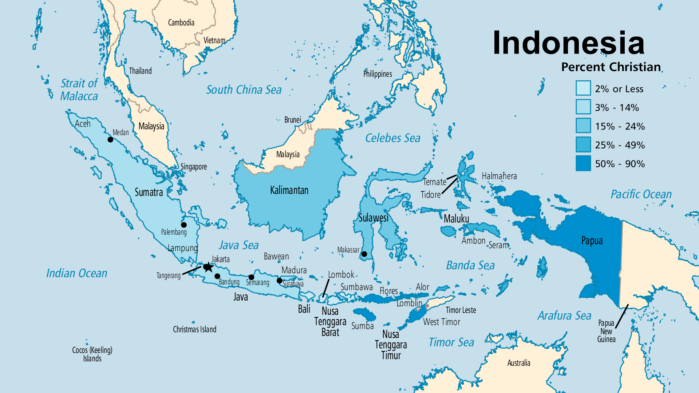

Slide 5

FOR PRAYER
Due to population growth, a sinking Jakarta, natural disasters (earthquakes, tsunamis, and floods), and overcrowding in some areas, many Indonesians need a new place to live. The government organized the relocation of over 8 million people from Java, Bali, and Madura to Sumatra, Kalimantan, Sulawesi, Papua, and West Papua where more space is available. Most of the people relocated were Muslims. In places like Papua and West Papua, the indigenous people have become minorities within their own homelands, and some have called the process “slow motion genocide”. Pray that Christians might show the love of Jesus to those displaced.

Slide 6
FOR PRAYER
Pray that the Church continues to grow amidst the intense opposition and persecution. Pray for revival. Some areas have been Christian for centuries (in North Sulawesi, North Sumatra, West Timor, Maluku), but many denominations lack spiritual life. They struggle with immorality, divisions, and even indigenous occult practices. Pray also for new believers from a Muslim background, who often face rejection and persecution from their communities. They can also find it difficult to fit into Christian culture and churches. Pray for whole households to come to Christ, and to follow Christ within their own culture.
Want to know more? Go to www.operationworld.org

Slide 7
FOR PRAYER
Sumatra is the largest unevangelized island on earth. Most of its largest people groups are strongly Muslim. Others practise folk Islam. Many spiritual strongholds must be broken. Christianity is strong here among previously animist peoples (the Batak, Nias, Mentawai), and among the Chinese. The Batak people are successful and migrate all over Indonesia. But their ethnic pride, strong devotion to old customs, and frequent conflict with Sumatran Muslims all hinder their Christian witness. The Chinese live in most cities, and operate 60% of businesses. Pray for Christians to reach beyond their own ethnic groups and witness to the non-Christian peoples around them.

Slide 8
FOR PRAYER
Java is not the largest island, but has the largest population. Praise God that the Church on Java continues to grow. Nearly 50% of Chinese-descent Indonesians and 5% of Javanese are Christian. The many religions of Java historically tolerated each other. But this has changed. Persecution now comes in the form of laws that prevent Christians from building, which sometimes results in the destruction of churches and Christian property. Christians of many traditions now draw together for prayer, worship, and mutual support. The love among them attracts many Muslims to Christ. Christian love for the needy and most vulnerable people in society has a powerful effect. This is a time of harvest!

Slide 9
FOR PRAYER
The unique culture and beauty of Bali attracts millions of tourists. Most bring a godless, self-seeking way of life. A few bring the gospel. Bali has 49,000 Hindu temples, as most Balinese practise a version of Hinduism. Occult, magic, and spiritism all influence the people. Balinese Christians are few. Converts to Christ often face persecution when they change their way of life. Bali needs the power of the gospel to set its people free. 1 million Balinese live on Sumatra, Sulawesi, and Lombok, and have more openness to the gospel in those places.
Want to know more? Go to www.operationworld.org

Slide 10
FOR PRAYER
The indigenous peoples of Kalimantan Island speak around 80 different languages and many dialects. Christians are a majority in many groups, and a sizeable minority in others. Christian leaders need training, but the isolation, spiritual opposition, and lack of indigenous Scriptures slow down development. Praise God that new models of Scripture translating and storying are accelerating this process significantly in many languages in Kalimantan.
Want to know more? Go to www.operationworld.org

Slide 11
FOR PRAYER
Sulawesi has over 110 people groups. Most coastal peoples are Muslim, and Christians are a majority in the northeast and the central highlands. Violent conflict between Muslims and Christians (1990s and 2000s) left over 1,000 people dead. Christians feel unfairly treated and harshly punished. Pray for a Christlike response. Bible translation is an enormous unfinished task. Pray for the less-reached Muslim Bugis, Makassar, and Gorontalo peoples. The Makassar are one of a few strongly Muslim groups to show some response to the gospel.
Want to know more? Go to www.operationworld.org

Slide 12
FOR PRAYER
The terrible violence and ethnic cleansing of 1999-2000 changed the Maluku Islands forever. Rioters destroyed many churches and mosques. Over 20,000 Christians died. Christians and Muslims now mostly live in separate villages. This helps peace, but hinders outreach. Pray for healing for the many who suffered. Pray for Christians to love their Muslim neighbours. The Maluku Protestant Church was founded in 1605. It is Asia's oldest Protestant denomination.
Want to know more? Go to www.operationworld.org

Slide 13
FOR PRAYER
Praise God for many people movements in West Papua in the last 100 years. Over 90% of indigenous peoples are Christian, but many have a mix of Christianity and animist practices. Workers have contacted 100 less-reached smaller ethnic groups. Many need evangelism and church planting. Christian aviation is necessary in this land with few roads. Bible translation for the many small language groups remains an immense task. The biggest challenge comes from millions of Indonesians from Java and Madura being resettled here. The indigenous Papuans are a minority in their own land, and feel like the national government is allowing them to be slowly wiped out.

