Slide 1




Slide 2

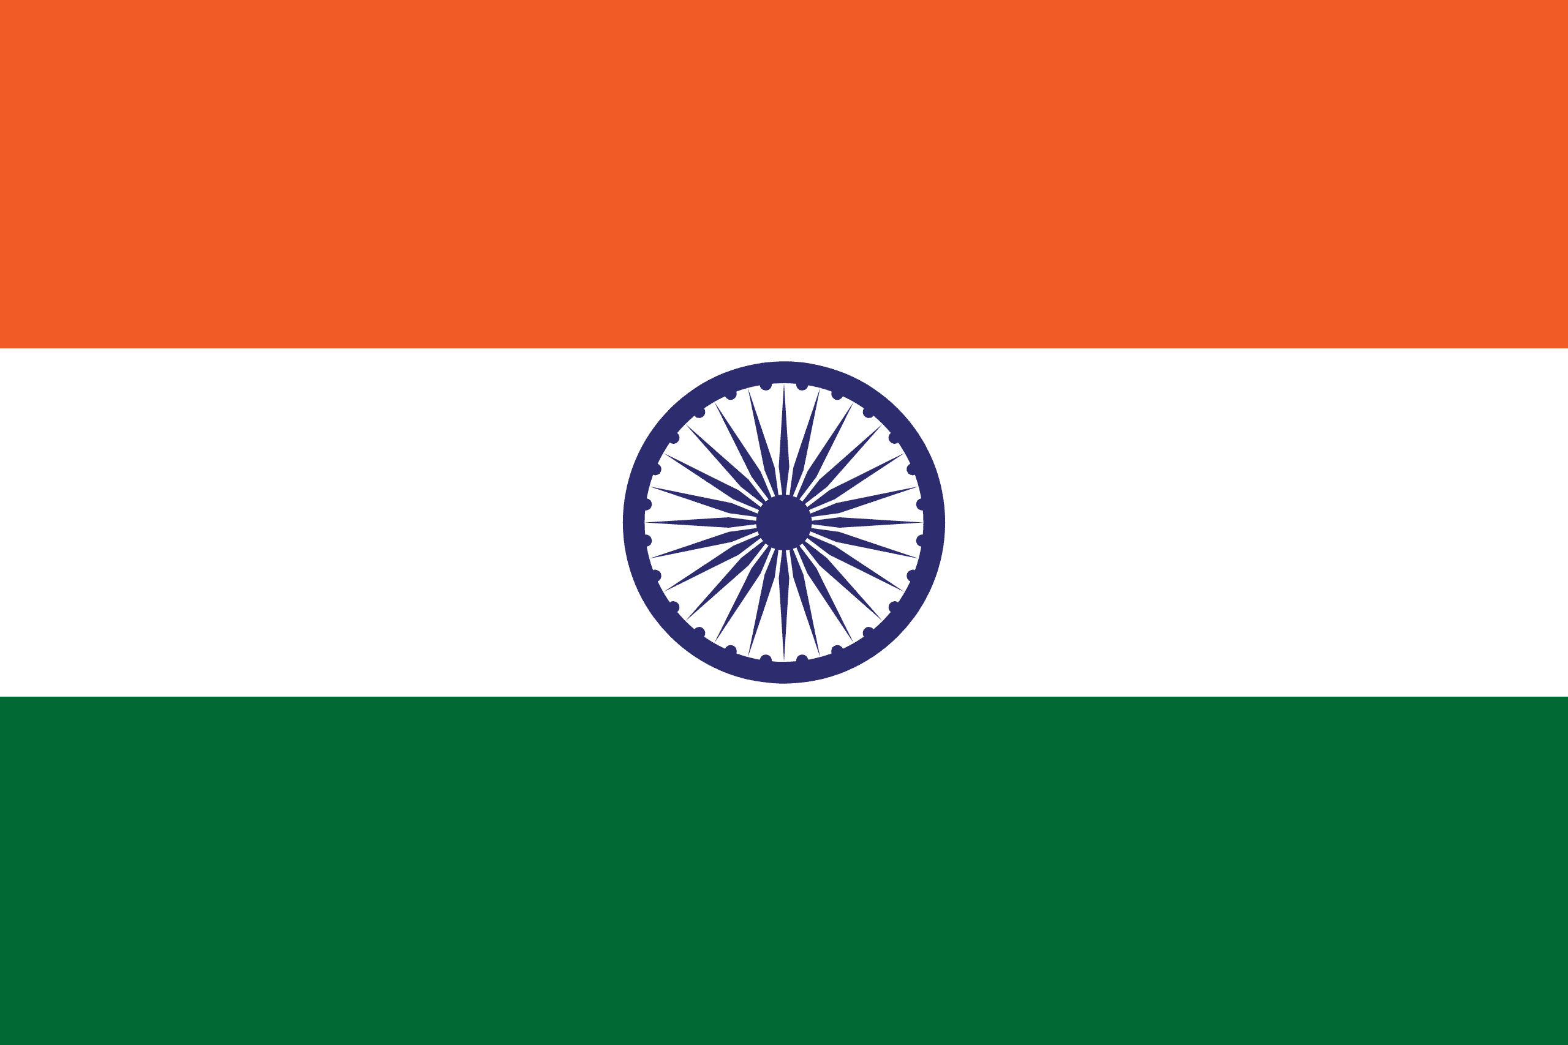
PRAYING FOR
INDIA

Slide 3
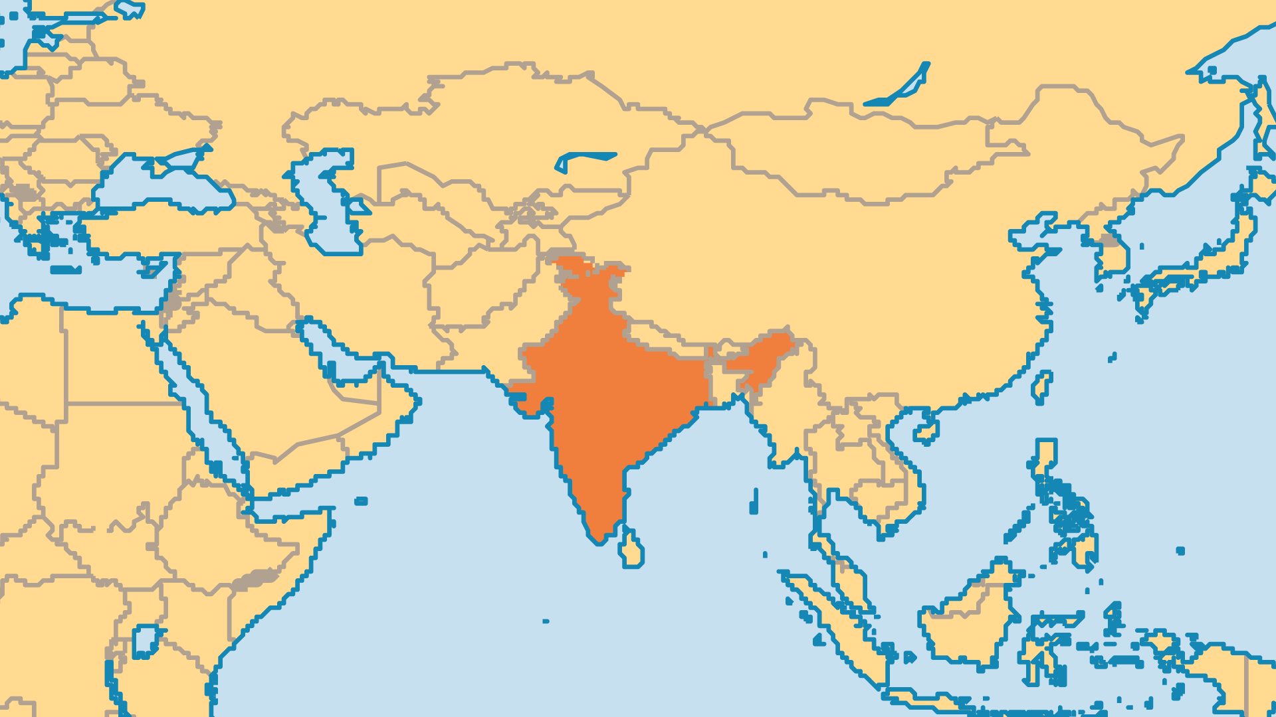
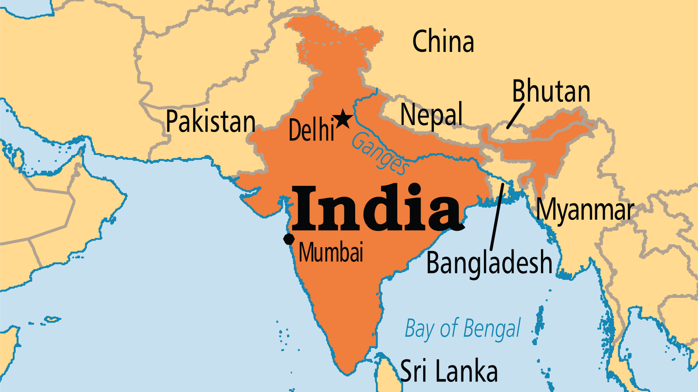
KEY STATS
Capital: | New Delhi
Population: | 1,463,865,525
Official Language: | 22 languages including Hindi and English
Languages: | 456
% Christian: | 5.8 %
% Evangelical: | 2.2 %
Largest Religion: | Hindu
Least Reached People Groups: | 2135
% Unevangelized: | 43 %
Persecution Rank: | 11/50

Slide 4
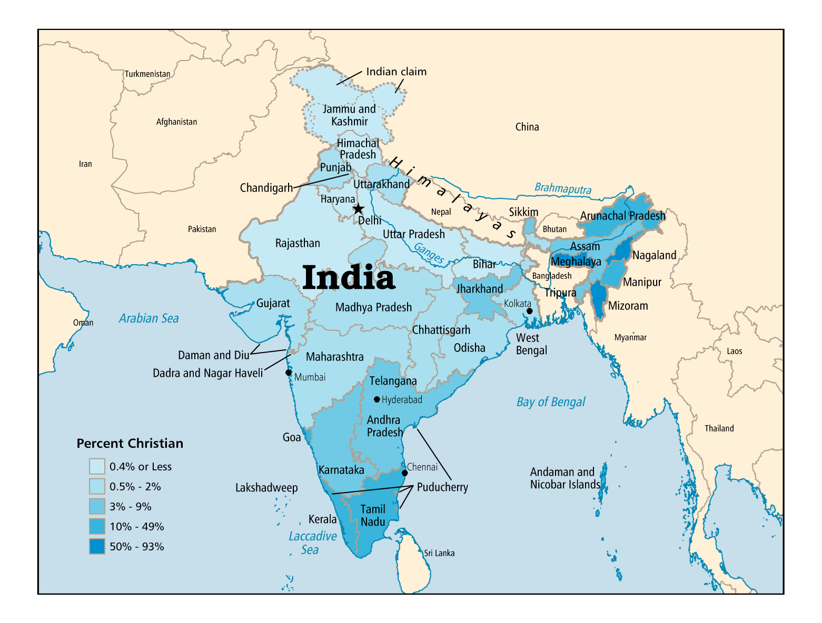

Slide 5

FOR PRAYER
India is the world's largest democracy and most populous nation. Political, economic, and social challenges all place heavy burdens on the government. Pray that India will choose to build on the progress of recent decades, especially to preserve and protect human dignity, rights, and freedoms. The current government operates on a Hindutva (Hindu nationalist) platform. This has brought about intensifying persecution, increased re-Hinduization/reconversion of Dalit and tribal groups, and many barriers of foreign Christian mission in India. The government's aggressive Hindutva stance - and persecution of other faiths - has emboldened religious violence by radical Hindu groups.

Slide 6
FOR PRAYER
The caste system remains a major issue. The Dalits/Bahujans/Scheduled Castes and Scheduled Tribes together are 25% of the population. Others oppressed these groups for thousands of years, and used the caste system (and Hinduism) to justify their harmful actions. The UN, the Indian government, international NGOs, and churches have all taken action to address the situation. Churches also work so that Dalits can encounter Jesus. The Church has an opportunity to show that the love of Christ extends to all people, regardless of caste, race, language, gender, and economic status. Pray for Christians to remove all caste discrimination from the Church, where it sadly does exist.

Slide 7
FOR PRAYER
Amidst all the suffering in India, it is women and children who suffer the most. Pray for state programs and Christian ministries to address these desperate needs. Sobering figures: 400 million children, up to 35 million orphans, 11 million abandoned (90% are girls), 3 million street kids, 2/3 of children suffer physical abuse, 1/2 suffer some kind of sexual harassment/abuse, 1 million+ end up in prostitution (mostly Nepalis & Bangladeshis). Women have lower rates of literacy and education, and domestic abuse is a widespread problem. Some girls get dedicated to the ancient service of Hindu temple prostitution. Pray for India's attitudes and practices to change to reflect God's care for women & children.

Slide 8
FOR PRAYER
The Indian Church is highly diverse, with a long legacy. Much of Indian Christianity results from people movements of the last 300 years, often started by local revivals. Some Christian groups today have remarkable growth, while other groups decline in numbers. Persecution of Christians has been steadily intensifying in recent years, and shows no signs of abating. Pray for our brothers and sisters in India to endure in the midst of this increasing pressure.
Want to know more? Go to www.operationworld.org

Slide 9
FOR PRAYER
Training for Christian workers: Most leaders and pastors receive little preparation. Pray for formal training institutions. India now has over 100 degree-level seminaries and 1,000 Bible schools. Training centres for indigenous church planters also play a significant role, but much more is needed. Pray for creative, effective models of leadership development. The Indian Church must learn to have greater impact in the workplace and in national life. Currently most Indians associate Christianity with the lower classes of society (80% of Indian Christians come from Dalit or tribal communities). The gospel has not yet made a significant impact on business, politics, arts, or culture.

Slide 10
FOR PRAYER
India has more unreached individuals than any other nation (more than 500 million). The south and northeast have a much higher proportion of Christians than the more populated north and west. Pray that the Church worldwide might rise to this task! The middle classes (between 400-500 million people). Half of cross-cultural missionaries worked among tribal groups, and many of the rest among the neediest sections of the population. Few today work among the urban middle class and the higher castes. This needs to change, but most workers feel unprepared for such challenges.
Want to know more? Go to www.operationworld.org

Slide 11
FOR PRAYER
Andhra Pradesh & Telangana: Many Indian mission agencies work in these states, and many people come to Christ! Every district now has churches. But 16 people groups remain unreached and unengaged. Millions of Hindus come to Andhra Pradesh every year to worship at Tirupathi. 200 Christian organizations have bases in Hyderabad (the state capital), a key centre for Christian ministry. 40% of Hyderabad are Muslim, and it is also a key centre for Islam in South India. Very little is done to reach out to Muslims - pray for effective outreach to them.
Want to know more? Go to www.operationworld.org

Slide 12
FOR PRAYER
Assam: Assam remains the major spiritual challenge in Northeast India. After 2 centuries of missions, Christians are only a small minority. Most tribal peoples remain unreached. Few Christians witness to the 9.7 million Muslims (who speak mostly Bengali) or the Hindu majority (who speak Assamese). The tea-estate workers are migrant peoples or tribal minorities from other states. Most are open to the gospel, but few Christians are there to share it. Pray for a new wave of loving witness, especially to those who are open to the Gospel.
Want to know more? Go to www.operationworld.org

Slide 13
FOR PRAYER
Chhattisgarh and Jharkhand both have minerals, forests, and good farm land. But the people are largely poor and under-educated. Rebel groups are very active in the forest and jungle regions, and violent conflict (which can include persecution of Christians) causes problems. The Christian Church remains small here, but house churches have begun to spread. Chhattisgarh is known as "Home of the Tribals". Pray that the light of the gospel shines into every tribal group, in both states.
Want to know more? Go to www.operationworld.org

Slide 14
FOR PRAYER
Gujarat remains a place of religious tension and persecution. The state government and the police support Hindu militant groups that intimidate Muslims and Christians in Dalit and tribal groups. Gujarat was the birthplace of the leader Gandhi. Pray for the peace and tolerance he promoted to become a reality here! Religious oppression at times prevents Christian outreach, and creates division among believers. But persecution sometimes brings new life and revival. Pray for labourers to the unreached, especially The Jains. The Saurashtra (peninsula that reaches into the Arabian Sea) has over 1 million Jains. Ahmadabad is a major Jain centre, with over 100 temples and little Christian work.

Slide 15
FOR PRAYER
Haryana is one of India's least-evangelized states. Only 32,000 identify themselves as Christian among its 29 million people. 6,000 villages have no Christian witness. But 15 Christian training centres have work here. Pray for them to equip many new workers for outreach. A significant number of Sikhs in Haryana have come into the Kingdom. Pray that this number increases, and has an impact on Sikhs elsewhere. Few known Christians exist among the 1.7 million Brahmins or the 750,000 Shaikhs.
Want to know more? Go to www.operationworld.org

Slide 16
FOR PRAYER
Jammu and Kashmir endure tragic suffering and conflict. Almost all groups in Jammu and Kashmir remain unreached. The Kashmir Valley region is 97% Muslim, the Jammu region is 66% Hindu, and the Ladakh region is 46% Buddhist. Pray especially for breakthrough among the more isolated Buddhist peoples. Christians have always been few, but in some places whole villages have now come to faith! Many feel tired of the hatred and violence, and find hope and peace in Christ. Christian growth usually meets persecution from families and communities. Pray for the protection of new believers and Christian workers.
Want to know more? Go to www.operationworld.org

Slide 17
FOR PRAYER
Madhya Pradesh was one of the last states to open up for missions. It is strongly Hindu, with strict laws that limit conversions to Christianity. Madhya Pradesh has many large tribal peoples, and more tribal groups than anywhere else in the world. Most practise a version of animism that was influenced by Hinduism. Many practise witchcraft, Shaktism (worship of female energy), and Saivism (worship of the god Shiva). Christians planted thousands of new churches in 20 years. Praise God for house church movements among some of the tribes. The whole state needs pioneer mission work. Pray for open doors for the gospel!

Slide 18
FOR PRAYER
Odisha state has more intense persecution of Christians than anywhere else in India. In many districts, Christians must either reconvert to Hinduism, leave their village, or face death. Pray that churches might grow in unity, and in their ability to withstand persecution. Despite the troubles, the Church multiplies rapidly, mostly among tribal and Dalit peoples. 709 of the 799 people groups in Odisha have no Christians, according to a census. Pray for the effective use of audio Scripture, and Christian radio and TV programmes, as illiteracy is common.
Want to know more? Go to www.operationworld.org

Slide 19
FOR PRAYER
Politics affects the Church and mission in Tamil Nadu state. Hindu extremists threaten the Church with anti-conversion laws. Pray that the current religious freedom continues. The Church grows despite the social pressures, especially among Dalit and tribal peoples. Muslims and higher caste Hindus receive very little outreach. Tamils founded many of the Christian organizations throughout India. Pray that the Church of Tamil Nadu presses forward with its mission vision and outreach.
Want to know more? Go to www.operationworld.org

Slide 20
FOR PRAYER
Uttar Pradesh (UP) is the home of Hinduism, the location of the holy city of Varanasi, and has a long historical connection to Buddhism and Jainism also. Sadly, it has given no home to the gospel. The size of the unfinished task in Uttar Pradesh should drive us to prayer. If Uttar Pradesh were its own country, it would have the third-largest unevangelized population in the world. 191 groups remain unreached and unengaged. This single state likely represents the world’s greatest missionary challenge. Praise God that more churches, mission agencies, and prayer networks (both national and expatriate) now focus some work on Uttar Pradesh.

