Slide 1




Slide 2

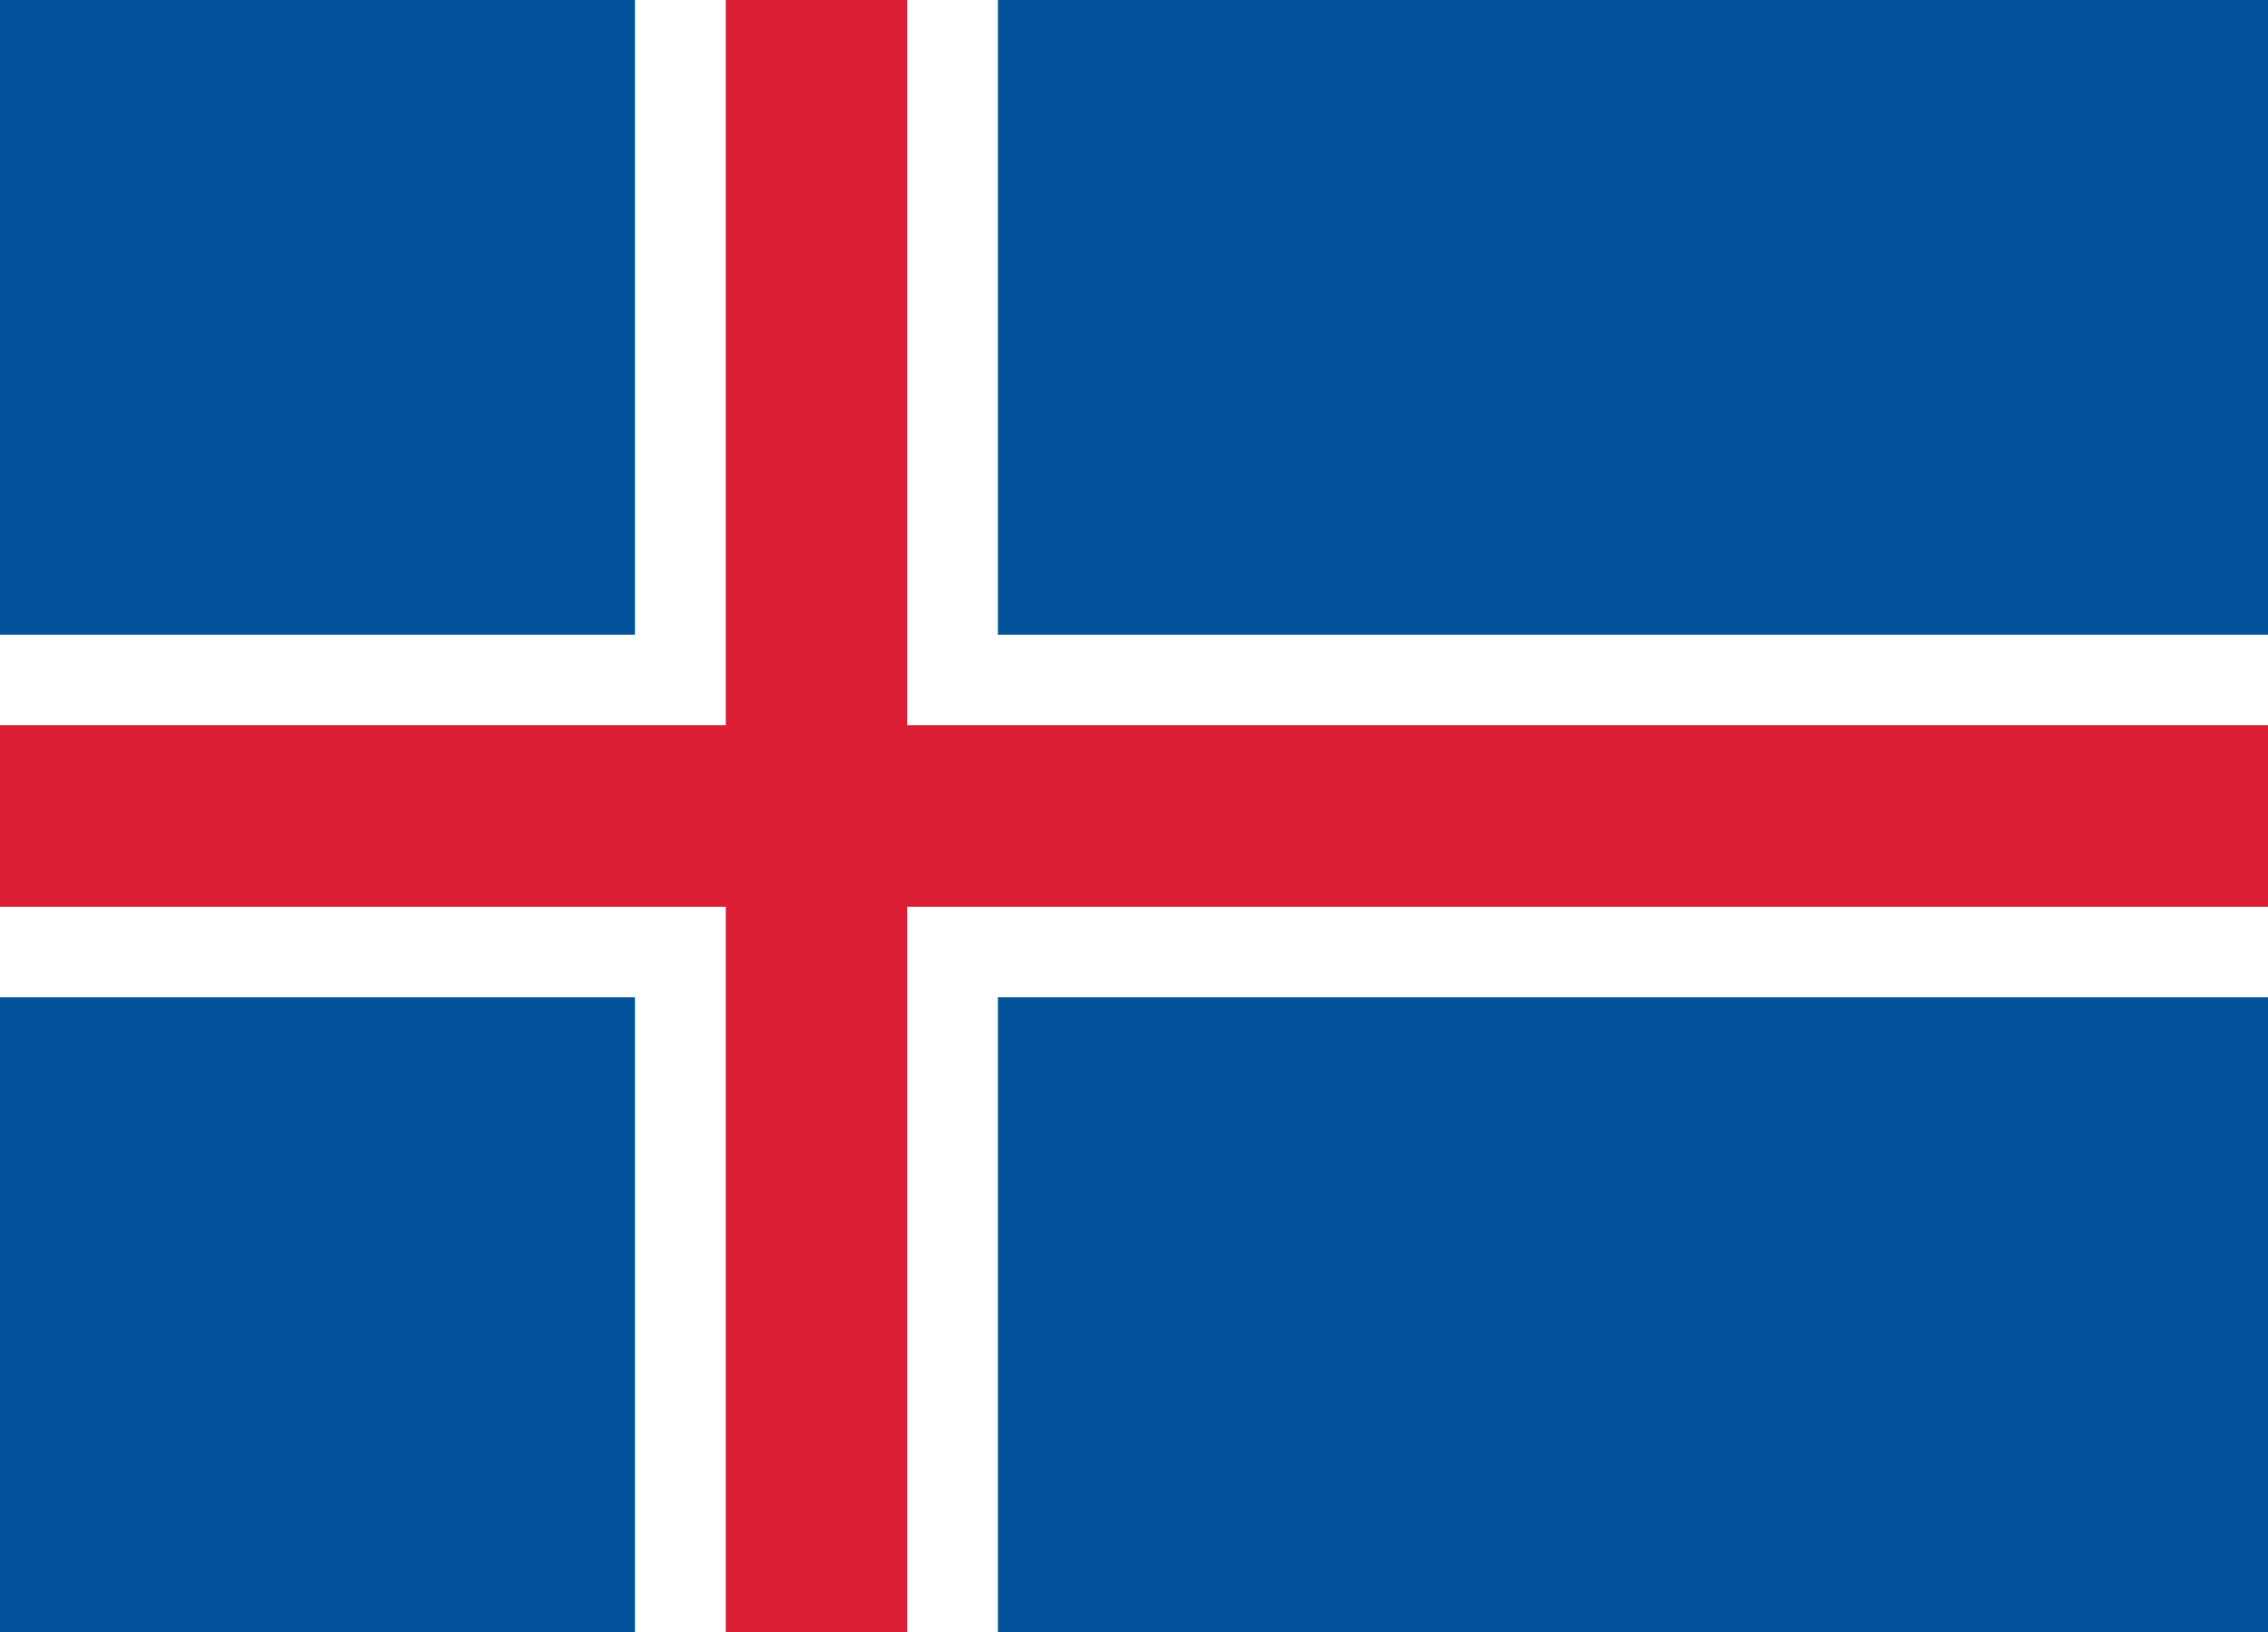
PRAYING FOR
ICELAND

Slide 3
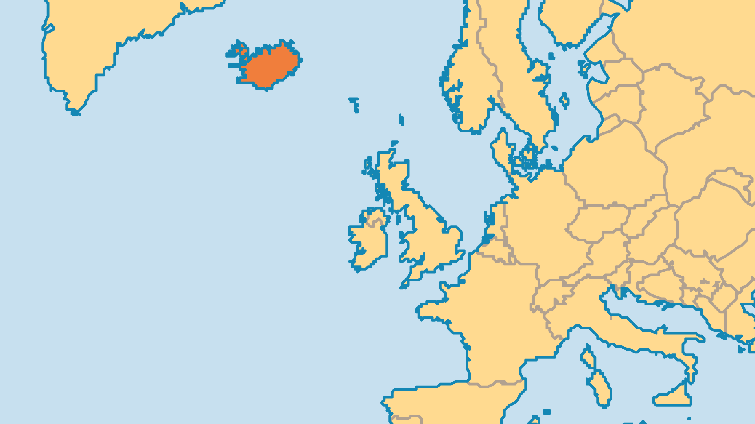
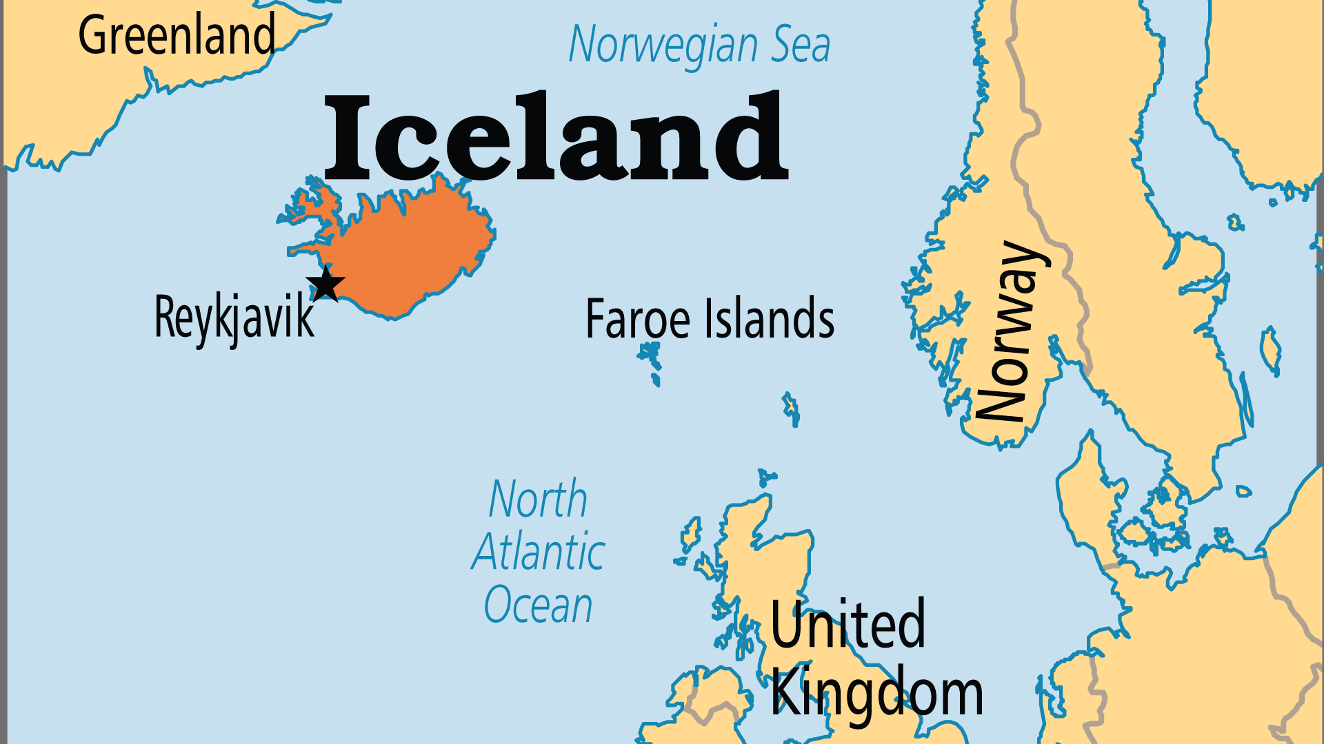
KEY STATS
Capital: | Reykjavik
Population: | 398,266
Pop Under 15 Yrs: | 19.6 %
Official Language: | Icelandic
Literacy Rate: | 100 %
Life Expectancy: | 82.7 yrs (16th/236)
HDI Ranking: | 3/193
% Christian: | 90.6 %
% Evangelical: | 3.8 %
% Unevangelized: | 1 %

Slide 4

FOR PRAYER
Despite Iceland's growing reputation as a paradise of rugged natural beauty and socioeconomic stability, challenges threaten to change traditional Icelandic life. Divisions come over land, where some want to conserve the environment and others want to make money from its resources. Immigration brings other faiths and cultures into a traditionally guarded society. Pray for wisdom for leaders who deal with these new challenges.
Want to know more? Go to www.operationworld.org

