Slide 1




Slide 2


PRAYING FOR
HUNGARY

Slide 3
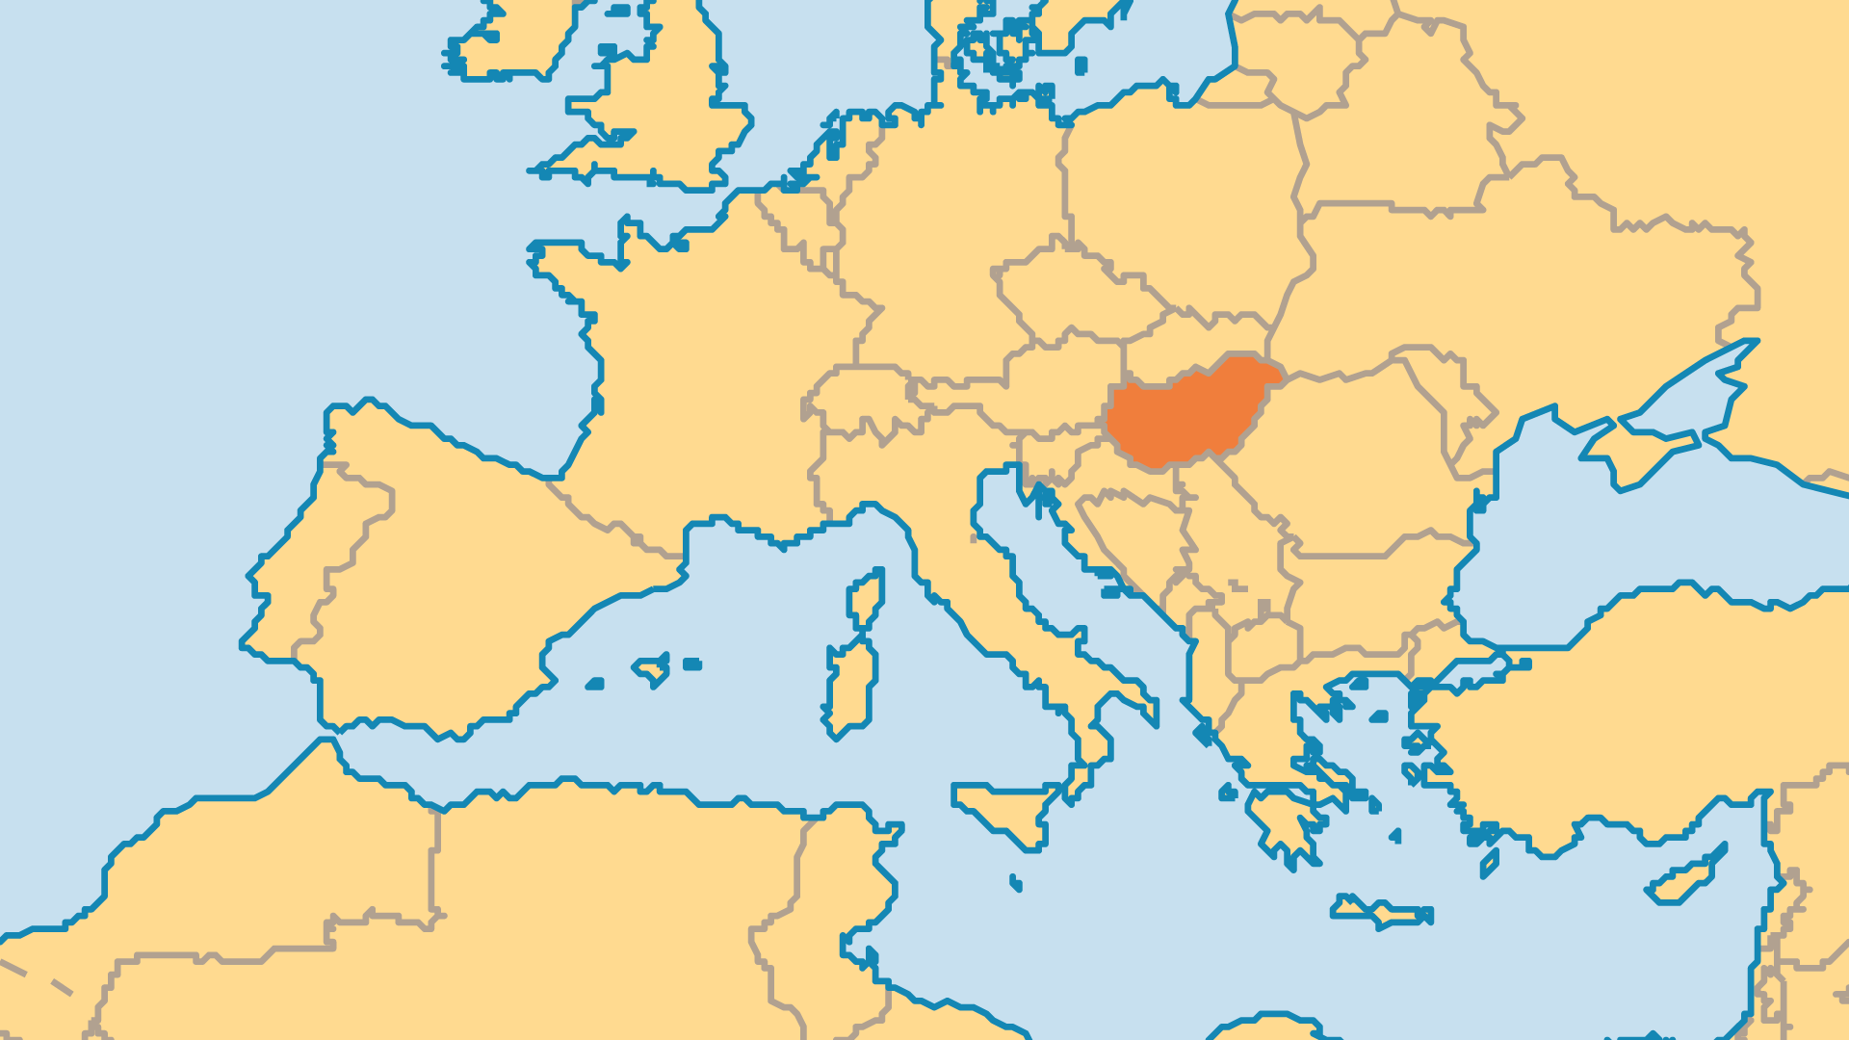
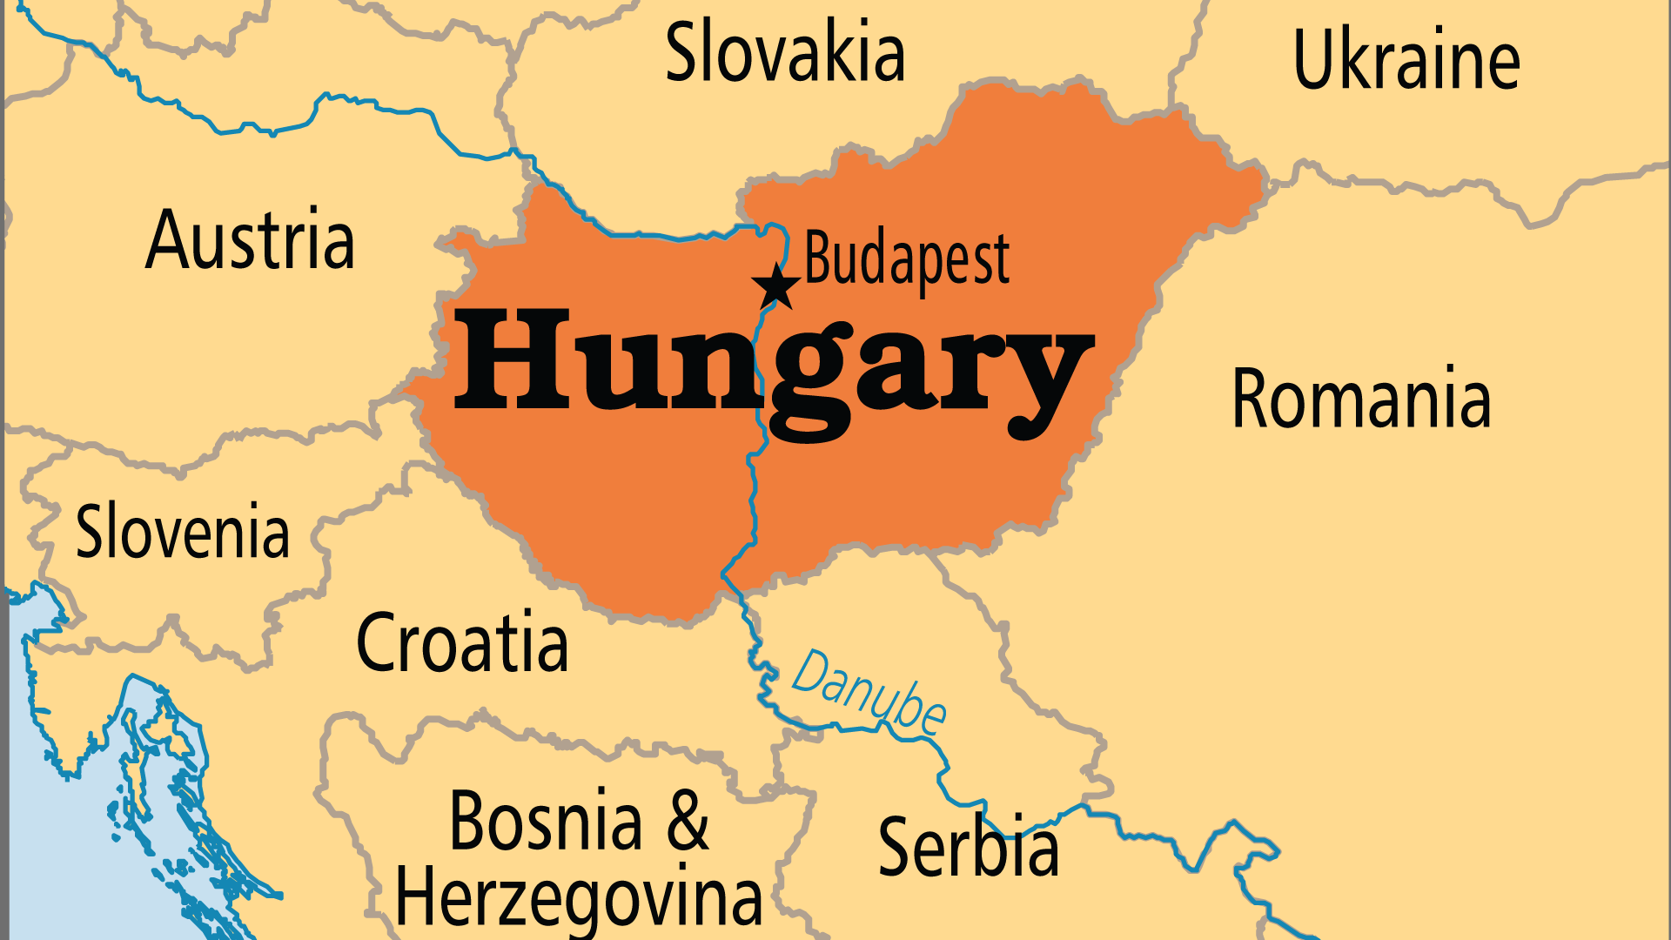
KEY STATS
Capital: | Budapest
Population: | 9,632,287
Official Language: | Hungarian
Literacy Rate: | 99 %
HDI Ranking: | 46/193
% Christian: | 88 %
% Evangelical: | 2.8 %
People Groups: | 28
Least Reached People Groups: | 4
% Unevangelized: | 1 %

Slide 4

FOR PRAYER
In 2000, Hungary celebrated 1,000 years since its conversion to Christianity. However, Hungarian people have now mostly lost contact with the gospel. Occult activity and Eastern mysticism, pagan witchcraft, ancient Magyar shamanism, Tibetan Buddhism, or a mix of these various spiritual ideas all increased in recent years. But mostly, people tend toward a non-religious approach that seeks material gain and personal pleasure. Ask God to expose all false teaching and empty philosophies, and to reveal Christ as the truth in this historically Christian nation.
Want to know more? Go to www.operationworld.org

