Slide 1




Slide 2

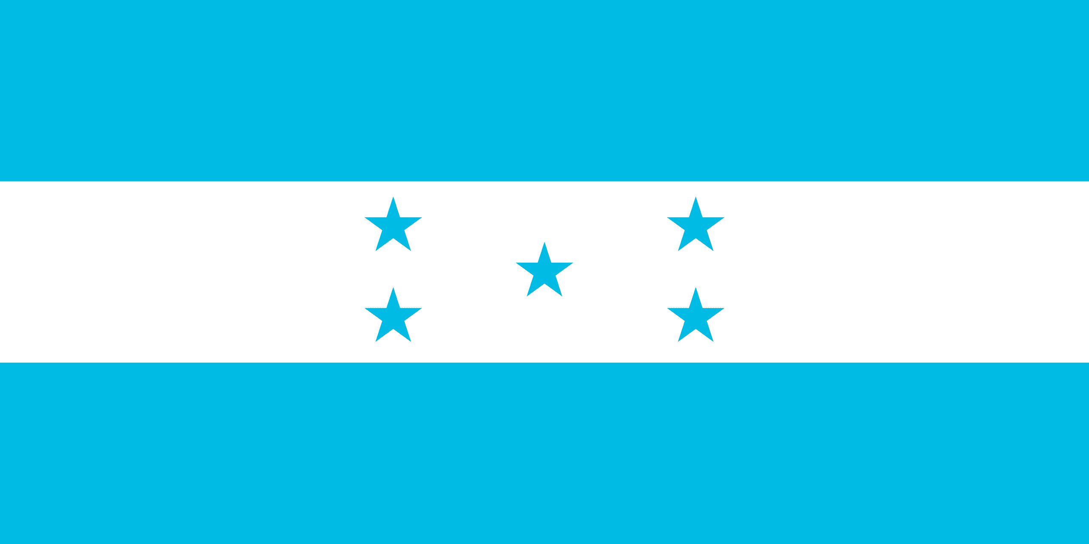
PRAYING FOR
HONDURAS

Slide 3
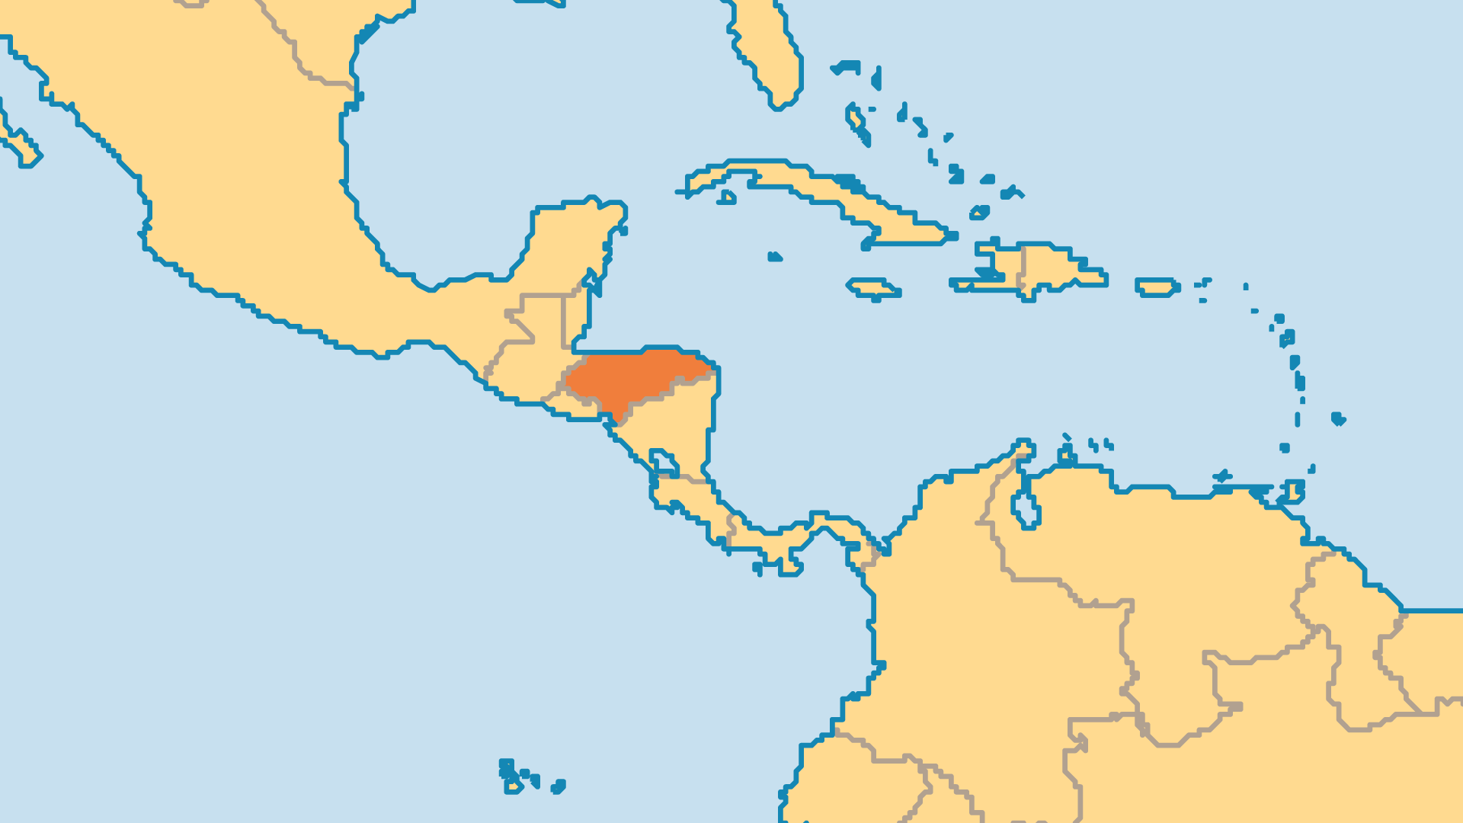
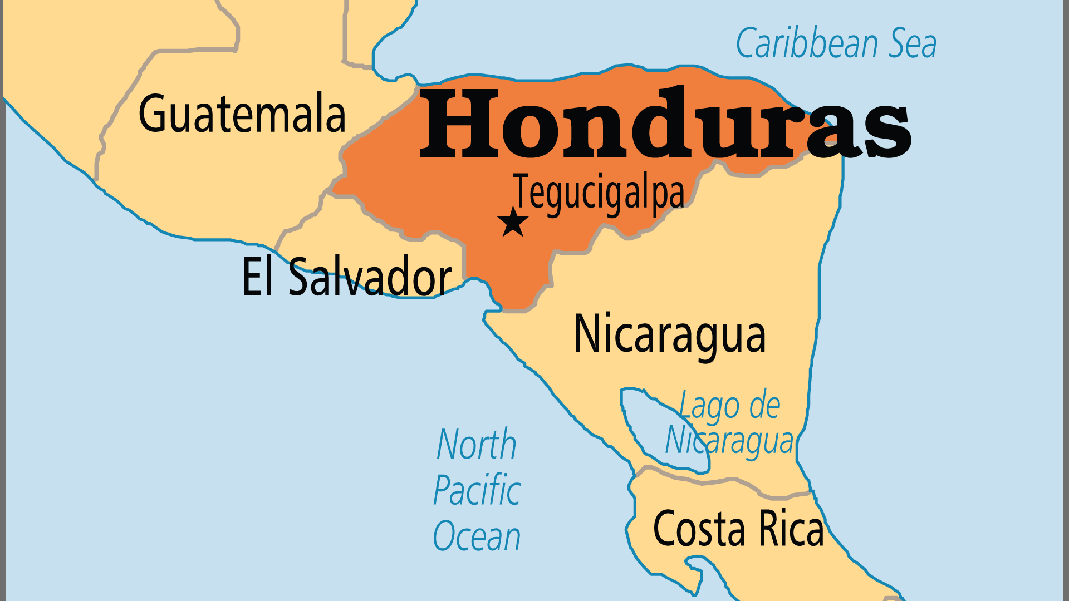
KEY STATS
Capital: | Tegucigalpa
Population: | 11,005,850
Pop Under 15 Yrs: | 31.2 %
Official Language: | Spanish
Languages: | 13
Life Expectancy: | 70.1 yrs (161st/236)
HDI Ranking: | 137/193
% Christian: | 96.6 %
% Evangelical: | 23 %
People Groups: | 22
% Unevangelized: | 1 %

Slide 4

FOR PRAYER
The most basic problem for Honduras is deep poverty. Children form more than half the population, and most live in poverty. Many try to reach the USA to find family members there but often end up suffering in prison in Mexico or Guatemala. Violent gangs exploit vulnerable children as members and sex workers. Honduras has 60% of Central America's AIDS cases. Organized crime and maras (gangs) link with drug cartels and hold power in society. Pray for moral courage for Hondurans to stop the spread of AIDS. Pray for righteousness, and for wise government that works equally for rich and poor.
Want to know more? Go to www.operationworld.org

