Slide 1




Slide 2

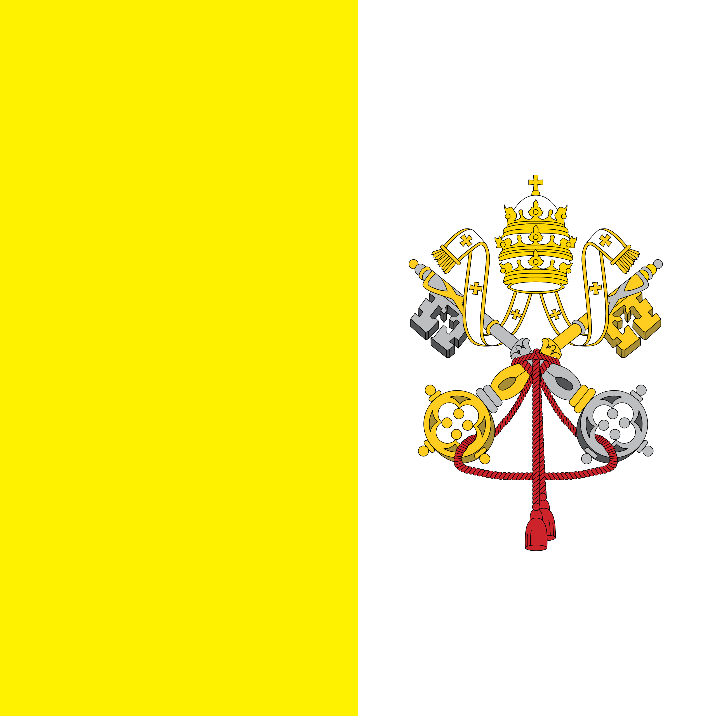
PRAYING FOR
HOLY SEE (VATICAN CITY)

Slide 3
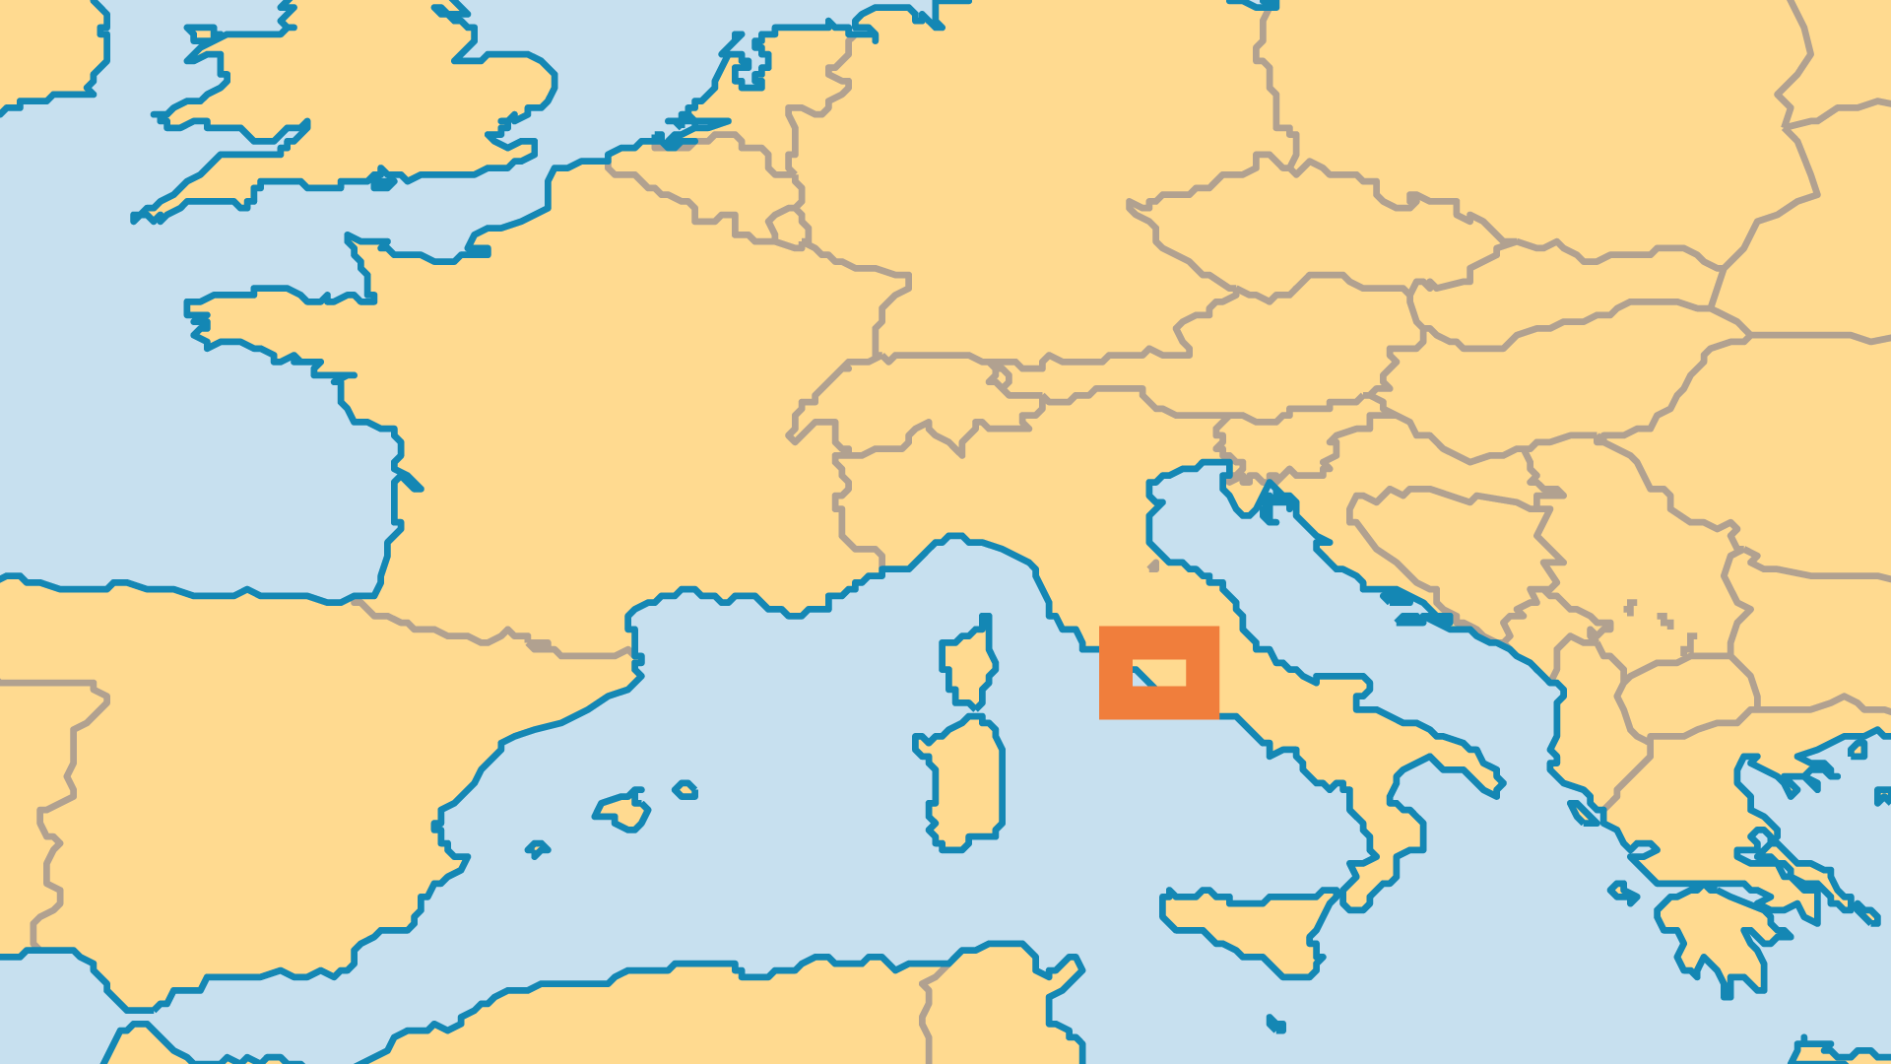
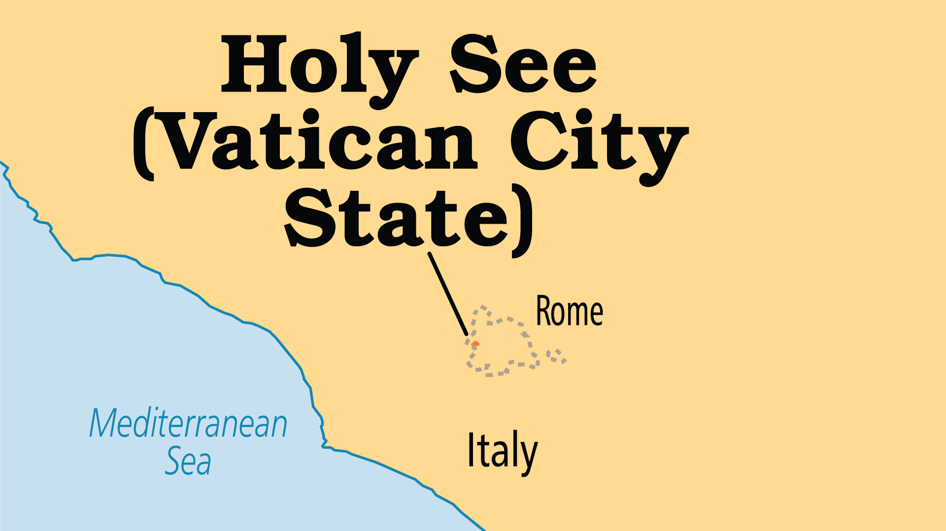
KEY STATS
Population: | 502
% Urban: | 100 %
Literacy Rate: | 100 %
Life Expectancy: | 82.3 yrs (21st/236)
% Christian: | 100 %
% Evangelical: | 2.5 %
Largest Religion: | Christian
% Largest Religion: | 100 %
People Groups: | 1
% Unevangelized: | 0 %

Slide 4

FOR PRAYER
The Vatican leadership plays a large role in the faith and lives of Roman Catholics. It also influences the wider world. The Pope is one of the world's most powerful and influential people. The fresh and humble approach of Pope Francis's leadership (from 2013) has begun to change people's perception of Catholicism, and even of Christianity overall. Yet Pope Francis also faces much upheaval within Catholicism globally, especially with the persistent troubles related to historic and present abuse of children by clergy. Pray for God's grace for this man, and for the Holy Spirit to guide him into all truth.
Want to know more? Go to www.operationworld.org

