Slide 1




Slide 2

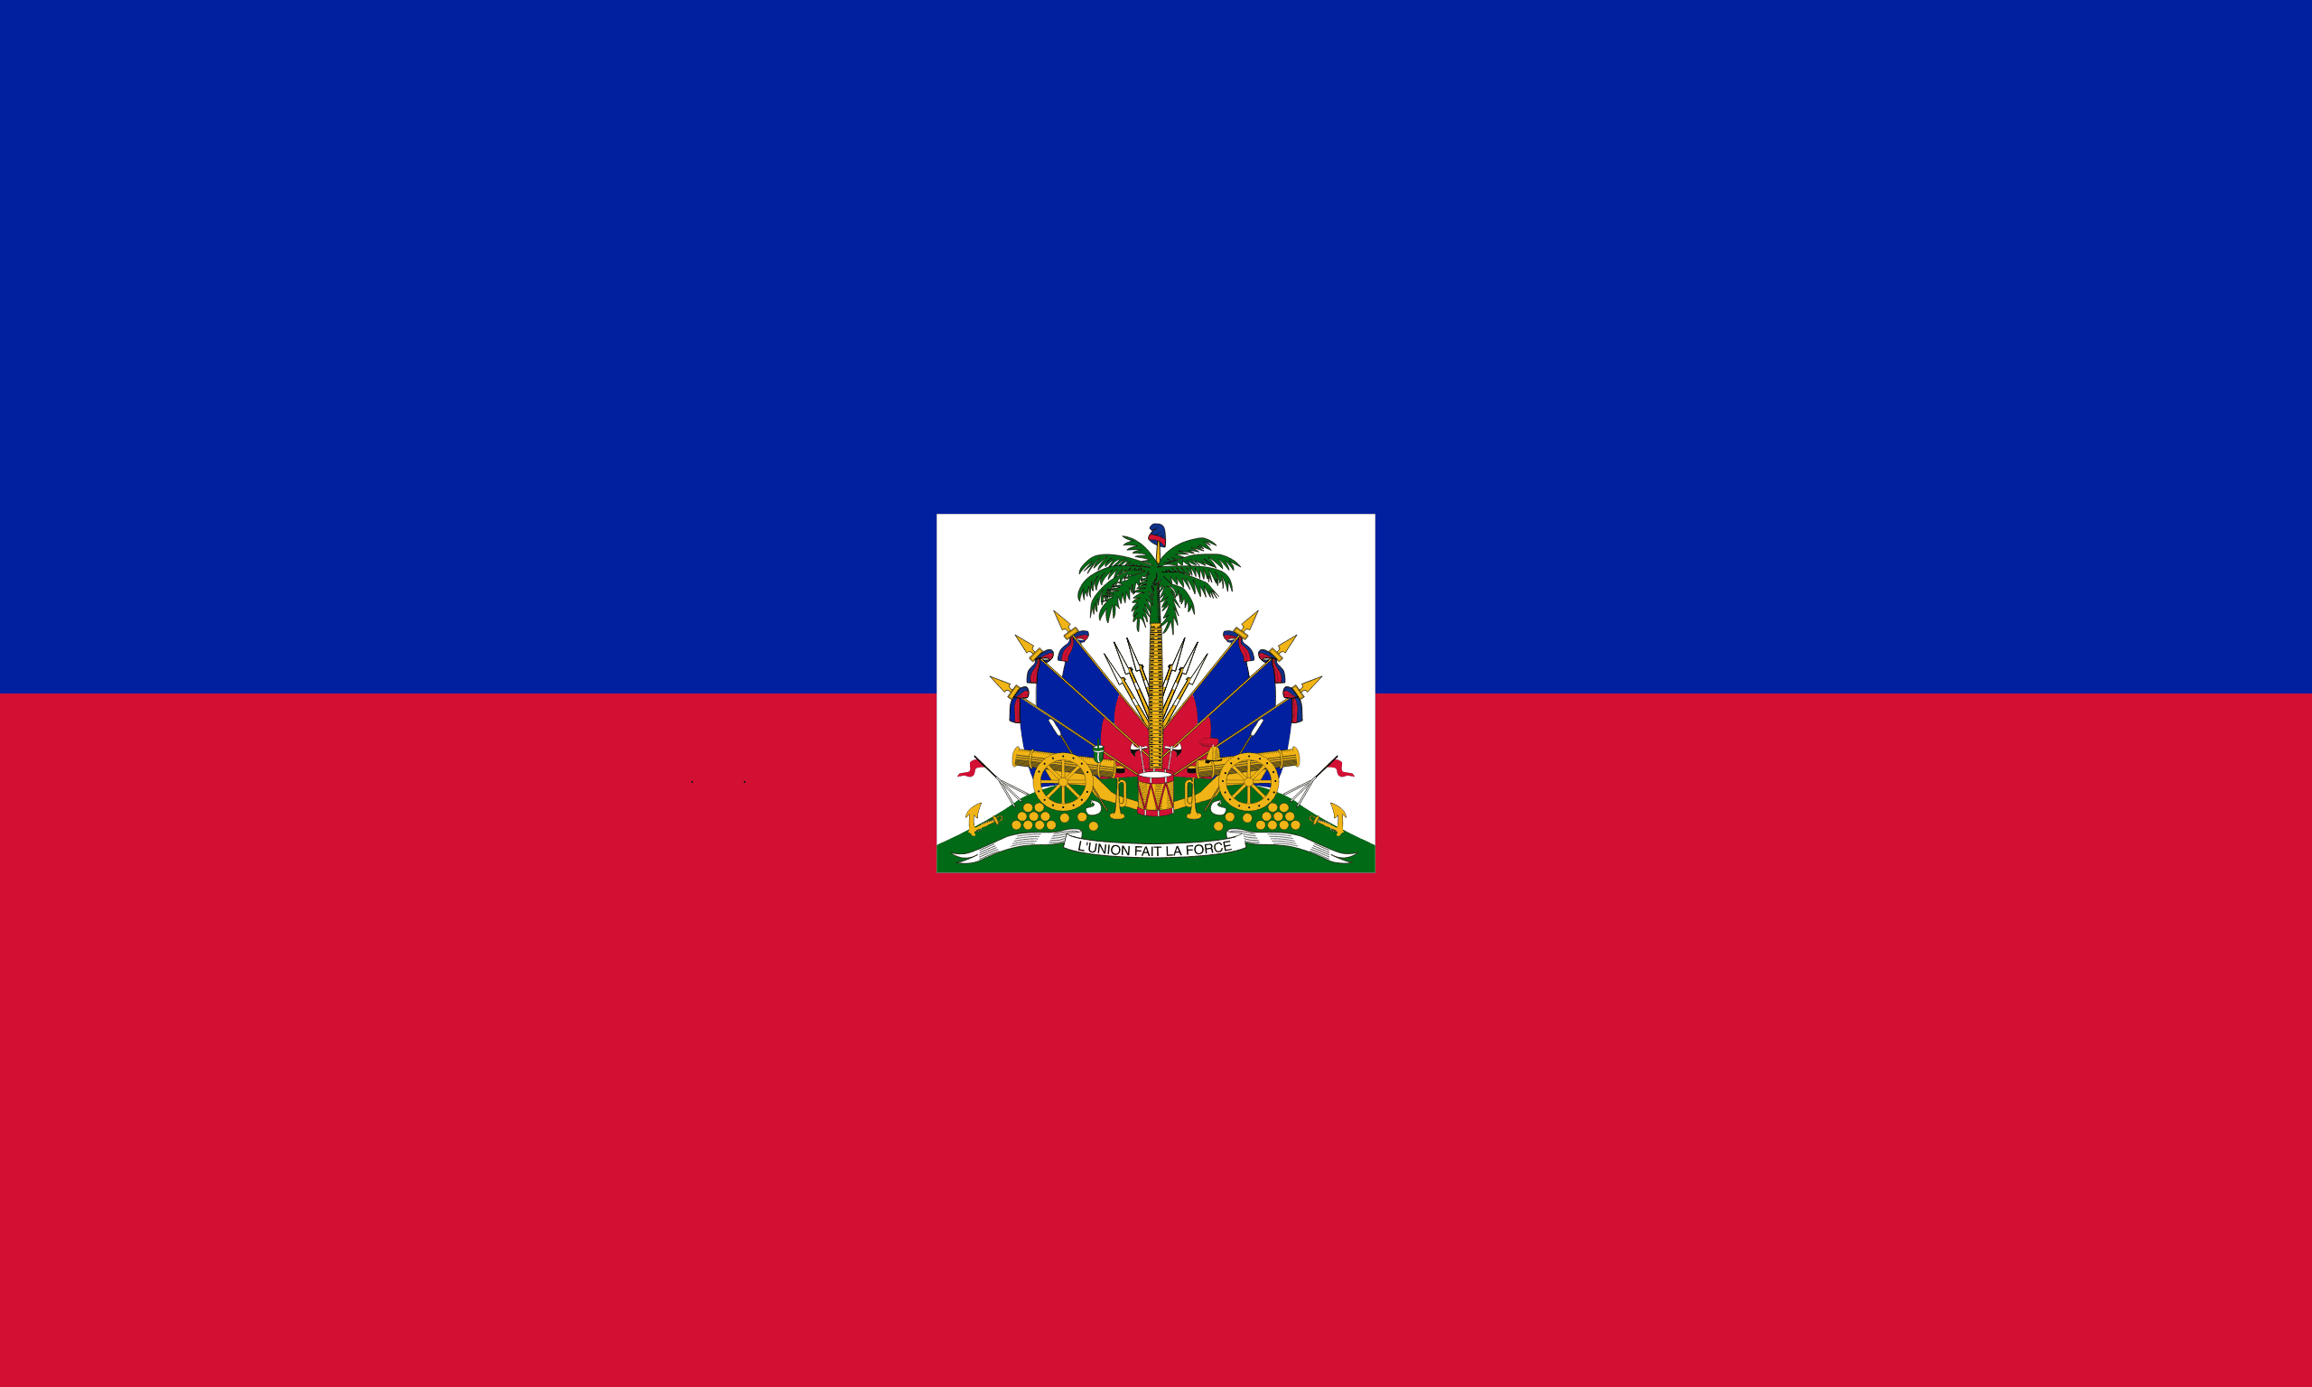
PRAYING FOR
HAITI

Slide 3
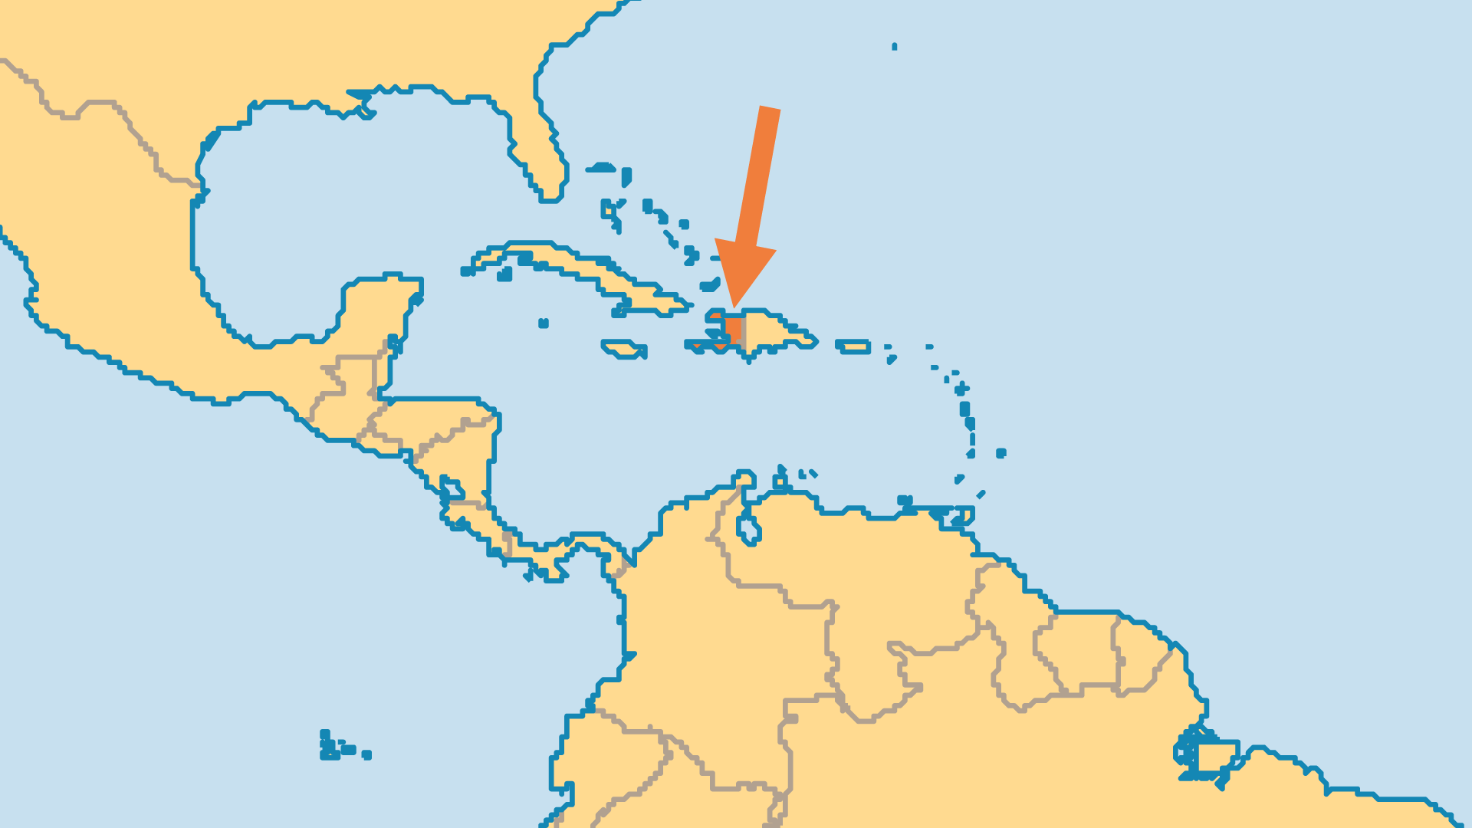
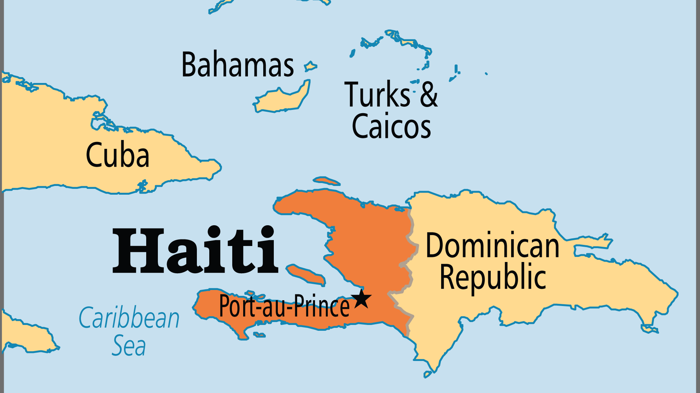
KEY STATS
Capital: | Port-au-Prince
Population: | 11,906,096
Pop Under 15 Yrs: | 32.9 %
Official Language: | French, Haitian Creole.
HDI Ranking: | 163/193
% Christian: | 95.1 %
% Evangelical: | 16 %
Largest Religion: | Christian
People Groups: | 6
% Unevangelized: | 1 %

Slide 4

FOR PRAYER
The litany of tragedies to strike Haiti seems unending. The 2010 earthquake, the cholera outbreak that followed, mass protests and high fuel prices in 2018-2021, the assassination of the President in July 2021, then another huge earthquake a month later. Now, ruthless armed gangs wreak havoc and wield more power than the government or police. Haiti’s plight began with centuries of unjust treatment at the hands of Western powers, and continued after independence. The layers of brokenness seem impossible to fix as corruption, exploitation, terrible poverty, acute hunger, and sexual violence are widespread. Pray for God to break through and bring lasting change in this land desperate for salvation.

Slide 5
FOR PRAYER
Tyranny, cruelty, and spiritual bondage fill Haiti's history. The Spanish genocide against the indigenous Arawaks, Spanish and then French slavery, and Haiti's own brutal leaders promoted a spirit of violence for centuries. Voodoo (a religion of spirits) creates fear throughout society. Many Catholics practise some voodoo. Pray that the power of the Holy Spirit might overcome the forces of evil. Pray for the Holy Spirit to cleanse the Church. Ask God to bind the powerful spirits underlying voodooism in Jesus' name, so the nation can be wholly dedicated to the Lord.
Want to know more? Go to www.operationworld.org

