Slide 1




Slide 2


PRAYING FOR
GUYANA

Slide 3
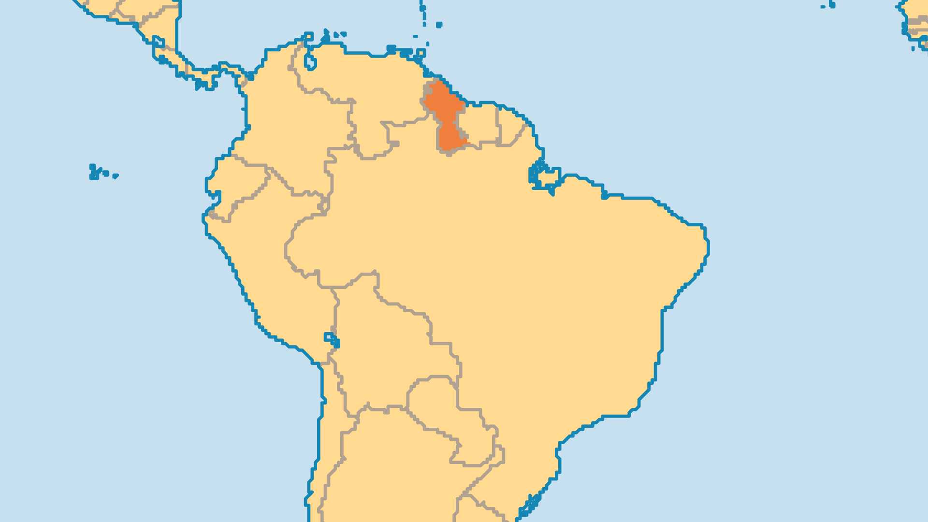
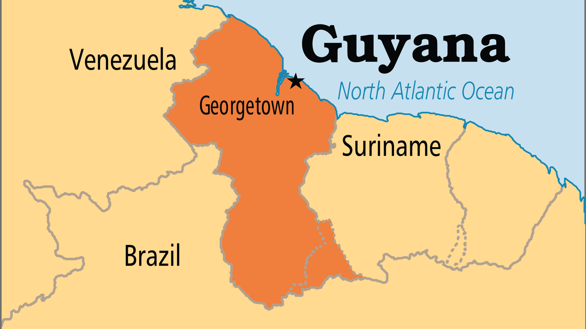
KEY STATS
Capital: | Georgetown
Population: | 835,986
Official Language: | English; Creole
Languages: | 19
Life Expectancy: | 65.7 yrs (187th/236)
% Christian: | 52.7 %
% Evangelical: | 19.8 %
Largest Religion: | Christian
People Groups: | 21
% Unevangelized: | 18 %

Slide 4

FOR PRAYER
Guyana faces various threats. Venezuela and Suriname both claim large parts of Guyana's land. The two main political parties divide along racial lines (Indo-Guyanese versus Afro-Guyanese). The land is rich in biodiversity and natural resources, but is at risk of exploitation by foreign companies and interests. Due to a lack of economic opportunities, many people emigrated, including many of the most talented. Pray for hope to come to Guyana, and for the gospel to transform society.
Want to know more? Go to www.operationworld.org

