Slide 1




Slide 2


PRAYING FOR
GUINEA-BISSAU

Slide 3
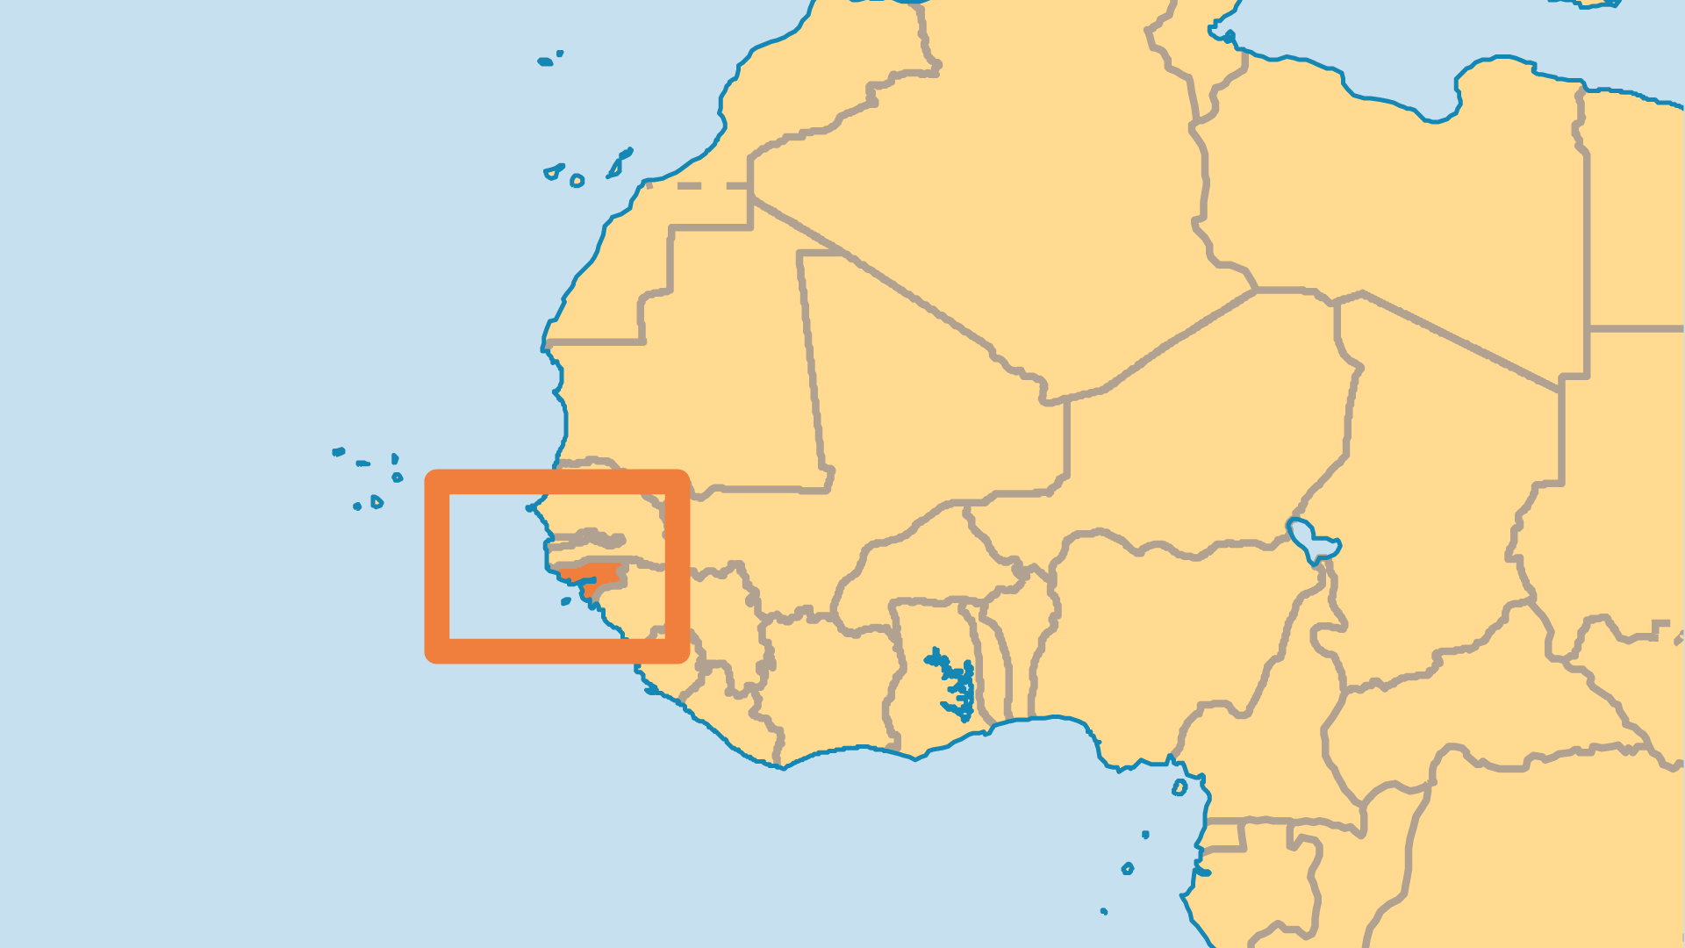
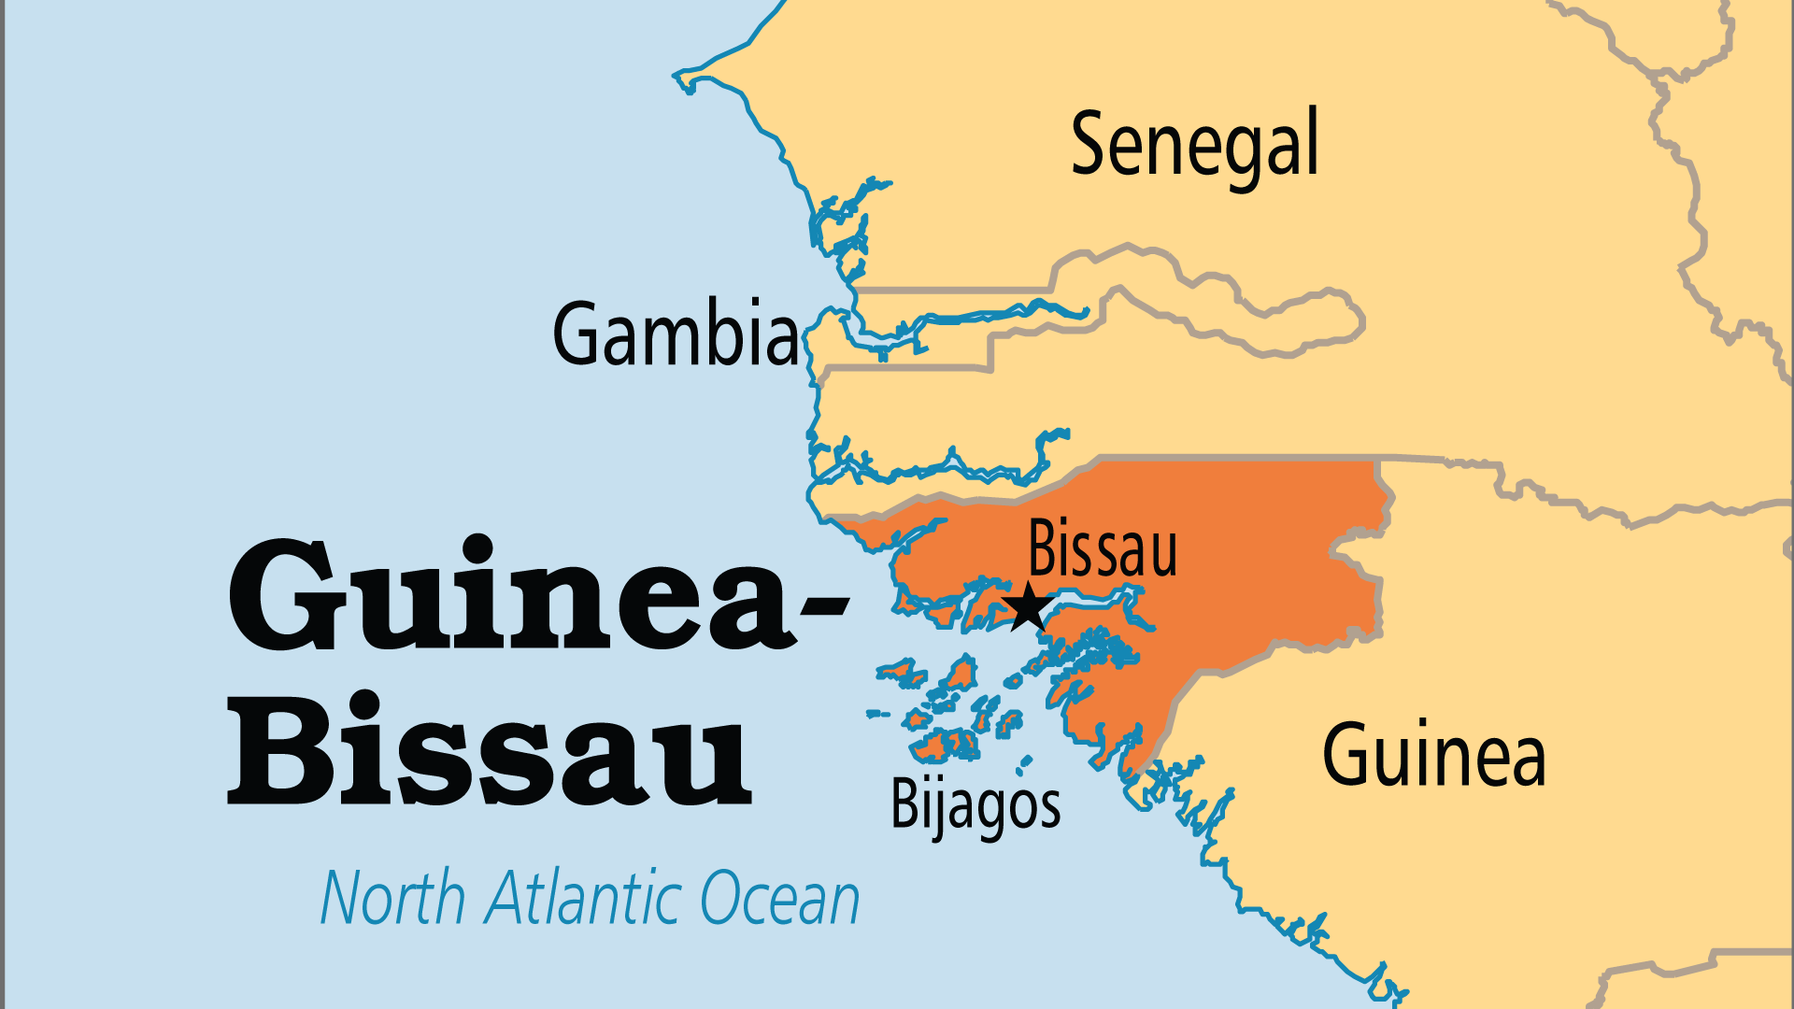
KEY STATS
Capital: | Bissau
Population: | 2,249,515
Official Language: | Portuguese. Portuguese Creole,
Literacy Rate: | 55 %
Life Expectancy: | 59.7 yrs (221st/236)
HDI Ranking: | 177/193
% Christian: | 10.9 %
% Evangelical: | 1.6 %
Largest Religion: | Muslim
% Unevangelized: | 53 %

Slide 4

FOR PRAYER
Poverty, political unrest, and violent conflict combine to burden the population. Opportunity for progress and development seems distant. The influence of drug shipments leads to corrupt police, army, and government leaders, and can trap already poor people in destruction. Guinea-Bissau's history of political unrest reveals a need for stability and forgiveness. Pray that God would raise up righteous leaders for the people.
Want to know more? Go to www.operationworld.org

