Slide 1




Slide 2

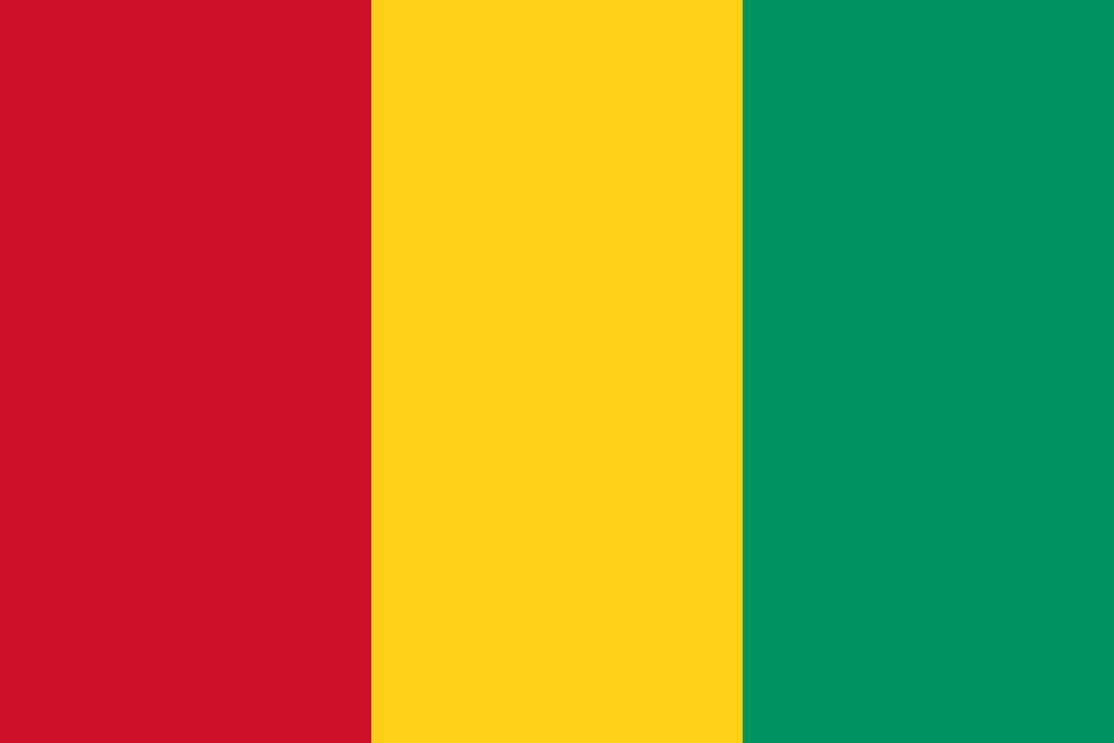
PRAYING FOR
GUINEA

Slide 3
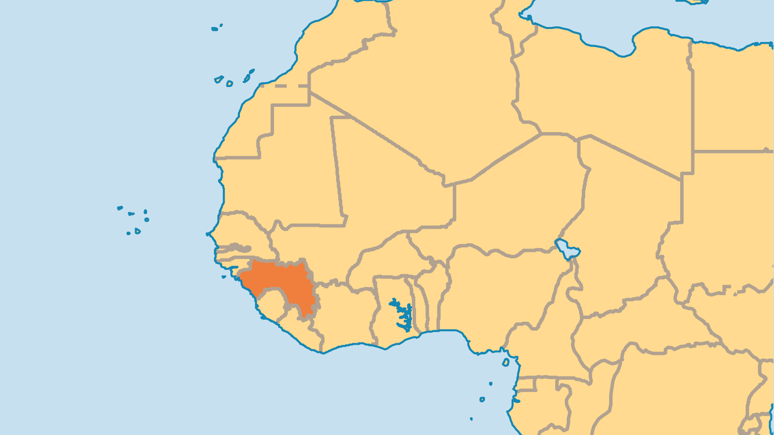
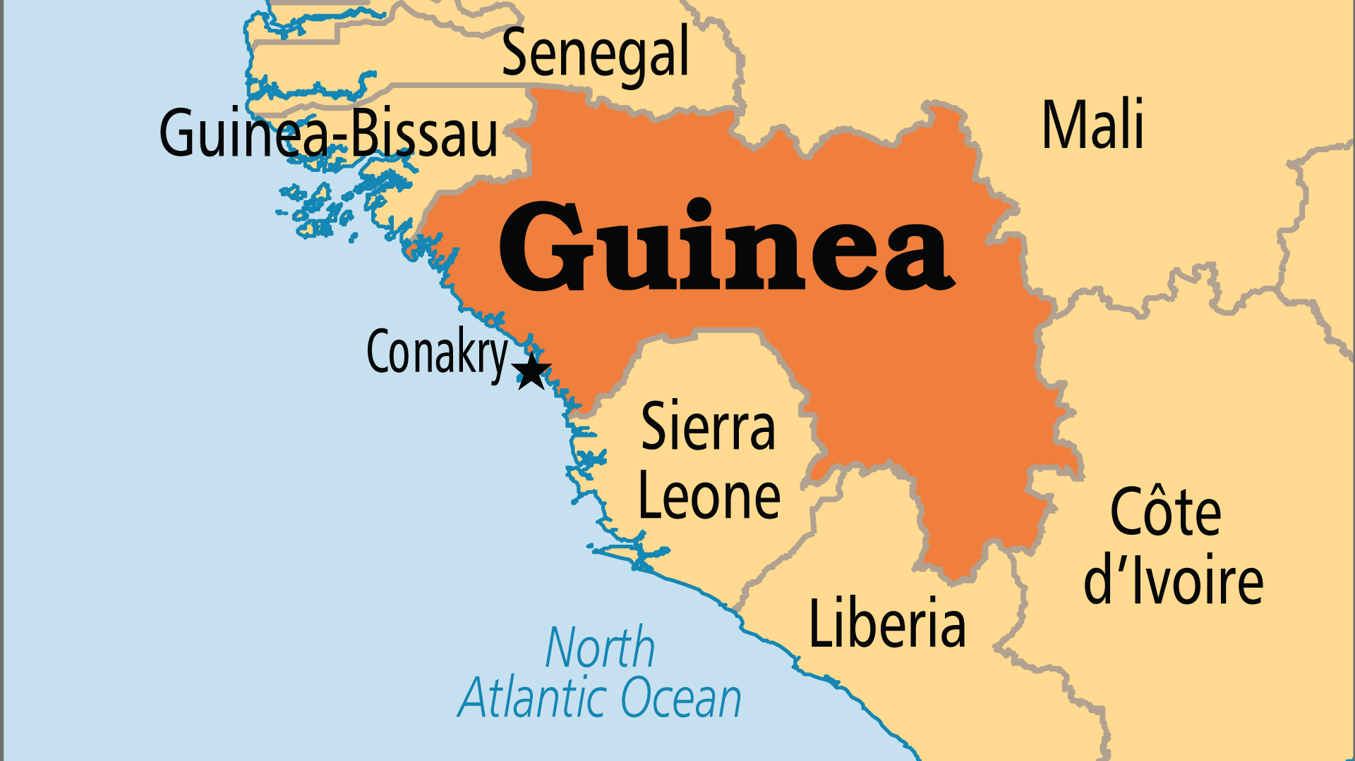
KEY STATS
Capital: | Conakry
Population: | 15,099,727
Official Language: | French, Fulbe, Malinke, Susu, Kissi, Guerze and Toma
Life Expectancy: | 58.9 yrs (227th/236)
HDI Ranking: | 182/193
% Christian: | 4.5 %
% Evangelical: | 0.7 %
Largest Religion: | Muslim
% Unevangelized: | 62 %

Slide 4

FOR PRAYER
Guinea's political situation is cause for prayer. Successful elections in the 2010s were followed by a Presidential attempt to change the constitution to allow himself more terms in office. Following massive protests and a food crisis, a military coup in 2021 deposed the President and promised a return to civilian rule by 2024. Instead, military authorities are cracking down on dissent, opposition, and the media. Currently, the Christian minority and the missionary community have the freedom to share the blessed hope of Christ to a nation long-plagued by poverty, corruption, and uncertainty. May they seize this opportunity with confidence and faith - the people of Guinea are desperate for hope.

Slide 5
FOR PRAYER
Christians make up a small minority of the population. Most live in Conakry and the southeast forests. The Church declined around 15 years ago. Evangelism and church planting slowed down, and less-committed Christians left the faith. Guinea has 3 Bible schools and 6 leadership training schools, but still lacks Christian leaders. 43% of the population are under age 15. Pray for believers who will persevere, and pray against the enemy who seeks to destroy young or weak Christians before they can grow.

