Slide 1




Slide 2


PRAYING FOR
GUATEMALA

Slide 3
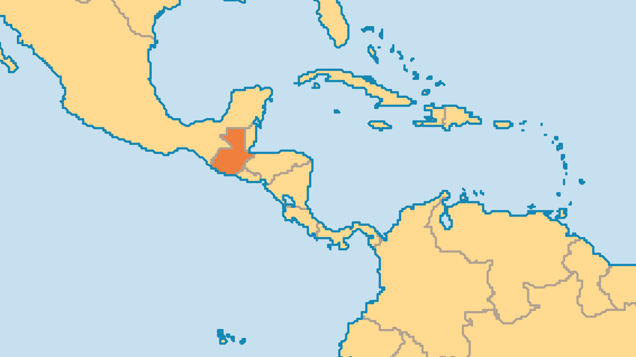
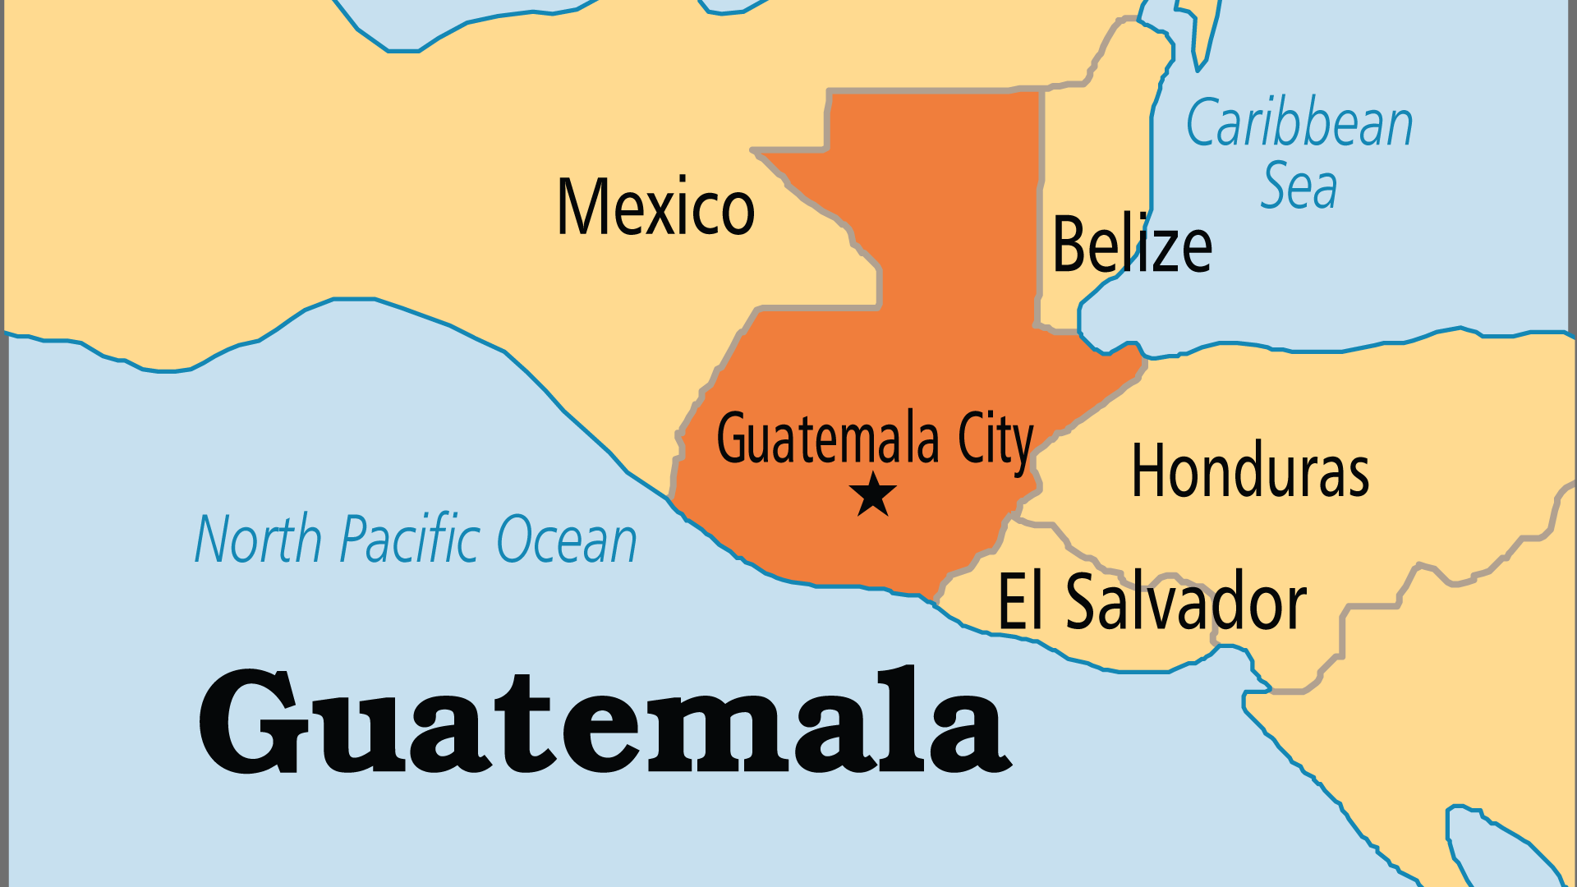
KEY STATS
Capital: | Guatemala City
Population: | 18,687,882
Official Language: | Spanish; 23 recognized Amerindian languages
Languages: | 42
Literacy Rate: | 81 %
HDI Ranking: | 135/193
% Christian: | 96.1 %
% Evangelical: | 24.4 %
% Unevangelized: | 1 %

Slide 4

FOR PRAYER
Praise God for the growth among evangelicals who now are almost 25% of the population, in 25,000 congregations! The 1976 earthquake, the pain of war, and the witness of believers and missionaries all drew many to Jesus. Growth came quickly among Pentecostals, but faith is not always deep. Many mix pagan practices and beliefs with biblical faith or follow attractive teachings on prosperity. Churches that fail to disciple new believers may lose them in the next two decades. Pray that pastors and leaders will demonstrate Christ-like humility and rise above foolish divisions and greed.

