Slide 1




Slide 2

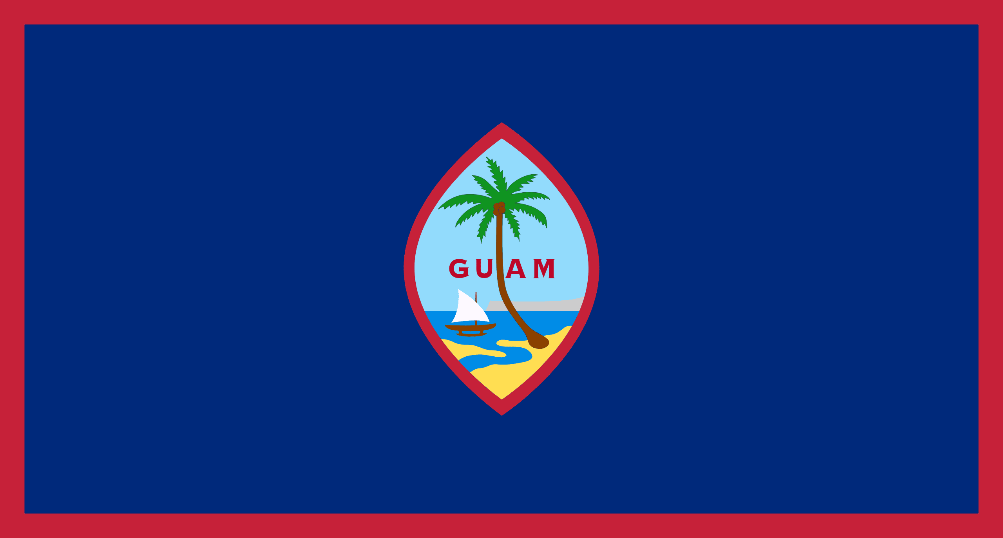
PRAYING FOR
GUAM

Slide 3
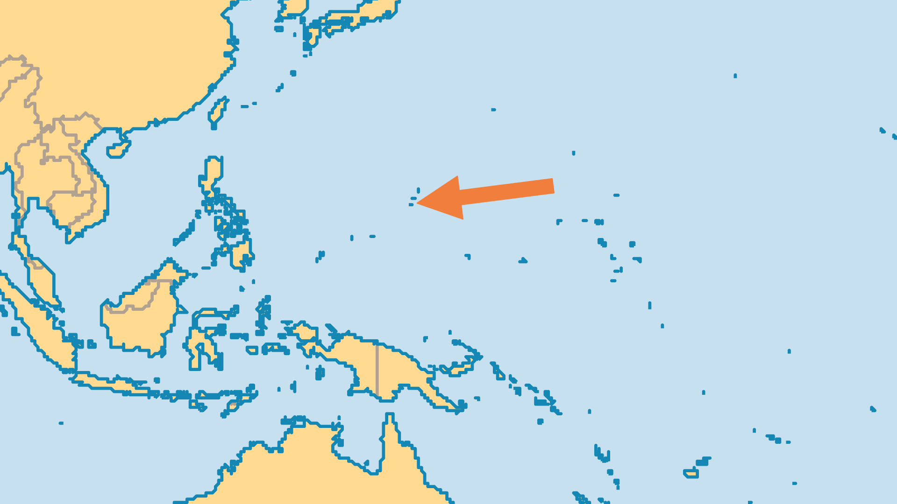
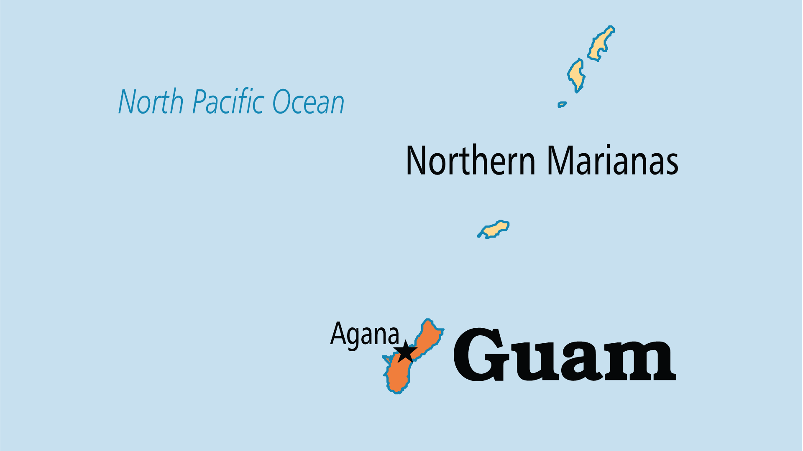
KEY STATS
Capital: | Agana
Population: | 168,999
% Urban: | 95.3 %
Pop Under 15 Yrs: | 24.1 %
Official Language: | Chamorro; English
Languages: | 8
Life Expectancy: | 76.7 yrs (72nd/236)
% Christian: | 96.7 %
% Evangelical: | 14.2 %
% Unevangelized: | 1 %

Slide 4

FOR PRAYER
Guam is the hub of Micronesia, and as such, the population is multicultural and diverse. There is spiritual and church growth among many of the immigrant communities, including the Chinese, Koreans and Filipinos. Micronesian groups have dozens of churches, although their more isolated villages and their tribal culture present an evangelistic challenge. The continued influence of cultural and animistic traditions holds back their discipleship. Also, with such ethnic and denominational variety, unity is an important issue and a need for prayer.
Want to know more? Go to www.operationworld.org

