Slide 1




Slide 2


PRAYING FOR
GUADELOUPE

Slide 3
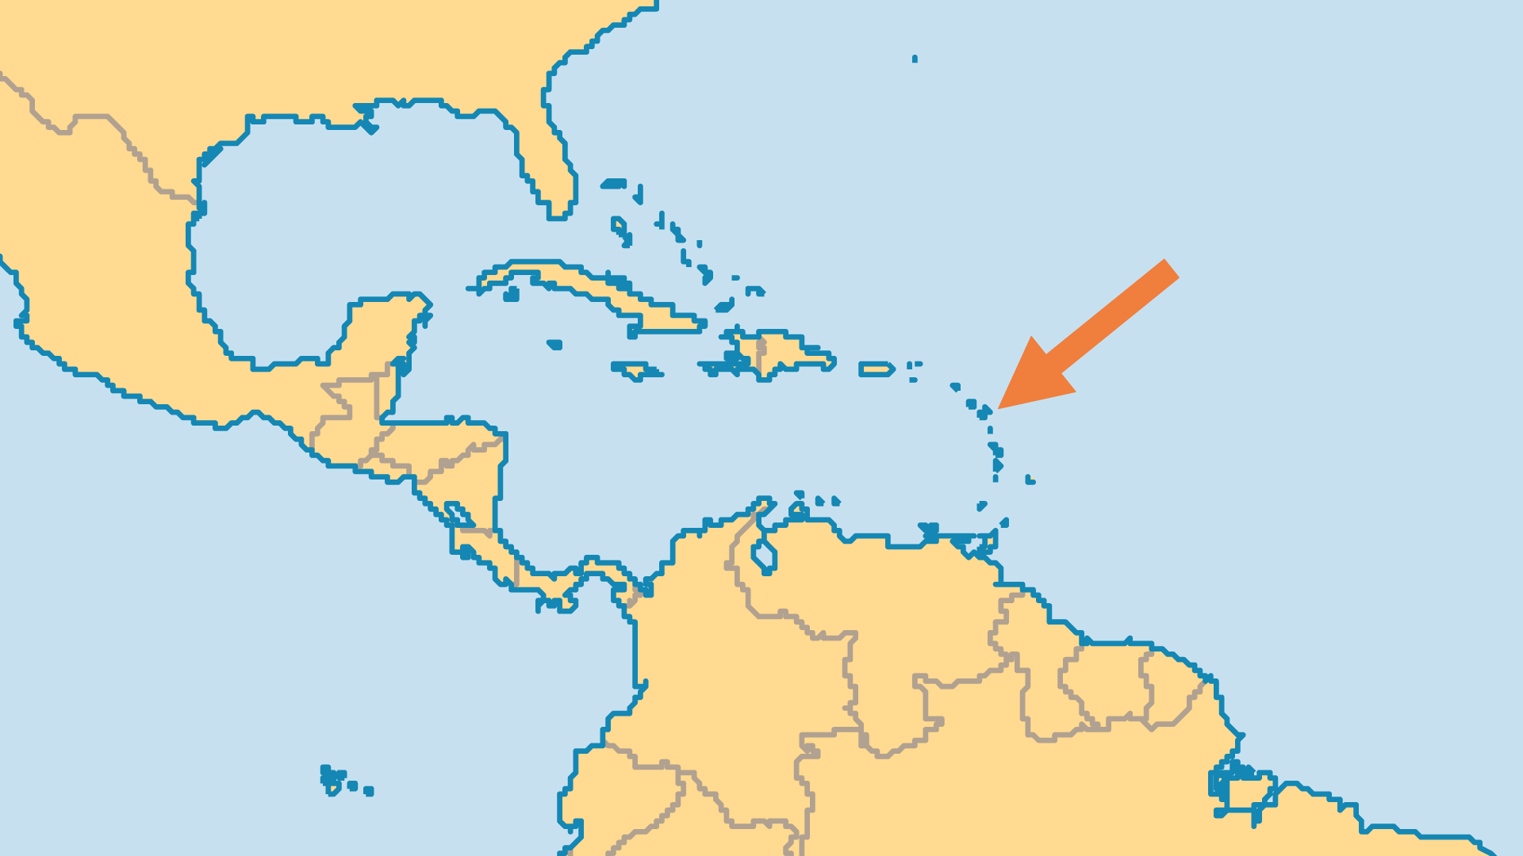
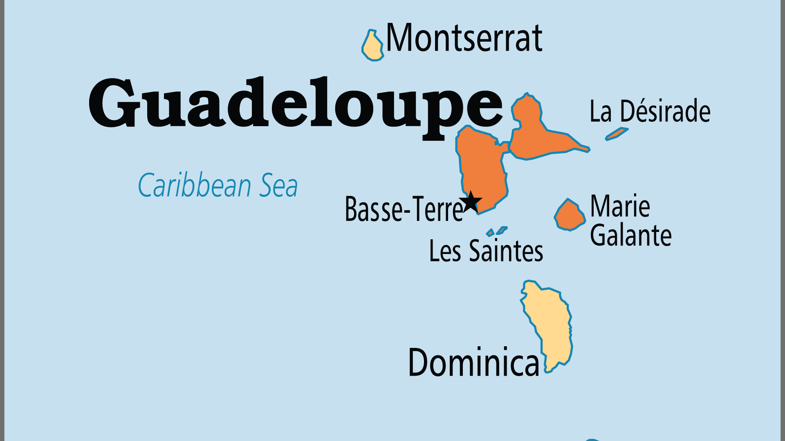
KEY STATS
Capital: | Basse- Terre
Population: | 373,791
% Urban: | 98.6 %
Official Language: | French
Life Expectancy: | 80.5 yrs (39th/236)
% Christian: | 94.1 %
% Evangelical: | 4.3 %
People Groups: | 7
% Unevangelized: | 1 %

Slide 4

FOR PRAYER
The strikes and riots of 2009, the largest in Guadeloupe's history, signified deep dissatisfaction France. Many feel like second-class citizens disadvantaged and resentful of the colonial dynamic with France and its rich white scions living on the islands. Though a settlement was reached for increased wages for many, the deeper issues of autonomy and identity continue to simmer. Historic and valid mistrust of the French government's health policies re-emerged in 2021-2022 with violent protests to its vaccine requirements. Pray for wisdom for both countries' leaders to peacefully handle issues that bring genuine long-term benefit to the people.

