Slide 1




Slide 2


PRAYING FOR
GRENADA

Slide 3
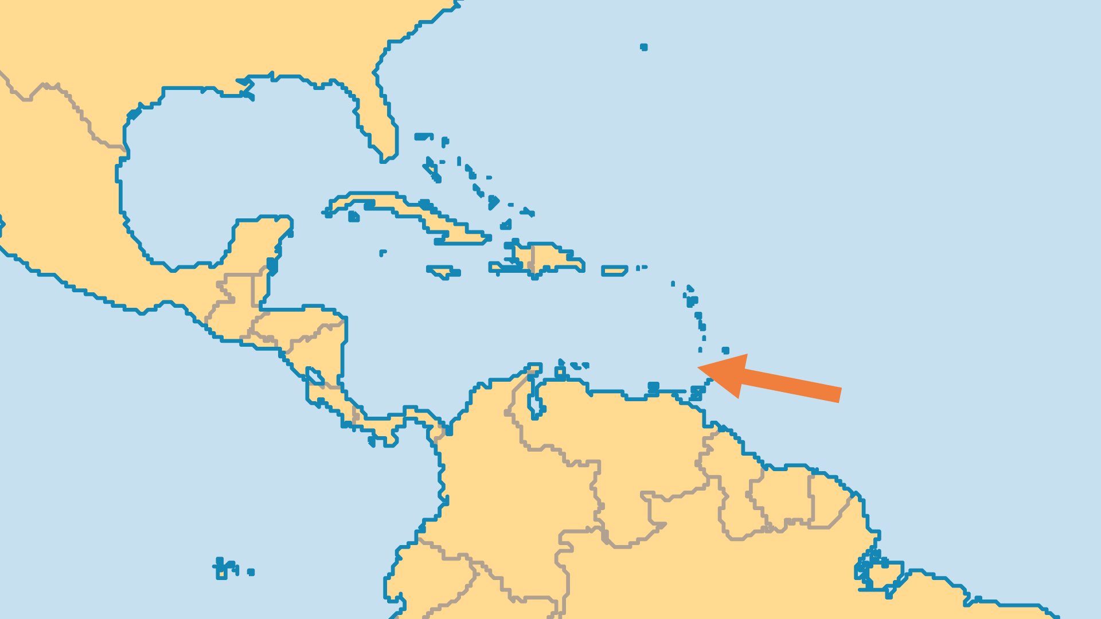
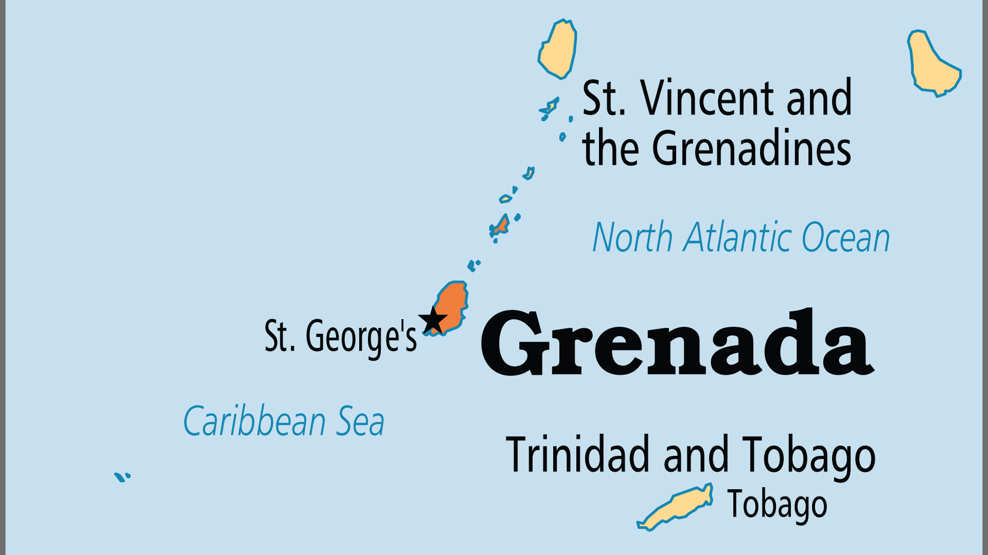
KEY STATS
Capital: | St. George's
Population: | 117,304
Official Language: | English
Languages: | 3
Life Expectancy: | 74.9 yrs (91st/236)
HDI Ranking: | 68/193
% Christian: | 93.7 %
% Evangelical: | 19.6 %
People Groups: | 6
% Unevangelized: | 1 %

Slide 4

FOR PRAYER
Hurricane Beryl's damage in 2024 was added to that from recent past hurricanes. Up to 90% of the island's buildings were destroyed or damaged. The agriculture and tourism sectors were virtually annihilated. Both sectors were rebuilt, but at the cost of crippling external debts. Some debt was restructured, but long-term solutions are still needed. Grenada heavily depends on tourism which suffered due to COVID. Pray for sustainable solutions to these challenges as hurricanes become more destructive. Pray for debt reduction or forgiveness and for Grenadians to put their faith in God above all.
Want to know more? Go to www.operationworld.org

