Slide 1




Slide 2

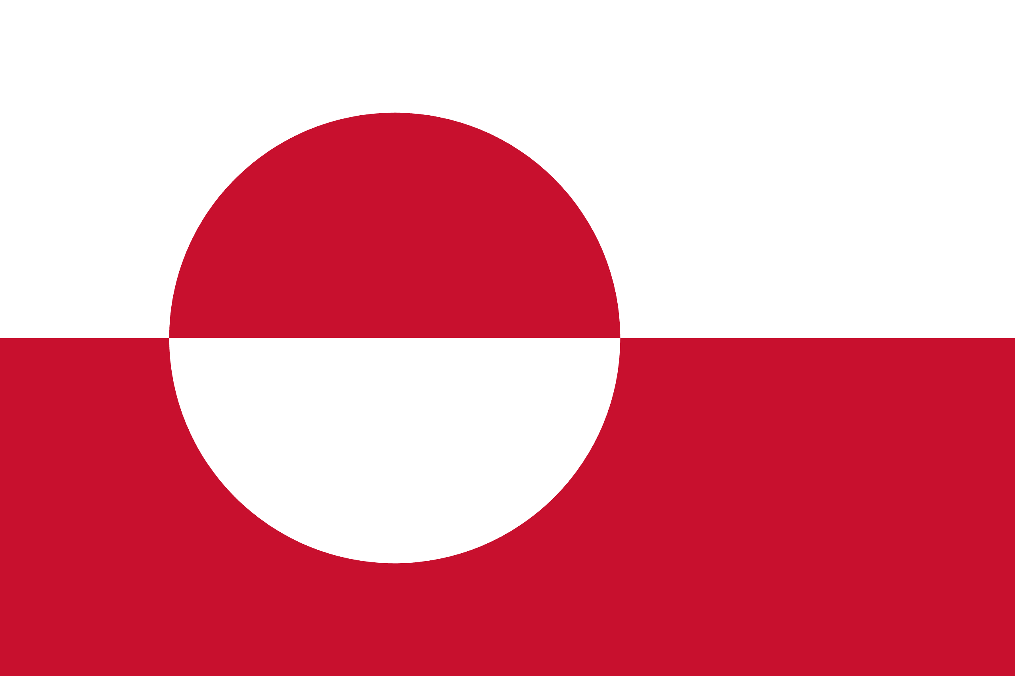
PRAYING FOR
GREENLAND

Slide 3
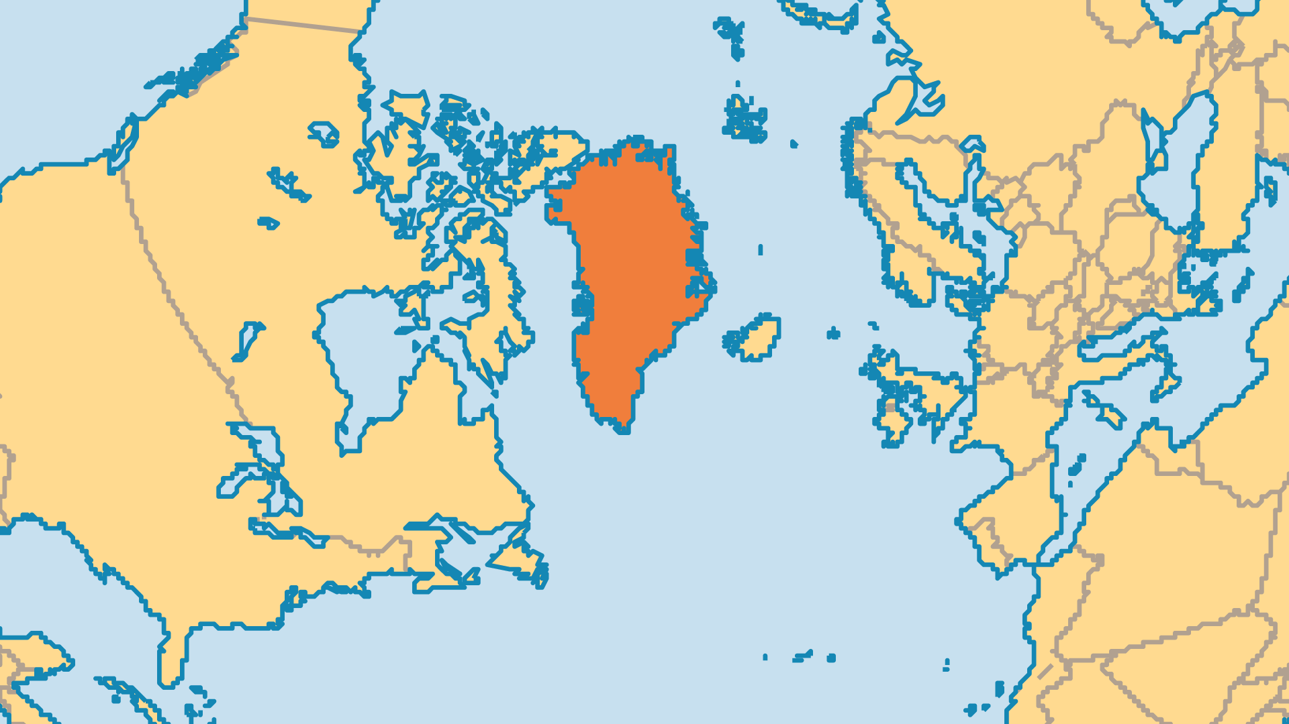
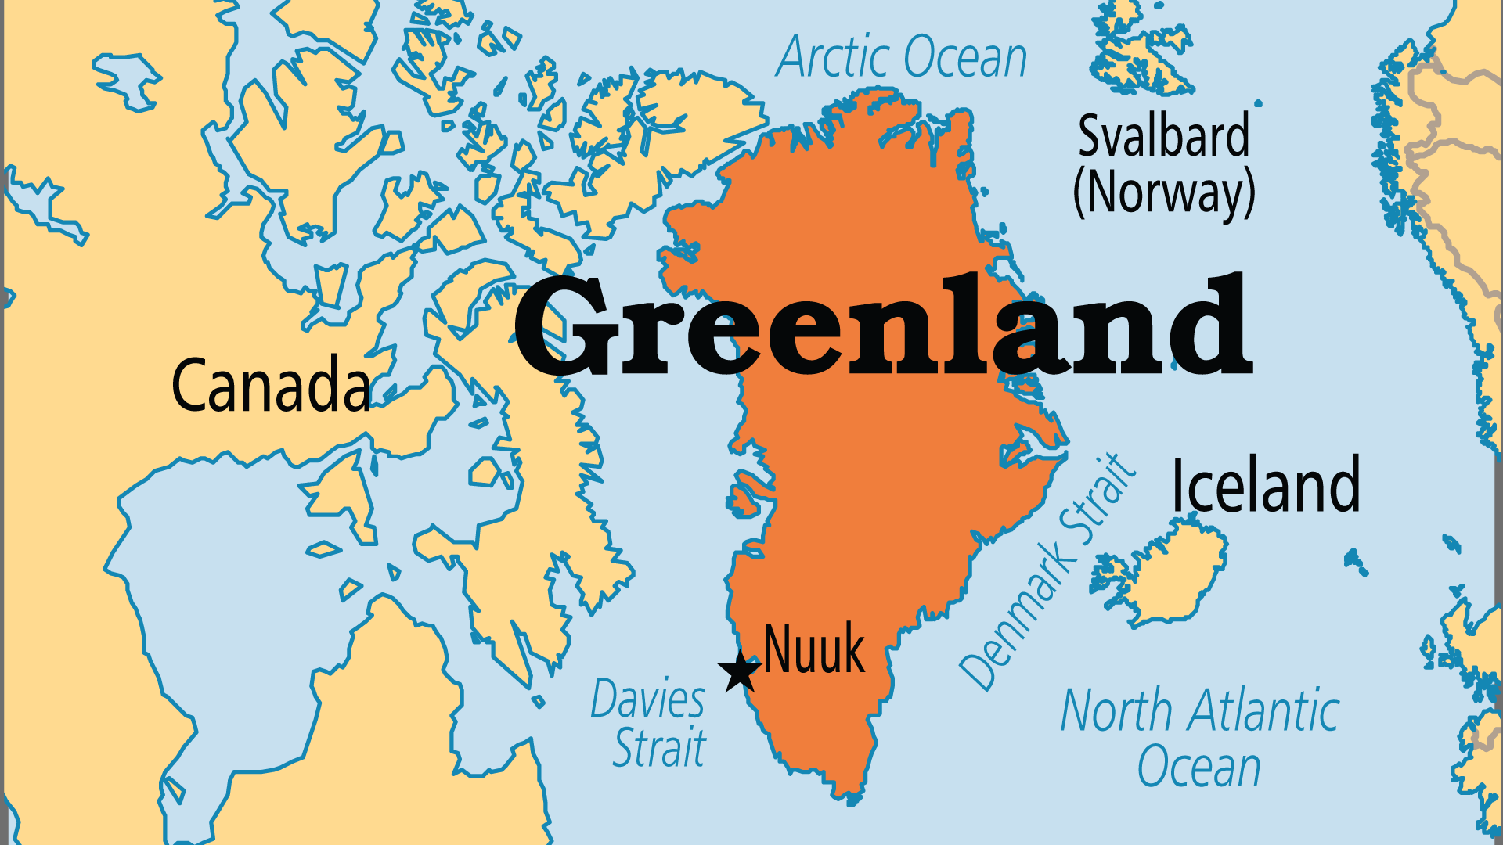
KEY STATS
Continent: | North America
Capital: | Nuuk
Population: | 55,745
% Urban: | 88.4 %
Official Language: | Inuktitut (Greenlandic)
% Christian: | 96.6 %
% Evangelical: | 4.7 %
People Groups: | 4
% Unevangelized: | 1 %

Slide 4

FOR PRAYER
Almost every settlement in Greenland has a Lutheran church - but many lack real spiritual life. Pray for renewal. Modern culture clashes with Greenland's old ways, and many now battle with immorality, sexual abuse, alcoholism, mental illness, and suicide. Some indigenous believers and foreign missionaries serve in counselling, healing, and deliverance, and see wonderful fruit by the work of the Holy Spirit. Pray for this to continue. Thank God for new airstrips that opened remote settlements for ministry.
Want to know more? Go to www.operationworld.org

