Slide 1




Slide 2

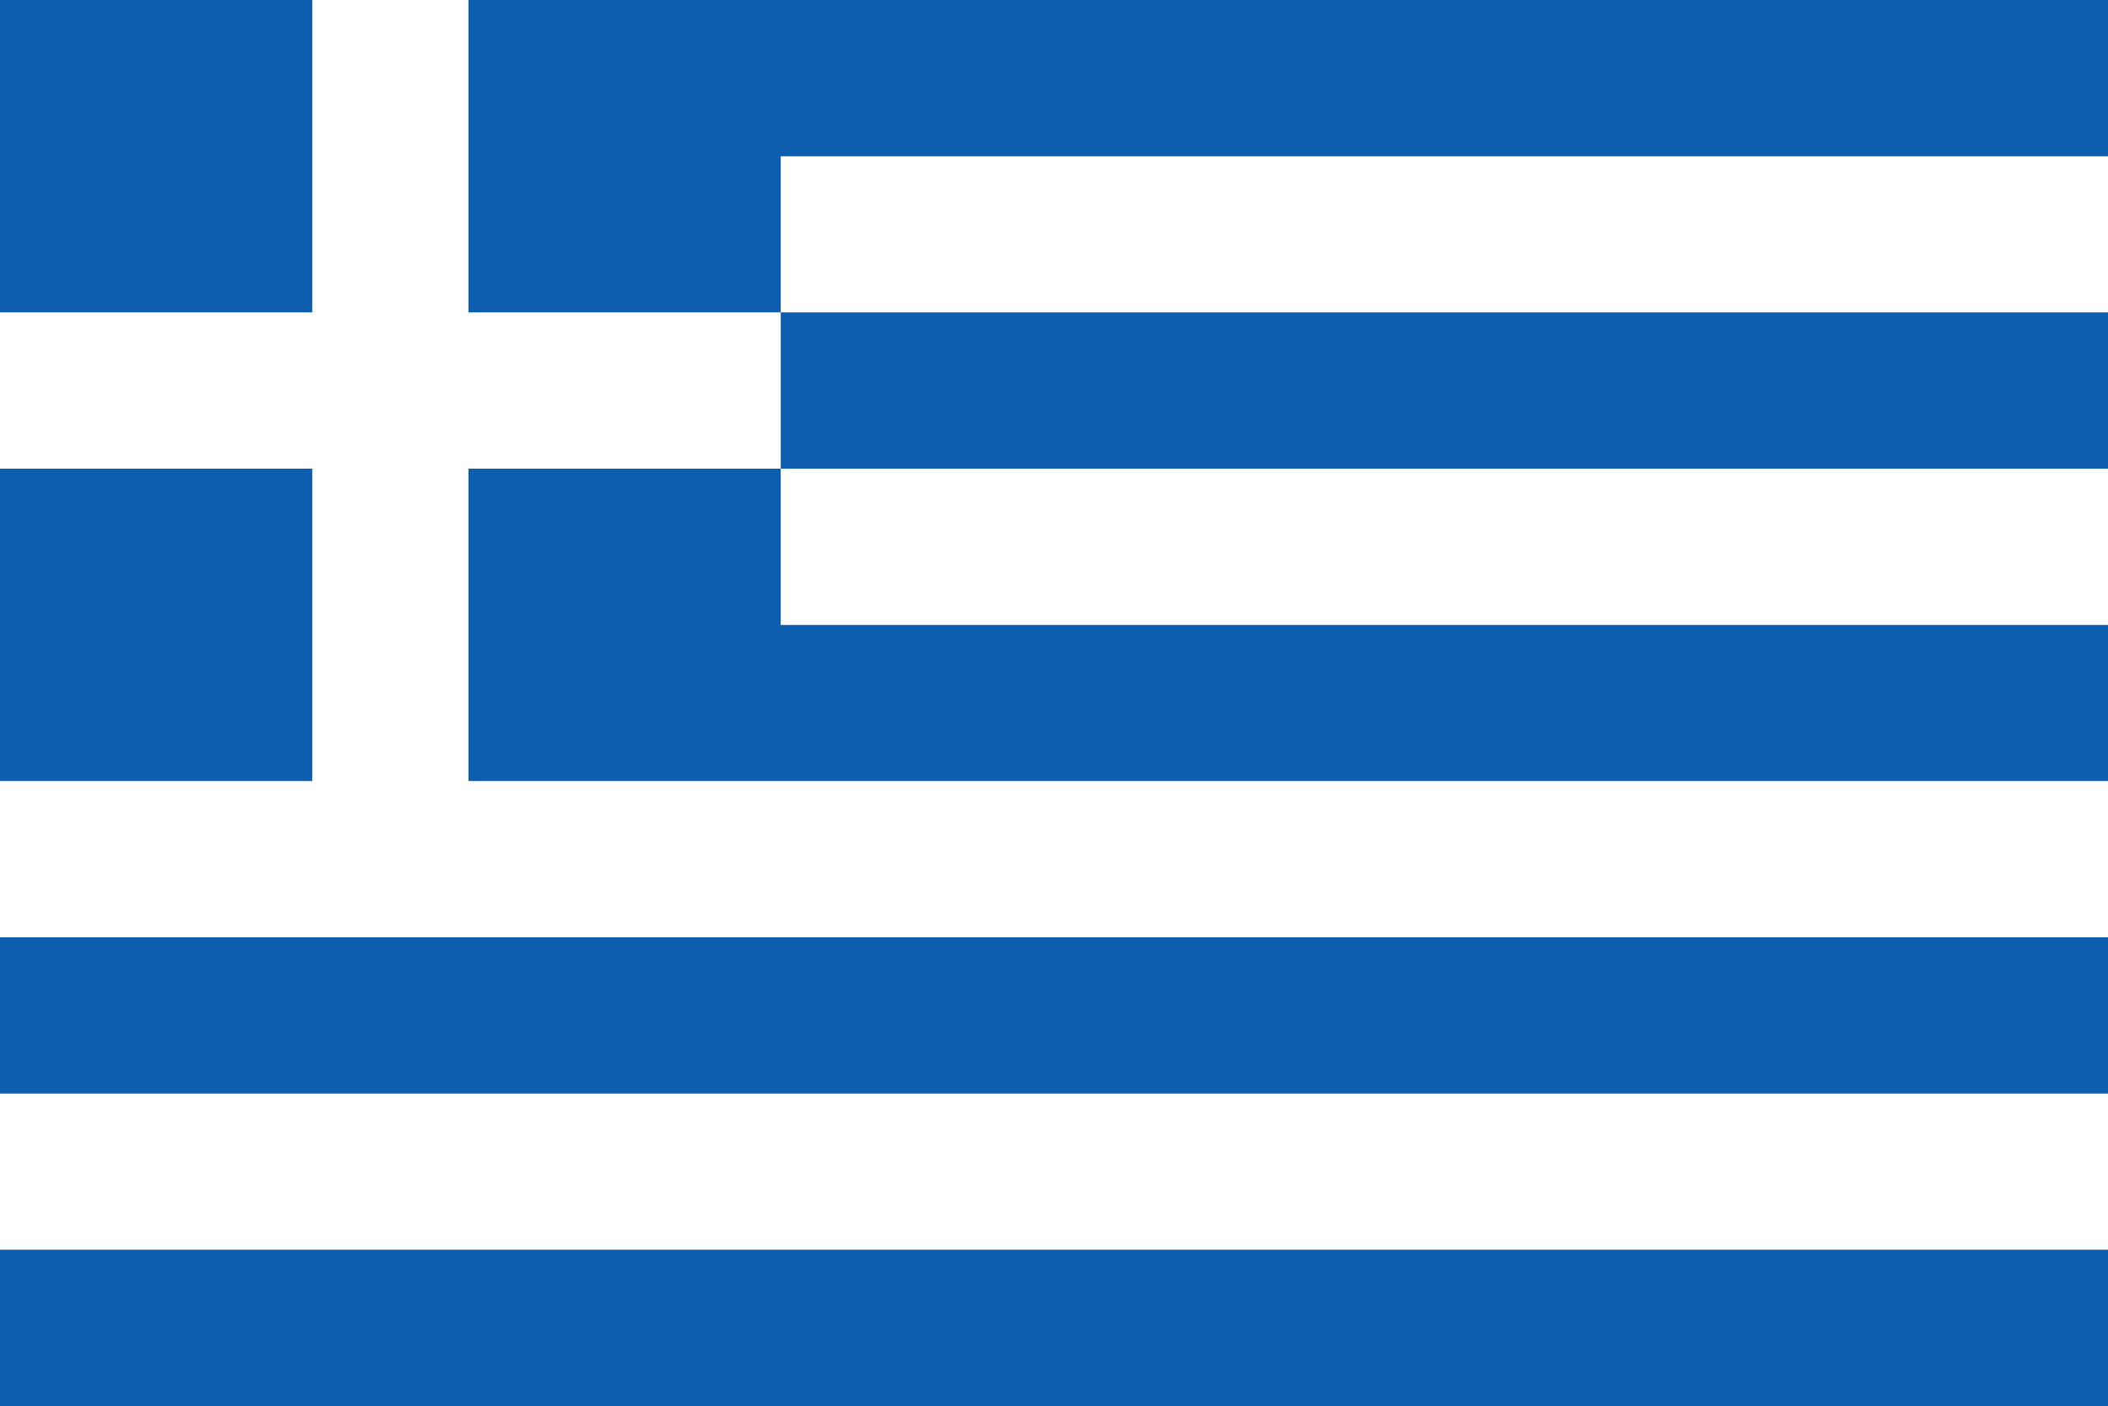
PRAYING FOR
GREECE

Slide 3
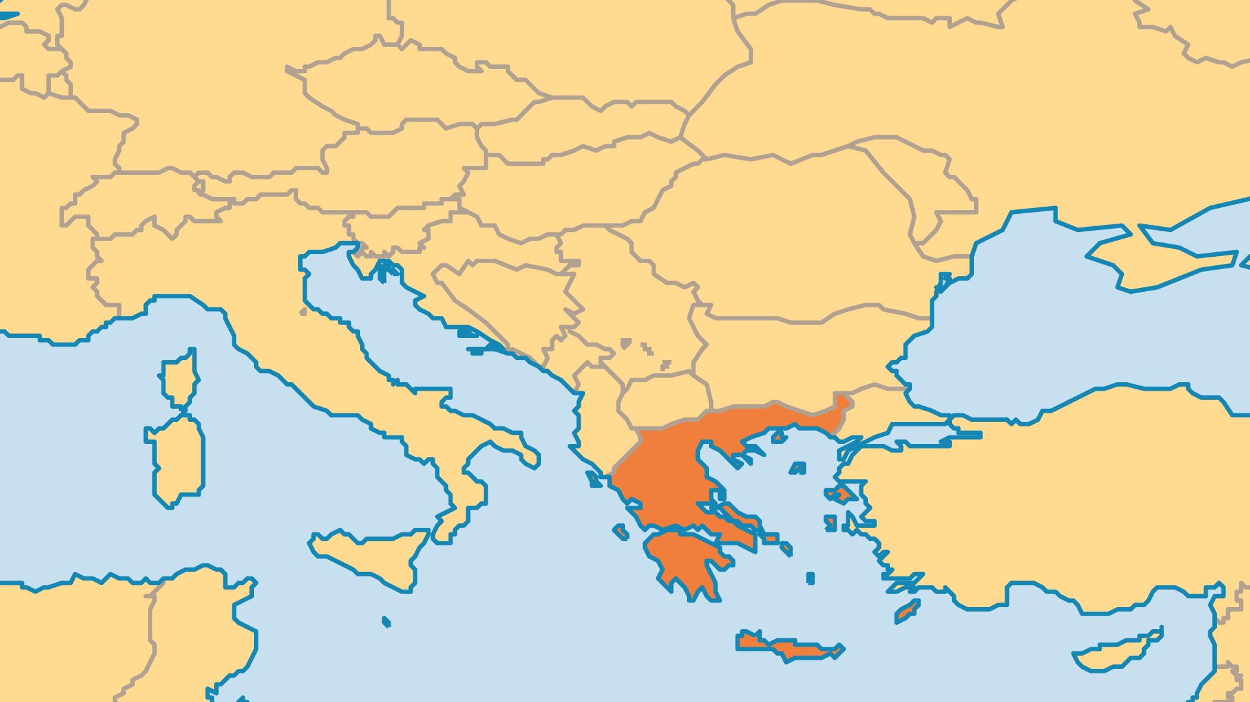
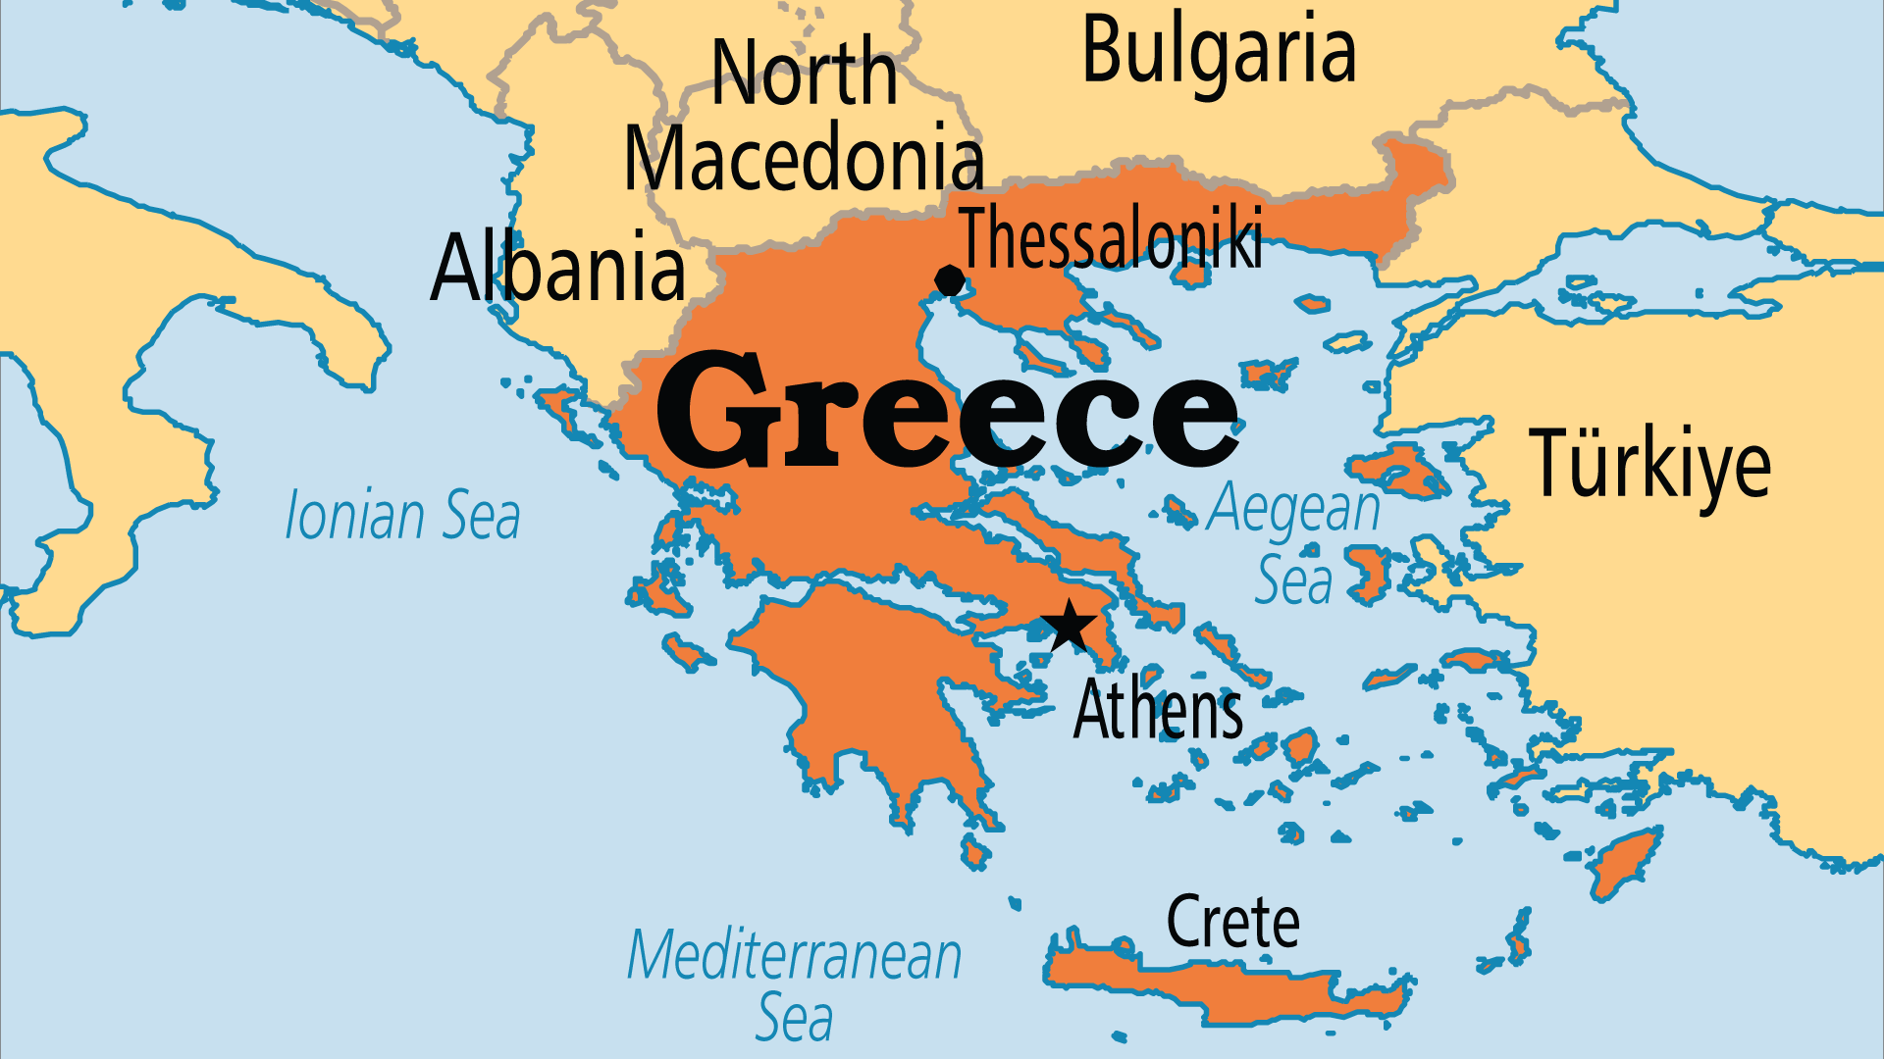
KEY STATS
Capital: | Athens
Population: | 9,938,845
% Urban: | 81.3 %
Official Language: | Greek
Languages: | 24
Literacy Rate: | 98 %
Life Expectancy: | 80.1 yrs (45th/236)
HDI Ranking: | 33/193
% Christian: | 91.5 %
% Evangelical: | 0.4 %
% Unevangelized: | 3 %

Slide 4

FOR PRAYER
Greece's economic and social problems of the 21st Century remain the cause of much uncertainty about the future. The economic meltdown (known as "The Crisis"), and the recession, austerity policies, protests and riots that followed, shook the country's foundations. Although there has been a significant degree of recovery, the fallout from these issues - compounded by Covid's impact - will shape Greece's politics and economy for years to come. Pray that this difficult time might drive the nation to cry out to God, and to rediscover the Christian faith which so shaped Greece for so many centuries.

Slide 5
FOR PRAYER
Greece was the first European country to be evangelized (Acts 16:10), but Christianity is now mostly a cultural expression. Less than 3% of the population regularly attend church. Evangelical churches represent less than 0.5% of the population, including all non-Greek evangelicals. The Macedonian call to evangelize is just as valid today.
Want to know more? Go to www.operationworld.org

