Slide 1




Slide 2

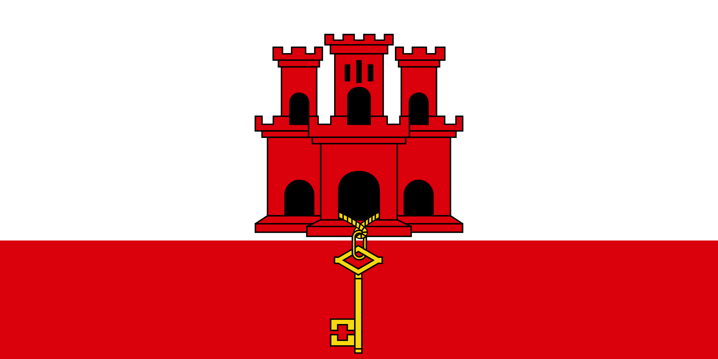
PRAYING FOR
GIBRALTAR

Slide 3
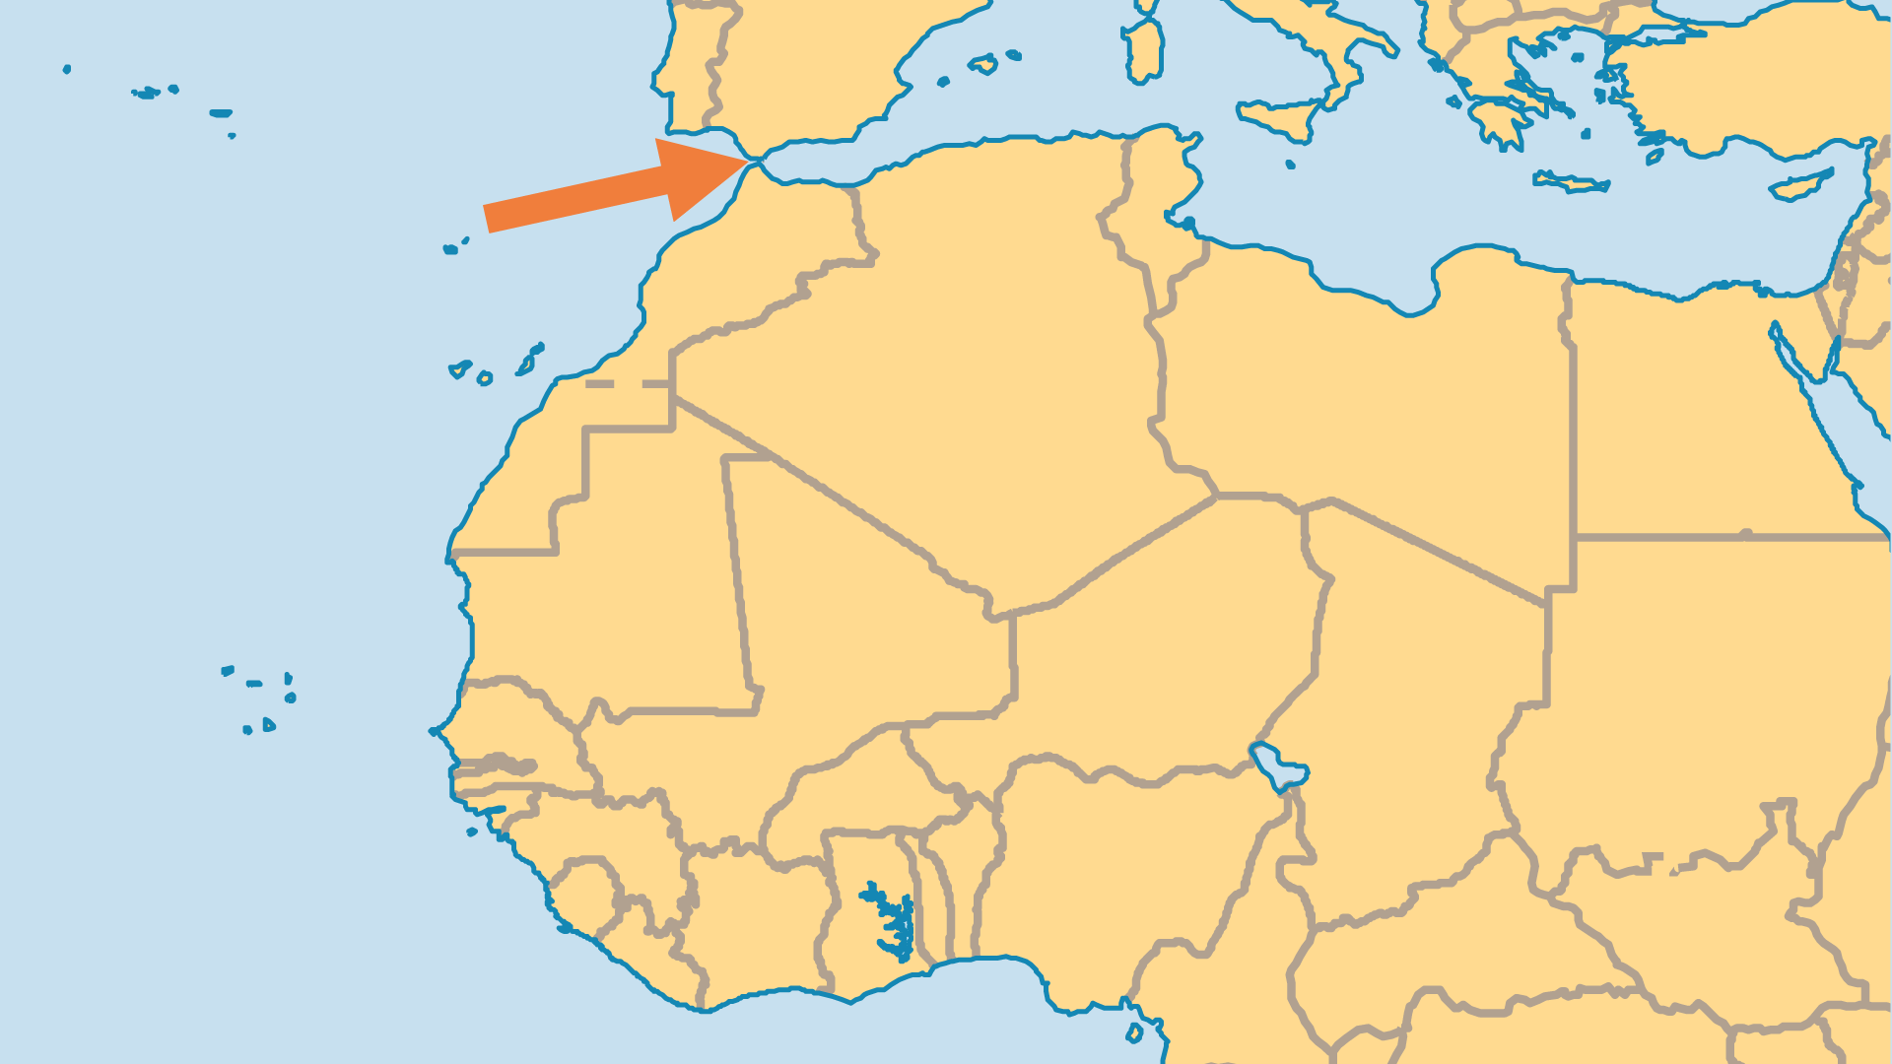
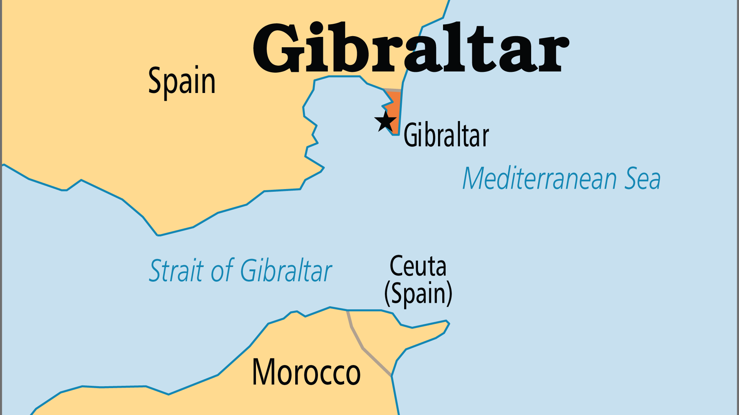
KEY STATS
Capital: | Gibraltar
Population: | 40,126
% Urban: | 100 %
Official Language: | English and Spanish
% Christian: | 84.8 %
% Evangelical: | 2.9 %
People Groups: | 6
Least Reached People Groups: | 3
% Unevangelized: | 5 %

Slide 4

FOR PRAYER
Gibraltar (34,000) is a British overseas territory since its capture in 1704, but self-governing since 2007. Most of the population are Catholic, but other denominations have churches. Evangelicals/charismatics have small numbers, but grow. Significant numbers of Moroccans work here, as well as Jewish and Hindu communities. Gibraltar has a good position for outreach to the region (southern Spain and North Africa), as well as to locals, immigrants, and foreign tourists. Pray that local congregations will gain vision for outreach!
Want to know more? Go to www.operationworld.org

