Slide 1




Slide 2

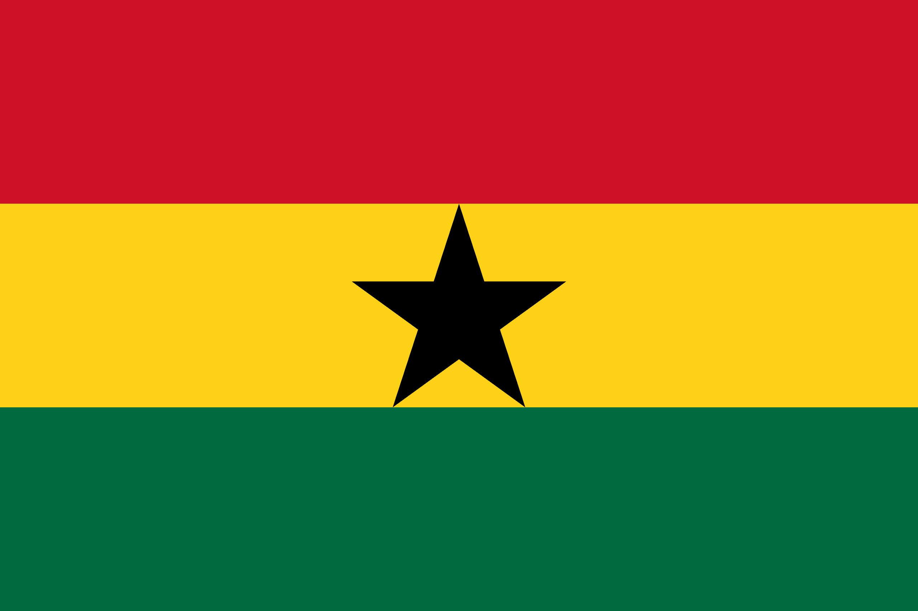
PRAYING FOR
GHANA

Slide 3
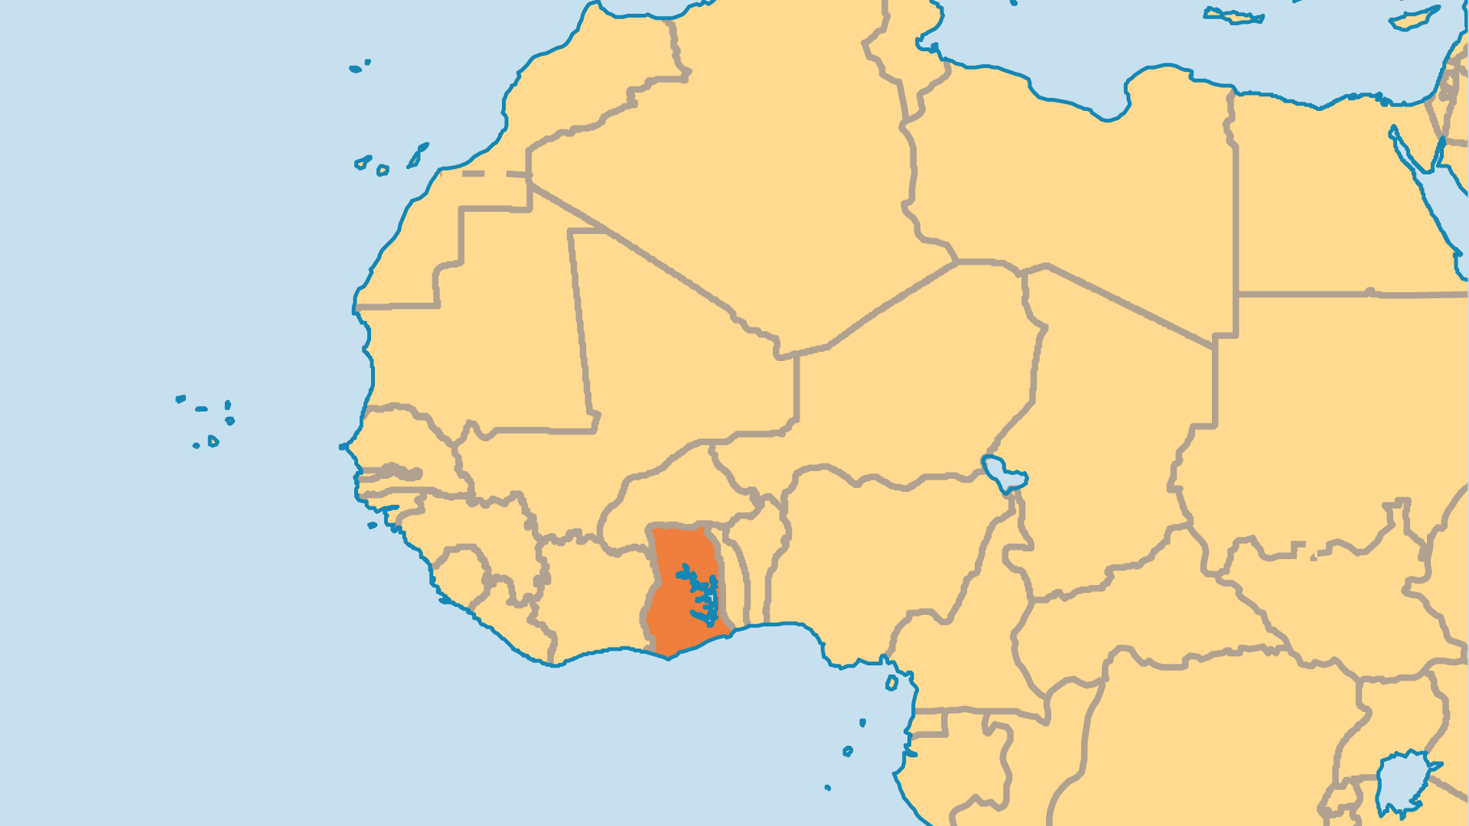
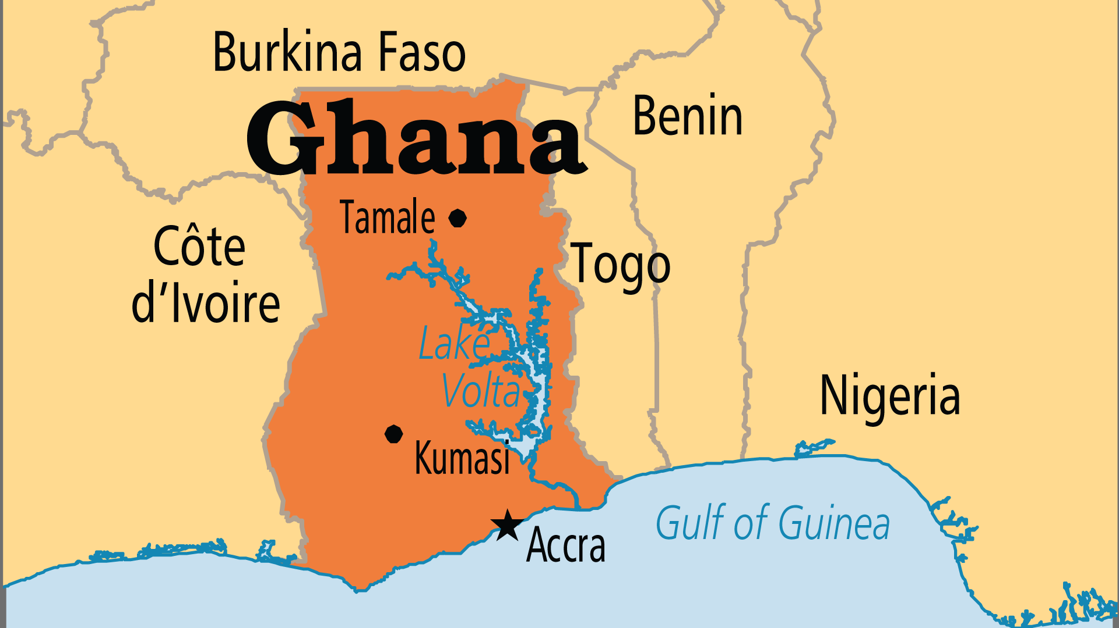
KEY STATS
Capital: | Accra
Population: | 35,064,273
% Urban: | 60.5 %
Pop Under 15 Yrs: | 37.4 %
Official Language: | English
Languages: | 84
HDI Ranking: | 133/193
% Christian: | 63.4 %
% Evangelical: | 24.2 %
People Groups: | 111
% Unevangelized: | 6 %

Slide 4

FOR PRAYER
Ghana has multiple ethnic groups and faiths, but it remains largely peaceful. Praise God! The education system and constitution brought together all ethnicities, and helped build a stable democracy. Almost half of Ghana's college-educated citizens live abroad. This slows development and prosperity at home. Pray that government leaders might seek guidance from God, and not from human philosophies or the spirits.
Want to know more? Go to www.operationworld.org

Slide 5
FOR PRAYER
Ghana enjoys a rich Christian tradition! Many newer churches emerged, and many traditional denominations have a vibrant spiritual life. When churches multiply quickly, doctrines can become confused. Ghana has the blessing of many training institutions. Pray for mature leaders for the Church. 63% of Ghanaians call themselves Christian, but only about 10% attend church regularly. Traditional African practices present the greatest challenge to Christians. Pray for a clear break from all bondage to charms and the occult, and pray for true liberty in Jesus.

