Slide 1




Slide 2


PRAYING FOR
GEORGIA

Slide 3
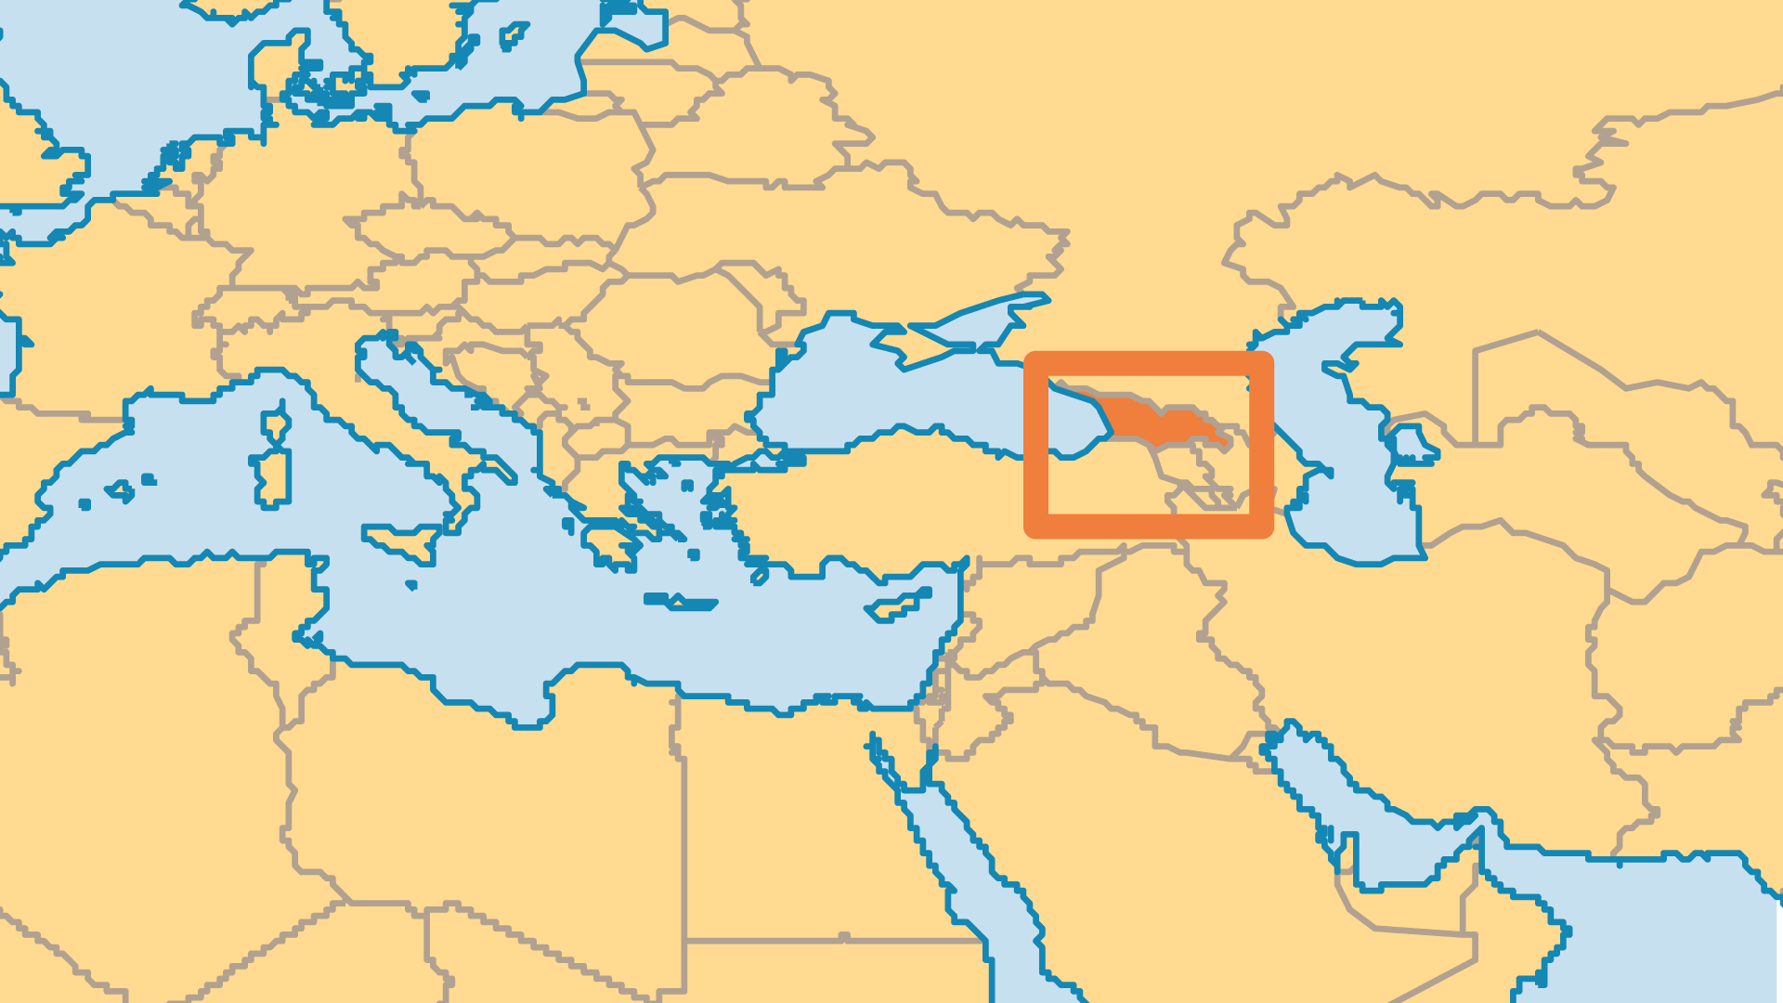
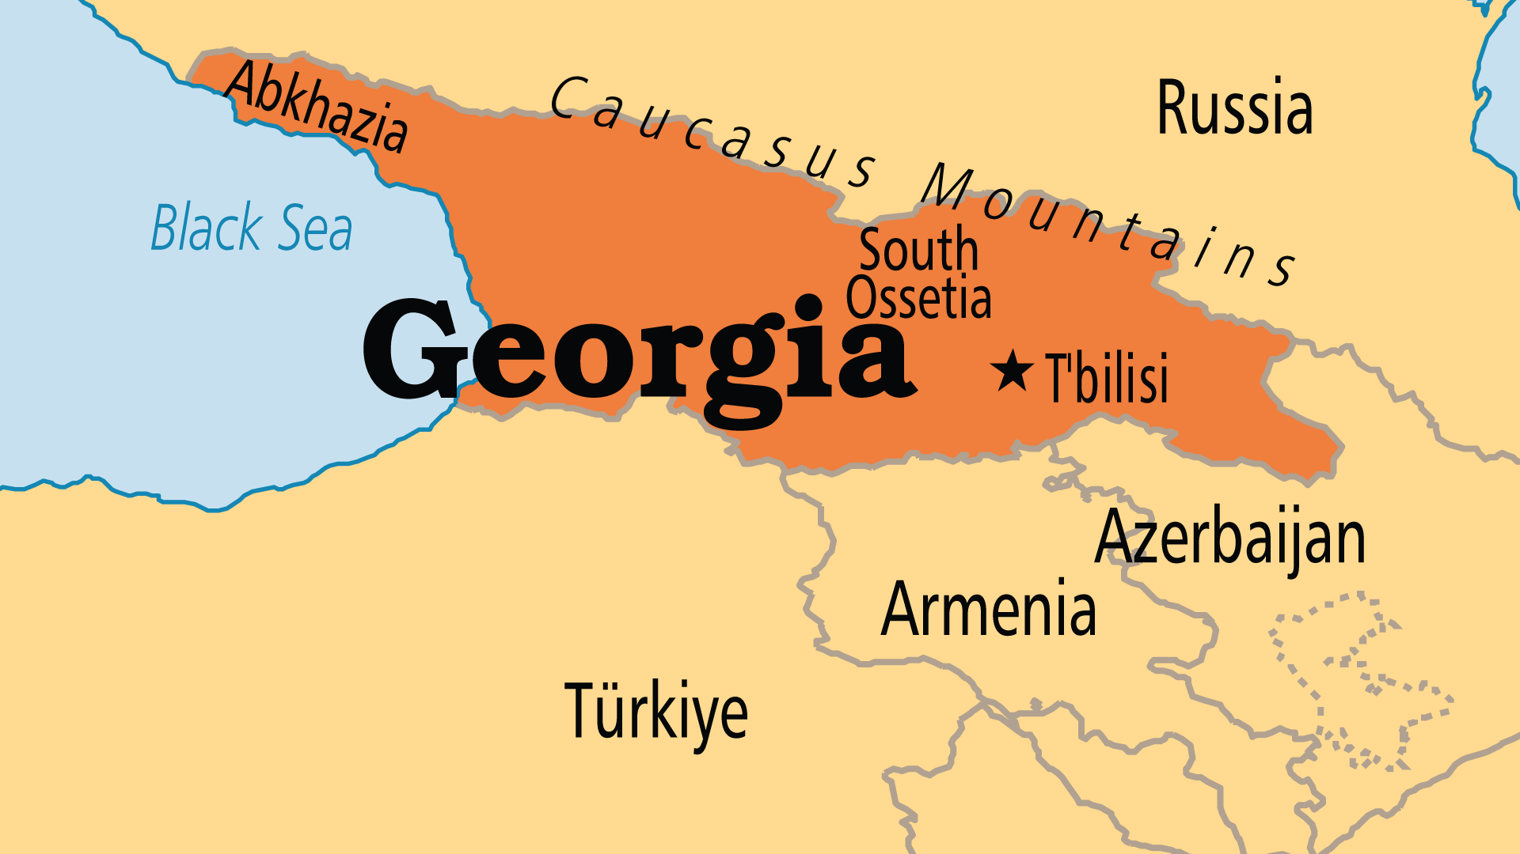
KEY STATS
Capital: | T'bilisi
Population: | 3,806,671
% Urban: | 59.9 %
Official Language: | Georgian
Languages: | 25
Literacy Rate: | 99 %
% Christian: | 78.7 %
% Evangelical: | 1.5 %
People Groups: | 38
Least Reached People Groups: | 16
% Unevangelized: | 6 %

Slide 4

FOR PRAYER
Georgia has, for the most part, enjoyed positive social, economic, and political changes since the end of the USSR. Openness to spirituality and Christianity in particular increased greatly in the early days of independence. Russian troops briefly occupied much of the country in the August War of 2008. As a result, the Abkhazia and South Ossetia regions now function as de facto independent republics (supported by Russia). Being Russia's neighbour is not easy. Georgia is currently experiencing a deep fissure between pro-Russian and pre-EU groups. Pray that Georgia's national progress might include not just economic and human development, but spiritual development also.

