Slide 1




Slide 2


PRAYING FOR
THE GAMBIA

Slide 3
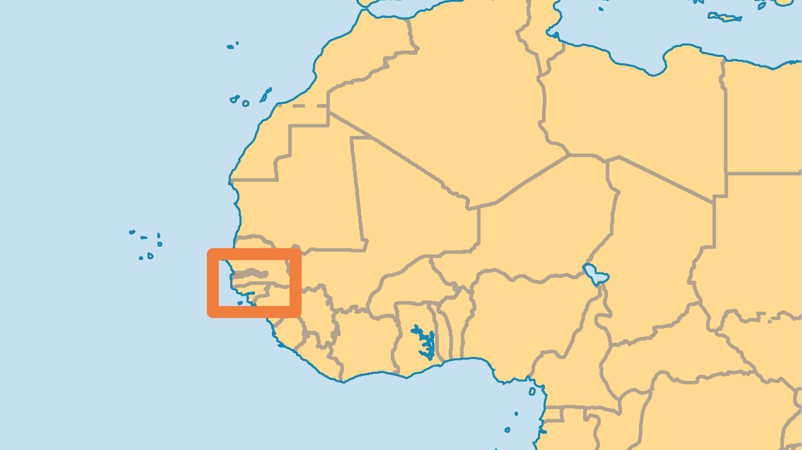
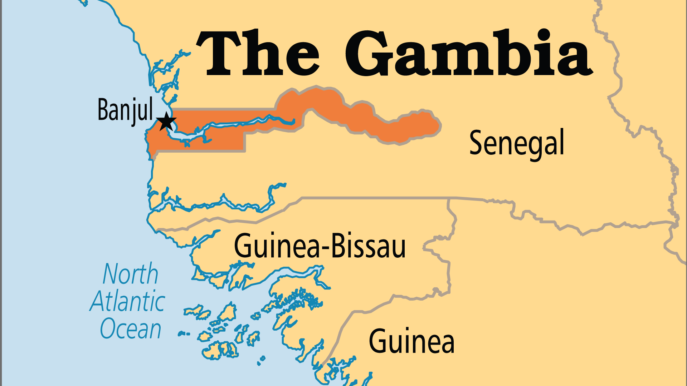
KEY STATS
Capital: | Banjul
Population: | 2,822,093
% Urban: | 65.7 %
Official Language: | English
Languages: | 23
HDI Ranking: | 174/193
% Christian: | 4.5 %
% Evangelical: | 0.8 %
Largest Religion: | Muslim
% Largest Religion: | 89.5 %
% Unevangelized: | 55 %

Slide 4

FOR PRAYER
Thank God for the mostly friendly relations between Muslims and Christians in Gambia. Christians have more religious freedom here than in most Muslim countries. But most Christian work has been in the Greater Banjul area (coast). Few reach out to the Muslim majority, especially to those who live upriver in the less-developed inland area. Pastors who serve inland struggle to maintain financial support. Pray for continued religious freedom and peace. Pray for Gambians to have a vision to reach their own nation, and for creative ways to support those who move into more isolated areas.
Want to know more? Go to www.operationworld.org

