Slide 1




Slide 2

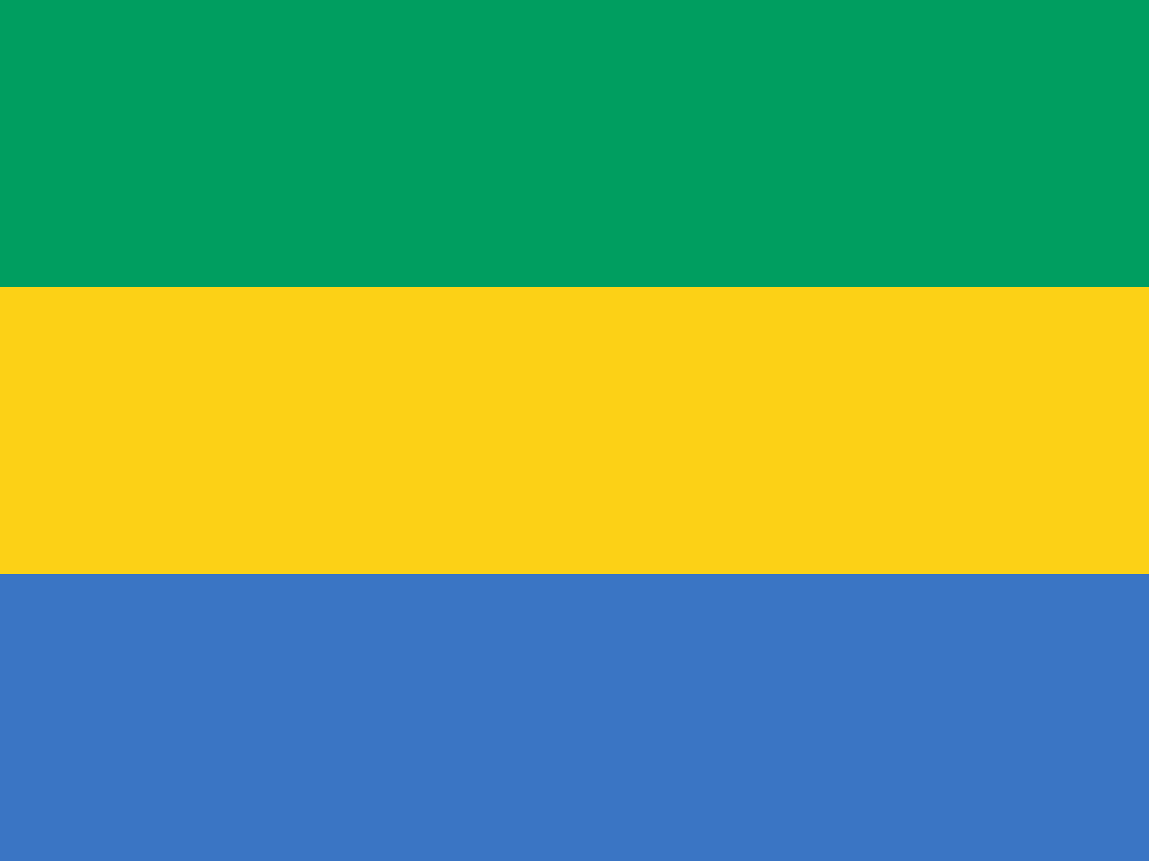
PRAYING FOR
GABON

Slide 3
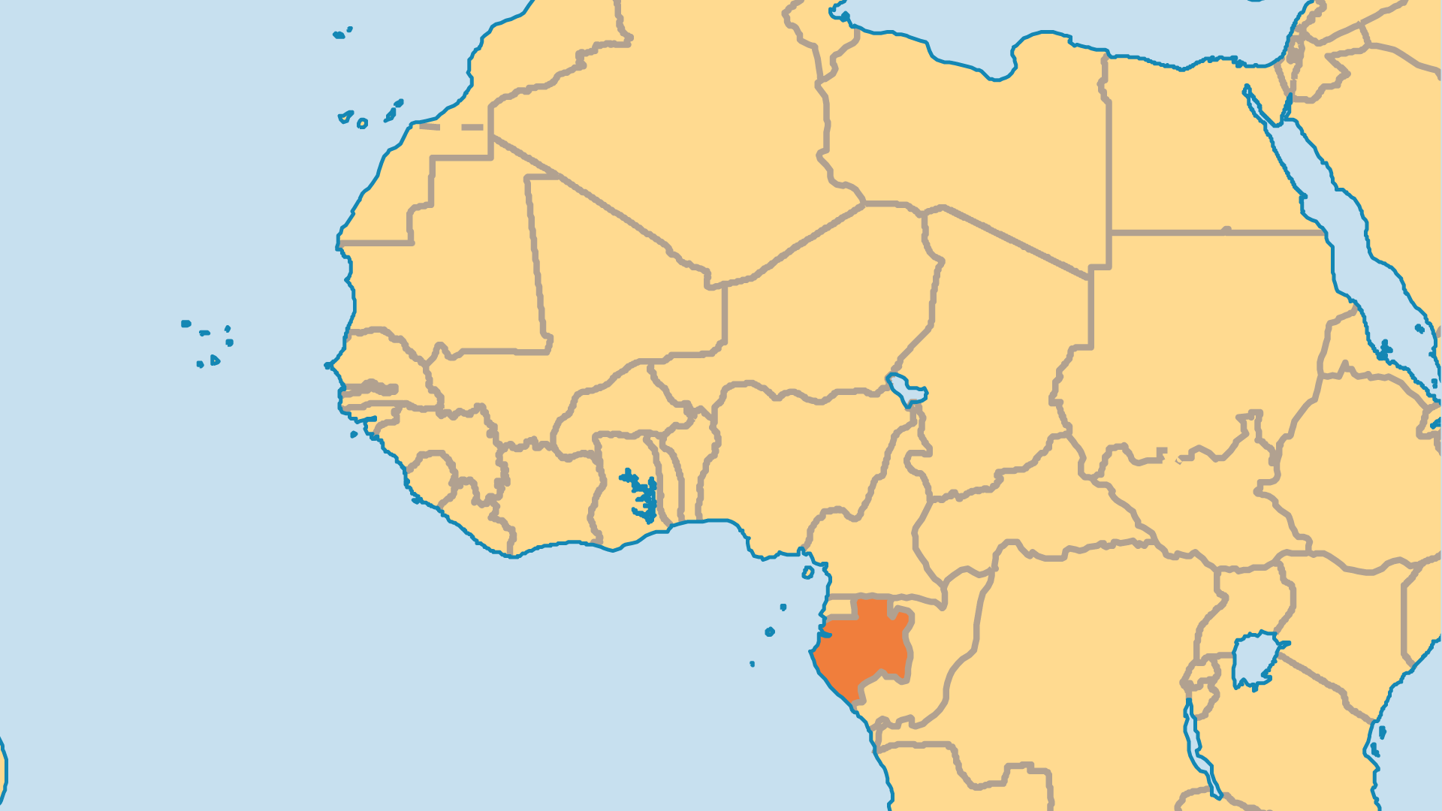
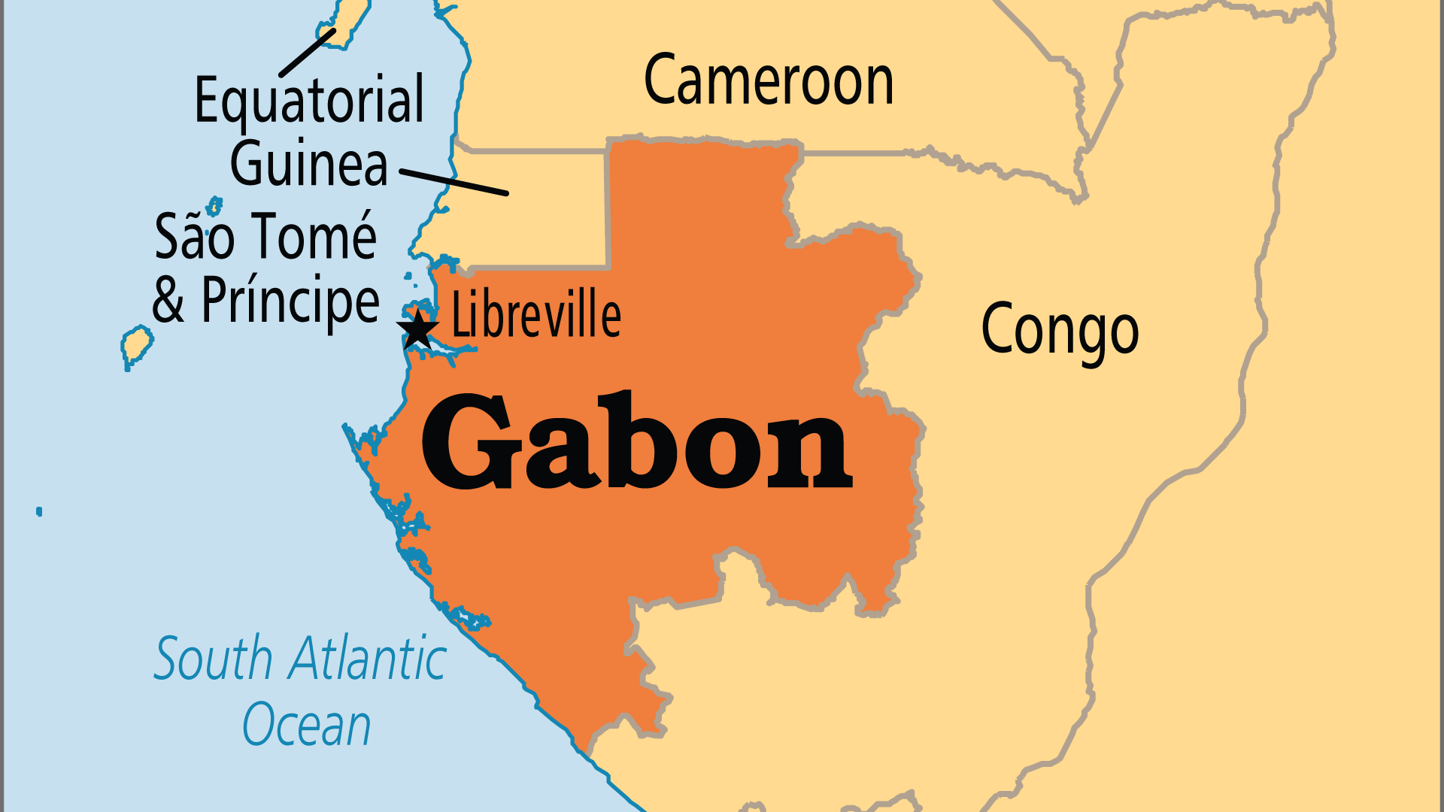
KEY STATS
Capital: | Libreville
Population: | 2,593,130
% Urban: | 91.6 %
Pop Under 15 Yrs: | 37.2 %
Official Language: | French
Languages: | 43
HDI Ranking: | 112/193
% Christian: | 79.4 %
% Evangelical: | 12.7 %
People Groups: | 51
% Unevangelized: | 5 %

Slide 4

FOR PRAYER
Spiritist beliefs and practices lie beneath the surfaces of Catholicism, other Christian groups, and Islam. Many Gabonese still use charms, hallucinogenic drugs, and ancestral spirits, and go to medicine men. Some leaders of the government, the police, and the army participate in nighttime rituals that use witchcraft and black magic. Christians who do not participate can be refused academic or professional opportunities. Pray for followers of Jesus to remain faithful to Him alone, and for such faith to spread the Gospel even further.
Want to know more? Go to www.operationworld.org

