Slide 1




Slide 2

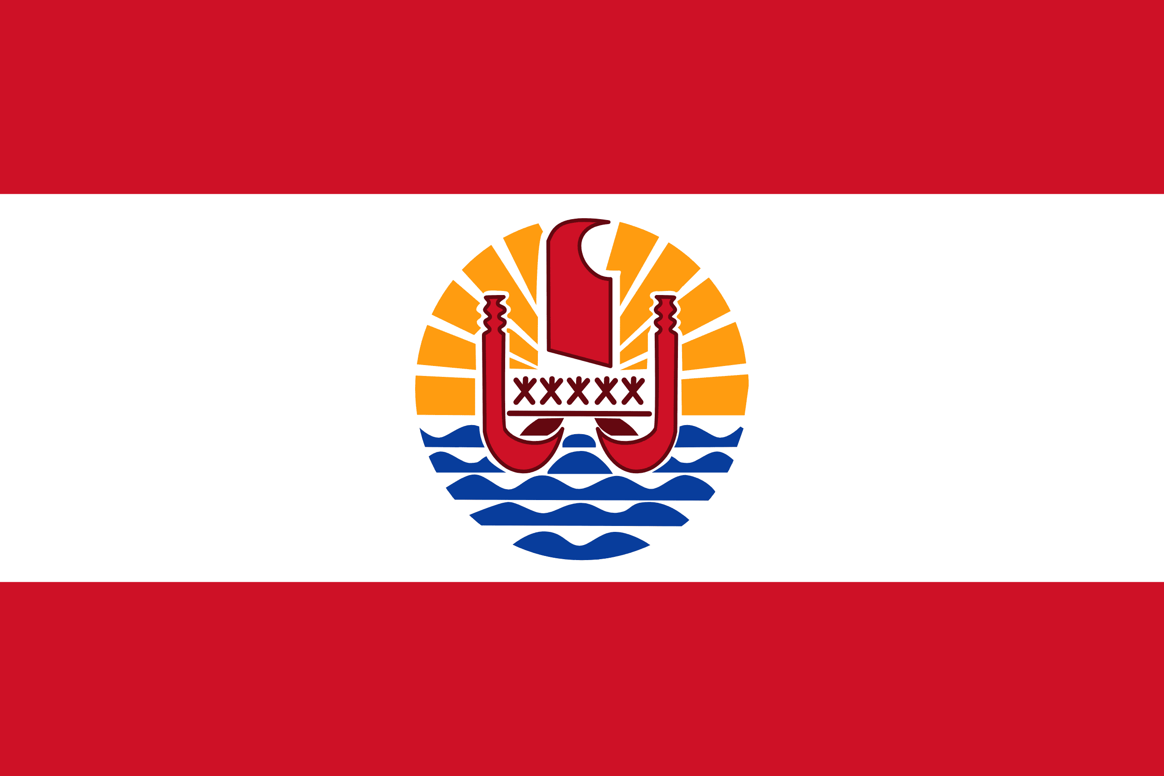
PRAYING FOR
FRENCH POLYNESIA

Slide 3
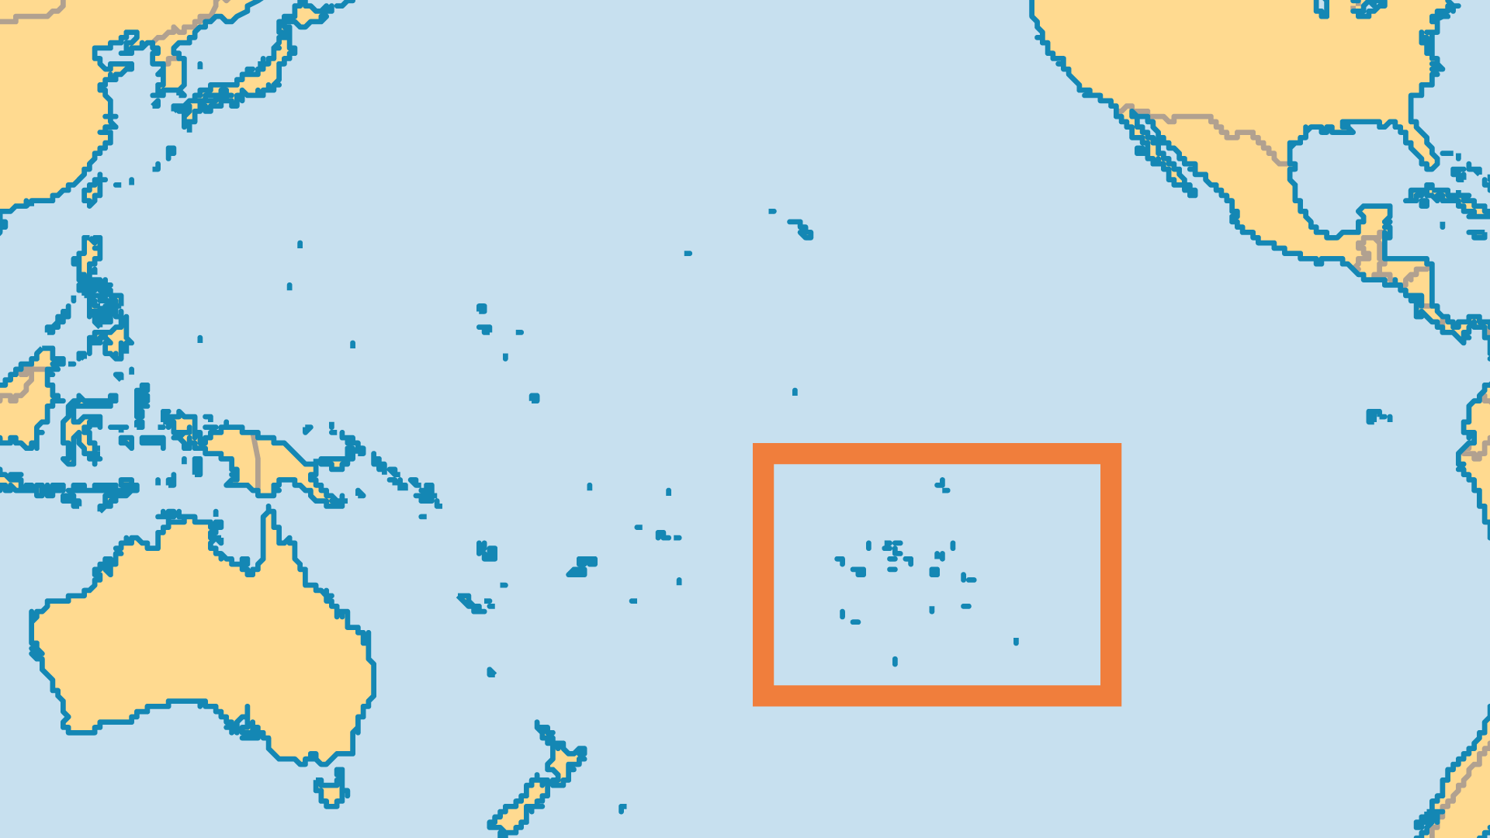
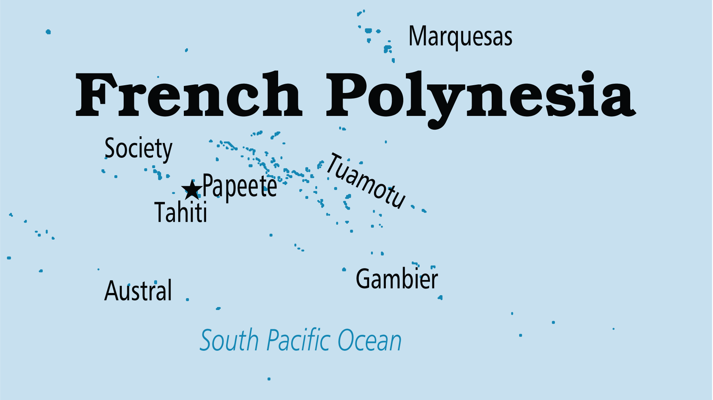
KEY STATS
Capital: | Papeete
Population: | 282,465
Official Language: | French and Tahitian
Languages: | 11
Literacy Rate: | 98 %
% Christian: | 92.3 %
% Evangelical: | 7.2 %
People Groups: | 13
% Unevangelized: | 1 %

Slide 4

FOR PRAYER
Those with a vital personal faith are now rare. As a result, there is a reversion to the bondage of pagan occultism and a multiplication of syncretistic and foreign sects, especially two forms of Mormonism. Pray for a spiritual revolution to take place among the many nominal Catholic and Protestant Christians.
Want to know more? Go to www.operationworld.org

