Slide 1




Slide 2

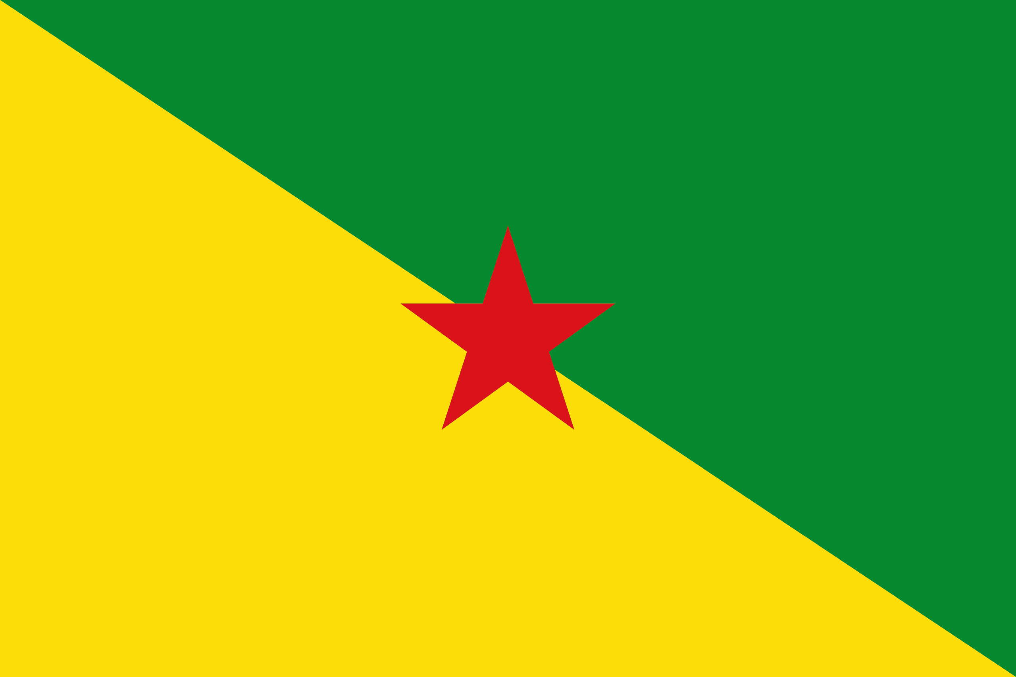
PRAYING FOR
FRENCH GUIANA

Slide 3
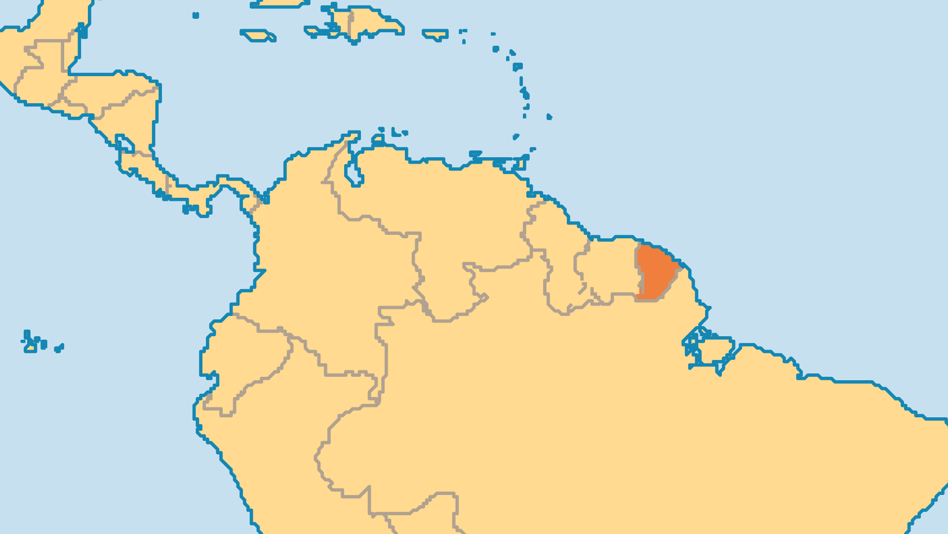
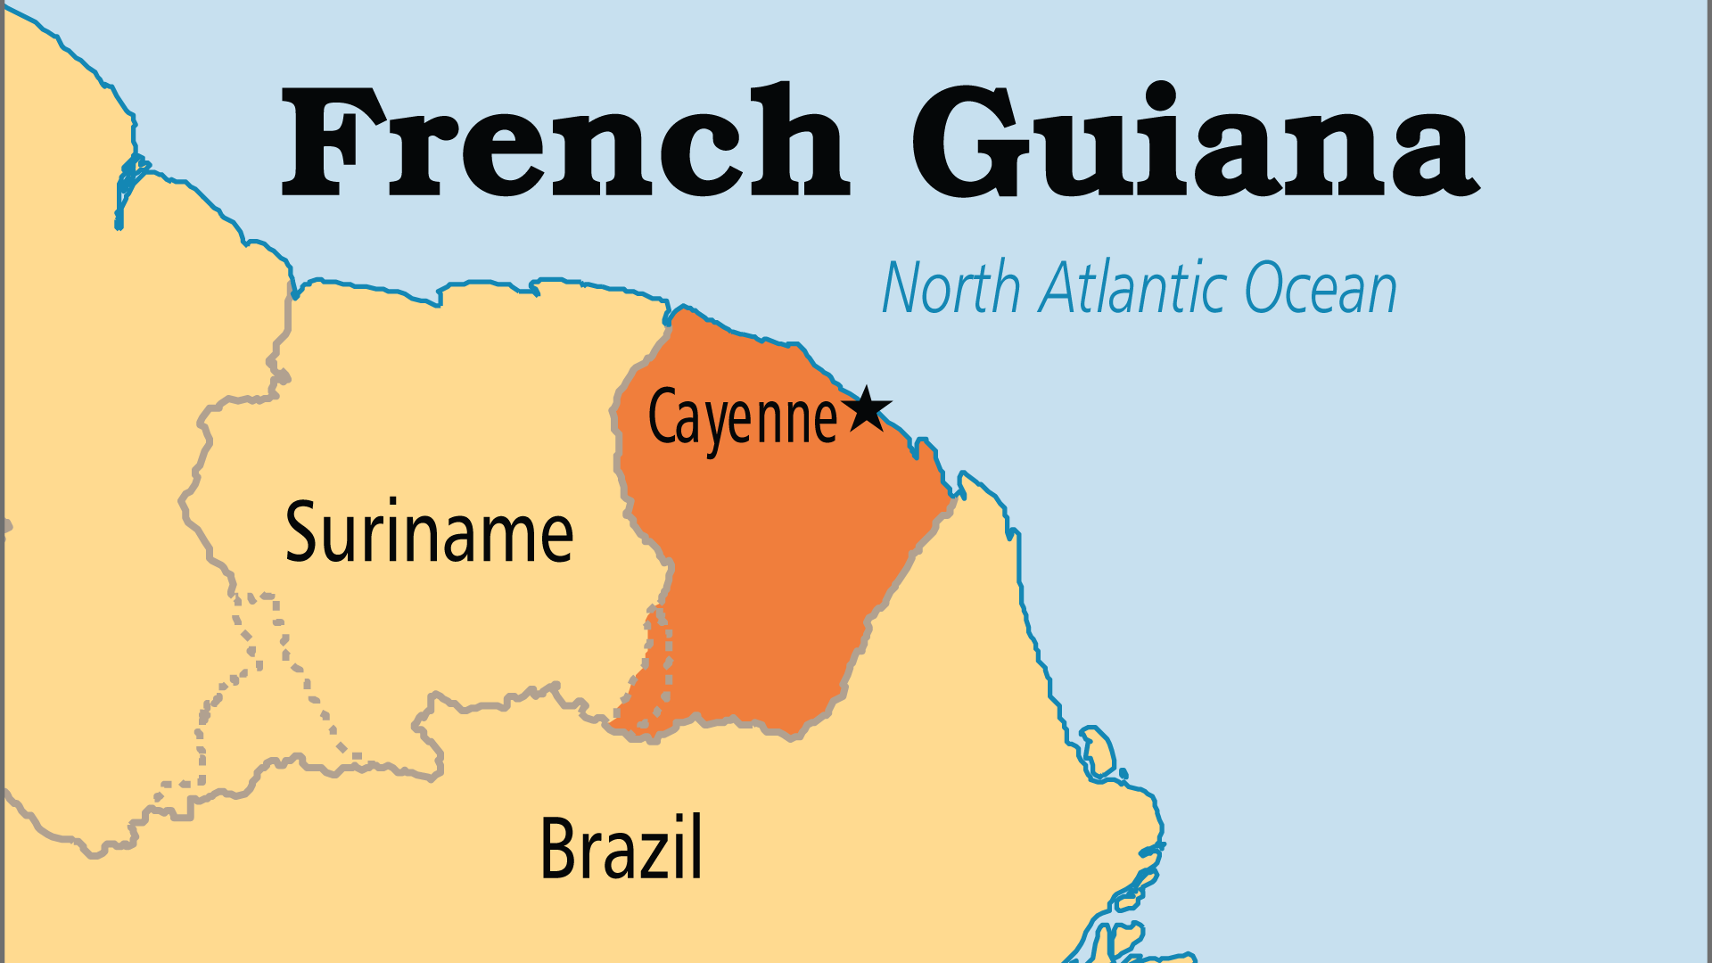
KEY STATS
Capital: | Cayenne
Population: | 313,666
% Urban: | 87.0 %
Official Language: | French. Guianese French Creole widely spoken
% Christian: | 91.3 %
% Evangelical: | 4.5 %
People Groups: | 22
Least Reached People Groups: | 1
% Unevangelized: | 2 %

Slide 4

FOR PRAYER
French Guiana has a new image as a developed multicultural society, rather than as a place for imprisoned criminals. This change also brought French secularism and moral challenges. Many young people cannot find employment and are restless. Graphic pornography from French satellite TV disturbs the moral framework. Families suffer with high rates of illegitimate births and many single-parent homes. Harm to the environment, illegal immigration, and human trafficking for the gold mine industry all cause problems.
Want to know more? Go to www.operationworld.org

