Slide 1




Slide 2


PRAYING FOR
FRANCE

Slide 3
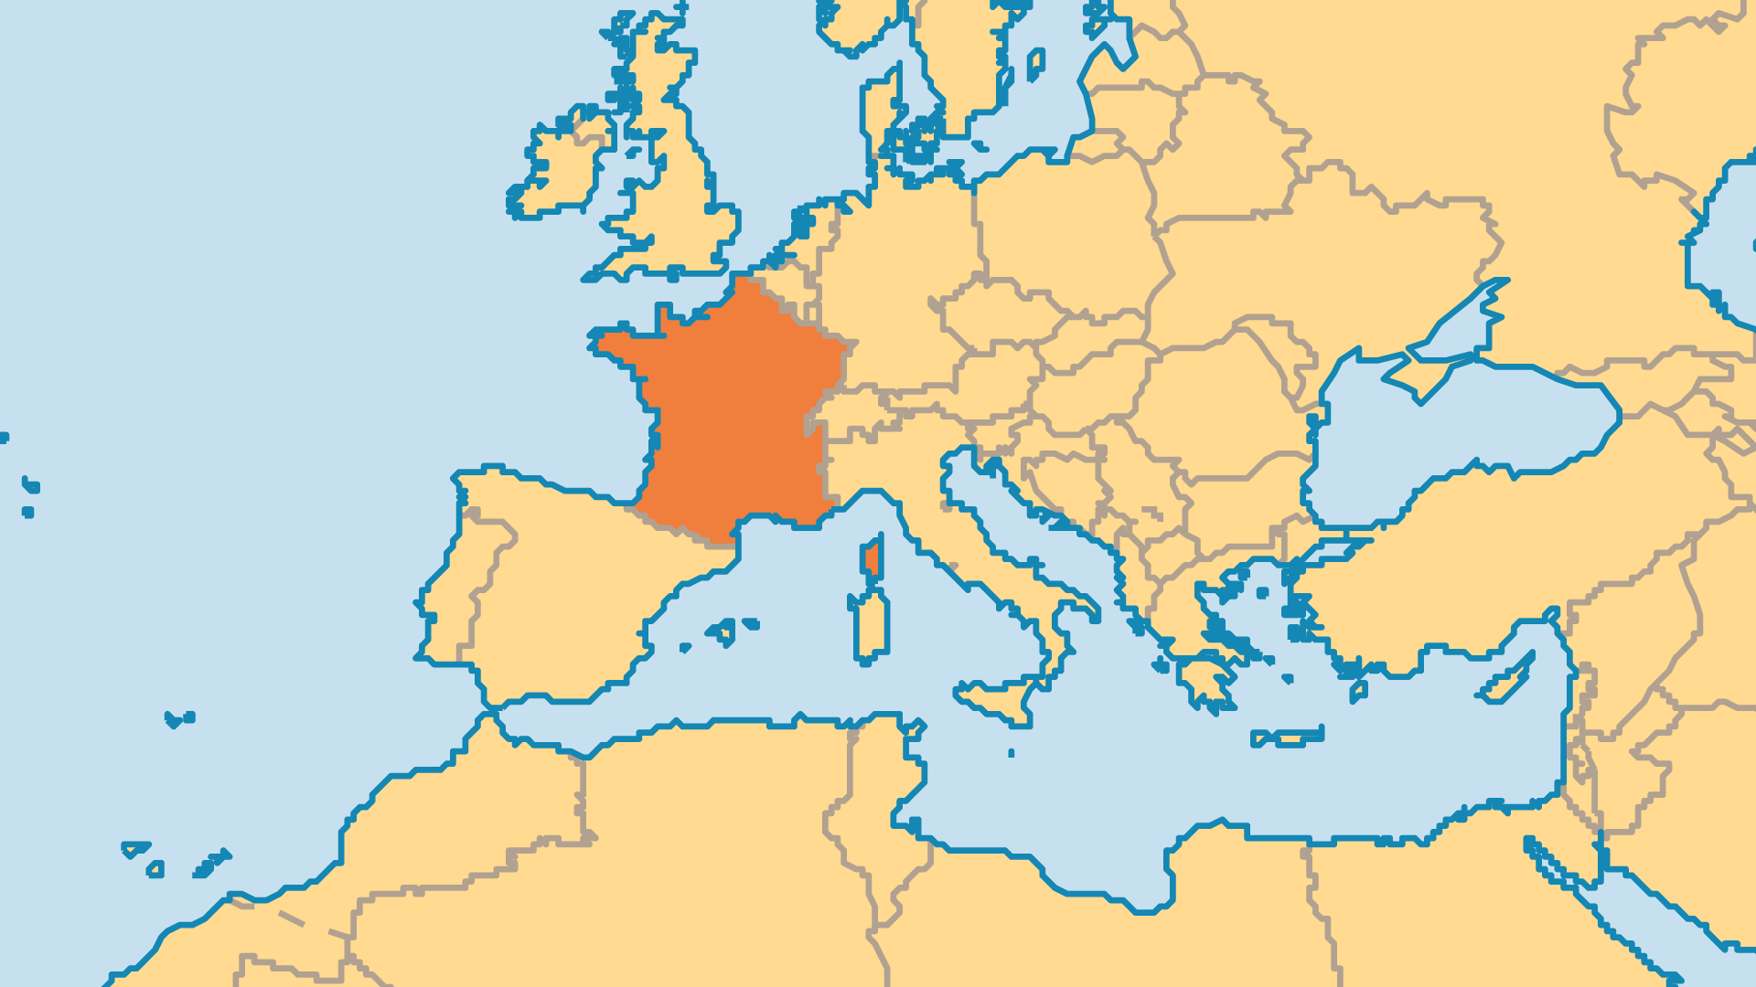
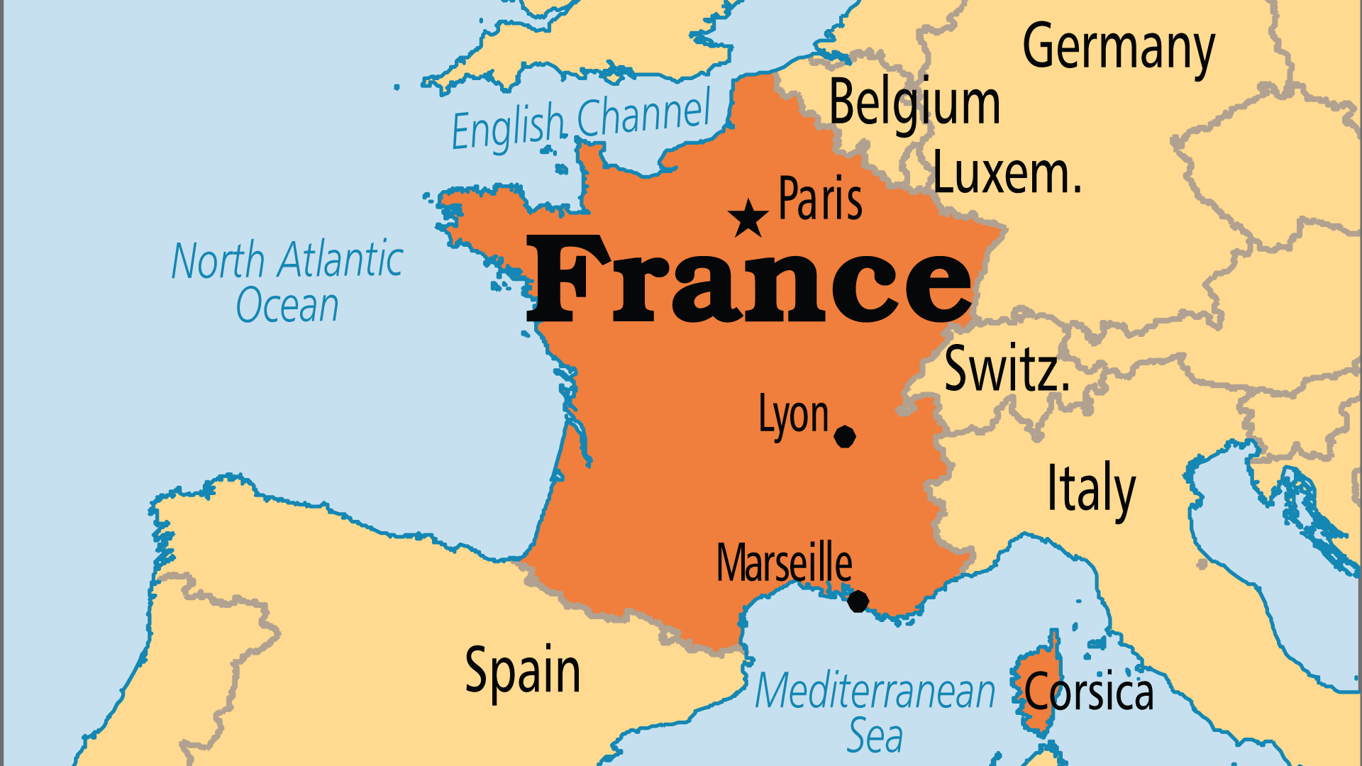
KEY STATS
Capital: | Paris
Population: | 66,650,805
Pop Under 15 Yrs: | 17.8 %
Official Language: | French
Languages: | 62
Literacy Rate: | 99 %
Life Expectancy: | 82.5 yrs (18th/236)
HDI Ranking: | 28/193
% Christian: | 61.1 %
% Evangelical: | 1 %
% Unevangelized: | 5 %

Slide 4

FOR PRAYER
France stands at a political and economic crossroads. The economy needs radical reforms to prosper in the globalized world. The population is ageing. The large immigrant community continues to grow and challenges the traditional understanding of French identity. Confidence in the Republic's future wanes. Young people especially feel the crisis, and often long for meaning and purpose. These factors, especially the economic frustrations of the working and middle classes, brought about the rise of the Yellow Vest movement. Pray for both economic justice in France and for Christians to be able to offer French people a hope beyond mere economic respite.

Slide 5
FOR PRAYER
The accelerating decline of religious faith since the 18th Century saw France's Catholic and mainline Protestant legacies plummet in recent years, even as atheism has grown. Hostility toward organized religion as well as the privatization of spirituality mean that regular attendance in any church is below 8%. Most French have never meaningfully encountered the gospel. Yet, the relativism of postmodernity has generated acute emptiness and existential angst; this in turn has created a spiritual hunger. Pray that such hunger might overcome the suspicion toward religion. Pray that Christians would be prepared to patiently and relationally share Jesus with those who seek.

